Slide 1
Welcome to the Arctic Research Collaboration Workshop
National Science Foundation support for this workshop has been provided in part under grant no. NSF-SES 1935653 & Cooperative Agreement No. PLR-1928794

Slide 2
Navigating Zoom
Your Zoom controls (video, mic, chat, etc.) can be found by hovering your mouse over the bottom of your Zoom window.

Slide 3
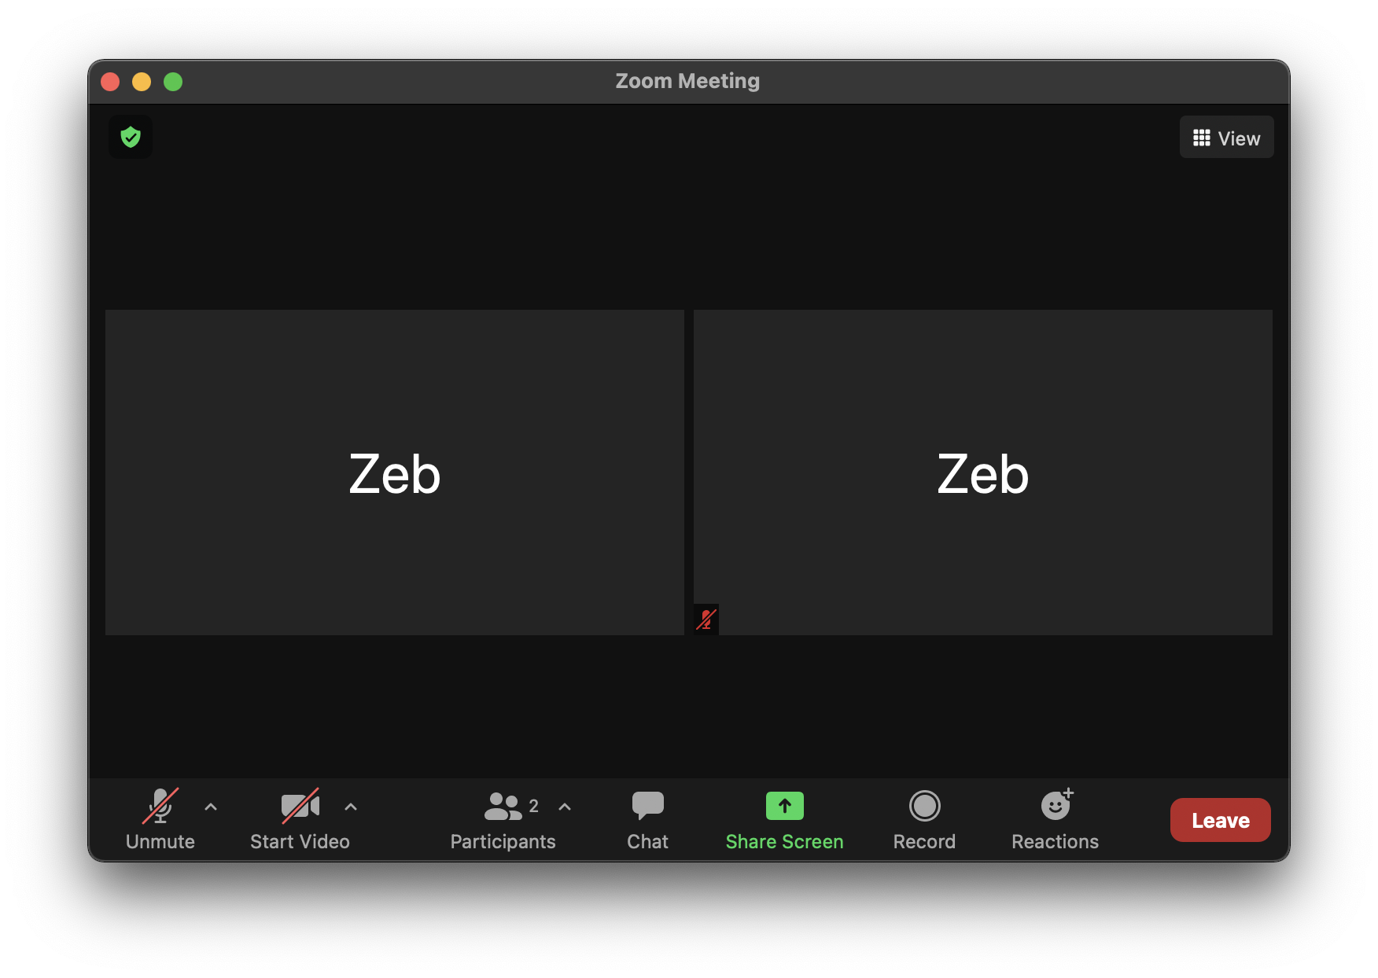
Navigating Zoom
You can view the Workshop in Gallery View or Speaker View.
Gallery View allows you to see the webcams of other online participants.
Speaker View allows you to only view the presenter’s webcam and presentation.
To switch between the views, use the button in the upper right.
You are encouraged to Chat with other participants at any time.
To do so, click the Chat icon at the bottom of the screen and select the name of the participant that you wish to chat with.
There is also an option to chat with everyone.

Slide 4
Navigating Zoom
When you entered the meeting, your video was switched off and your audio was muted by the Host.
You may turn on your video or mic at any time. However, we do ask that you please keep your microphone muted when you are not speaking to help prevent disruptions and background noise.
If you are joining the meeting audio by phone you can unmute and mute yourself by pressing *6.

Slide 5
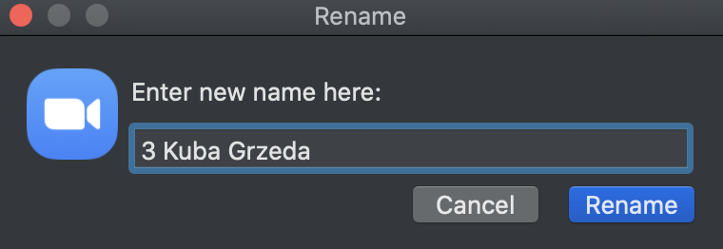
VIRTUAL MEETING SCREEN NAMES
Please use your full name (this will help us prepare for the breakouts!)
We will talk to phone participants one-on-on to rename them.
1
2
3
Click on the “Participants” icon at the bottom of your Zoom window.
Type in the display name you’d like to appear during the meeting and hit “Rename”.
In the “Participants” list on the right side of the Zoom window, hover over your name and click the “More” and then “Rename” buttons.
https://www.arcus.org/

Slide 6
Recording & Security
Please note that the plenary sessions of this workshop are being recorded.
If you notice any suspicious or inappropriate behavior, please let one of the meeting organizers know.
In case of “Zoom Bombing” or other security breaches, the offending parties will be removed and the meeting room will be locked.
If you are having technical difficulties please send a private chat message to “Kuba Grzeda” or email Kuba at kuba@arcus.org for assistance.

Slide 7
Welcome and Introductions
Notes:
Welcome – briefly explain inspiration and rationale for today’s workshop and format (Par 1 – panel discussion; Part 2 – hands on conceptual exercise in small group breakout rooms)
Acknowledge financial support for the workshop by NSF, etc.

Slide 8
Workshop Goals
Bring together an interdisciplinary group of Arctic researchers interested in finding new collaborators.
Share examples of how other experienced interdisciplinary researchers have approached new collaborations, and discuss processes for achieving inter- or transdisciplinary integration and practical ways to overcome potential challenges.
Provide an opportunity for people to share collaboration ideas, seek diverse feedback, and practice interdisciplinary collaboration skills.
Encourage more social science and engineering leadership/co-leadership in Arctic interdisciplinary research projects.
Help identify next steps for moving collaborative research project ideas forward.
Notes:
Share examples…. – emphasize that although some of our speakers will likely touch on the topic of community engagement and share some insights from their work with local communities, our focus today is primarily on interdisciplinary integration across different scientific fields.

Slide 9
Panel Discussion: Developing New Interdisciplinary Collaborations
Elise Miller-Hooks, George Mason University (Engineering)
Kathy Duderstadt, University of New Hampshire (Atmospheric Science)
Jennifer Brewer, University of New Hampshire (Geography)
Courtney Carothers, University of Alaska, Fairbanks (Anthropology)
Notes:
Explain format – each panelist will first give a short presentation on the interdisciplinary work they’ve conducted, reflecting a set of guiding questions [see below[; followed by guided discussion among panelists on key issues and insights that emerge from their individual presentations followed by time for questions and comments from participants.
Guiding questions (need to abbreviate):
1. How has an inter/transdiciplinary research approach benefited your work, your projects, and your own discipline/field of research? What challenges have you had to face/overcome to realize these benefits? How have these challenges changed the way you approach new collaborations? What general observations have you made about the challenges and rewards of inter/transdisciplinary research?
2. How have you approached forming or joining an inter/transdisciplinary team? What factors should be considered in the constitution of inter/transdisciplinary teams? Do you have any recommendations for enriching the scientific contributions that social science, engineering, or community participation might make within a new team collaboration? What best practices should be considered when you are developing a new research collaboration wishing to engage communities?
3. What conceptual frameworks or approaches have you found to be effective for inter/transdisciplinary integration? How have you/your teams approached the process of inter/transdisciplinary integration? Can you share any examples of how the use or development of the framework may have changed research outcomes/findings?
4. How have you assessed/are you assessing the outcomes of past/current inter/transdisciplinary research efforts? What elements were/are most critical for the success of your efforts - both in terms of accomplishing research goals/outcomes and in terms of team satisfaction and experience?

Slide 10
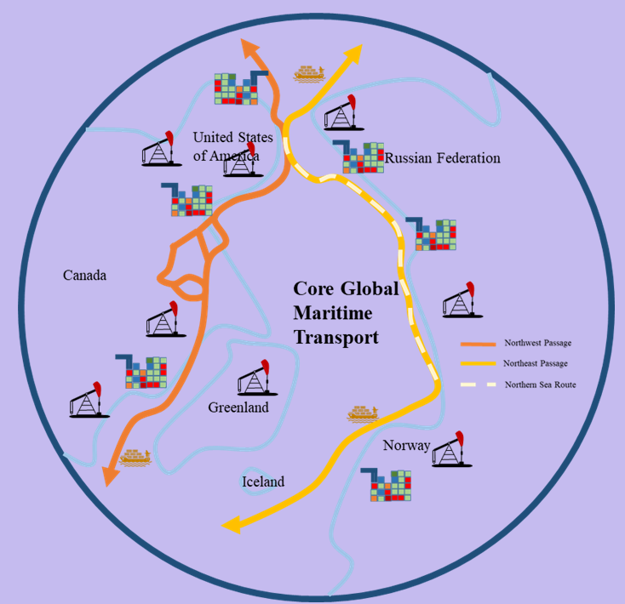
NSF-NNA: An Expanding Global Maritime Network, its Arctic Impacts and Reverberations
Elise Miller-Hooks (PI), Sara Cobb (CoPI), Celso Ferreira (CoPI) at George Mason University
Anne Garland (CoPI) at Applied Research in Environmental Sciences (ARIES) NonProfit
Jinlun Zhang (Senior Investigator) at University of Washington
Thomas Ravens (Consultant) at University of Alaska - Anchorage
Ralph Pundt (Consultant) at Maine Maritime Academy

Slide 11
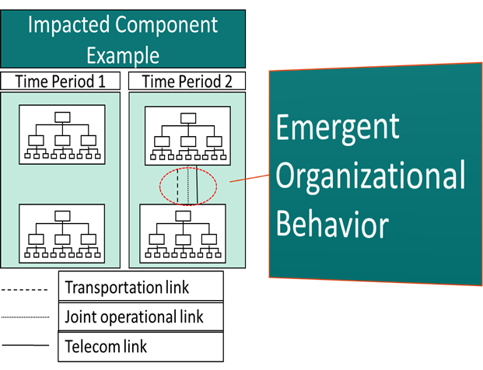
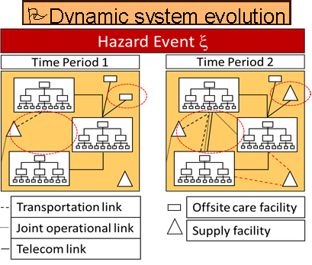
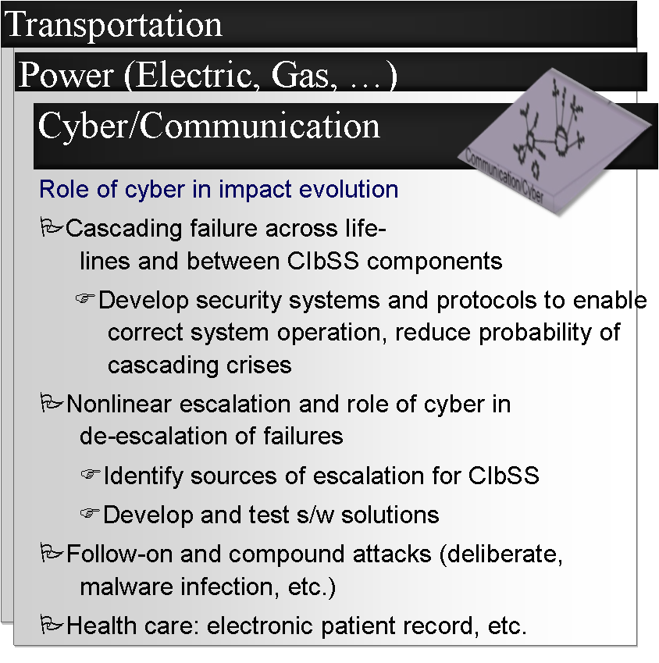
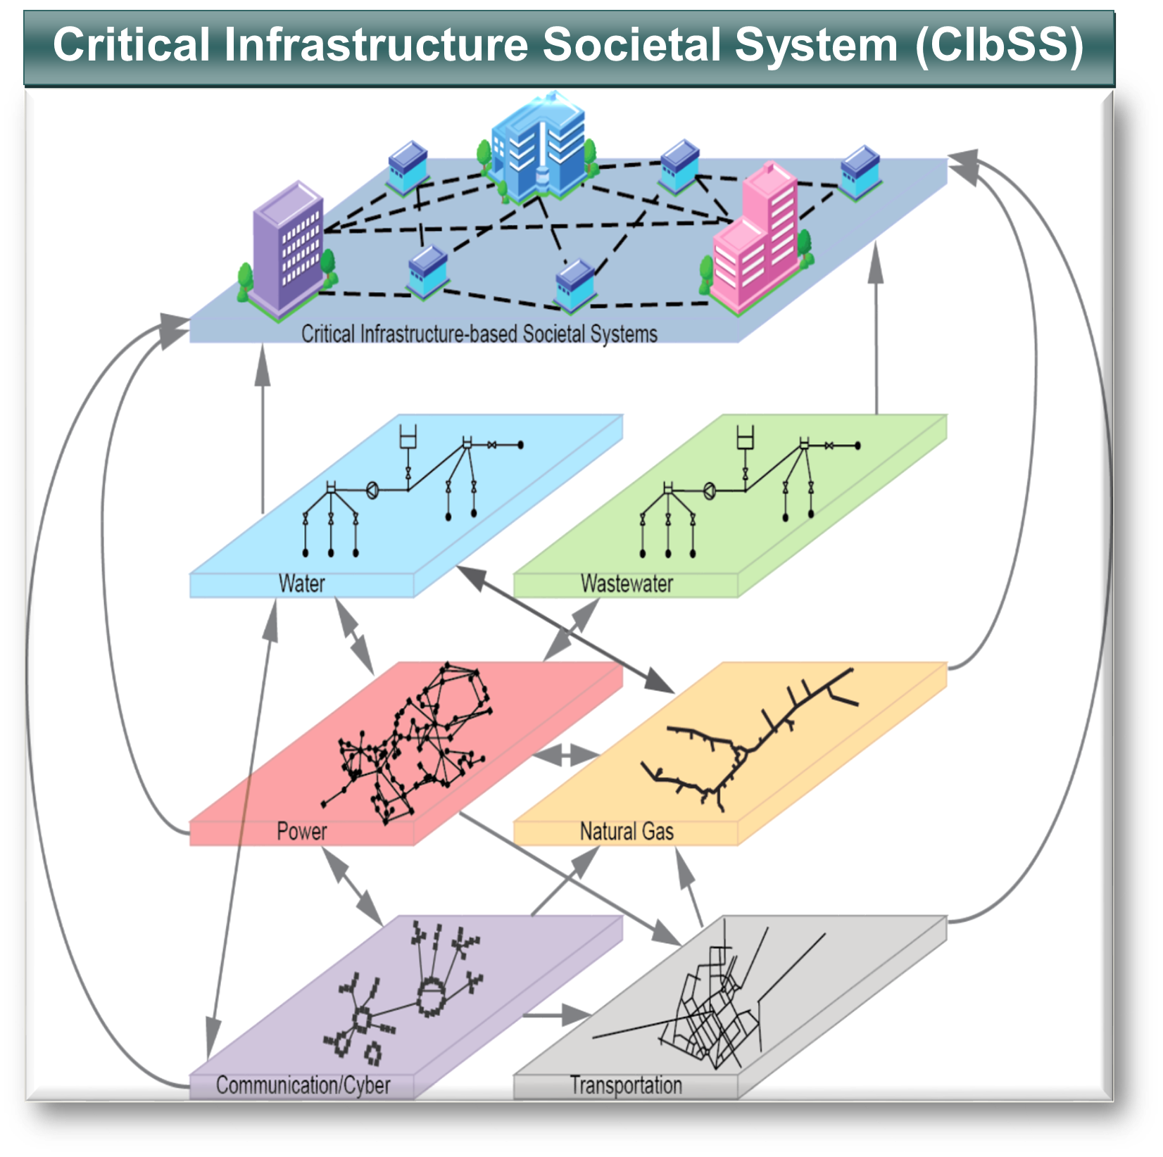
NSF RIPS II: Quantifying Disaster Resilience of Critical Infrastructure-Based Societal Systems with Emergent Behavior and Dynamic Interdependencies
George Mason Univ.: Elise Miller-Hooks (PI)
Univ. of Maryland: Brooke Fisher Liu (Co-PI)
Univ. of Delaware: Joanne Nigg (Co-PI)
Johns Hopkins: Judy Mitrani-Reiser (PI on collab, at NIST) Matthew Green (Co-PI)
Univ. of Delaware: Joanne Nigg (Co-PI), Rachel Davidson (SI)

Slide 12
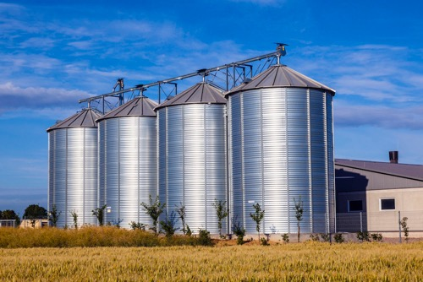
Lessons from Five Interdisciplinary Collaborations
Katharine Duderstadt
The University of New Hampshire
Arctic Research Collaborations Workshop
16 April 2021
Women in STEM Academic Pipeline
From Leaky Pipelines to Water Cycles
From Disciplinary Silos to Seed Vaults

Slide 13
Lessons from Five Interdisciplinary Collaborations
Katharine Duderstadt
The University of New Hampshire
Arctic Research Collaborations Workshop
16 April 2021
Women in STEM Academic Pipeline
me
From Leaky Pipelines to Water Cycles
From Disciplinary Silos to Seed Vaults
Leaking out of the pipeline led to interdisciplinary opportunities…

Slide 14
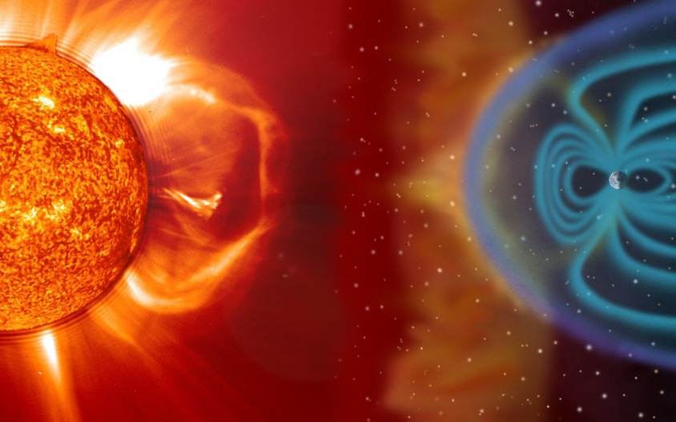
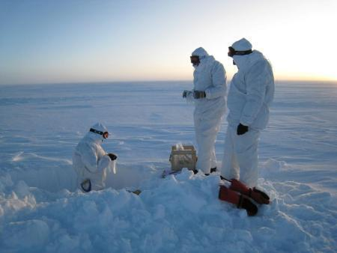
1
Atmospheric Modeling helped to end a 30-year controversy between Space Science and Glaciology communities
SUN
TO
ICE
Can we use nitrate spikes in Greenland ice cores to study the frequency and strength of solar storms?
NSF FESD Sun-to-Ice Project

Slide 15
1
Duderstadt, K. A., J. E. Dibb, N. A. Schwadron, H. E. Spence, S. C. Solomon, V. A. Yudin, C. H. Jackman, and C. E. Randall (2016), Nitrate ion spikes in ice cores not suitable as proxies for solar proton events, J. Geophys. Res. Atmos., 2015JD023805.
SUN
TO
ICE
Look for the table
with an empty seat
Tip: Used textbooks are great
for learning the language

Slide 16
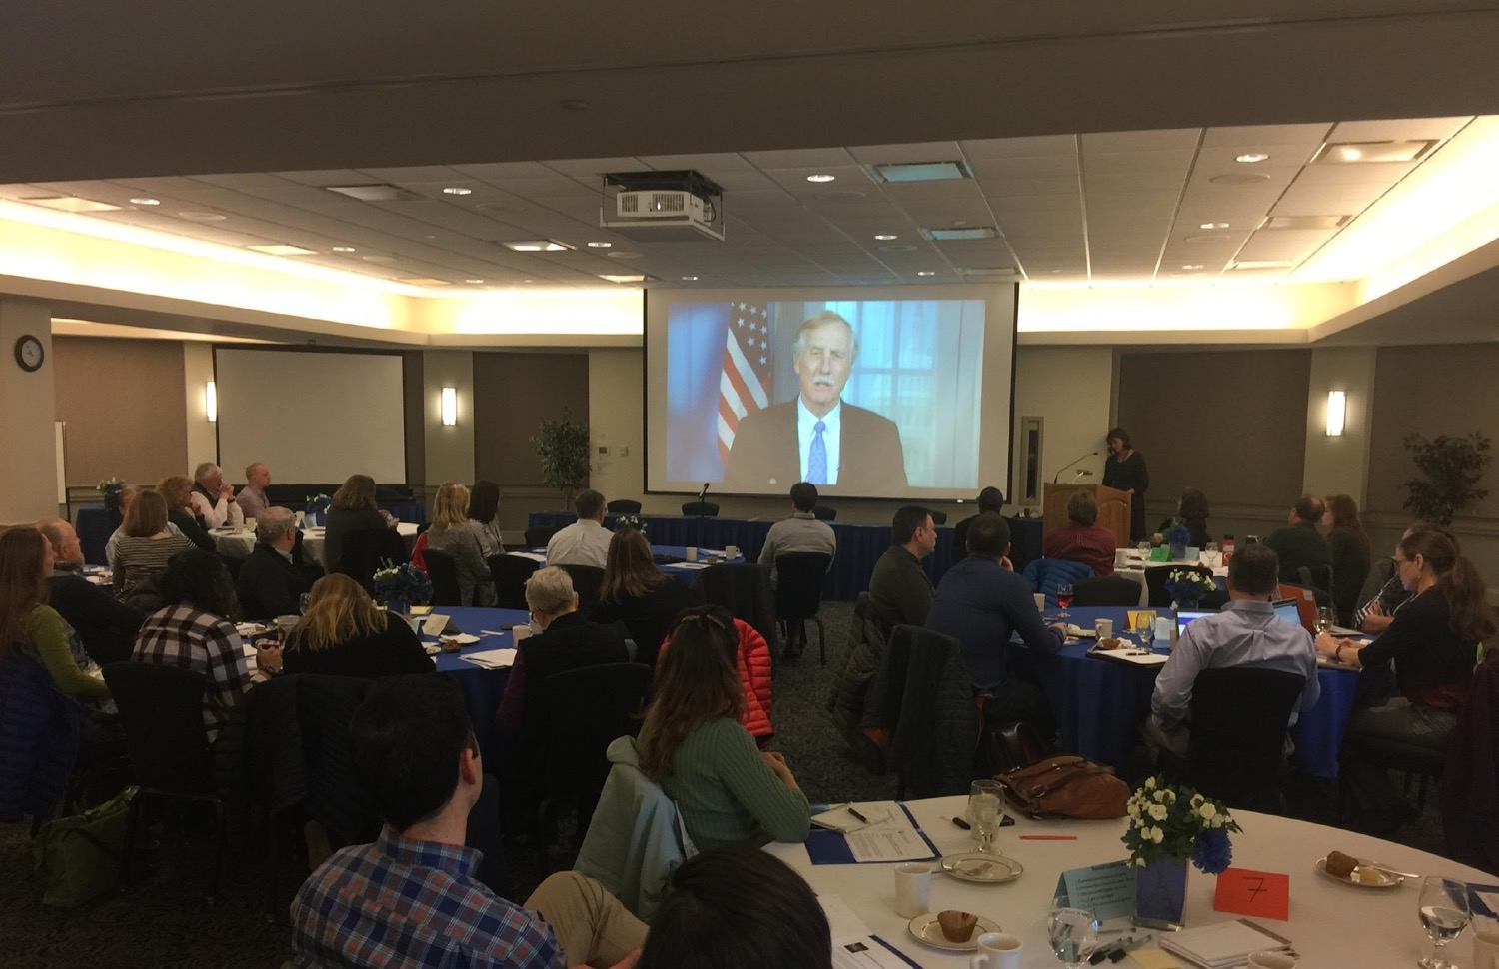
Preparing for a Northwest Passage:
The Role of New England in Navigating the New Arctic
NSF-funded Convergence Navigating the New Arctic (NNA) Workshop
March 2018
2
Say YES to opportunities
Duderstadt, K. A., C.M. Ashcraft, J. F. Brewer, E. Burakowski, E., J. M. Coffin, J. E. Dibb, L. C. Hamilton, N. E. Kinner, L. A. Mayer, J. L. Miksis-Olds, J. Salisbury, K. D. Seger, R. K. Varner, and C. P. Wake (2018), "Preparing for a Northwest Passage: A Workshop on the Role of New England in Navigating the New Arctic" (2018). Earth Systems Research Center.

Slide 17
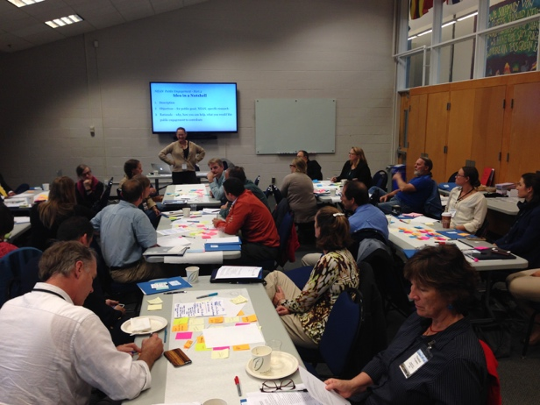
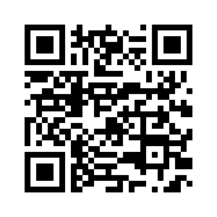
2
New England Arctic Network
Persistence & Humility
Keep inviting people back,
and attend everyone else’s events.
#neanconvergence
website: nearctic.net
Email: info@neartic.net
facebook.com/neanconvergence
@neanconvergence

Slide 18
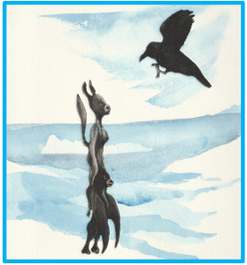
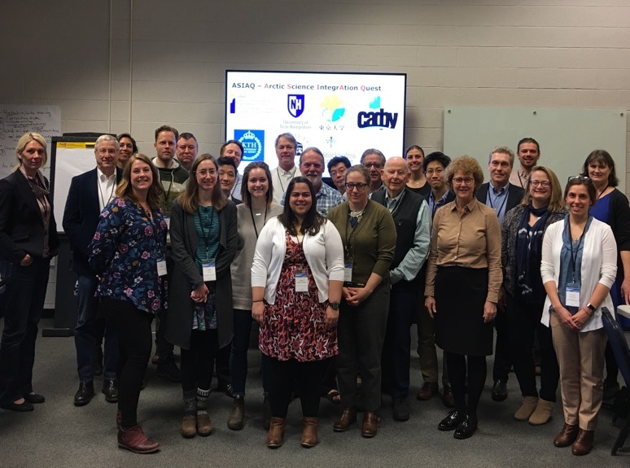
3
Arctic Science Integration Quest (ASIAQ)
Objective: identify common goals and collaborative research initiatives on the theme of Arctic waters: those on land and the Arctic Ocean.
(Using the framework of the UN Sustainable Development Goals)
Stockholm University
KTH Royal Institute of Technology
Umeå University
University of New Hampshire
University of Tokyo
Northern (Arctic) Federal University (NArFU)
Arctic Engineering and Technology
Arctic Physical Sciences
Arctic Medicine and Health
Arctic Social Sciences
https://asiaq.org/

Slide 19
3
Arctic Science Integration Quest (ASIAQ)
J. G. Ernakovich, N. Eklund , R. K. Varner, N. Kirchner, J. Jeuring , K. Duderstadt, A. Granebeck, E. Golubeva, and ASIAQ participants (2021). Is a common goal a false hope in convergence research? Opportunities and challenges of international convergence research to address Arctic change, Earth’s Future, in press.
Co-developing
research questions
is challenging.
International interdisciplinary collaborations require even more patience and perseverance.
https://asiaq.org/

Slide 20
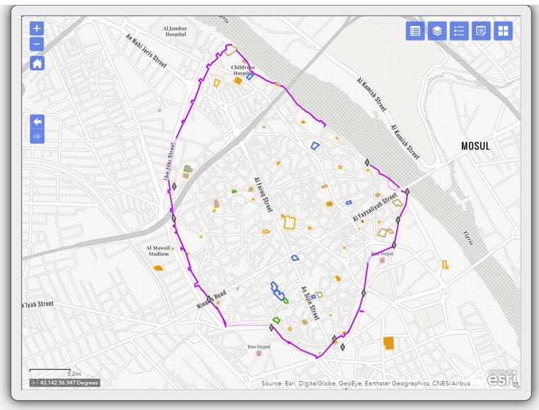
Transformative Investigations of Geospatial, Environmental, and Social Sciences (TIGERS)
4
Importance of “seed funds”
to start building relationships
Monthly meetings for two years sharing academic talks…usually spent an hour on the first two slides. What does ”data” in your field look like?
Maps are excellent boundary objects. But even the idea of a map has different meanings across fields.
Intellectual Challenge: “This is why I entered academia in the first place!” – Sara
Ground-truth the destruction of ancient walls and monuments
Mosul, Iraq
Jeannie Sowers (Political Science); Michael Palace (Earth Sciences); Ethel Sara Wolper (History); Christina Herrick (Geospatial Science); Katharine Duderstadt (Atmospheric Science); Erika Weinthal (Environmental Policy). – UNH and Duke 2018-2020

Slide 21
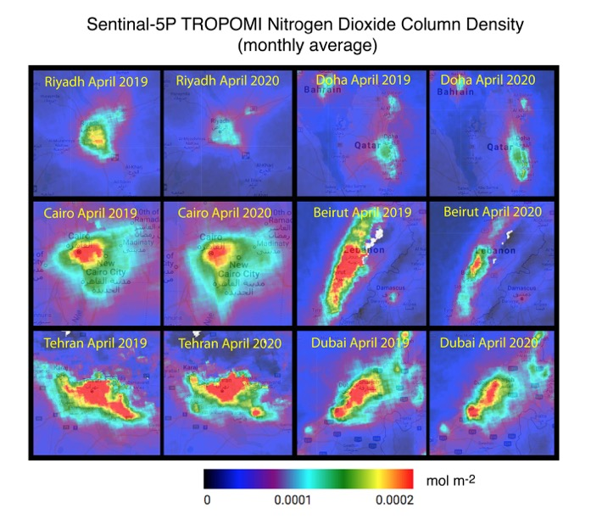
Transformative Investigations of Geospatial, Environmental, and Social Sciences (TIGERS)
4
Establishing
trusting relationships prepares a team for rapid response!
Meet frequently and consistently
May 2020…The COVID Project
Duderstadt, K. and Sowers, J. Air Pollution and COVID-19 in the GCC and the Middle East (2020). The COVID Project. Center for International and Regional Studies. Georgetown University Qatar. https://cirs.georgetown.edu/news-analysis/air-pollution-and-covid-19-gcc-and-middle-east.

Slide 22
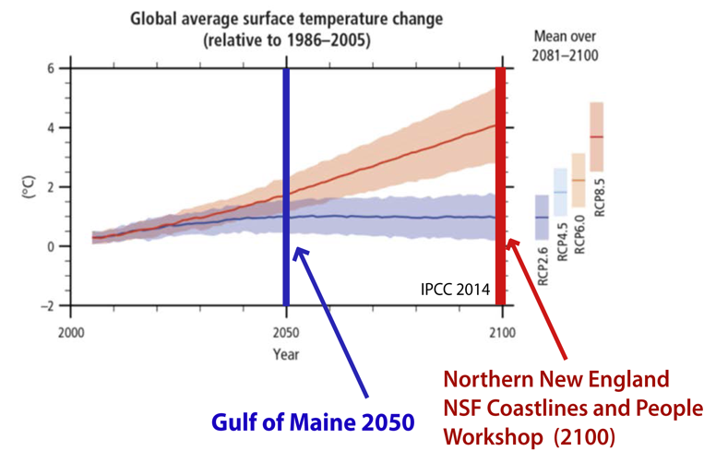
5
NSF Coastlines
and People
How is long-term thinking affecting short-term decision-making across communities?
How do we prepare for rapid response to uncertain futures and surprises?
Arctic ice melt and a warming climate will bring both opportunity and hazards to New England.
University of New Hampshire: Katharine Duderstadt, Jennifer Brewer
University of Southern Maine: Terry Shehata (PI), Maggie Vishneau

Slide 23
5
NSF Coastlines
and People
How is long-term thinking affecting short-term decision-making across communities?
How do we prepare for rapid response to uncertain futures and surprises?
Arctic ice melt and a warming climate will bring both opportunity and hazards to New England.
We are here…
University of New Hampshire: Katharine Duderstadt, Jennifer Brewer
University of Southern Maine: Terry Shehata (PI), Maggie Vishneau

Slide 24
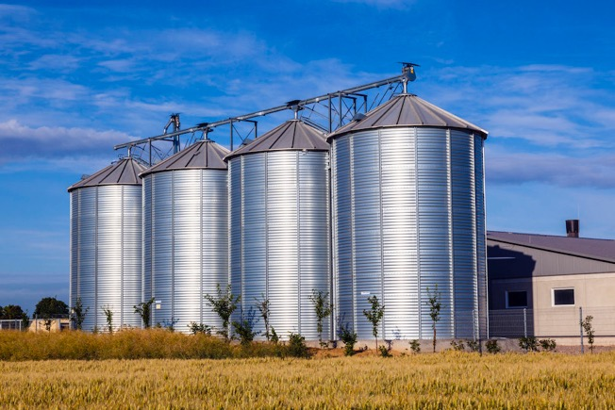
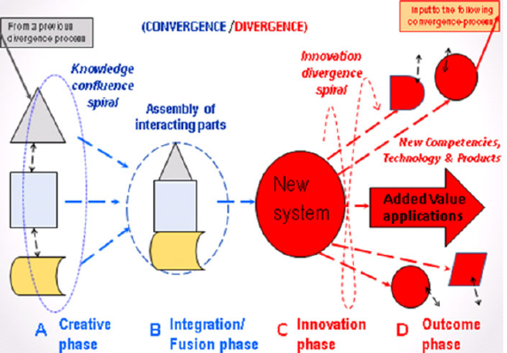
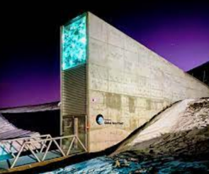
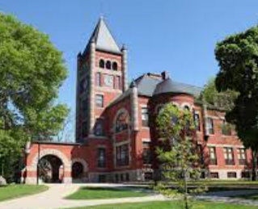
A final note on the importance of Diverging back to Disciplines
Roco et al., 2013
How do we break open the silos
to feed the masses…
Bring back what you learn to enhance your own disciplines.
…without giving away the seed corn?
(And make sure you still earn a paycheck)

Slide 25
A final note on the importance of Diverging back to Disciplines
Let’s Collaborate!
Roco et al., 2013
How do we break open the silos
to feed the masses…
Bring back what you learn to enhance your own disciplines.
…without giving away the seed corn?
(And make sure you still earn a paycheck)

Slide 26
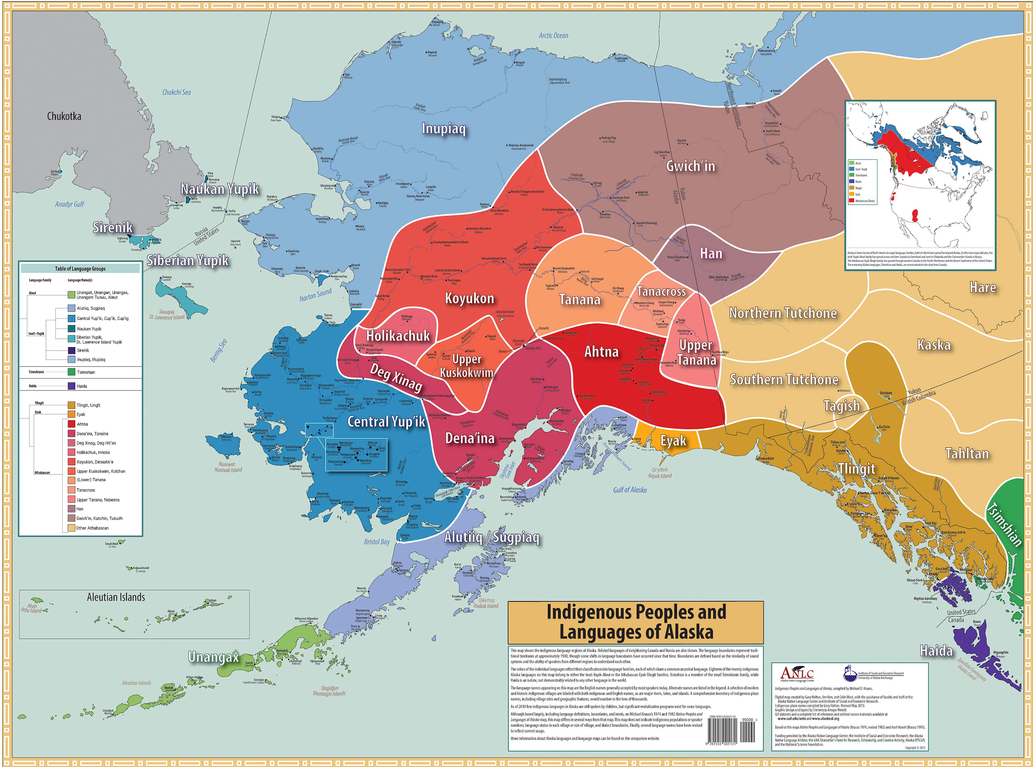

Slide 27
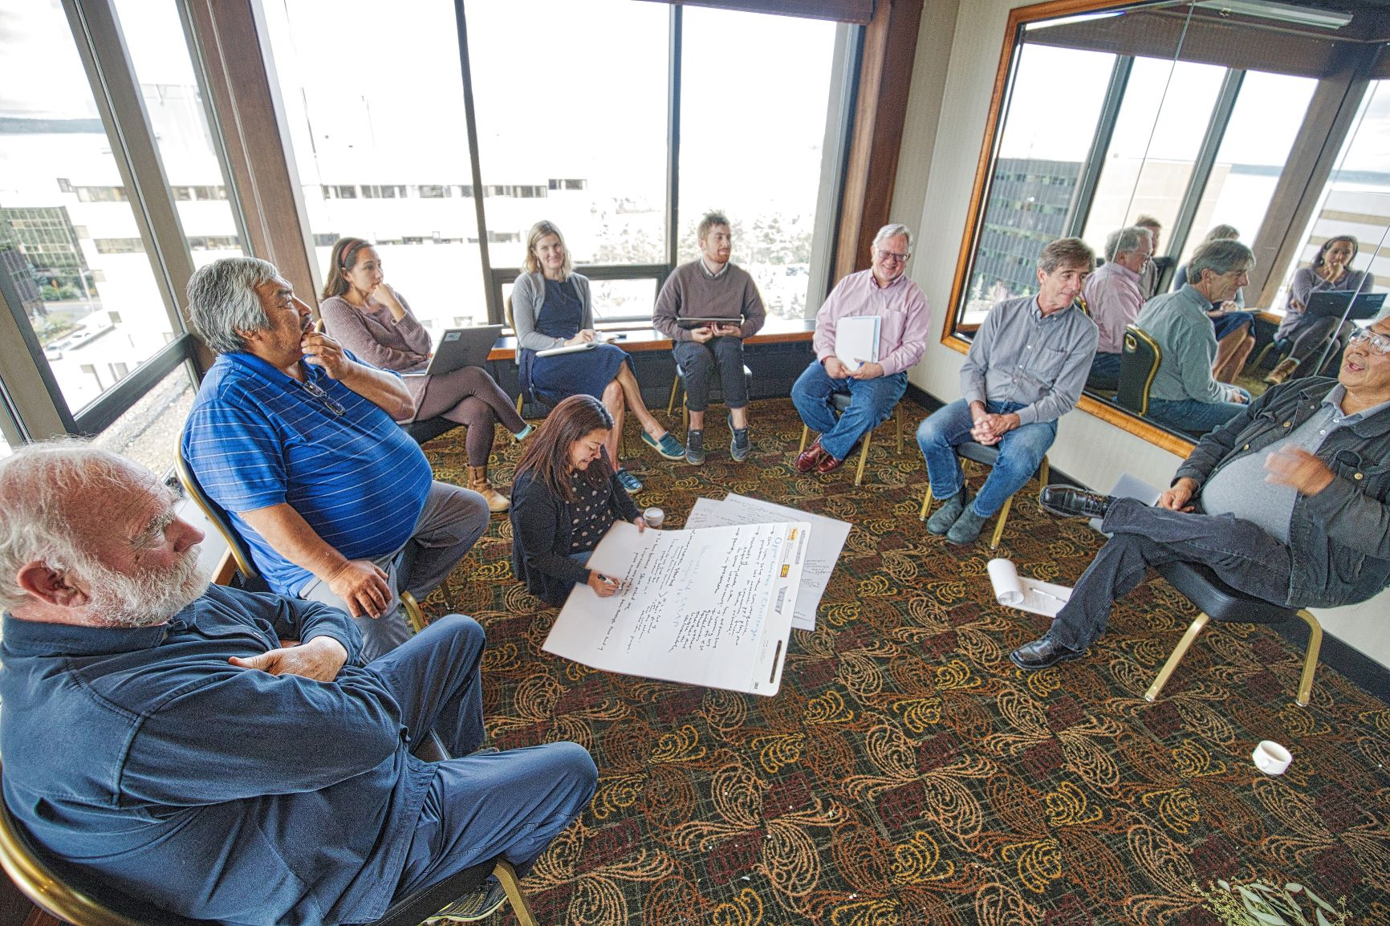
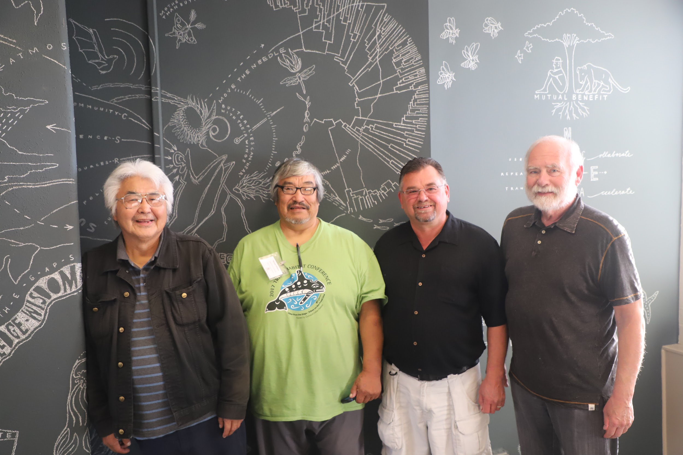
Relationships
Notes:
Peter talks about SASAP pass to CC to talk about ISM

Slide 28
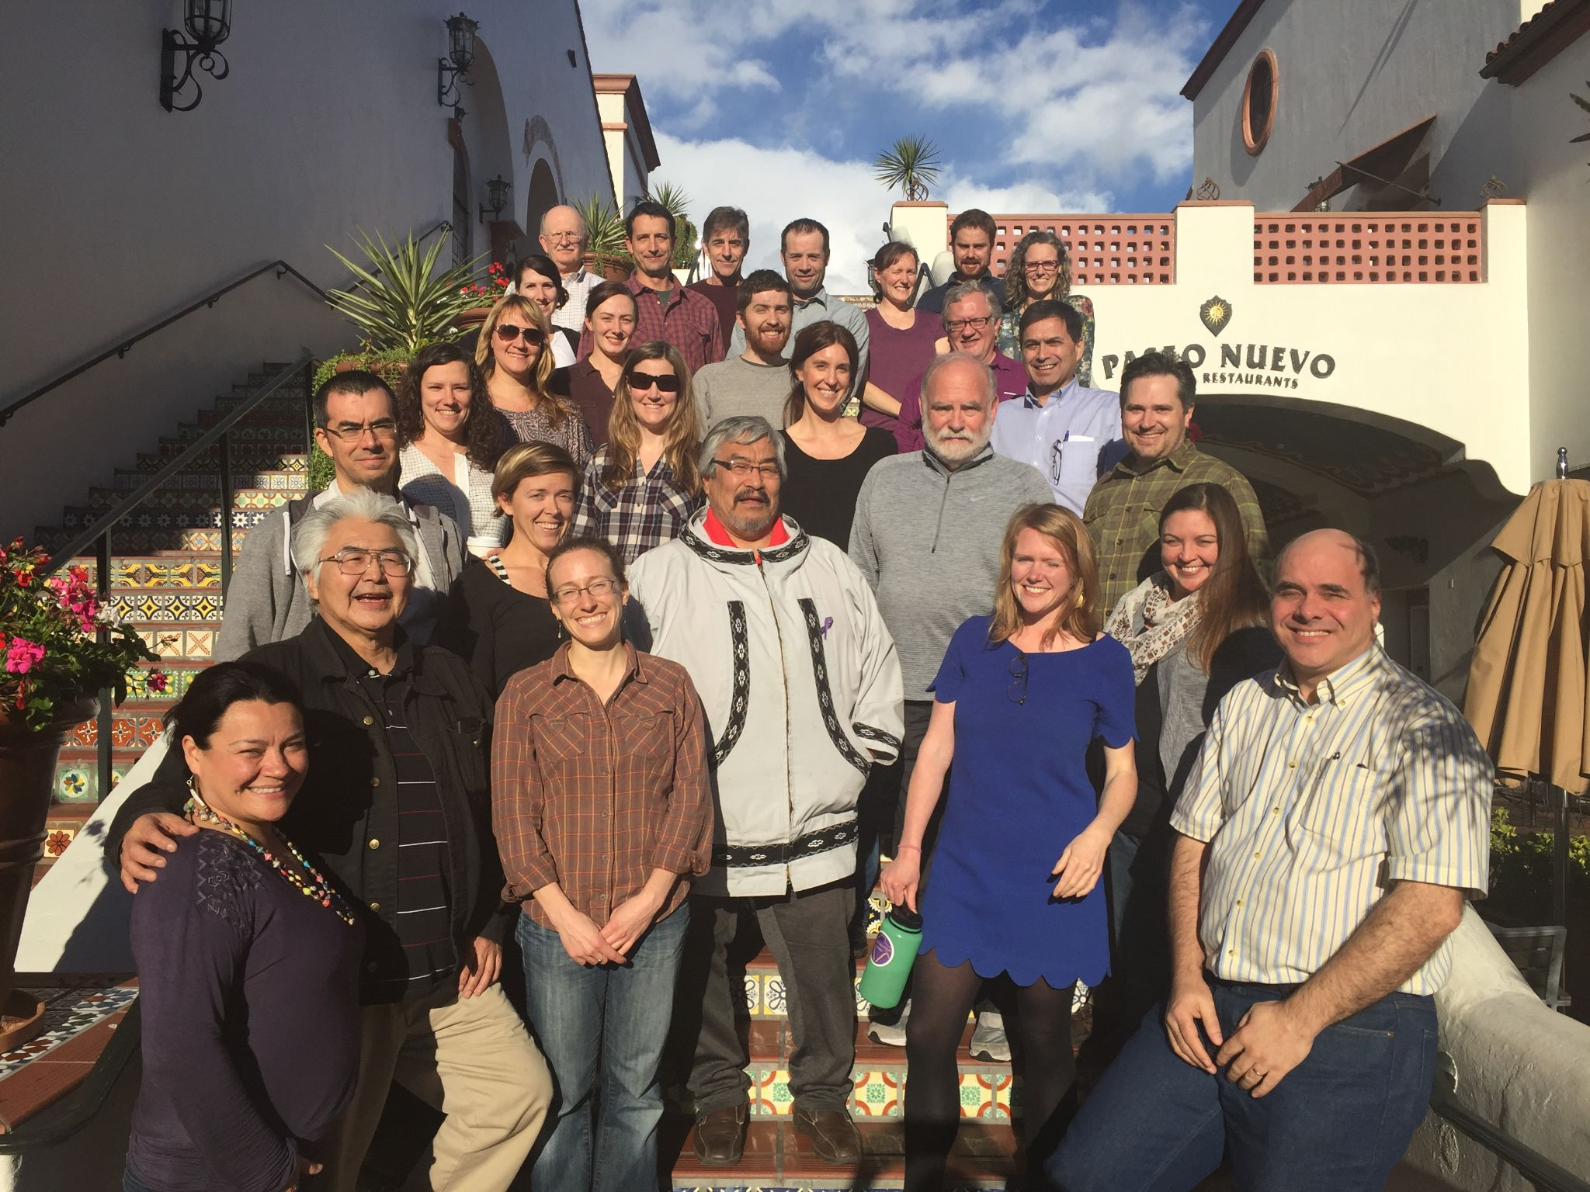

Slide 29
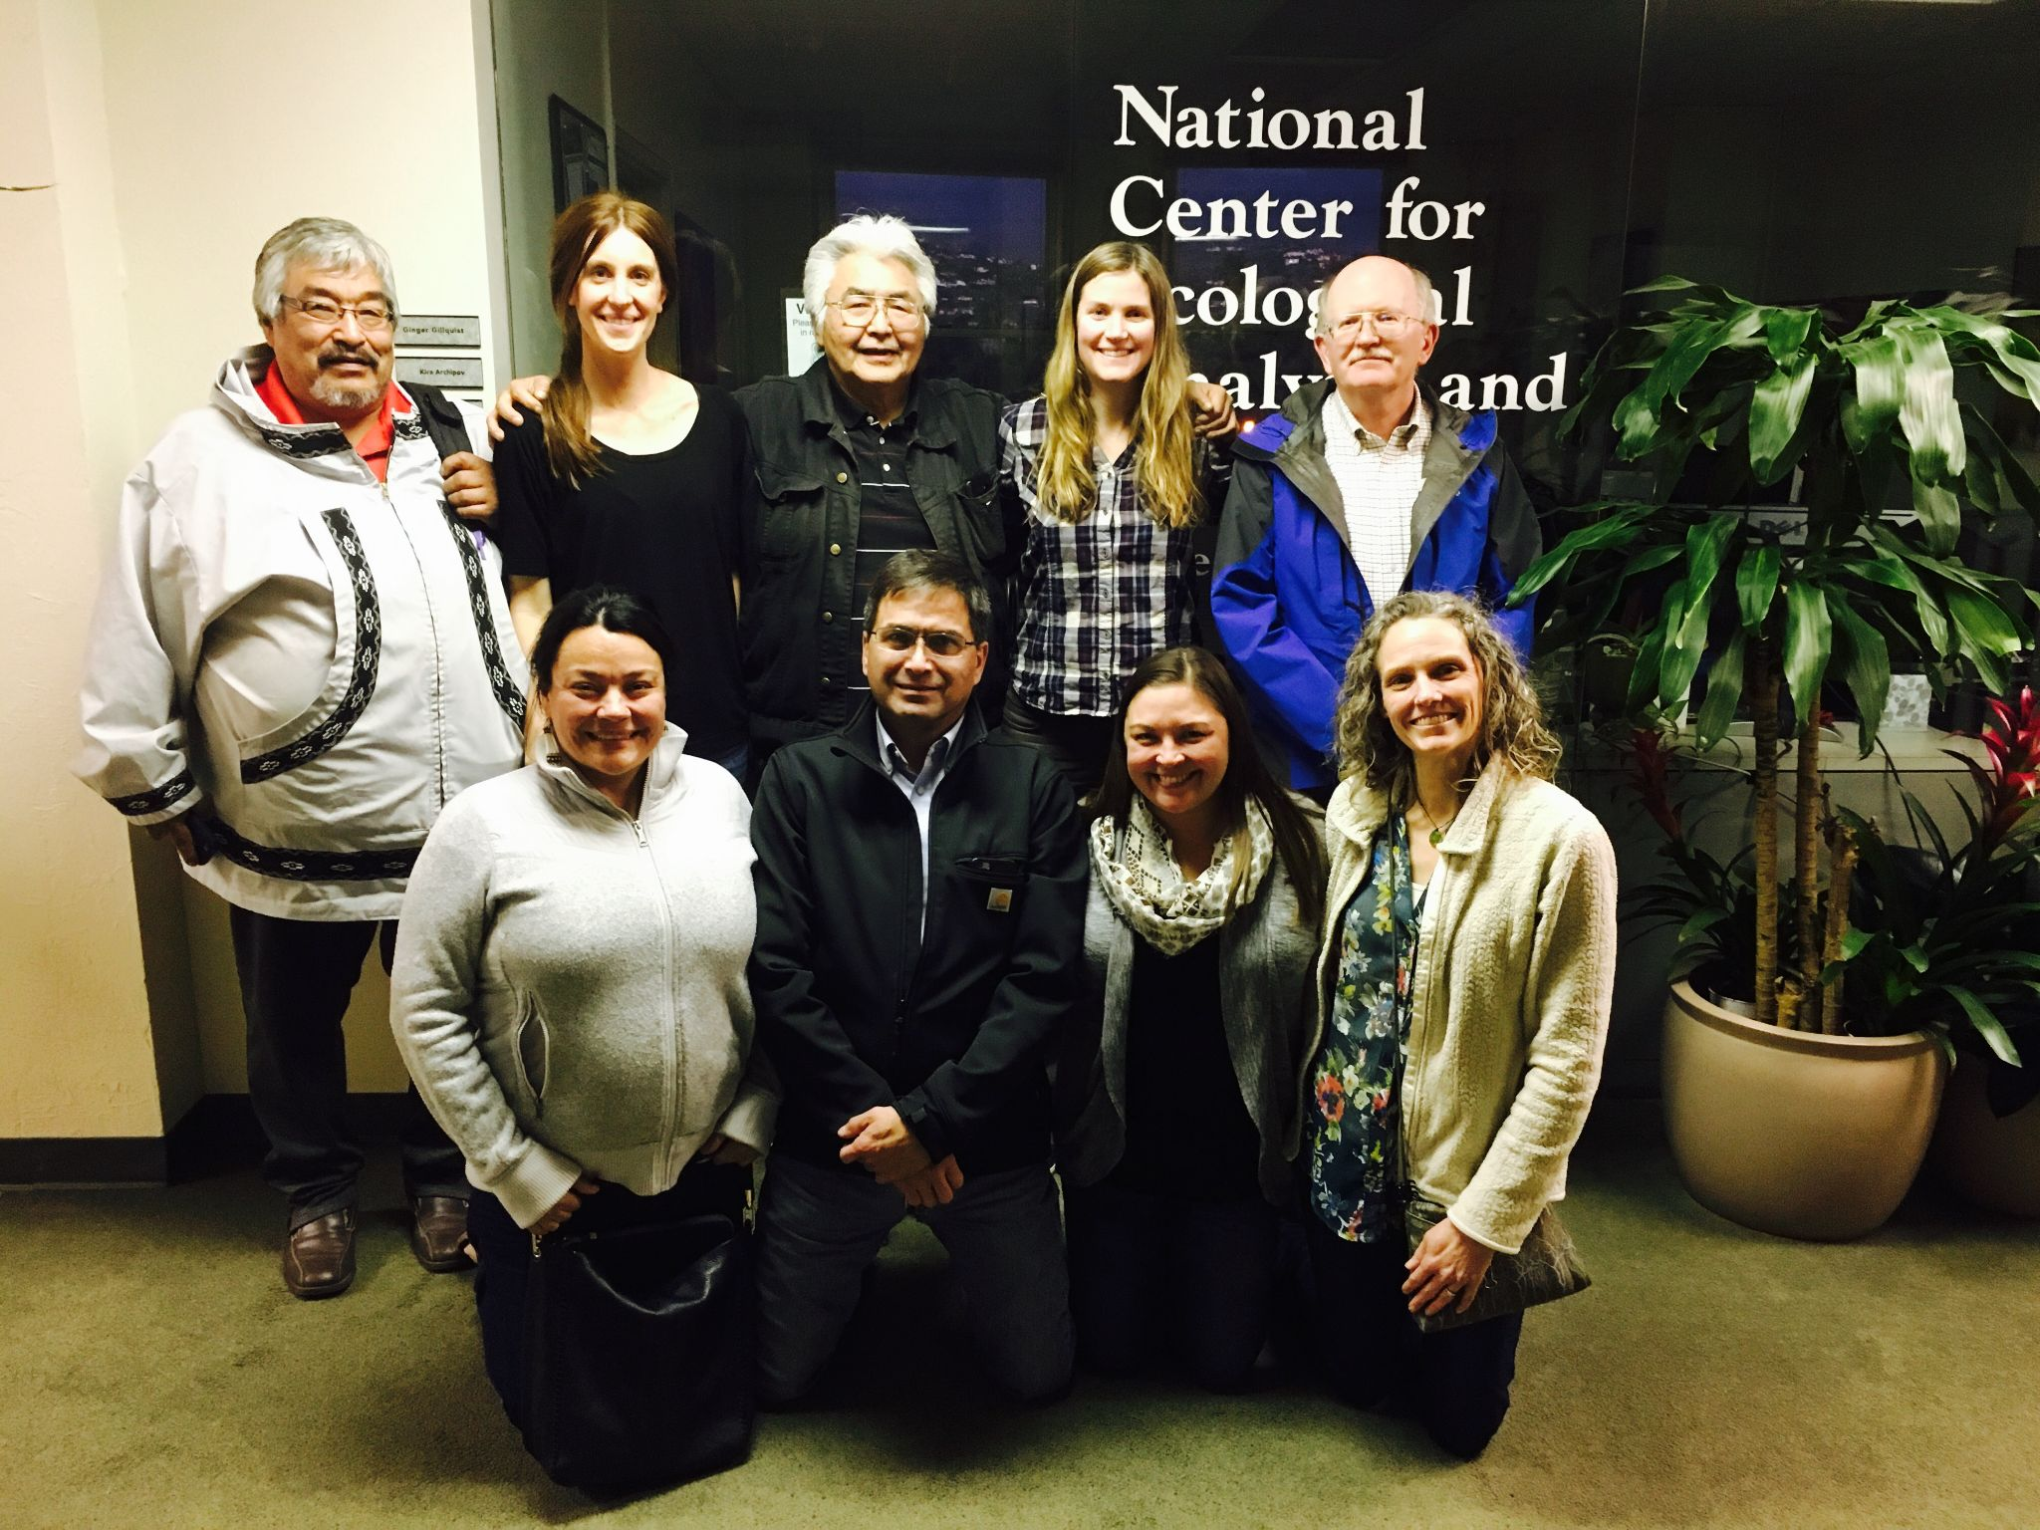
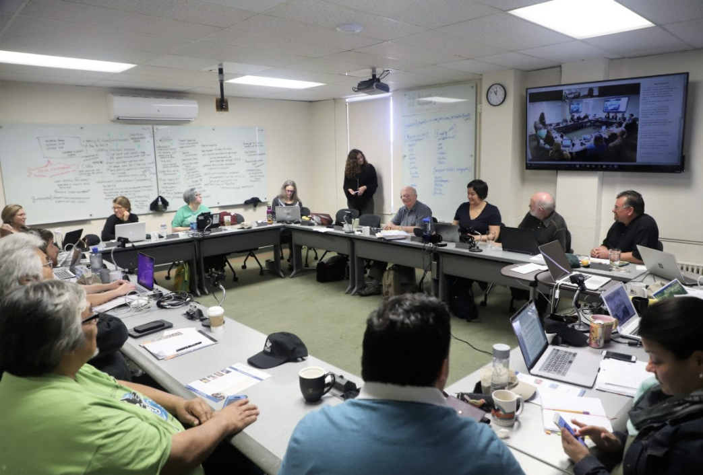

Slide 30
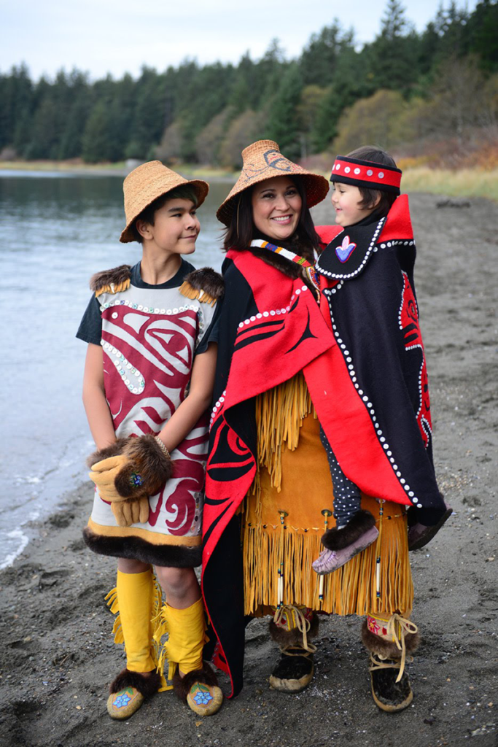
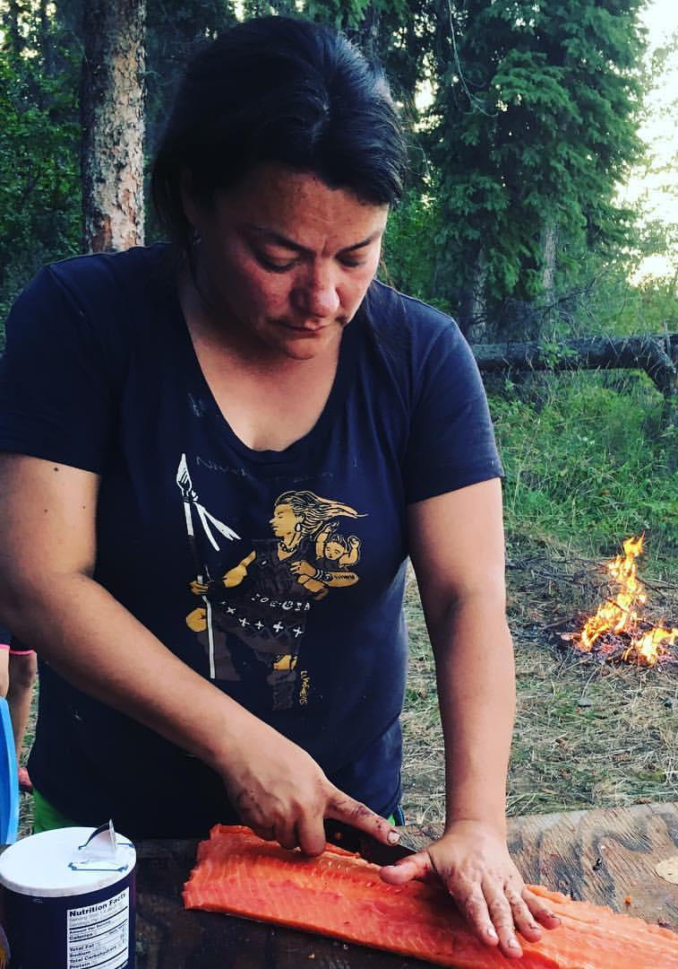
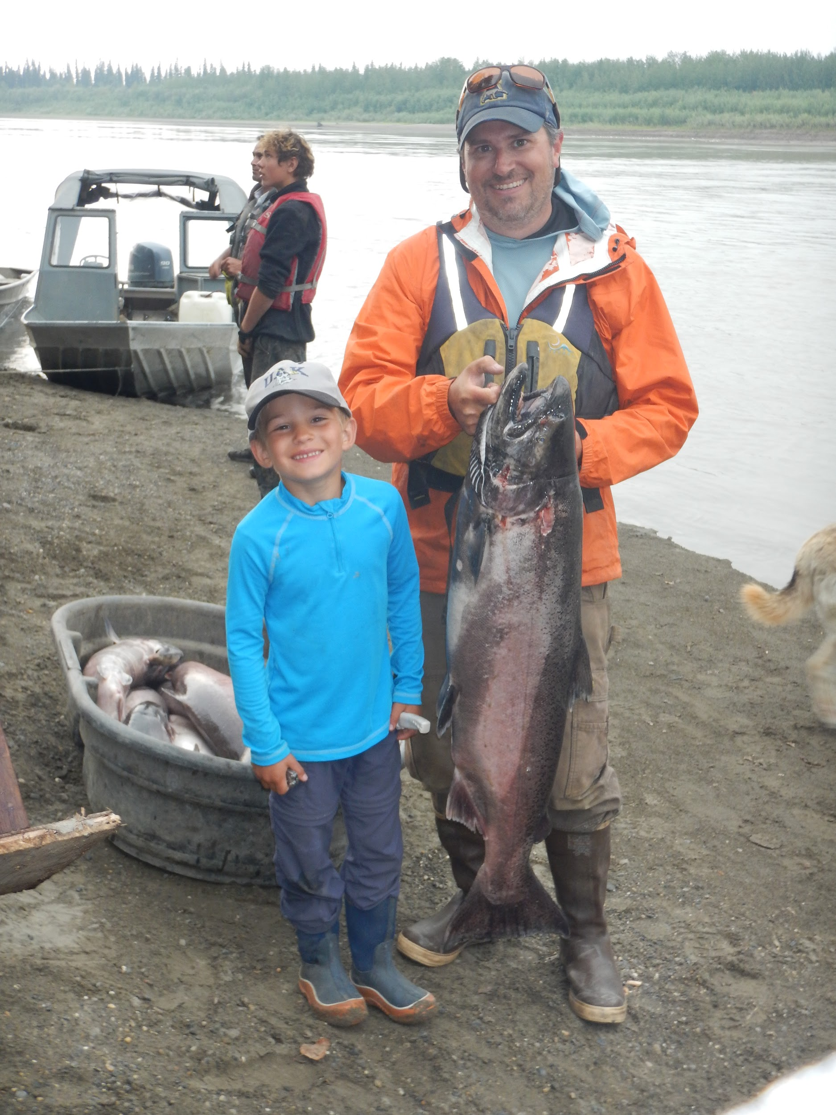
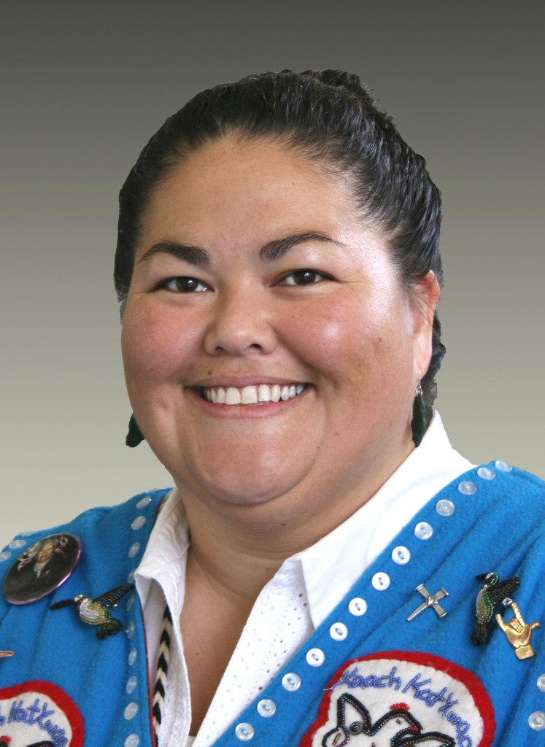
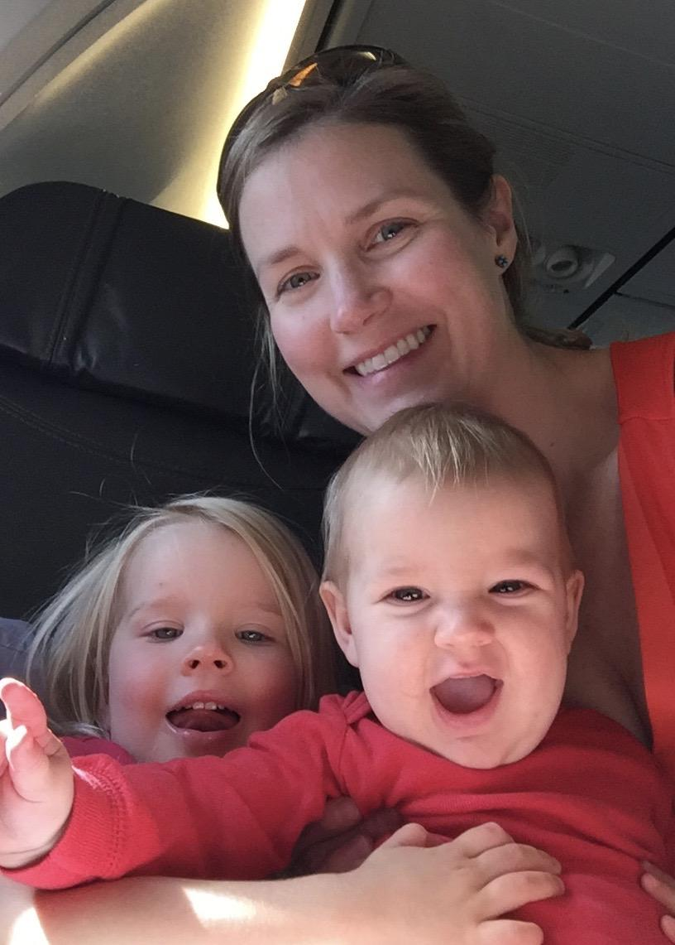
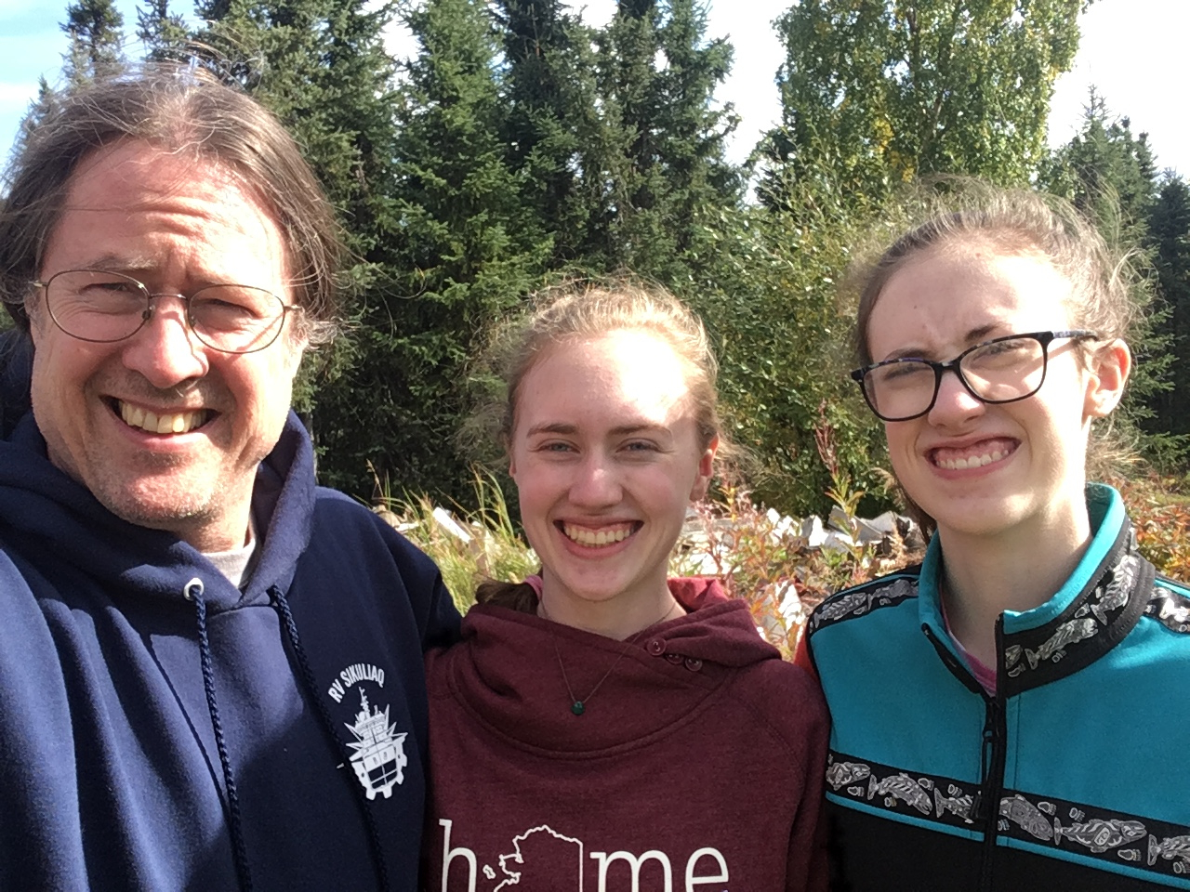
NSF NNA: Atautchikkun Iḷitchisukłuta (Coming Together to Learn)

Slide 31
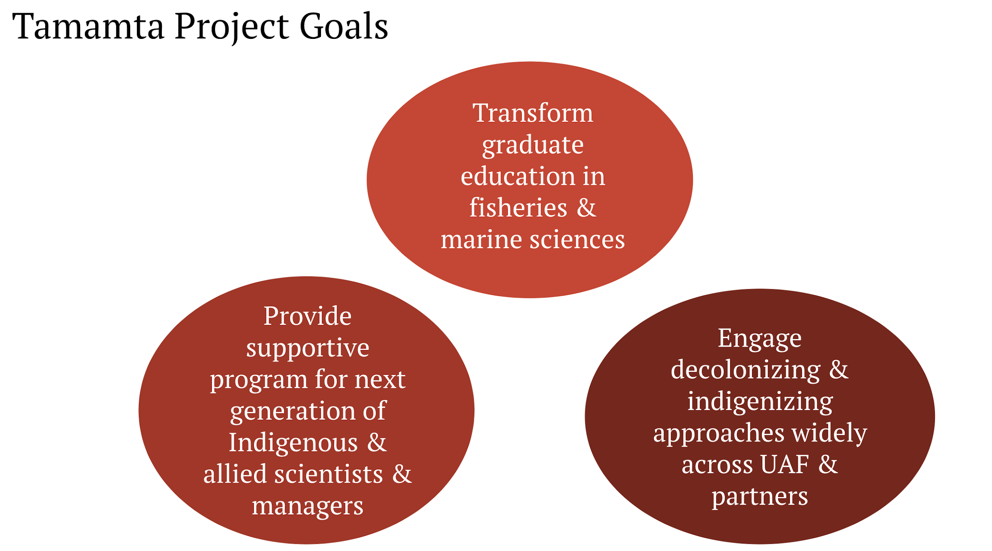
NSF NRT NNA: Tamamta (All of Us): Transforming Western and Indigenous Fisheries and Marine Sciences Together
PIs: Courtney Carothers, Jessica Black, Charlene Stern, Peter Westley, Seth Danielson
Institution: University of Alaska Fairbanks
Indigenous Approach
Goals & Program Activities
Relationships
14,000+ years of Indigenous stewardship and care
Ongoing erasure, exclusion, and deep inequities
A need to shift education and research, to center Indigenous Peoples, self-determination, and knowledge
This material is based upon work supported by the National Science Foundation under Grant No. (NSF grant 2022190). Any opinions, findings, and conclusions or recommendations expressed in this material are those of the author(s) and do not necessarily reflect the views of the National Science Foundation.

Slide 32
The Arctic Research Collaboration Workshop will take a break from 10:40 – 11:00 am AK Please help us prepare for the upcoming small group breakouts by staying logged into Zoom during the break.
Workshop Break

Slide 33
Small Group Activity: 11:15 am -12:15 pm AK
25 minutes: each group member introduces themselves and shares their pre-workshop assignment (2-3 minutes per person)
5 minutes: the group selects 1 assignment idea to explore for today’s activity
10 minutes: group members provide written feedback on assignment idea
20 minutes: the group talks through the written feedback, refine their ideas, and discuss questions outlined in the agenda
* Each group will need to ID one rapporteur to give a brief 2 minute report-out during the final workshop plenary session

Slide 34
Breakout Rooms
You will be placed in a breakout room automatically.
While in your breakout you will be unable to send Zoom chat messages to anyone outside the room.
If you click Ask for Help, it will notify the meeting host and we will send someone to the breakout room to help with any questions. You may also “Leave Breakout Room” to return to the plenary for assistance.
https://www.arcus.org/

Slide 35
The Arctic Research Collaboration Workshop will take a break from 12:15 – 12:30 pm AK When we return, rapporteurs from each group will have ~2 minutes to: 1) briefly describe the idea the group discussed 2) highlight one surprising or interesting insight that came from the interdisciplinary exploration of the idea 3) share any next steps planned or ways other workshop participants can learn more or get involved
Workshop Break

Slide 36
Group 1 (Olivia Lee’s Group) Group 5 (Courtney Carother’s Group) Group 2 (Holly Hapke’s Group) Group 6 (Pip Veazey’s Group) Group 3 (Elise Miller-Hook’s Group) Group 7 (Liz Weinberg’s Group) Group 4 (Katharine Duderstadt’s Group) Group 8 (Jennifer Brewer’s Group) Rapporteurs from each group will have ~2 minutes to: 1) briefly describe the idea the group discussed 2) highlight one surprising or interesting insight that came from the interdisciplinary exploration of the idea 3) share any next steps planned or ways other workshop participants can learn more or get involved
Small Group Reports

Slide 37
What Comes Next?
Circulation of workshop participant info, assignment files, and a bibliography of other helpful resources shared to encourage additional networking and support among all workshop participants.
Project champions invited to touch base with workshop hosts to discuss next steps.
Arctic Research Funders Meet & Greet Virtual Networking Event on Friday, 7 May from 9-11am AK.
Plans underway for future Arctic Research Collaboration events

Slide 38
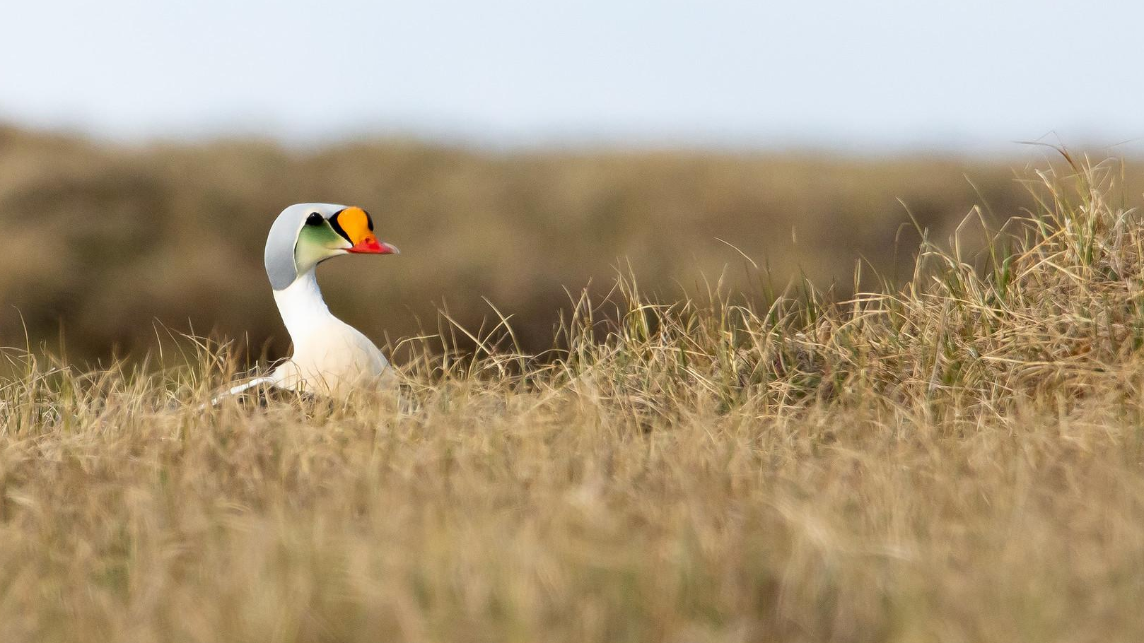
What is IARPC?
The Interagency Arctic Research Policy Committee
Photo: Lisa Hupp/USFWS
Notes:
IARPC is the Interagency Arctic Research Policy Committee. By bringing together leaders from 16 agencies, departments, and offices across the U.S. federal government, we enhance research on environmental issues in the Arctic.
IARPC was created in 1984 under the Arctic Research and Policy Act of 1984 (ARPA). The act called for a comprehensive national policy focused on research needs and objectives in the Arctic. It established IARPC and our sibling organization, the Arctic Research Commission (USARC), to help implement the act.

Slide 39
IARPC Agencies
Notes:
One of the main purposes of IARPC is to bring together federal agencies to coordinate Arctic research and reduce duplication of efforts.
IARPC is organized into a several levels of staff and participants. The “top” level is the Principals. These include one policy-level member from 14 federal agencies responsible for the U.S. investment in research in the Arctic, as well as representatives from the White House Office of Science and Technology Policy and the Office of Management and Budget. The IARPC Principals meet annually to provide policy advice and direction. They also develop the five-year Arctic Research Plan, and sometimes direct the staff group to address particular issues.

Slide 40
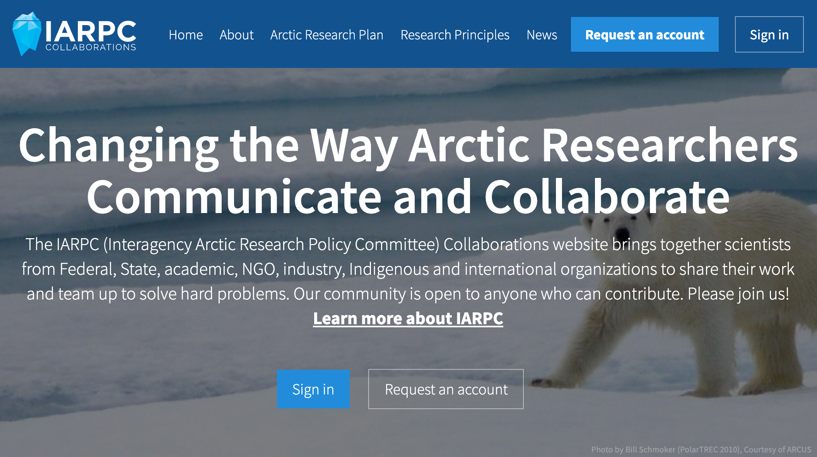
Notes:
Liz:
The IARPC Collaborations website is free and open to anyone who can contribute, regardless of their role in Arctic research. Our member space includes more than 2,500 members of the Arctic research community, including those from federal, state, academic, non-profit, industry, Indigenous, and international organizations. If you’re not already an IARPC Collaborations member, I encourage you to sign up for an account by visiting iarpccollaborations.org and clicking the “Request an Account” button.

Slide 41
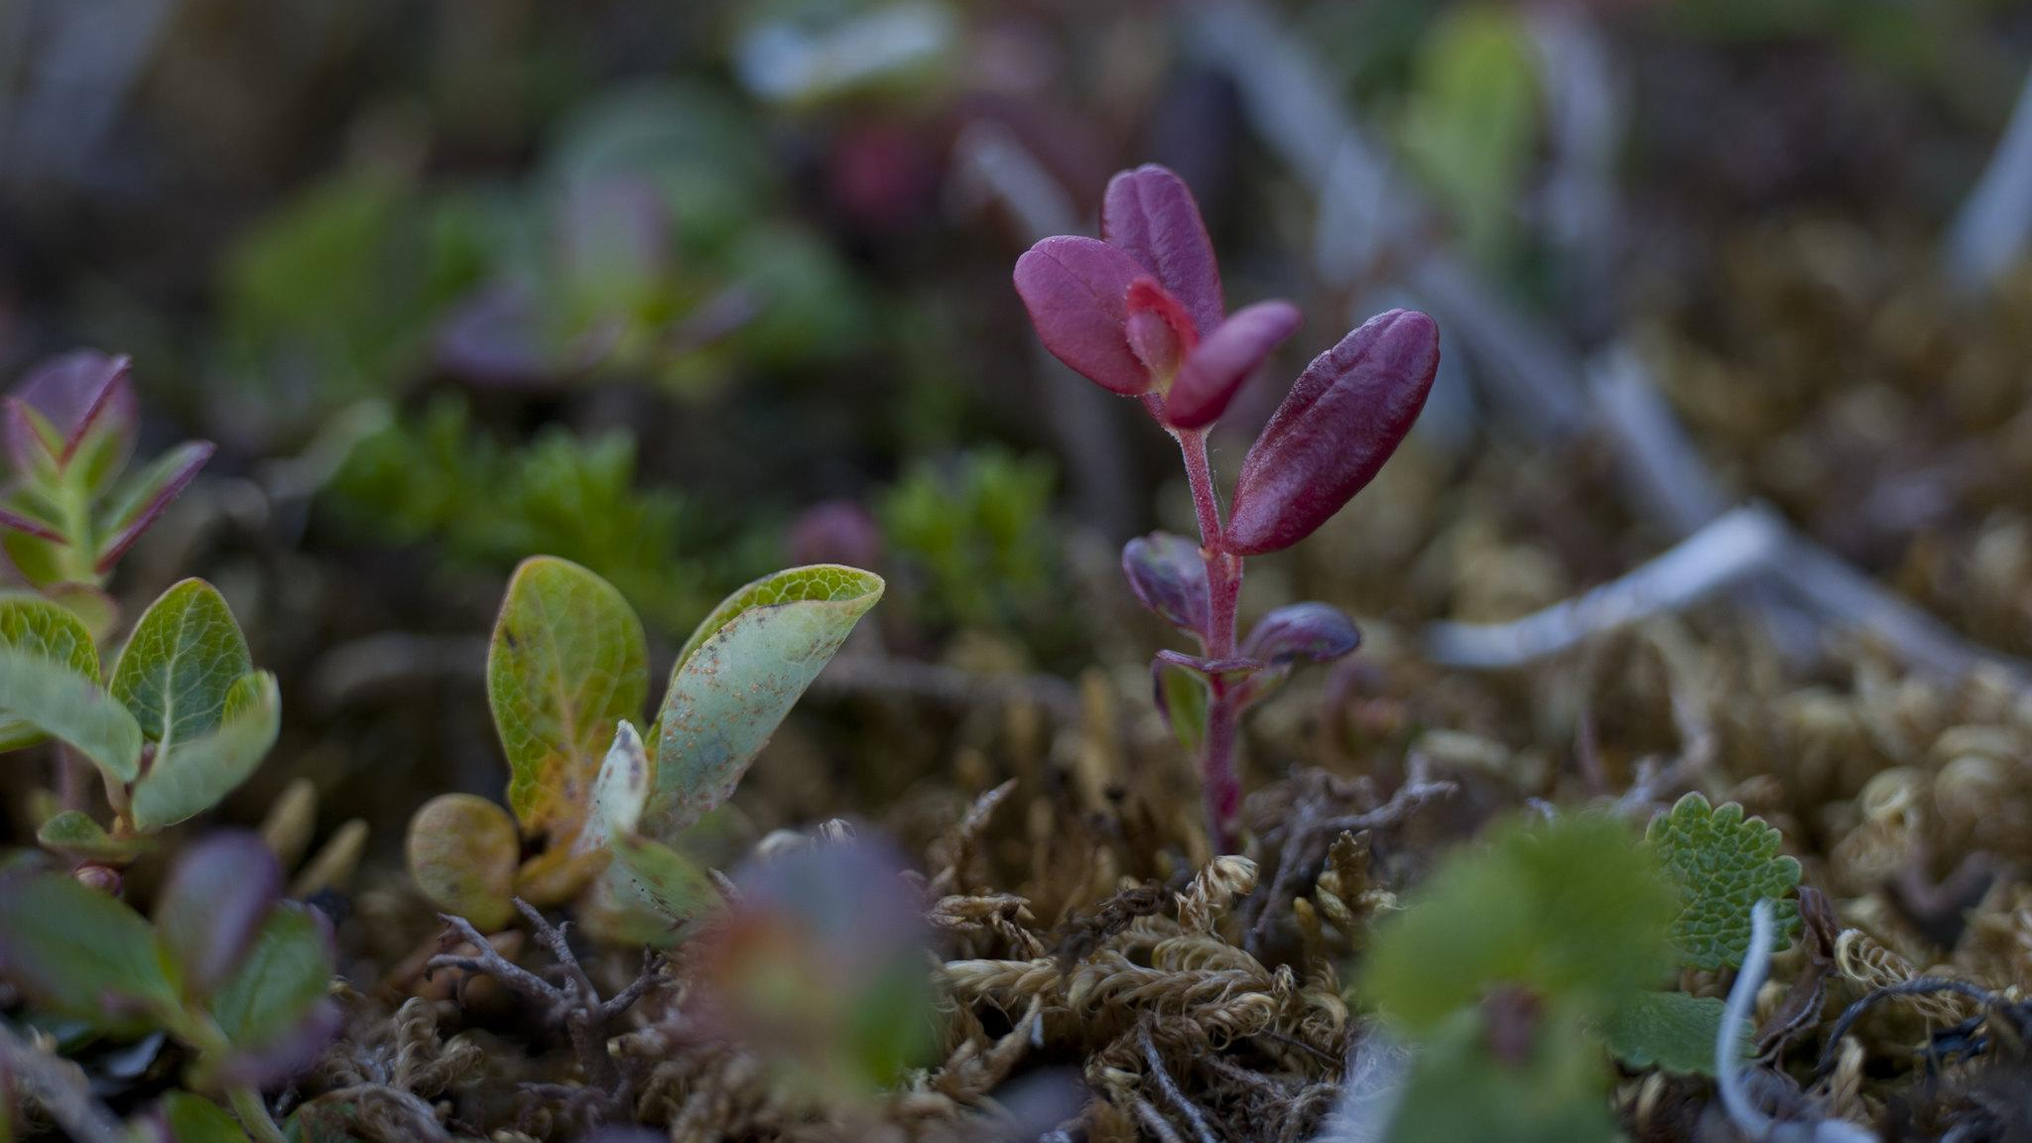
Collaboration Teams
Atmosphere
Coastal Resilience
Environmental Intelligence
Data
Observing
Modeling
Glaciers & Sea-Level
Health & Well-Being
Marine Ecosystems
Permafrost
Sea Ice
Terrestrial Ecosystems
Photo: Neal Herbert/NPS
Notes:
Meredith:
One of the main roles of the IARPC Collaborations website is to bring together the collaboration teams and self-formed teams.
Collaboration teams were created by staff group in 2013 to assist with the implementation of the current Arctic Research Plan. They are organized around the nine goals of the current Arctic Research Plan. They use the website to communicate and meet monthly. Together, they enhance the implementation of the plan through research and community engagement. They are open to anyone wishing to advance knowledge about the Arctic.
CTs include Atmosphere
Coastal Resilience
Environmental Intelligence
Data
Observing
Modeling
Glaciers & Sea-Level
Health & Well-Being
Marine Ecosystems
Permafrost
Sea Ice
Terrestrial Ecosystems
Also self-forming teams: STEM education, Diversity & Inclusion, Early Career, Physical oceanography, and more
If you have a project that comes out of your discussion:
We often have opportunities in for community updates in our team meetings – can share if you want new collaborators, want community feedback, etc
Next Arctic research plan will be more interdisciplinary, so we hope to have more interdisciplinary efforts and opportunities within the next plan (with the caveat that we don’t provide funding, just a platform for collaboration)

Slide 42
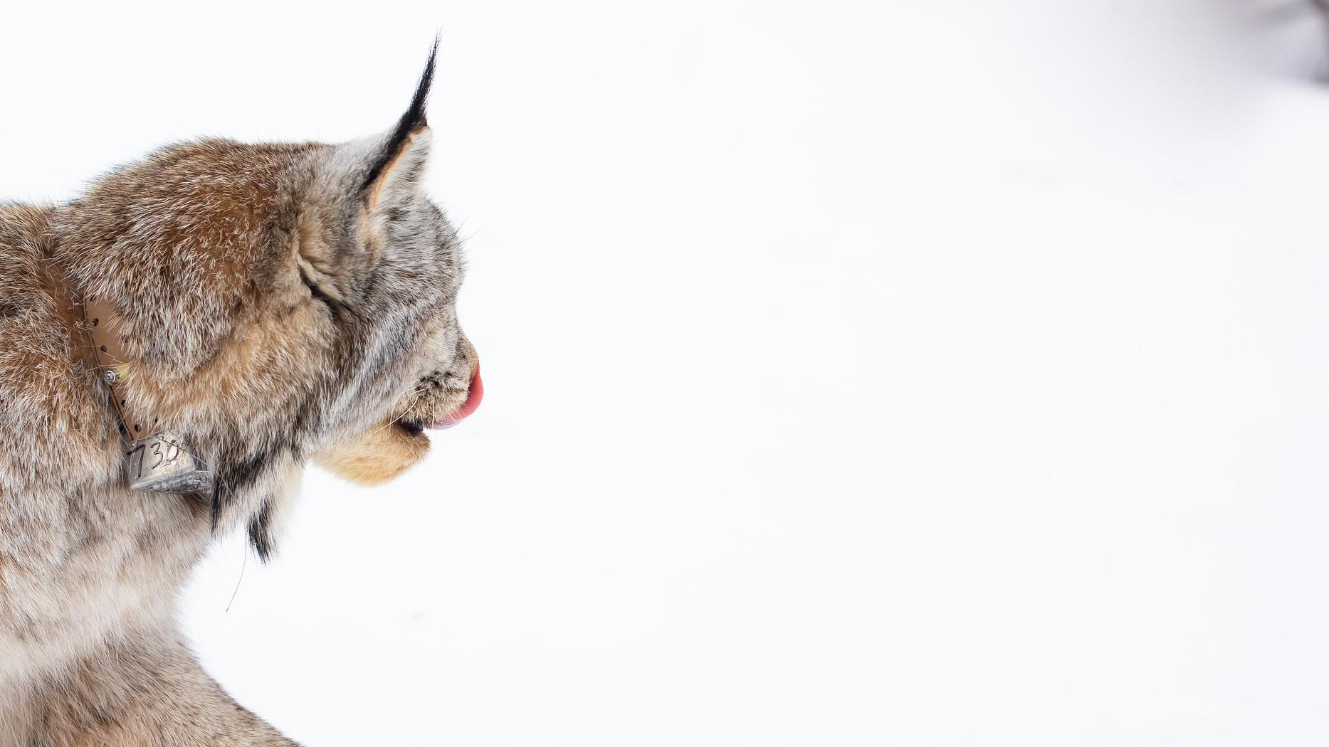
Arctic Research Plan 2022-2026
Read the plan:
tinyurl.com/arcticplandownload
Comment through June 11
Photo: Lisa Hupp/USFWS
Notes:
New Arctic Research Plan draft is out for comment
Can comment via federal register, email, voicemail, or mail – see details at that website

Slide 43
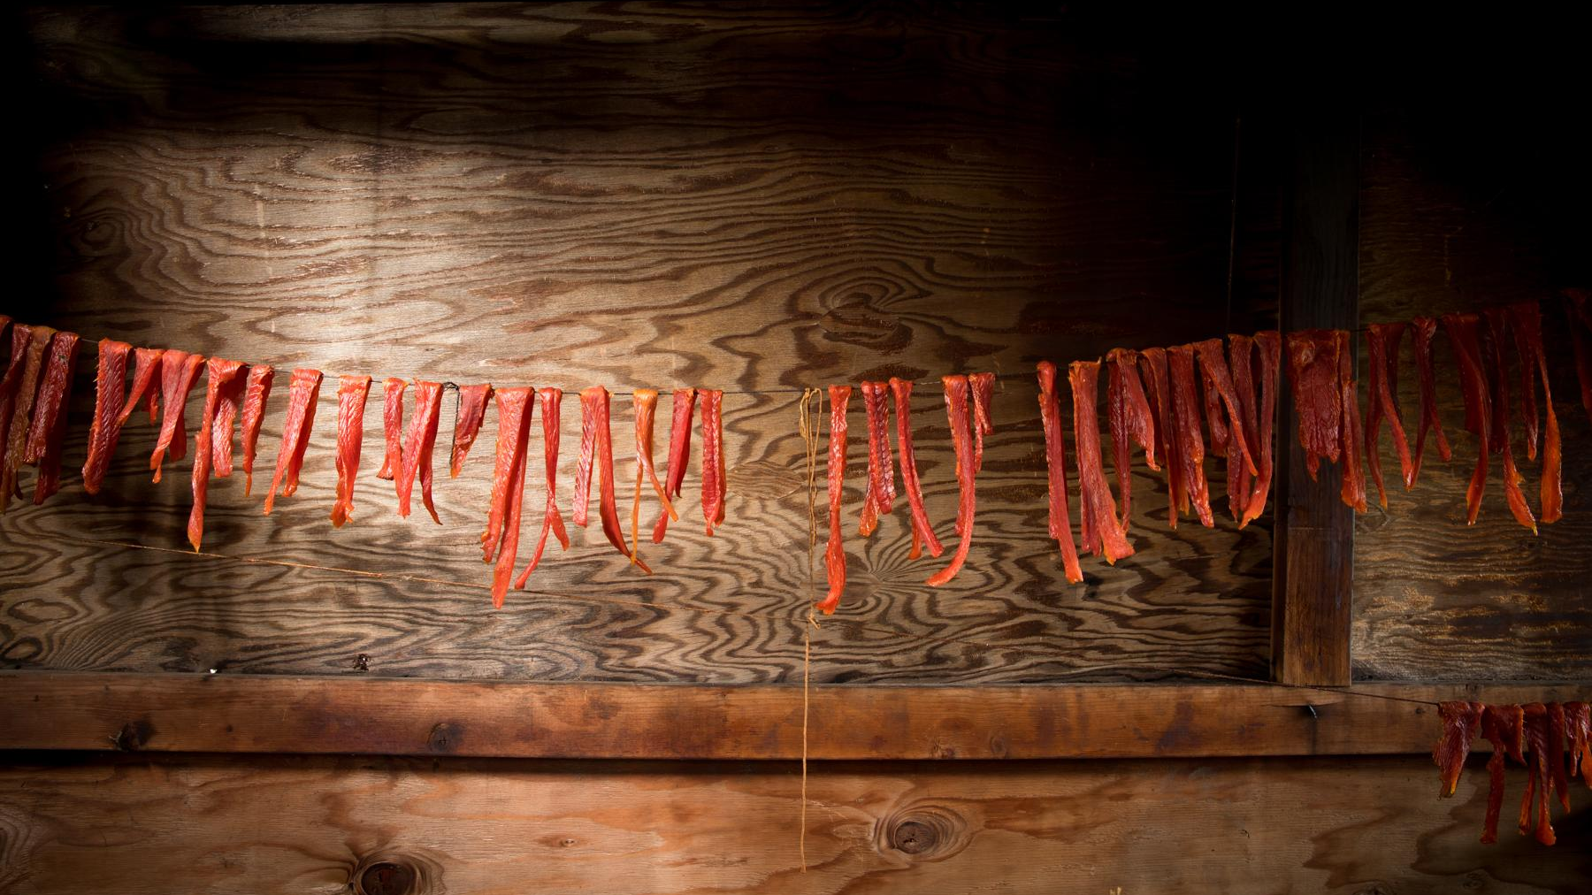
iarpccollaborations.org
facebook.com/iarpccollaborations
@IARPCCollab
@iarpccollaborations
Photo: USFWS
Notes:
Liz:
Again, if you aren’t already a member on IARPC Collaborations, I strongly encourage you to sign up at iarpccollaboration.org so you can stay in the loop with the community. You can also follow us on social media.

Slide 44
Please take a few minutes to tell us about your experience today! Survey Link: https://www.surveymonkey.com/r/R7XPQC3
Workshop Evaluation Survey

Slide 45
THANK YOU FOR ATTENDING!
Notes:
Post workshop Communication – will share out ideas generated today; will also share a bibliography of resources that we are in the process of compiling
THANKS to …. And THANK YOU Everyone for attending. We hope to see you at our next event on May 7th.

Slide 46
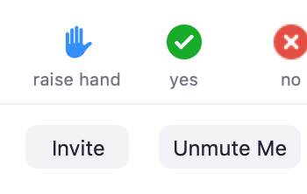
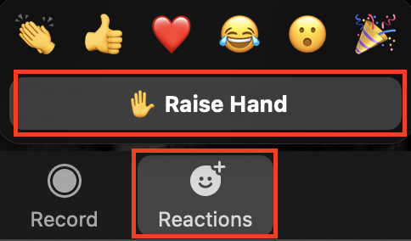
Q & A / Discussion
To participate in this Q & A/Discussion period, you may either type your questions in the chat box or raise your hand.
The host will select and read questions typed into the chat box.
When raising your hand, the host will call on you and you may unmute yourself and ask your question.
If you are calling in, you can raise your hand by pressing *9 and then pressing *6 to unmute/mute yourself again.
Click the Participants icon
Click the “Raise Hand” icon on the Participant window
Click “Unmute Me” when the host calls on you
OR
Hit the “Reactions” Button at the bottom of your zoom toolbar
Click the “Raise Hand” icon in the reactions window

