Slide 1
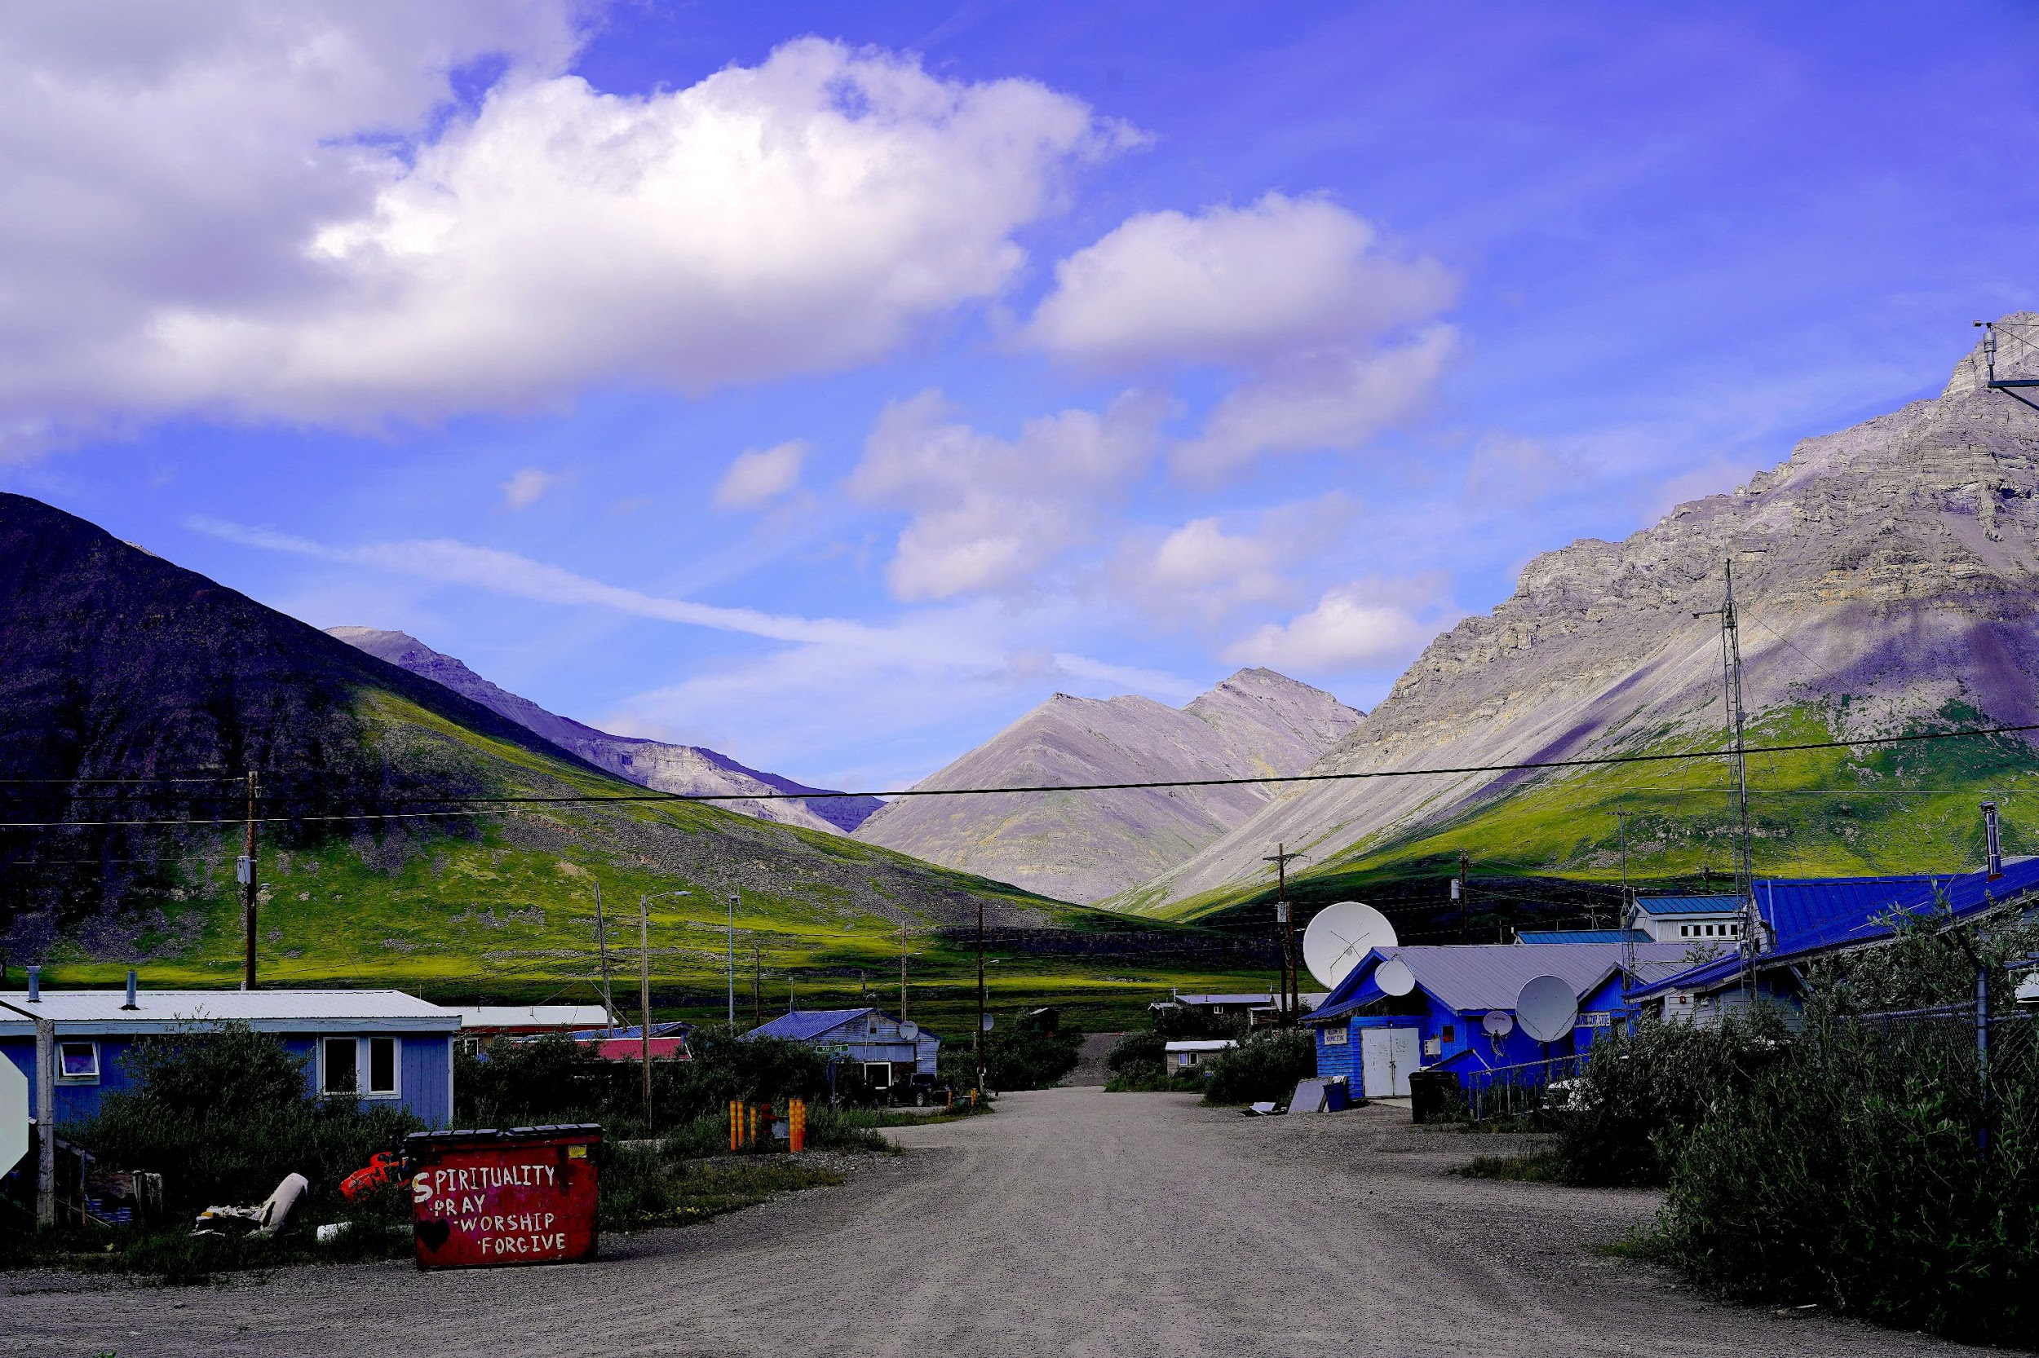
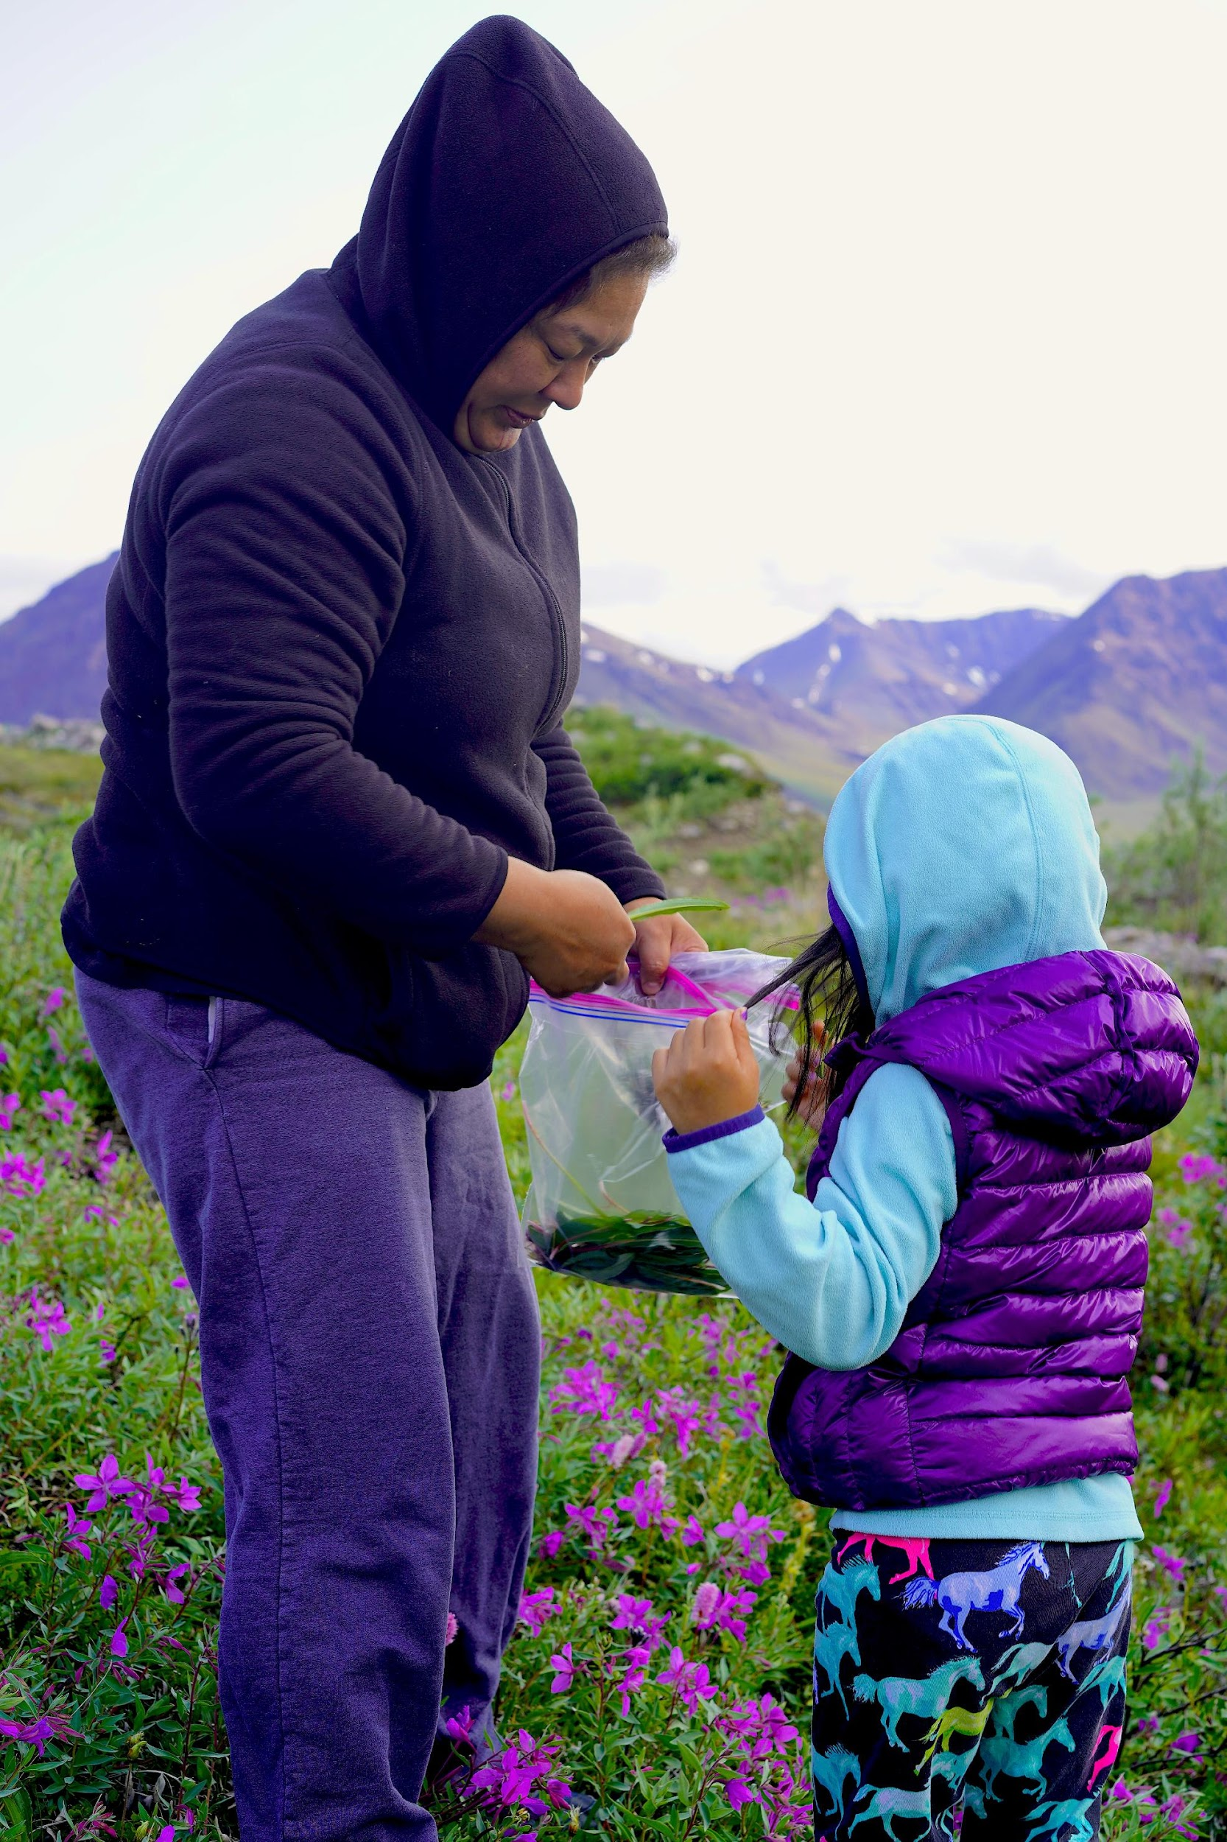
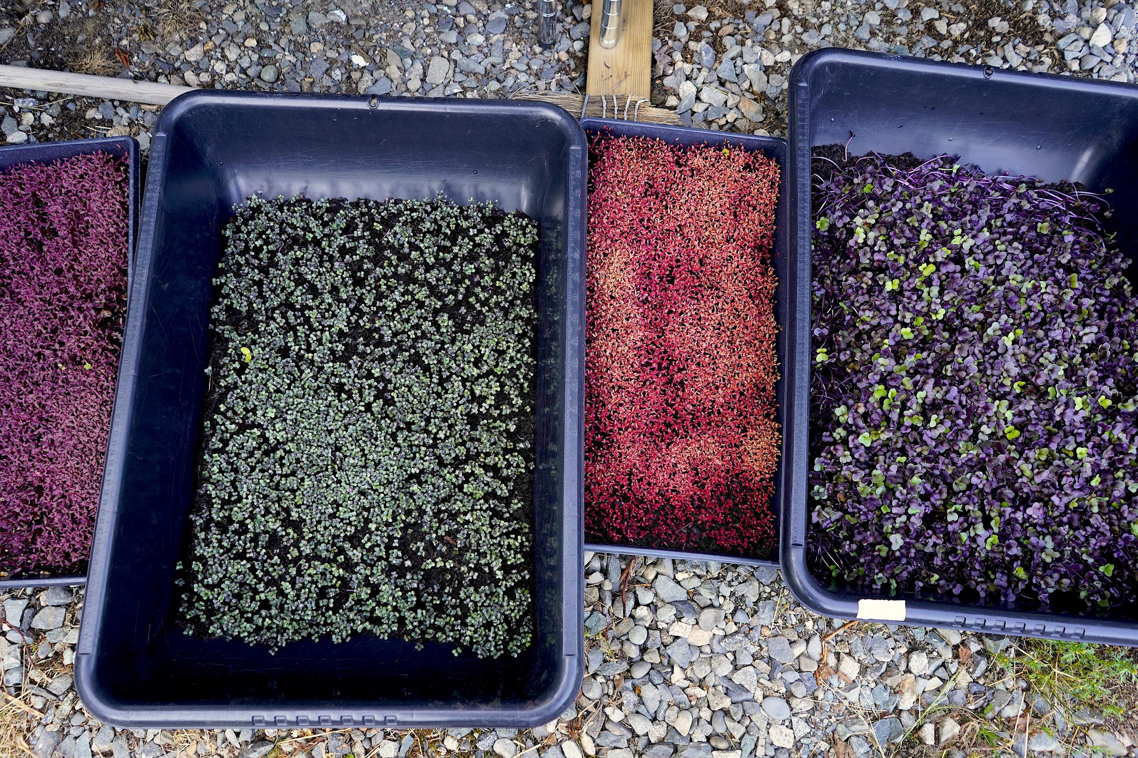
Farming the Tundra? Climate Change, Agribusiness Expansion, and Arctic Food Security
Serena Stein, Wageningen University
Hannah Bradley, Princeton University

Slide 2
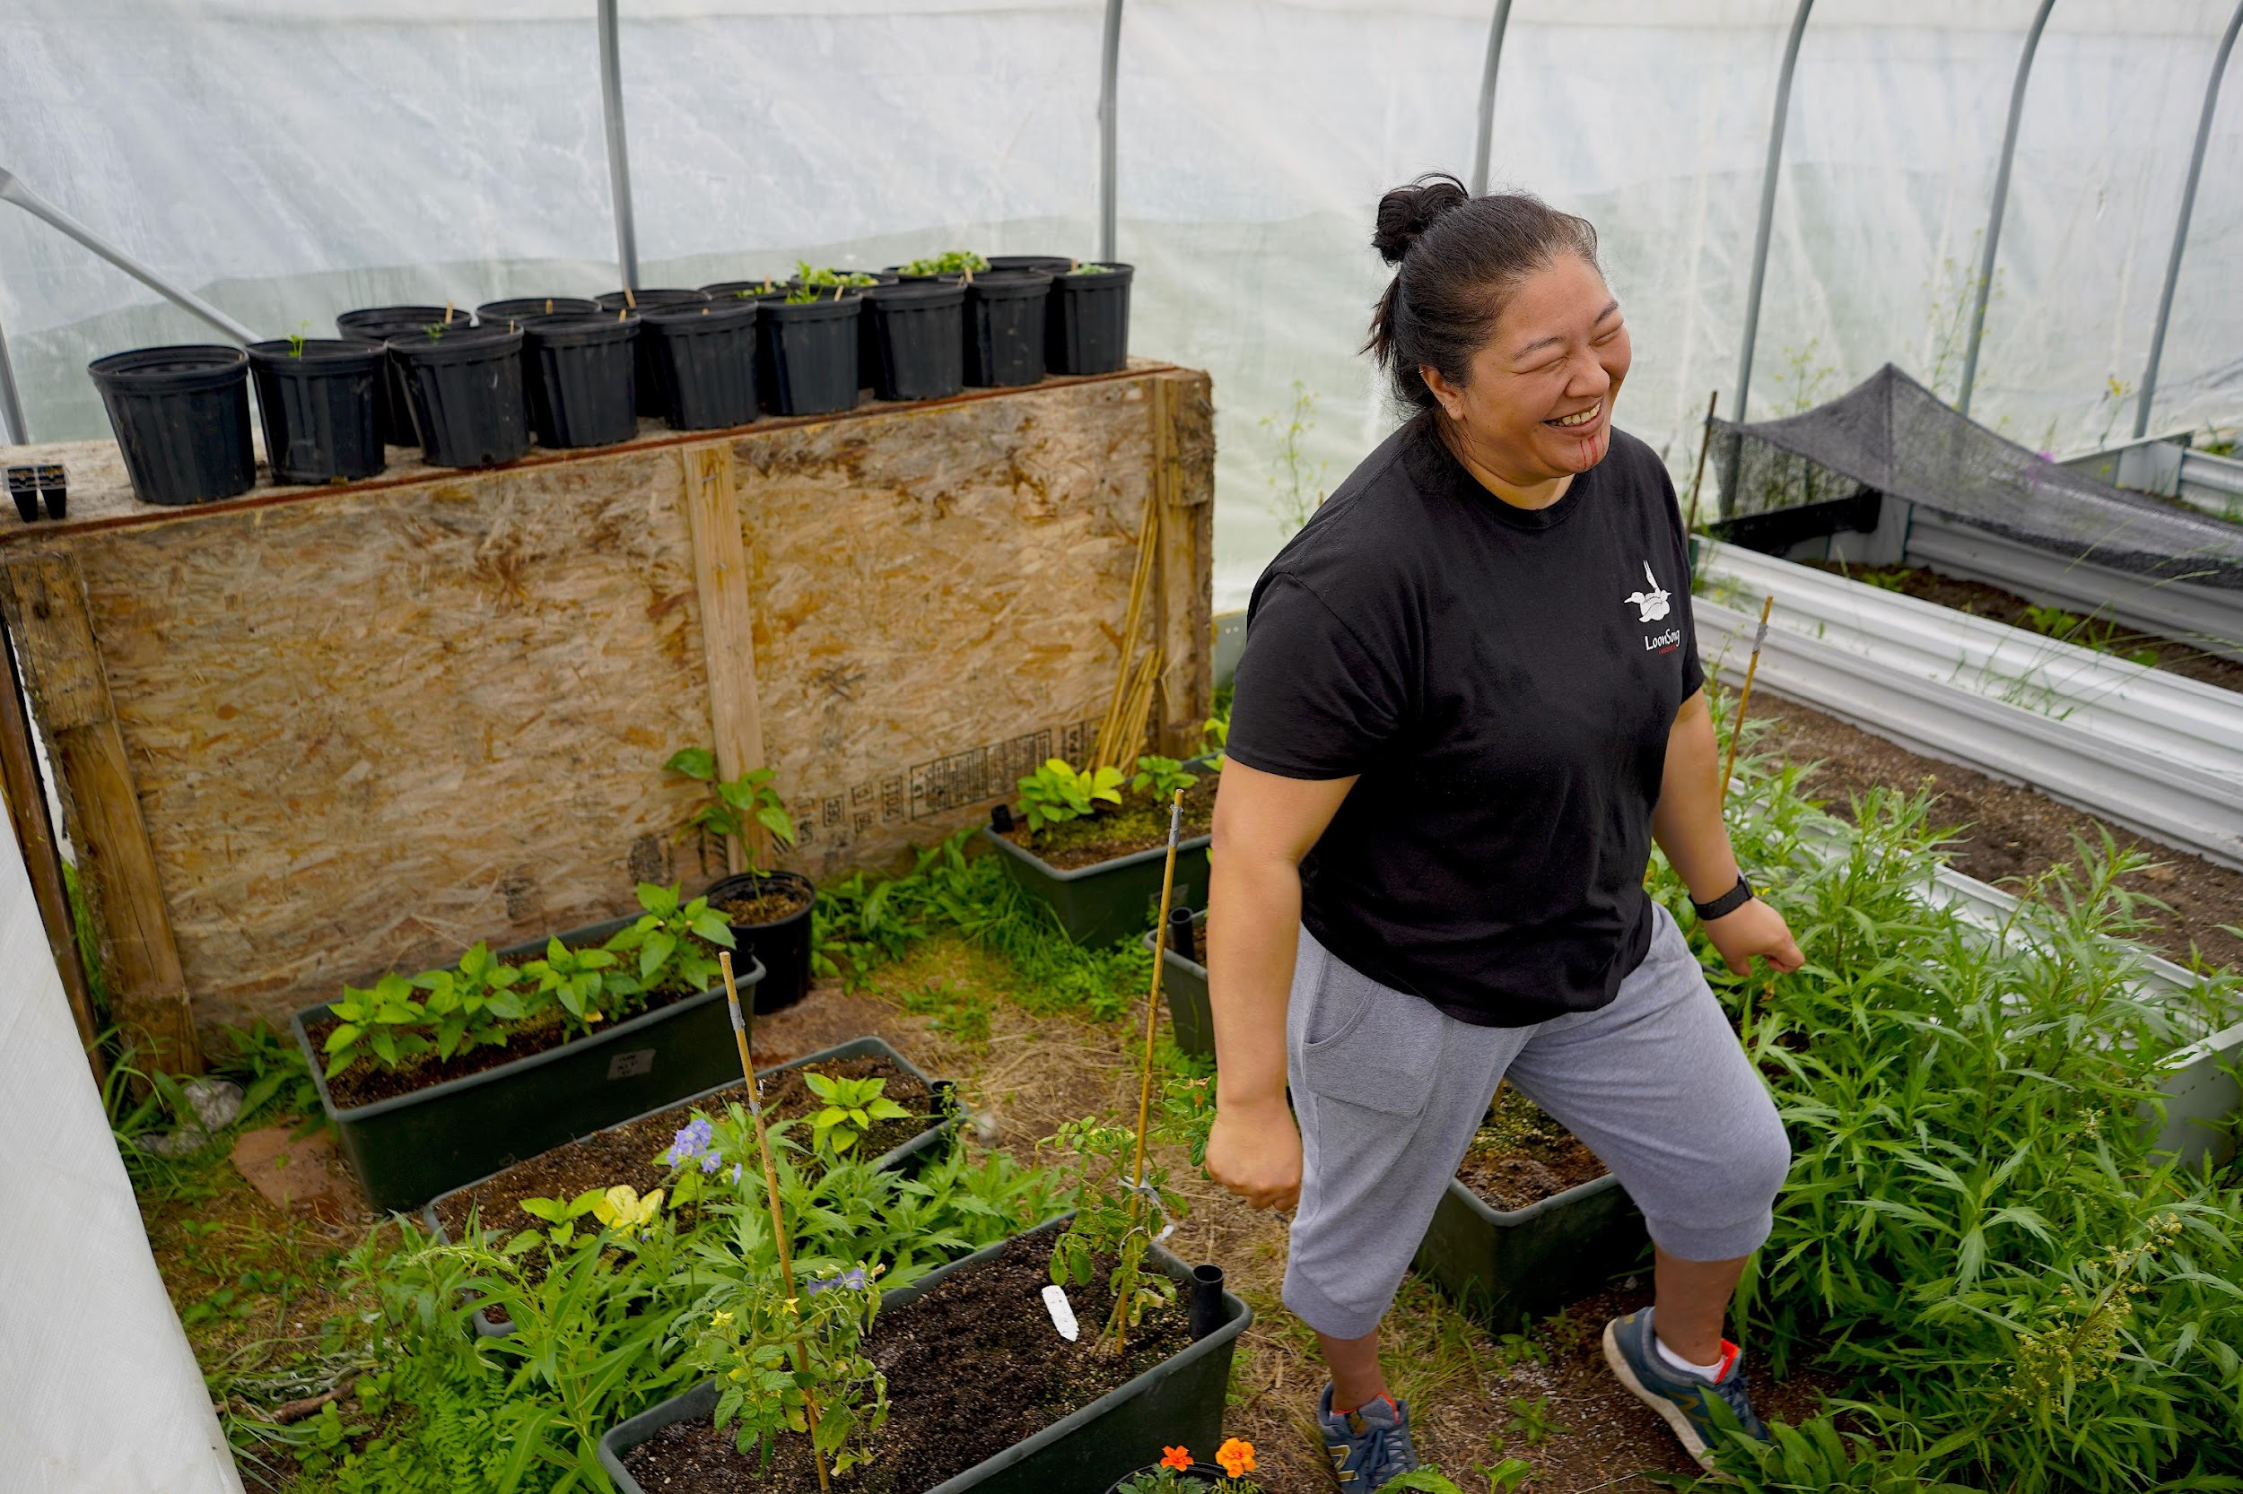
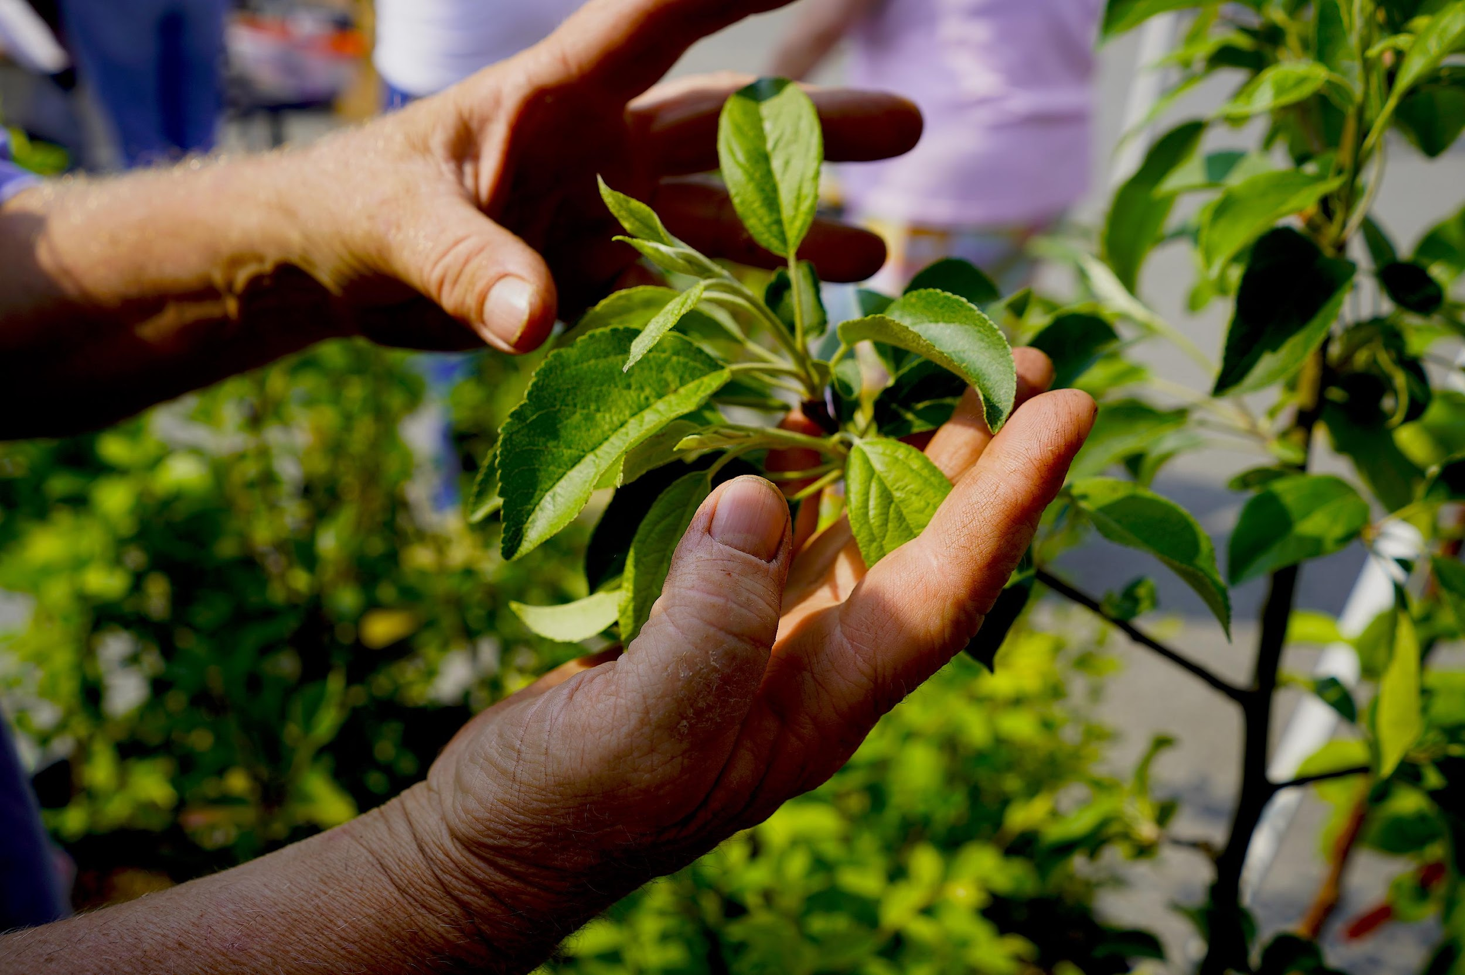
Project Description: As climate change reconfigures agroecological possibilities worldwide, the Arctic is being reimagined as an emerging frontier of agribusiness. This research will assemble an interdisciplinary team of anthropologists, geographers, agronomists, pedologists, and others to:
a) map agribusiness investments and community farming and gardening initiatives rising in 3 comparative sites of the Arctic;
b) work with leaders and practitioners from Native communities in 3 Arctic sites to investigate how indigenous knowledge and Euro-scientific approaches compare and share understandings of adaptation, cultivation, and resilience;
c) build an ethical and policy framework for tundra farming in collaboration with indigenous community leaders, practitioners, and academic research team that deals explicitly with continuities and comparative experiences of colonization, racism, and social inequalities.
f

Slide 3
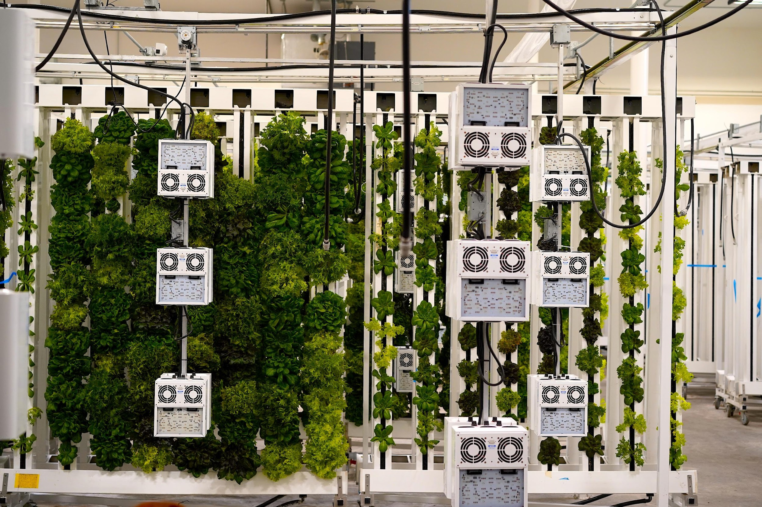
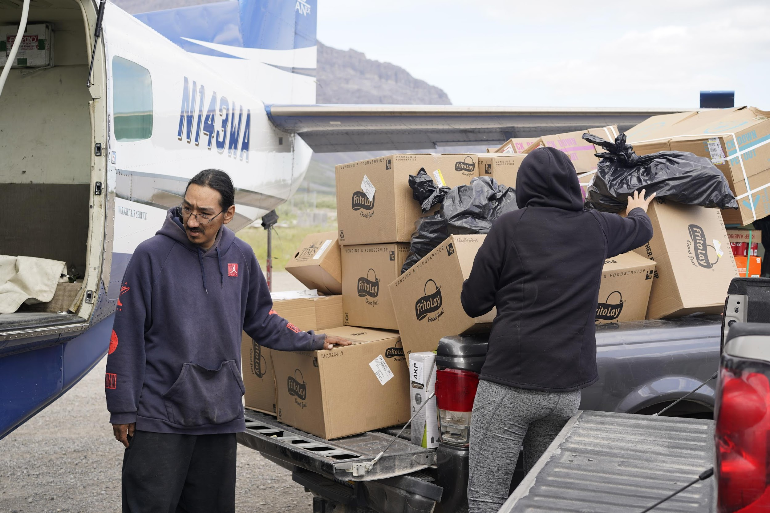
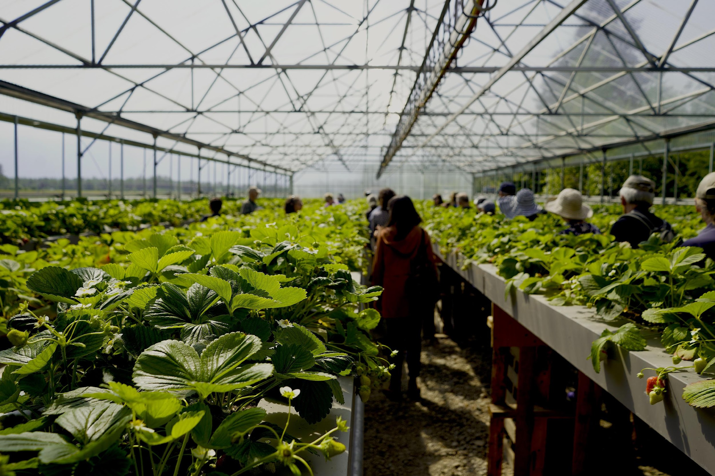
Our Concepts 1. Climate opportunism (Bradley and Stein, forthcoming) - An approach to studying those harnessing opportunities that climate change reveals - Identifying practices of improvisation and adaptation in and beyond extractivism - Defining ”climate winners” and potential processes of repair & justice in policy debates. 2. Speculative frontiers - Describing social, symbolic, material realities to frontier imaginations (Tsing, Li, etc) - Examining how change takes place and remakes communities, economies, and ecologies on the ground.

