Slide 1
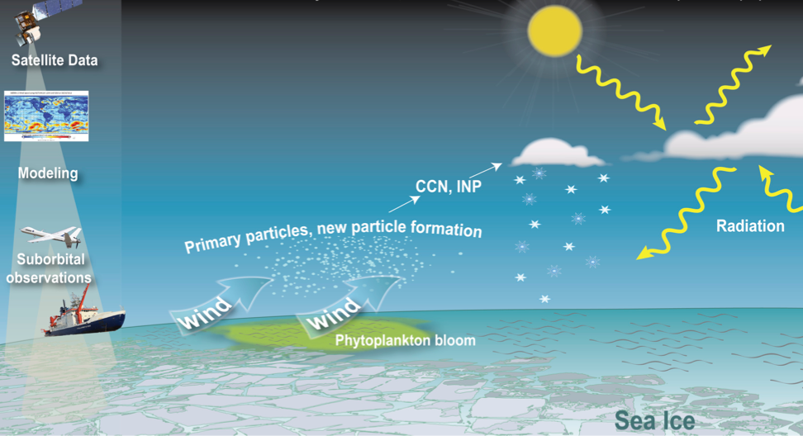
Lauren Zamora
Univ. of Maryland / NASA GSFC
lauren.m.zamora@nasa.gov
The Arctic is warming faster than other areas of the planet
Clouds and aerosols have potentially large but uncertain effects on this warming
I am mostly NASA funded, and use satellites and aircraft data to understand how aerosols impact Arctic clouds
This remote sensing climate data (e.g., clouds, aerosols, meteorology) can help provide long-term context for Arctic environmental systems and their impacts on humans, including over remote locations and during polar night
Aerosol particles
Human and environ-mental well-being
Arctic Research Collaboration Workshop, Apr 16, 2021

