Slide 1
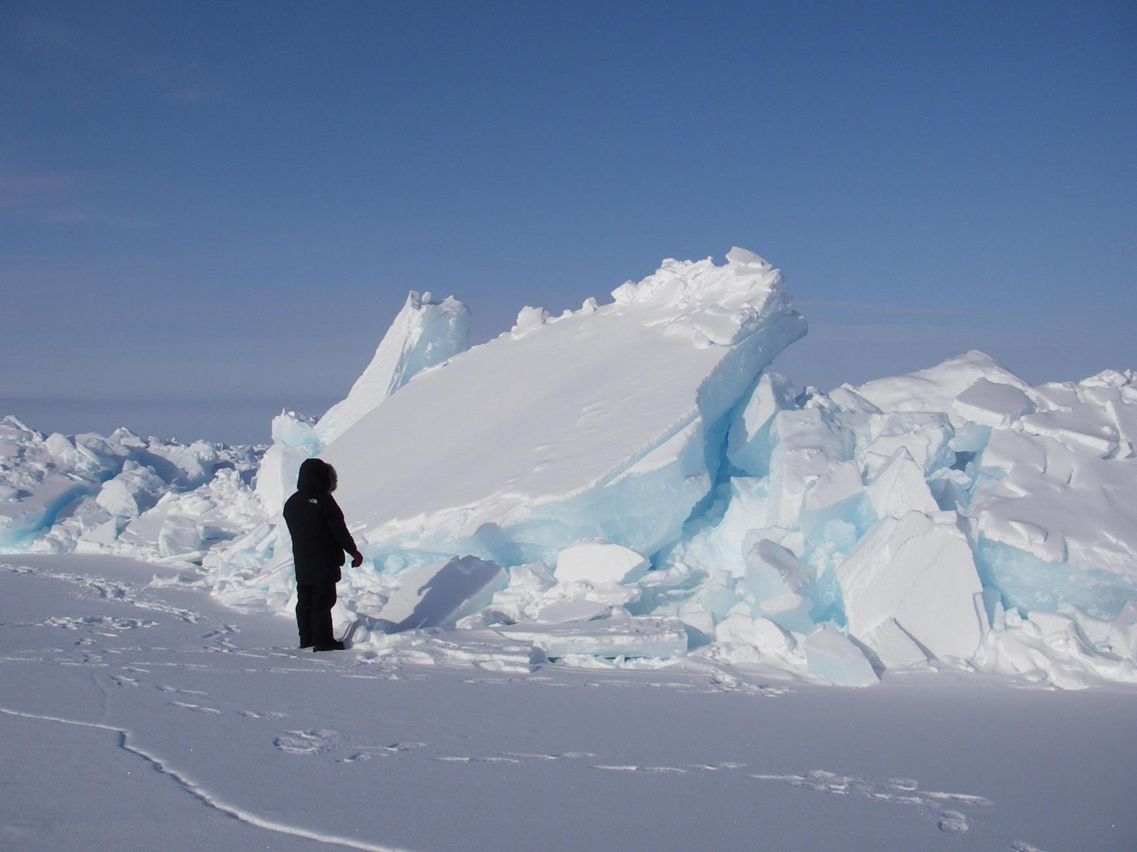
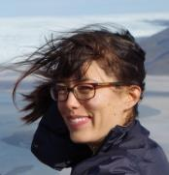
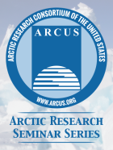
Welcome
ARCUS Arctic Research Seminar Series
“Development on Ice: Social and Economic Impacts of Arctic Transportation Infrastructure”
14 April 2017
Presented by Mia Bennett
UCLA & Cryopolitics
#arcuswebinar

Slide 2
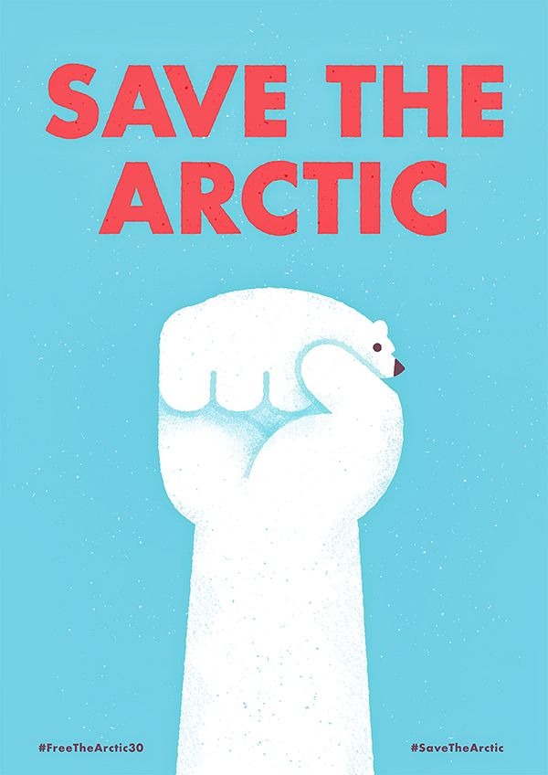
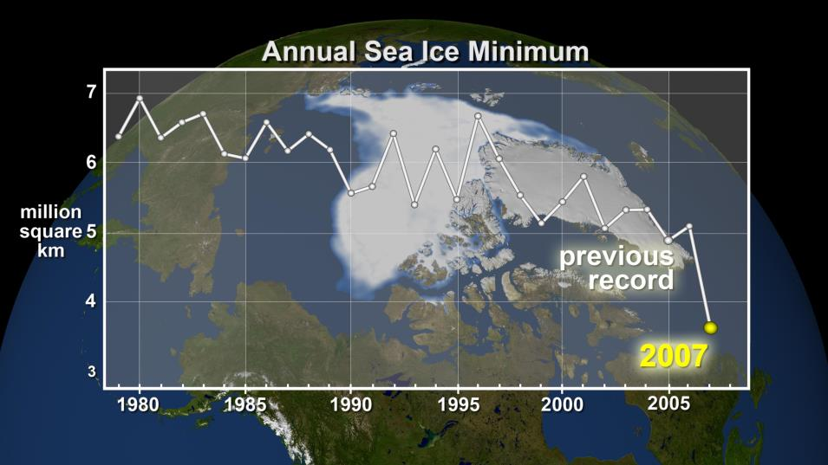
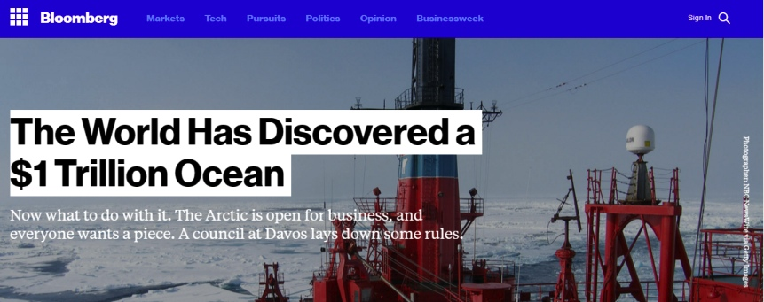
Climate change and the opening of a new frontier
Image: NASA
Notes:
Climate change is happening: Sea ice is thinning and melting, permafrost is thawing, and temperatures are rising. These massive environmental shifts have led to an idea that the Arctic needs saving, a perspective most clearly voiced by environmental organizations such as Greenpeace.
These interventions are seen as apolitical.
However, there is another perspective that is not so much competing with the idea that the Arctic needs saving as it is in fact supported by it, and that is the idea that the Arctic may have a chance to benefit from climate change.
You may have heard this expressed in a slightly different formation as the Arctic paradox: that the very activities that Arctic environmental change is supposedly generating are fossil-fuel and carbon intensive industries – oil and gas production and mining – that will further intensify Arctic climate change.

Slide 3
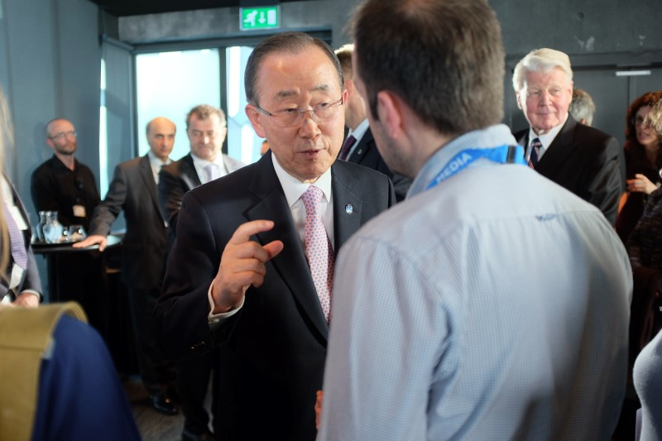
The Arctic paradox
“Arctic melting affects Miami, Mumbai, Shanghai, coastal cities – and so much else. When the Arctic suffers, the world feels the pain.”
-Former UN Secretary General Ban-ki Moon (2016)
The Arctic is like “discovering a new Africa.”
-Former president of Iceland (2015)
Photo: M. Bennett, Iceland, 2016
Notes:
Fieldwork – flag this.
The establishment of the Arctic as a region in crisis legitimizes external intervention
The narrative of a space newly opened by climate change creates a speculative frontier for capital-intensive resource extraction
Mike Davis (1999) aptly called ‘ecologies of fear” mixed with ecologies of opportunity”
And yet, while much of the investment is pouring into natural resources and transportation infrastructure, Arctic transportation infrastructure is still framed as having a societally transformative potential. To illustrate, the head of a shipping company in Labrador recently said, “It will lower the cost of goods. It'll make access much easier, it'll make construction much easier. It will also bring a transportation mode that will help with development in the North and…it will also help…when it comes to opportunities."

Slide 4
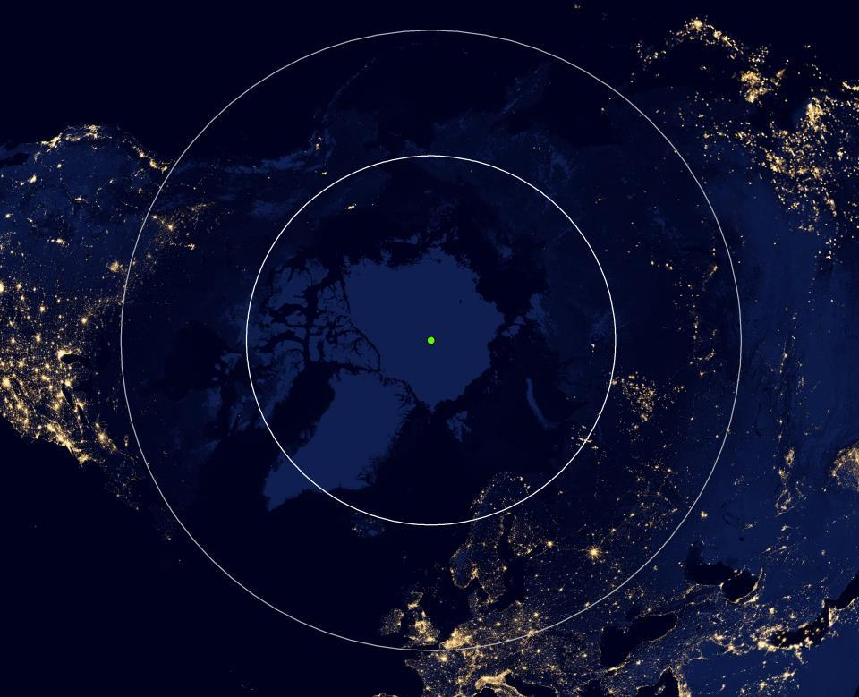
North Slope
(Alaska)
ASIA
NORTH
AMERICA
North Pole
NW Siberia(Russia)
Northern
Norway
Northern Sea Route
Arctic Circle
Northwest Passage
EUROPE
Suomi-NPP Day/Night Band Imagery
50°N
Data: Suomi-NPP
Notes:
Clearly makes a lot of sense – because it’s looks relatively isolated at first and is undeveloped relative to the rest of the world and sits in between three major world regions via newly opening shipping routes.
With night-light imagery being a dataset that has been well-established in the literature as a reliable proxy for socioeconomic parameters such as GDP and population, we can use apply it both qualitatively and quantitatively in the Arctic.
First, we can see that narratives that present the Arctic as undeveloped are in some sense right: Relative to the rest of the world, the Arctic does not emit much light. We can see that the main points of light are concentrated around areas like Yamal LNG in Russia, where Chinese and Korean companies are contributing capital and infrastructure to the project, northern Norway, one of the Arctic’s most urbanized regions, and Alaska’s North Slope, where oil and gas has been extracted for four decades.
Filling out the picture, we can start to see the lights of Europe and the oil fields of northern Canada come on, and filling it out even more, we see how the Arctic stands at the center of three of the world’s global markets: Asia, Europe, and North America. Thus, from this projection, it is more evident why states and corporations in these three markets would wish to use the Arctic as a shipping shortcut once the sea ice has melted along passages such as the Northern Sea Route, north of Russia and which leads to Asia, or the Northwest Passage through Canada. These shipping shortcuts would also pass through rich fossil fuel deposits, as I mentioned before.
More quantitatively, we can also use night-light imagery to view change over time in the Arctic and see where there have been increases and decreases of light. We see that the areas in red, where there has been the most change, are around places like the increasingly northern oil fields of Russia and Canada along with coastal areas in Scandinavia and Iceland, and in decline are villages in the Russian North and along railroads, for instance.

Slide 5
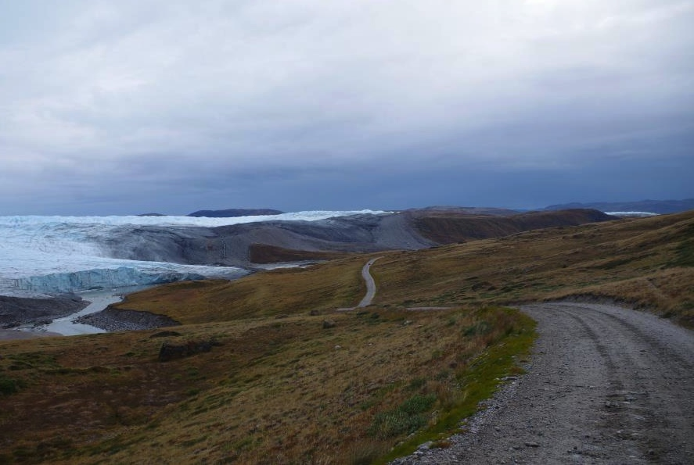
Research questions
What do we know about the history of Arctic development?
How is Arctic development unfolding today?
What does the future hold?
Photo: M. Bennett, Greenland, 2014
Notes:
But I think the real puzzle, the real question we have to ask is: for whom are these new types of access and opportunities, where are they located, and what are they connecting?

Slide 6
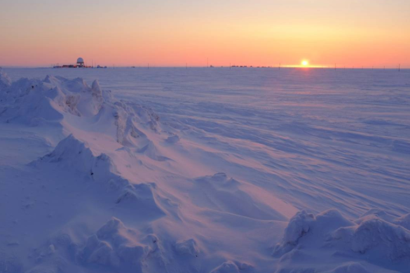
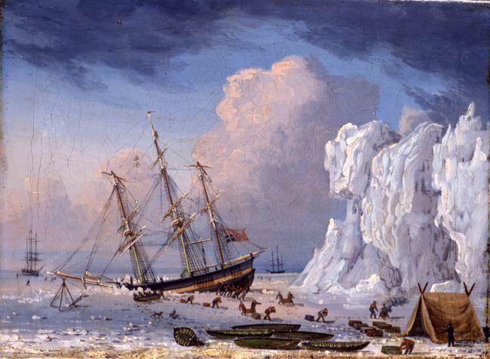
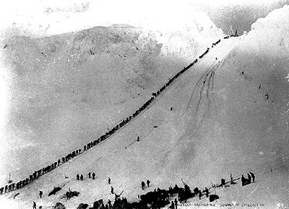
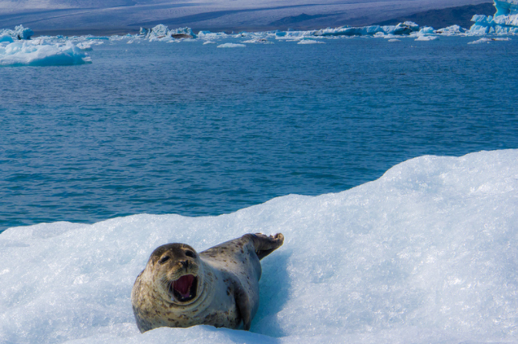
Modes and scales of Arctic development
Plunder and profit by individuals, companies, states, and empires
Modernization & militarization as national projects
1600 1700 1800 1900 2000
Sustainable development as global and local effort to save the Arctic
Whaling off Greenland, 1828
Klondike Gold Rush, 1896-1899

Slide 7
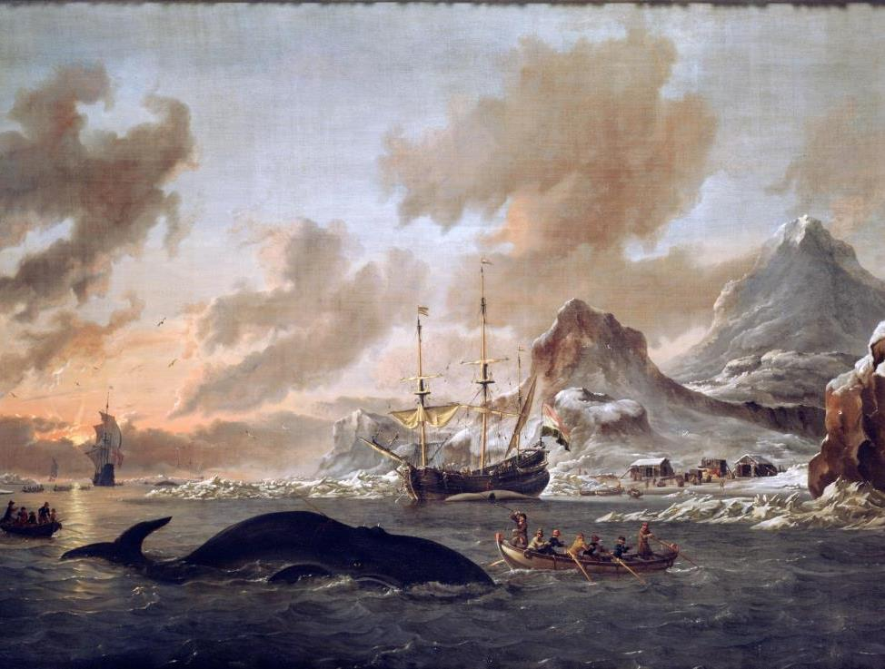
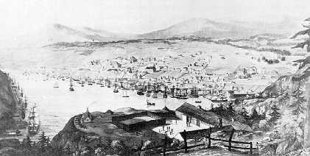
Pre-industrial Arctic development
Pan-Inuit Trails
Adapted from Aporta, Bravo, and Taylor (2014)
Ship voyages north of 60°,
1677-1803
Generated in R from
CLIWOC ship logs
Cod fishing season in St. John’s, Newfoundland
1831
Dutch Whalers near Spitsbergen
Abraham Storck, 1690

Slide 8
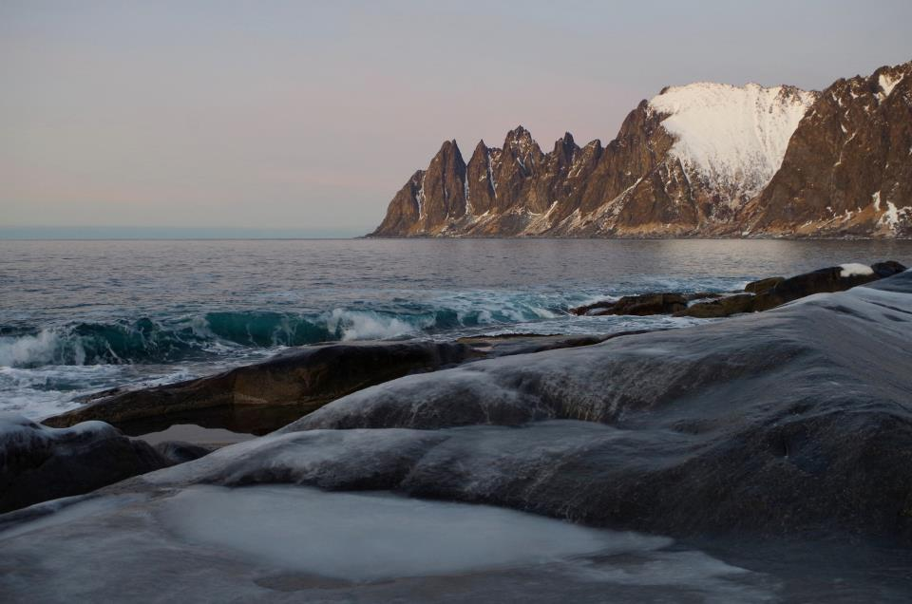
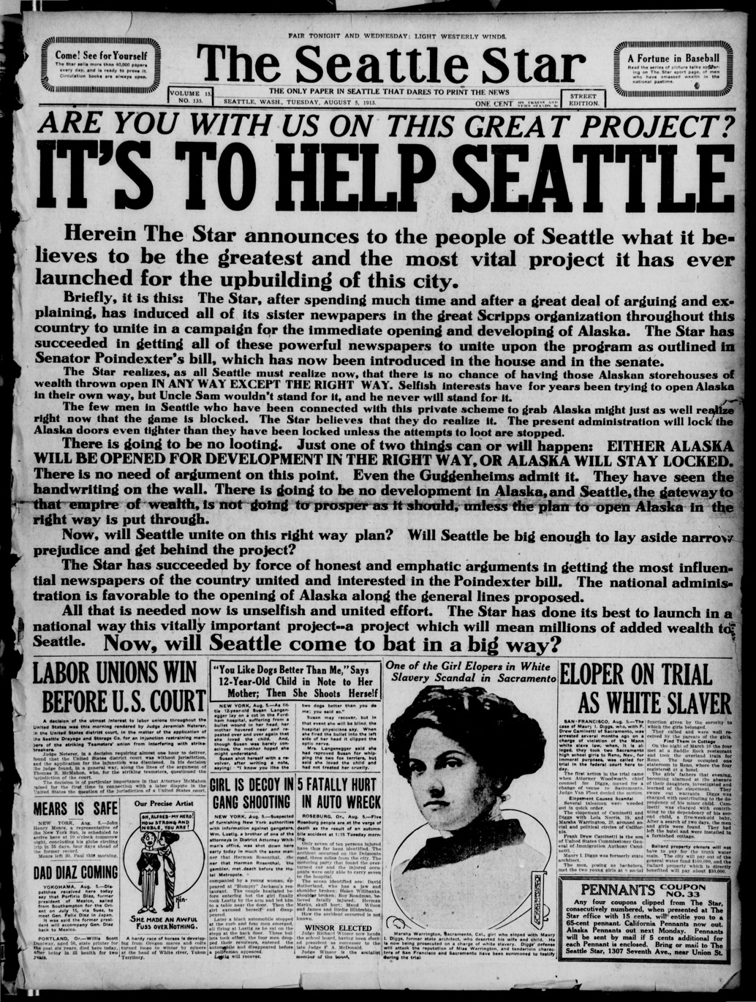
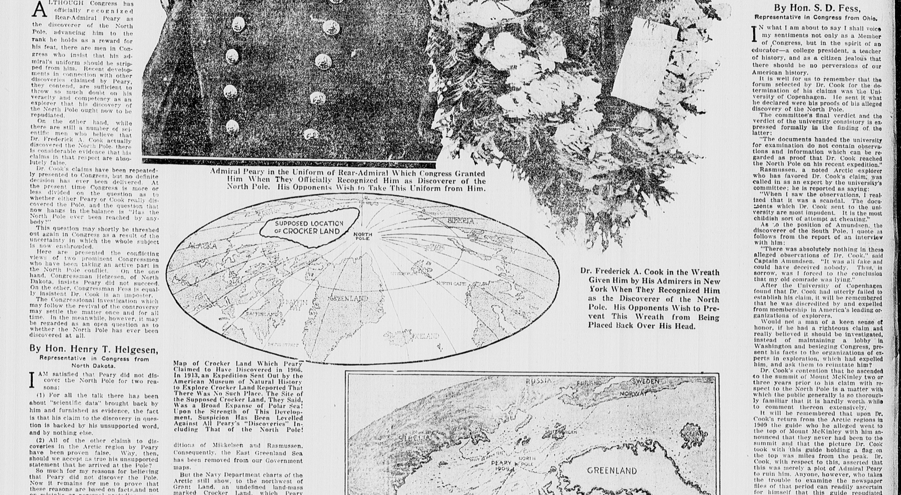

.6
Development as extractivist
Norway, 2014
Notes:
I’d like to start off by showing this photograph I took in northern Norway, which I think captures popular imaginings of the Arctic as isolated and remote. Throughout this presentation, I’ll be showing photographs I’ve taken during my fieldwork and travels in and beyond the Arctic in order to help illustrate the ways in which I think the full texture of Arctic development cannot be grasped unless approached from both inside and outside the region, and from above and from the ground.
Now, while imaginings of the Arctic as iconic and frozen in time have persisted for centuries, as many of us know, climate change is fast challenging this notion by creating a “new era” of melting sea ice and thawing permafrost. As indigenous peoples contend with alterations to their landscapes and seascapes and villages sink into the ocean, climate change presents numerous vulnerabilities to the Arctic.
Yet, particularly in the Arctic compared to other regions, climate change is seen as bringing a promise of prosperity. One news headline went so far as to declare that “the world has discovered a $1 trillion ocean,” in reference to a claim made by the Chief Financial Officer of a leading financial firm interested in investing in Arctic infrastructure that the region needed $1 trillion of investments in infrastructure and projects – mostly centered around oil, gas, mining, and shipping.

Slide 9
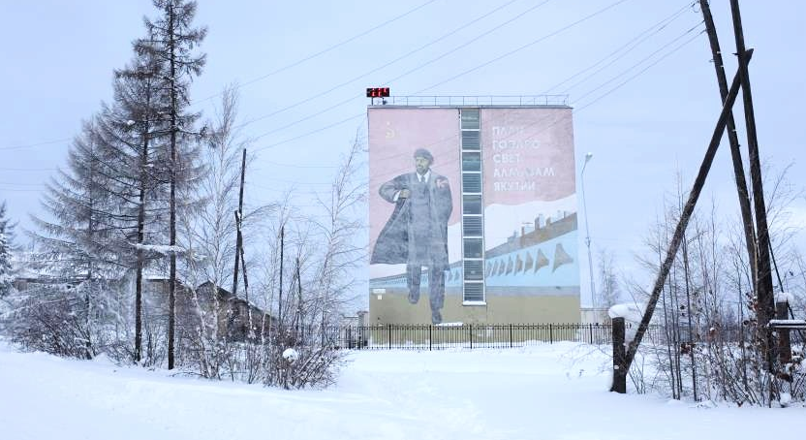
Modernization, militarization, and nationalism
Russia, 2016
Photo: M. Bennett, Russia, 2016

Slide 10
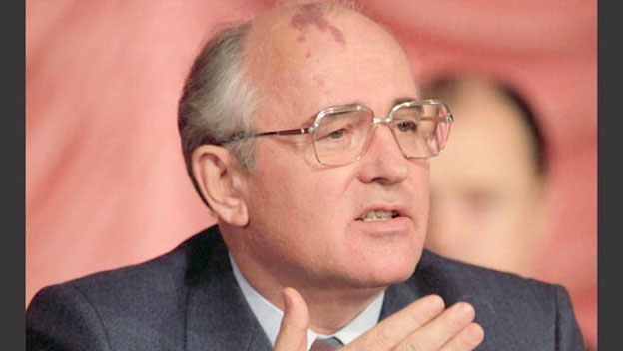
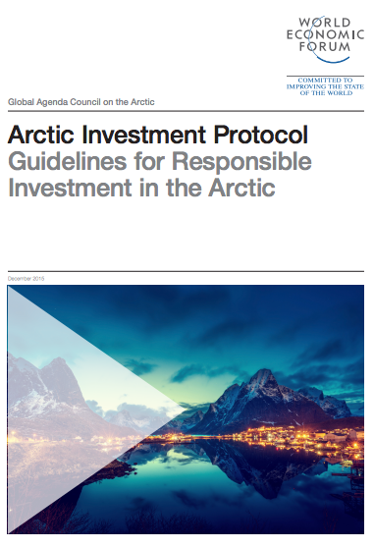
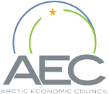
From national sovereignty to global governance
“Let the North of the globe, the Arctic, become a zone of peace.” – Gorbachev, 1987
est. 2015
Goal: “Establishing strong market connections between the Arctic states”
pub. 2016

Slide 11
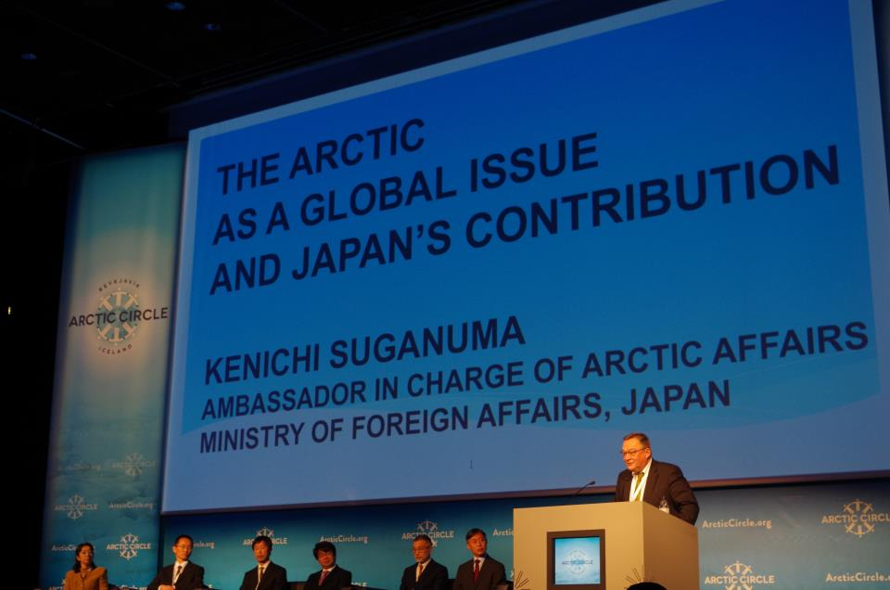
d q
Arctic Circle Conference, Reykjavik, Iceland, 2014.

Slide 12
Actors in 21st century Arctic development
Arctic states
(Canada, Russia, U.S.,
Iceland, Norway, Sweden, Finland)
Intergovernmental
organizations
Subnational
governments
The Arctic
Indigenous
organizations
Indigenous
organizations
Non-Arctic states
(eg China, Japan,
S. Korea, Singapore
Non-Arctic states
(eg China, Japan,
S. Korea, Singapore
Environmental
organizations
Corporations
(State-owned, national,
and multinational)
Corporations
(State-owned, national,
and multinational)

Slide 13
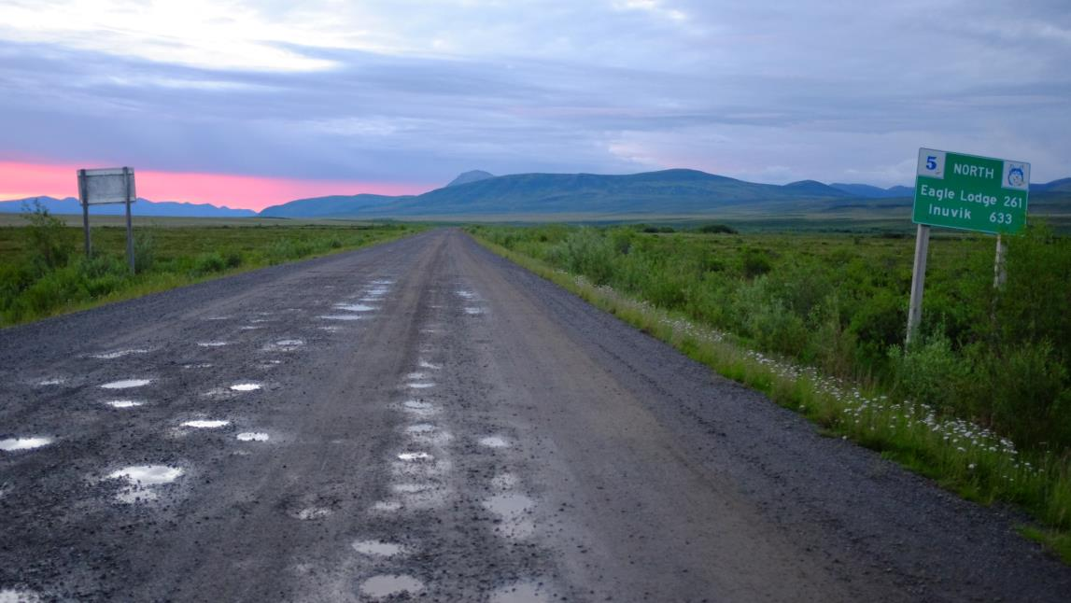
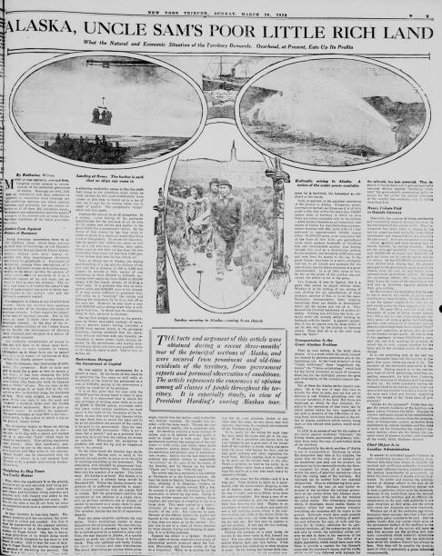
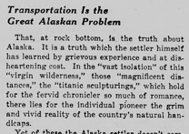
New actors, old “problem”
New York Tribune, 26 March 1922
Photo: M. Bennett, Canada, 2016
Notes:
Set up the idea that Arctic development is new – but in fact it is not.

Slide 14
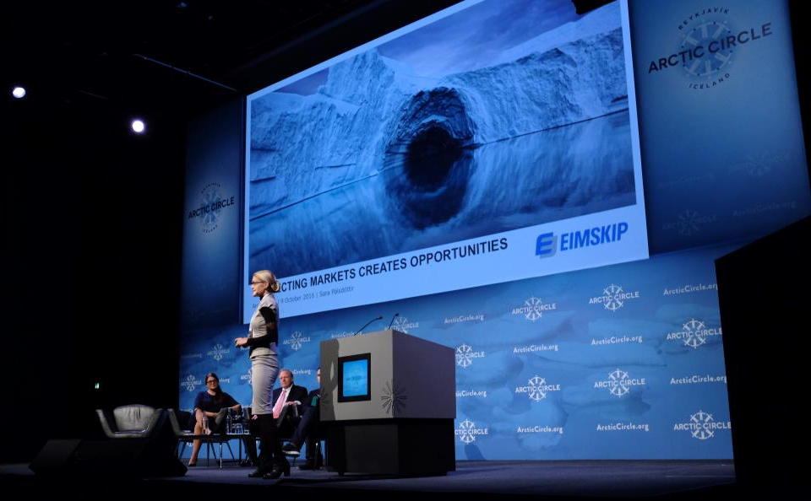
Transportation as a technical solution to deliver regional and human development
Biggest Arctic development conference, held annually in Iceland since 2014
Icelandic shipping company
Photo: M. Bennett, Iceland, 2016
Notes:
Frontier discourses rest on the presumption of disconnection and underutilization

Slide 15
How is Arctic development unfolding today?

Slide 16
Night Lights
Increase
Decrease
ASIA
NORTH
AMERICA
North Pole
Arctic Circle
EUROPE
1993-2011
DMSP/OLS Imagery
50°N
Notes:
Clearly makes a lot of sense – because it’s looks relatively isolated at first and is undeveloped relative to the rest of the world and sits in between three major world regions via newly opening shipping routes.
With night-light imagery being a dataset that has been well-established in the literature as a reliable proxy for socioeconomic parameters such as GDP and population, we can use apply it both qualitatively and quantitatively in the Arctic.
First, we can see that narratives that present the Arctic as undeveloped are in some sense right: Relative to the rest of the world, the Arctic does not emit much light. We can see that the main points of light are concentrated around areas like Yamal LNG in Russia, where Chinese and Korean companies are contributing capital and infrastructure to the project, northern Norway, one of the Arctic’s most urbanized regions, and Alaska’s North Slope, where oil and gas has been extracted for four decades.
Filling out the picture, we can start to see the lights of Europe and the oil fields of northern Canada come on, and filling it out even more, we see how the Arctic stands at the center of three of the world’s global markets: Asia, Europe, and North America. Thus, from this projection, it is more evident why states and corporations in these three markets would wish to use the Arctic as a shipping shortcut once the sea ice has melted along passages such as the Northern Sea Route, north of Russia and which leads to Asia, or the Northwest Passage through Canada. These shipping shortcuts would also pass through rich fossil fuel deposits, as I mentioned before.
More quantitatively, we can also use night-light imagery to view change over time in the Arctic and see where there have been increases and decreases of light. We see that the areas in red, where there has been the most change, are around places like the increasingly northern oil fields of Russia and Canada along with coastal areas in Scandinavia and Iceland, and in decline are villages in the Russian North and along railroads, for instance.

Slide 17
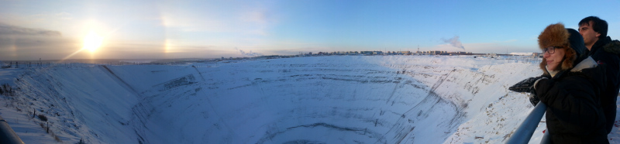
Mirny City, Sakha, Russia
Photo: M. Bennett, Russia, 2016
Notes:
The Kremlin’s recent efforts continue the Soviet project, and imperial and tsarist projects prior to that, of reorganizing Siberia and the Russian North into essentially a colony of western Russia for extraction. In Mirny City, Sakha, for instance, lies one of the world’s largest open pit mines – around which a city sprung up as an afterthought to house the workers who were originally meant to just be fly-in, fly-out workers.

Slide 18
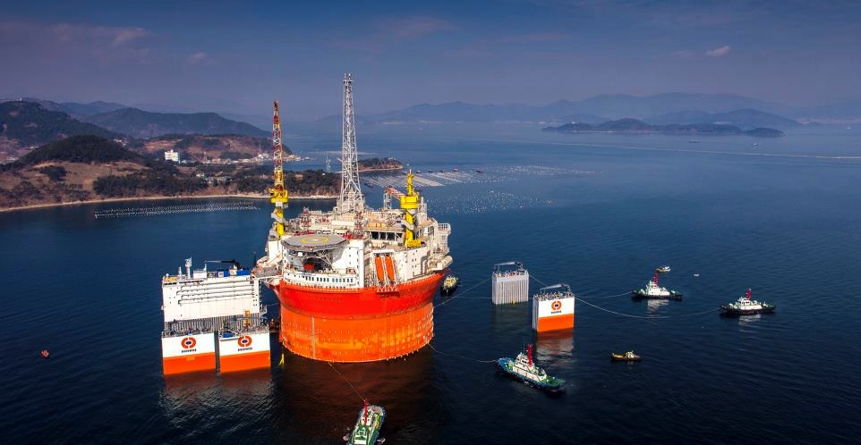
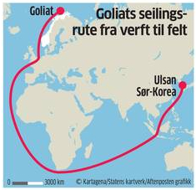
The world’s largest FPSO,
shipped by the world’s largest heavy transport vessel,
to the world’s northernmost oil field.
Manufactured in South Korea
Eni’s Goliat Floating Production Storage and Offloading Unit
off Hammerfest, Norway

Slide 19
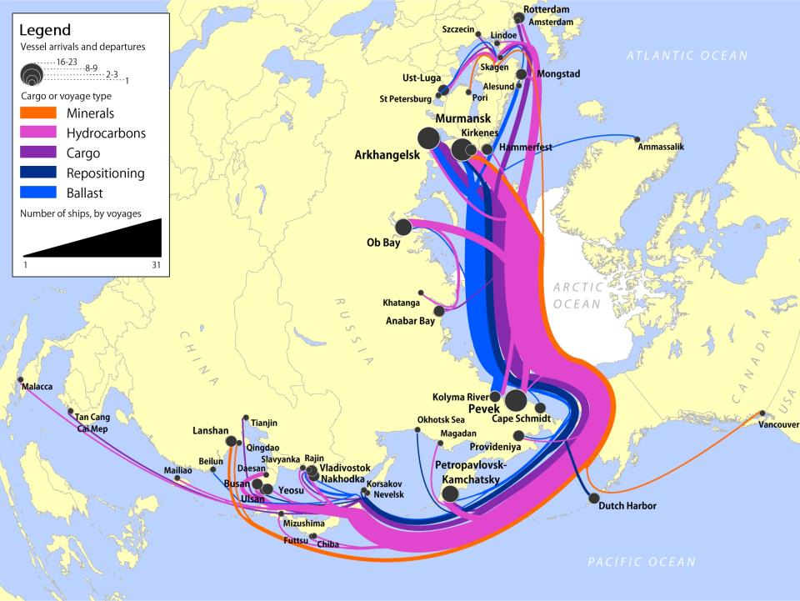
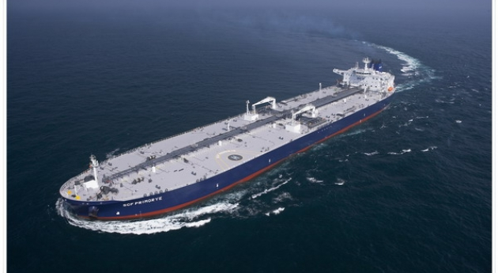
  Bennett (2014) Eurasian Geography and Economics
Notes:
To give you a sense of what this supposed “new era” of Arctic development looks like, here is a map I made as part of my Mphil work at SPRI capturing trade flows along the Northern Sea Route in 2013 – a route that hugs the north coast of Russia and shortens the distance between ports in Asia and Europe by up to 30%. This map visualizes the way in which the Arctic, I argue, is increasingly connected to the rest of the world, particularly Asia, by flows of goods and also capital.
This map also demonstrates that the main type of cargo being moved along the NSR in 2013 was hydrocarbons, underscoring the primacy of natural resources in long-distance shipping through the Arctic. Particularly in Russia, the twinned development of natural resources and infrastructure is emerging from shifts in Russian oil and gas production as it moves north from older fields in Western Siberia and into the Russian offshore, with oil tankers such as this moving oil and gas to energy-hungry markets in East Asia.
This northward shift is also visible in Norway, where the world’s largest Floating Production Storage and Offloading Unit, built in South Korea, will soon start producing oil from the world’s northernmost field.

Slide 20
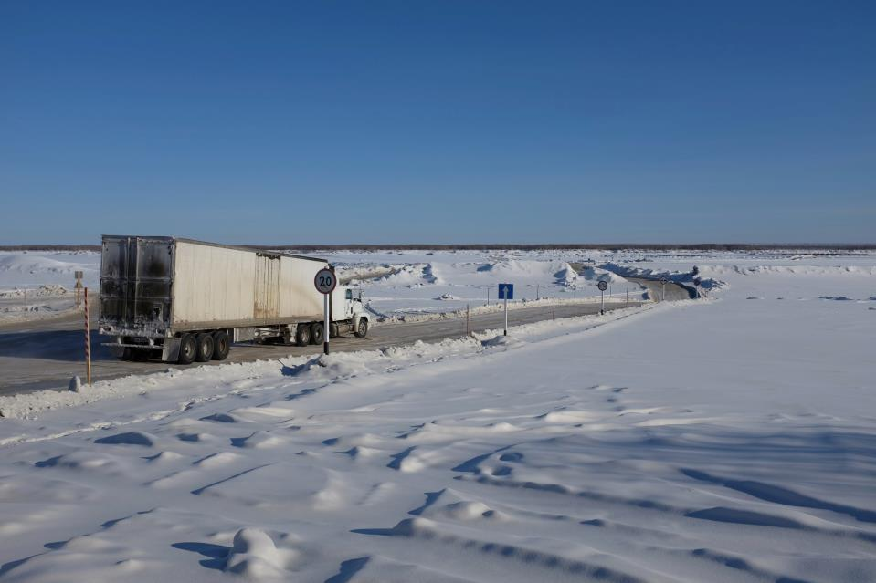
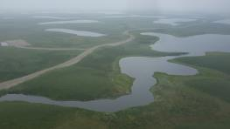
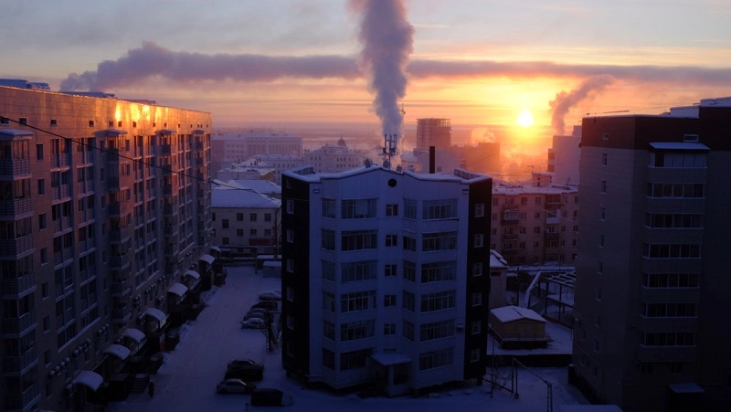
Ice road replacement in Canada and Russia
Climate adaptation is done to:
Moderate climate change’s impacts
Take advantage of new opportunities
Cope with the consequences
(Adger et al., 2013)
Northwest Territories, Canada
Sakha Republic, Russia
New highway from Inuvik to Tuktoyaktuk, coastal indigenous hamlet on Arctic Ocean
Fieldwork
June-July 2016
One of the world’s largest cities without an overland connection
Fieldwork
February-March 2016
Methods
-20+ semi-structured interviews
-1 focus group
-Informal conversations
-Participant observation
Photo: M. Bennett, Russia, 2016
Notes:
As a result of these two regional drivers I identify, for my case studies of Arctic access and opportunity, I chose to examine Singapore and Russia’s Sakha Republic.
First, Singapore is, as we all know, a tropical city-state that in theory shouldn’t have much to do with the Arctic. Yet the island has projected itself into the Arctic thanks to its world-class maritime sector, port, shipping and shipbuilding, and offshore rig industries. Singaporean companies have manufactured ice-class ships used in the Russian Arctic, for instance. In an interview I conducted, a representative of one such company remarked:
But in reality, Singapore is not going to the Arctic for the benefit of the whole world: as a state from which leaders have called the world “its hinterland,” Singapore wants to access the region for its own economic benefit. Individuals living in the Arctic who may benefit from this investment see the bright side of this. A representative from an indigenous organization which has had several dealings with Singapore noted, “I think Singapore has a genuine interest in helping the indigenous people of the Arctic. I also think that they are trying to secure some sort of foothold that gives them a position of leverage in what may be a changing world in terms of shipping.” So for this indigenous representative, who lives in a place where Singapore is considering helping to build a port, his people could benefit from Singapore’s effort to make itself more connected to the Arctic.
Yet in contrast, other places remain disconnected from northern development projects. One such place is Yakutsk, the capital of the Sakha Republic, Russia, a bit south of the Arctic Circle, and one of the coldest and most remote places on earth. Its remoteness is due to the fact that it has no permanent connection to the outside world, since it sits on the west side of the Lena River, and there is no bridge to the east side, where Russian railway and highway connections terminate.

Slide 21
Case studies: Ice roads in Canada and Russia
Northwest Territories, Canada
Yakutsk, Sakha Republic, Russia
New highway from Inuvik to Tuktoyaktuk, a coastal indigenous hamlet on Arctic Ocean
Fieldwork
June-July 2016
One of the world’s largest cities without an overland connection
Fieldwork
February-March 2016
Methods
-20+ semi-structured interviews
-1 focus group
-Informal conversations
-Participant observation
Notes:
As a result of these two regional drivers I identify, for my case studies of Arctic access and opportunity, I chose to examine Singapore and Russia’s Sakha Republic.
First, Singapore is, as we all know, a tropical city-state that in theory shouldn’t have much to do with the Arctic. Yet the island has projected itself into the Arctic thanks to its world-class maritime sector, port, shipping and shipbuilding, and offshore rig industries. Singaporean companies have manufactured ice-class ships used in the Russian Arctic, for instance. In an interview I conducted, a representative of one such company remarked:
But in reality, Singapore is not going to the Arctic for the benefit of the whole world: as a state from which leaders have called the world “its hinterland,” Singapore wants to access the region for its own economic benefit. Individuals living in the Arctic who may benefit from this investment see the bright side of this. A representative from an indigenous organization which has had several dealings with Singapore noted, “I think Singapore has a genuine interest in helping the indigenous people of the Arctic. I also think that they are trying to secure some sort of foothold that gives them a position of leverage in what may be a changing world in terms of shipping.” So for this indigenous representative, who lives in a place where Singapore is considering helping to build a port, his people could benefit from Singapore’s effort to make itself more connected to the Arctic.
Yet in contrast, other places remain disconnected from northern development projects. One such place is Yakutsk, the capital of the Sakha Republic, Russia, a bit south of the Arctic Circle, and one of the coldest and most remote places on earth. Its remoteness is due to the fact that it has no permanent connection to the outside world, since it sits on the west side of the Lena River, and there is no bridge to the east side, where Russian railway and highway connections terminate.

Slide 22

The first public highway in North America to the Arctic Ocean
Land Surface Temperature Anomaly
(Nov. 2016)
NASA Earth Observatory
Arctic Ocean
Inuvialuit
Settlement
Region
Inuvik
Tuk
Dempster
Highway
GREENLAND
North
Pacific
Ocean
NWT
Yellowknife
Hudson
Bay
North
Atlantic
Ocean
Northwest Passage
CANADA
85 miles
$300 million
USA
Bennett, M. M. (In prep). A road home or a “road to resources”? Indigenous and state visions of Canada’s first highway to the Arctic Ocean
C°
-12 0 +12
Notes:
Inuvik highway: Made possible by melting sea ice/opening Northwest Passage and shortening of winter road season

Slide 23
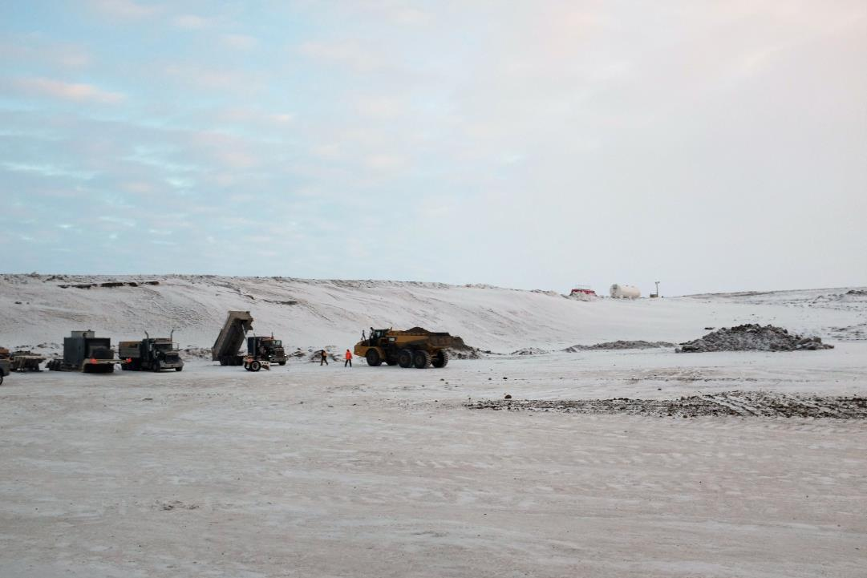
120 kilometers
$300 million
5 years to construct
Funded in 2013 by PM Stephen Harper
Photo: M. Bennett, Canada, 2016
Notes:
Good afternoon and thank you for the opportunity to be here today. It’s great to be back at Cambridge’s Department of Geography and the Scott Polar Research Institute, where as an Mphil student in Polar Studies, I was first really challenged to think about the Arctic in a broader, more interconnected way. It’s this perspective that has continued to motivate my research, and which I’ll be presenting to you today in my talk entitled, “Regional and Global Geographies of Northern Resource Frontiers.”

Slide 24
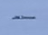
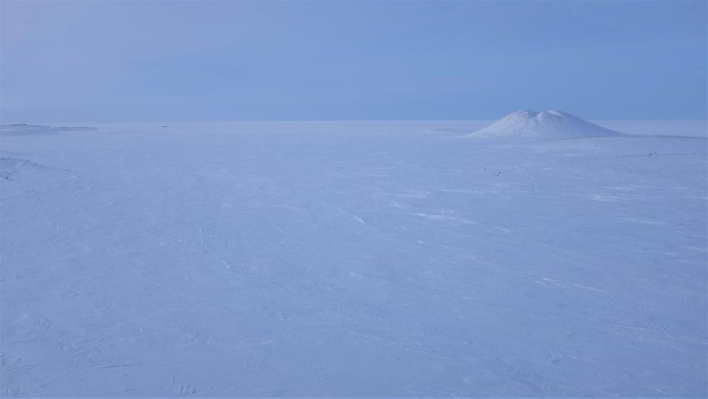
truck
Photo: M. Bennett, Canada, 2016
Notes:
Good afternoon and thank you for the opportunity to be here today. It’s great to be back at Cambridge’s Department of Geography and the Scott Polar Research Institute, where as an Mphil student in Polar Studies, I was first really challenged to think about the Arctic in a broader, more interconnected way. It’s this perspective that has continued to motivate my research, and which I’ll be presenting to you today in my talk entitled, “Regional and Global Geographies of Northern Resource Frontiers.”

Slide 25
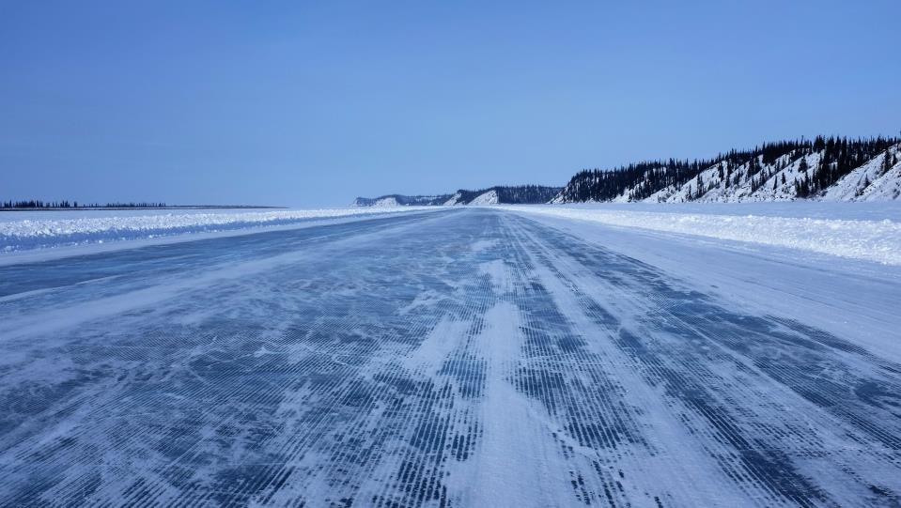
Photo: M. Bennett, Canada, 2016
Notes:
Good afternoon and thank you for the opportunity to be here today. It’s great to be back at Cambridge’s Department of Geography and the Scott Polar Research Institute, where as an Mphil student in Polar Studies, I was first really challenged to think about the Arctic in a broader, more interconnected way. It’s this perspective that has continued to motivate my research, and which I’ll be presenting to you today in my talk entitled, “Regional and Global Geographies of Northern Resource Frontiers.”

Slide 26
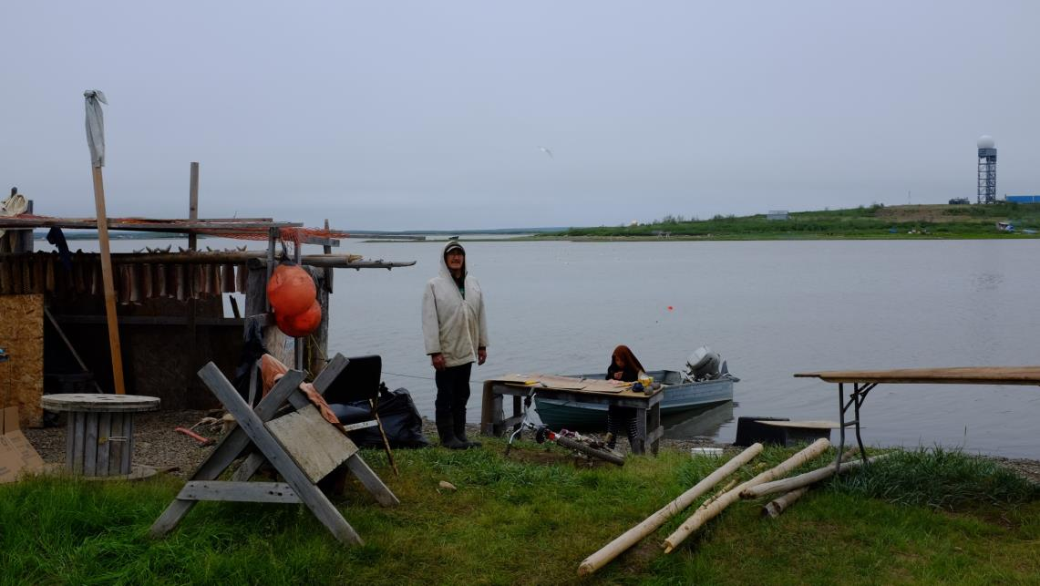
Historical context
1930s: Whaling
1950s: DEW Line construction
1970s/1980s: Oil and gas
1984: Land claims agreement
Photo: M. Bennett, Canada, 2016

Slide 27
Land claims agreement: key aspects
The Western Arctic Claim – Inuvialuit Final Agreement
4 corporate structures
35,000 square miles of land
$45 million plus $10 million for developing industries and businesses
Economic objectives:
“Full Inuvialuit participation in the northern Canadian economy”
“Inuvialuit integration into Canadian society through development of an adequate level of economic self-reliance and a solid economic base”

Slide 28
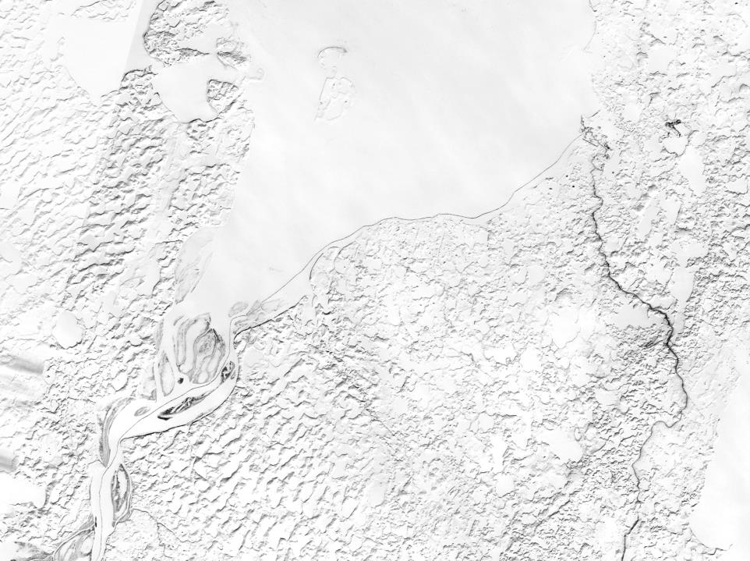
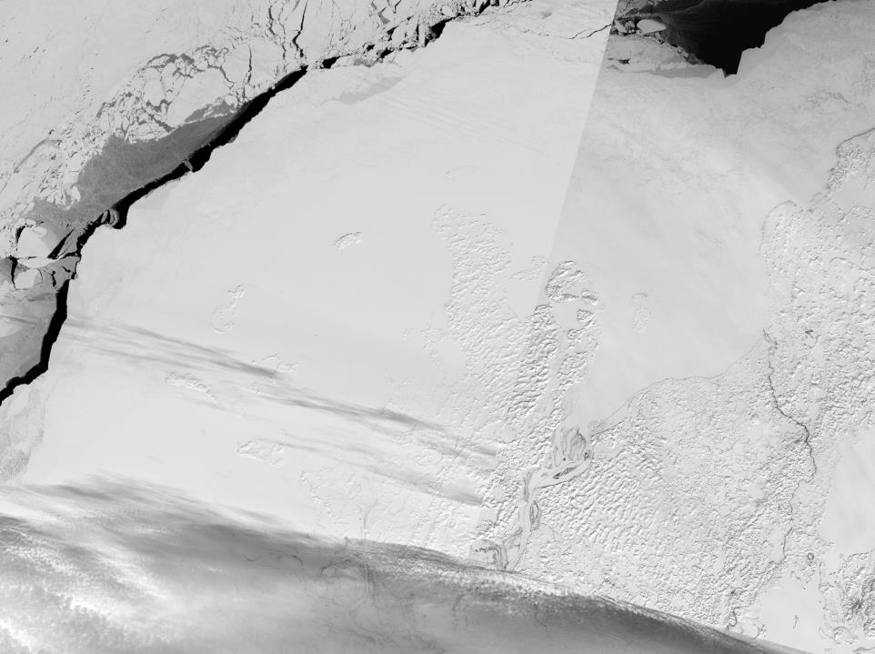
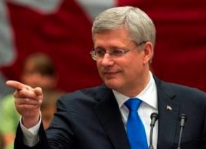
State visions of Arctic development
Tuktoyaktuk
Arctic Ocean
“This road, which extends the Dempster Highway to the Arctic Coast, will complete Canada’s road network from coast to coast to coast. It will strengthen Canada’s Arctic presence and contribute to economic and social development in the North.”
April 6, 2016
Landsat-8 Imagery
Notes:
It’s here where finally, under the former administration of Prime Minister Stephen Harper, the government is realizing a plan first mentioned by the state in the 1950s to extend the Canadian highway system all the way to the Arctic Ocean. Next year, at a cost of over $300 million, the road will finally be complete. Various documents from the Harper administration have promoted the road’s social benefits, claiming, “This road will complete Canada’s road network from coast to coast to coast. It will strengthen Canada’s Arctic presence and contribute to economic and social development in the North.”
We can see here the road from space, extending to the shore of the Arctic Ocean and the small, largely indigenous hamlet of Tuktoyaktuk, population 900. The road will in theory reduce costs of food and transport for the people living there.

Slide 29
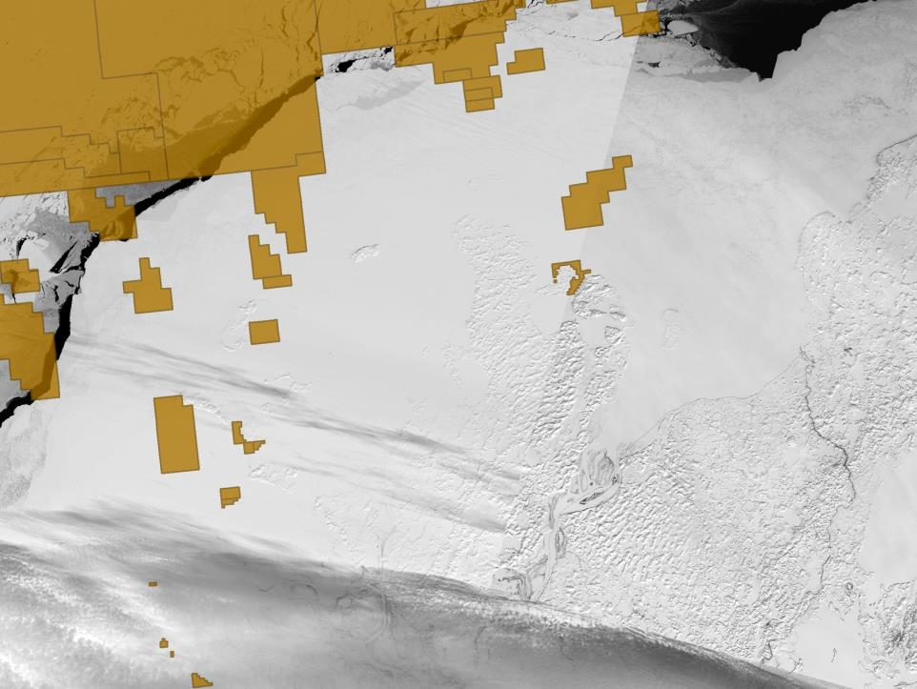
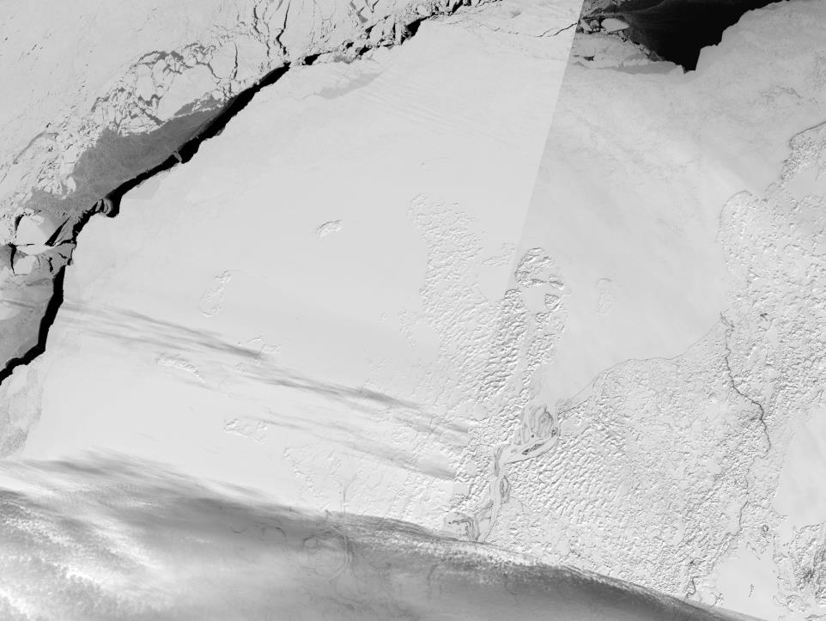
oil and gas leases
Tuktoyaktuk
New highway
as seen from space
April 6, 2016
Landsat-8 Imagery
Notes:
But the road does not just extend to Tuk: it also will provide year-round, permanent access to the Beaufort Sea, where the Canadian government has issued numerous oil and gas leases offshore. As sea ice retreats, the oil and gas will in theory be more readily accessible, and with the road coming up from the south, oil companies will be able to truck in the equipment to extract it.

Slide 30
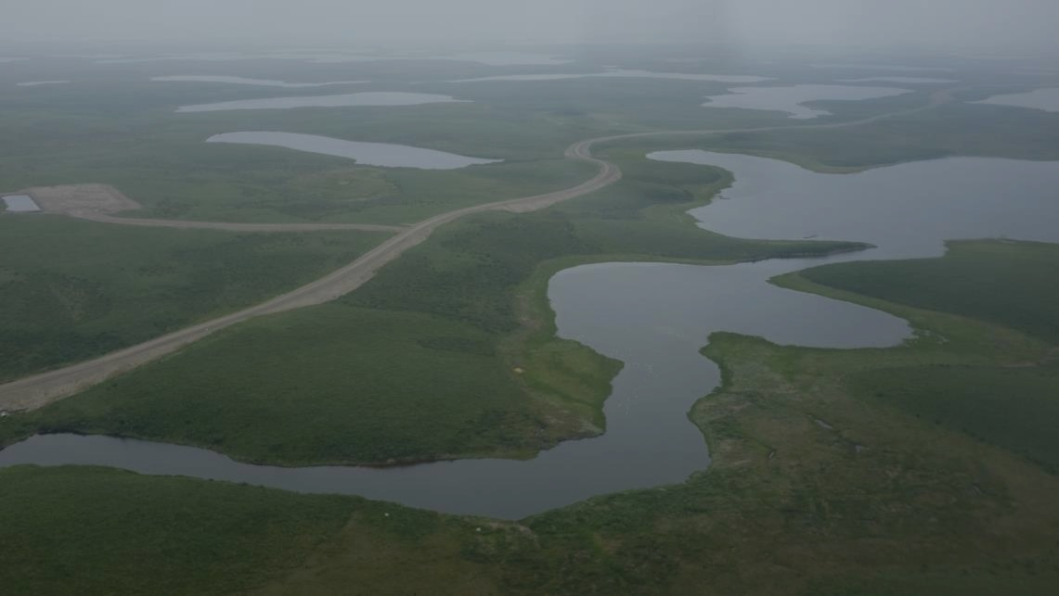
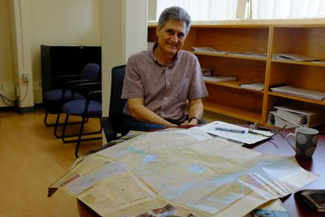
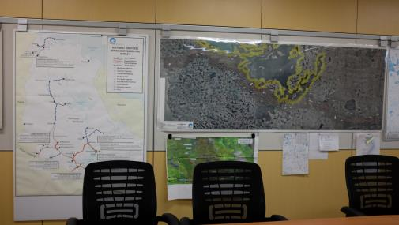
State visions of Arctic development
Photos: M. Bennett, Canada, 2016

Slide 31

Indigenous and local visions of development
“The government does what the government does. It pushes its way anywhere and anywhere it wants to. And the people don’t have really much to say about it. They say we do, but…
-Interview with Inuvialuit/Gwi’chin female, Inuvik
the people with the money are the people that do something. The little people left behind that give their comments is not taken into consideration much. ‘Cuz money talks.”
Photo: M. Bennett, Canada, 2016

Slide 32

Indigenous mobilization of state visions
“Inuvik and Tuk, they rallied and went after the federal government, and the federal government agreed to let it go. So we kind of went about it backwards. The design was here for 30 years, we wanted to build it, we wanted something to do. They call it the ‘Road to Resources’ – so I mean there’s gas fields out there, oil fields out there, this’ll just make access much easier. Plus there’s a deep sea port potential – there’s just so much hook to it.”
– Indigenous corporate representative, July 2016
Photo: M. Bennett, Canada, 2016

Slide 33
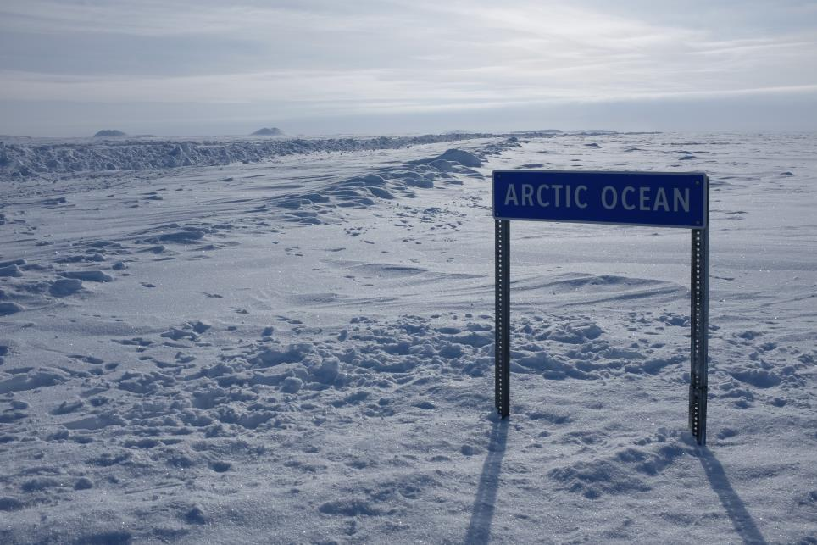
Indigenous mobilization of state visions
“We talked about this road to the North could be what the railway was for the West. Once you’re opening up the Arctic, obviously, you’re talking about sovereignty. What better way to establish sovereignty in the country then to build infrastructure on the coast?
-Former municipal government and current IRC employee
Photo: M. Bennett, Canada, 2016

Slide 34
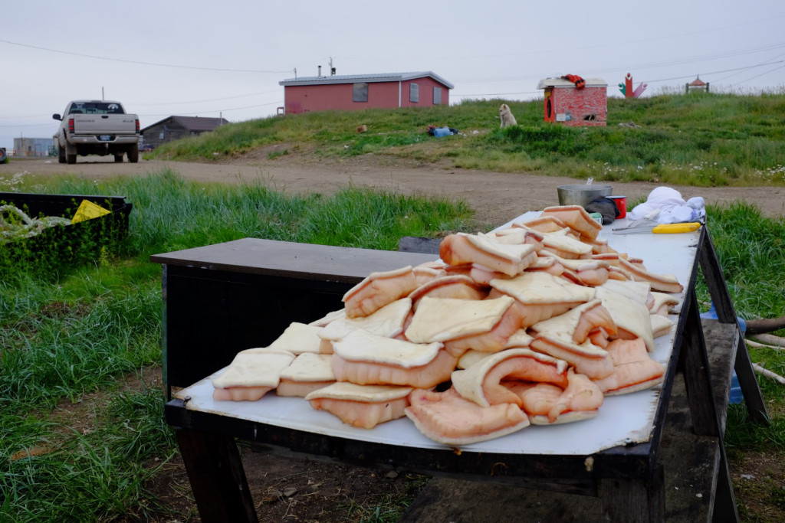
Indigenous and local visions of development
Photo: M. Bennett, Canada, 2016

Slide 35

Indigenous and local visions of development

Slide 36

The road as life
“Inuvik is dead. If it weren’t for the road, there would be a lot of desperate people.”
--“The road will ruin my land.”
--“I don’t care. It fed my family for five years.”
Photo: M. Bennett, Canada, 2016

Slide 37

Photo: M. Bennett, Canada, 2017
Notes:
Good afternoon and thank you for the opportunity to be here today. It’s great to be back at Cambridge’s Department of Geography and the Scott Polar Research Institute, where as an Mphil student in Polar Studies, I was first really challenged to think about the Arctic in a broader, more interconnected way. It’s this perspective that has continued to motivate my research, and which I’ll be presenting to you today in my talk entitled, “Regional and Global Geographies of Northern Resource Frontiers.”

Slide 38

Diversity in local views
“Caribou won’t cross it…Without those denning areas there we’re gonna see less grizzly bears…It’s gonna be increased access to fishing lakes, fishing lakes will be fished out.”
-Interview with hunter, Inuvik
Photo: M. Bennett, Canada, 2016

Slide 39

What comes next?
A deep sea port or
“the world’s longest boat launch”?
Photo: M. Bennett, Canada, 2017
Notes:
Climate change is happening
There is an idea that the Arctic needs saving
Interventions are seen as apolitlcal
However there is a chance to benefit from climate change

Slide 40

Short-term development, long-term dependence?
Photo: M. Bennett, Canada, 2016

Slide 41

Short-term development, long-term dependence?
Photo: M. Bennett, Canada, 2016

Slide 42

The looming issue of climate change
Photo: M. Bennett, Canada, 2016

Slide 43

Lessons from an Arctic highway for Arctic development
Local development needs are more likely to be met if they satisfy national or global imperatives
State rhetoric promotes the highway as fostering long-term development, but locals are more skeptical
Indigenous land rights and corporations can support the expansion of capital, the state, and industrial development
Photo: M. Bennett, Canada, 2016
Notes:
1. ….rather than transformative even if “microprocesses of accumulation” are occurring
After drawing this multi-scaled perspective of Arctic development, to offer some concluding remarks, we can start by saying that dominant narratives and state and corporate strategies of Arctic development prioritize the connection of northern resources rather than people to southern markets, which increases connectivity but paradoxically periphalizes the Arctic as a region economically.
Second, while new modes of access and economic opportunities are arising in the Arctic, they generally continue to perpetuate the region’s longstanding status as a resource frontier for the world’s economic core – now increasingly cities in East Asia.
Third, multi-scaled analysis of Arctic development contributes to broader theorizations of regional peripheralization under the current round of globalization and planetary urbanization.
***
Despite enormous material and environmental changes to the Arctic, we continue to imagine the region as undiscovered, facilitating its future as a global resource frontier.

Slide 44
What does the future hold?

Slide 45



Future trends in Arctic development
Geophysical | Geoeconomic | Geopolitical
Warmer and wetter | Resources and transportation | Asia-Arctic partnerships; “glocal” development
Arctic Circle
Data: NASA Earth Observatory
Notes:
But first, to situate this research, I want to outline some of the main drivers I see as pushing Arctic resource extraction. As I discussed earlier, climate change is opening up new landscapes and seascapes for development in the Arctic, and climate change is particularly intensified in the North due to the positive feedback loops associated with the polar amplification effect.
Yet in my research, I am more concerned with political and economic factors. At the global scale, globalization and deterritorialization, or rather the increasing tendency of footloose capital, is affecting Arctic development in the more open, less militarized era of the post-Cold War Arctic. Regionally, I identify the rise of East Asia and the dissolution of the USSR as two major drivers behind Arctic resource development, with the former looking for places to invest and from which to draw energy, and Russia in particularly looking for investment and for places to which to sell its resources.

Slide 46

Singapore: a “Global City” in a melting Arctic
The world’s largest offshore oil rig builder
The world’s second-busiest container port
One of world’s most active sovereign wealth funds in infrastructure investments
“[Arctic melting] may come to pass or it may not. But it probably will, and if it does, we will be there.”
Prime Minister Lee Hsien Loong, 2015
“There’s no point in saying [the Arctic] is a pristine area and no point in going there. We have to convince critics that this is what we need to do – fulfill the economic needs of the whole world.”
Interview with Singaporean corporate representative, 2015
Photo: M. Bennett, Singapore, 2015

Slide 47

Local does not necessarily mean “sustainable”
Photo: M. Bennett, Alaska, 2017

Slide 48

Local does not necessarily mean “sustainable”
Photo: M. Bennett, Alaska, 2017

Slide 49

Source: Yale Program on Climate Change Communication

Slide 50



Slide 51

Rethinking the future of Arctic development
Conventional
Alternative
Imposed from above
Environmentally determined
Development versus saving the Arctic
Locally negotiated
Socially produced
Development as saving the Arctic
Photo: M. Bennett, Russia, 2016

Slide 52

Acknowledgements
John Agnew, Laurence Smith, Dave Rigby, and R. Bin Wong
National Science Foundation Graduate Research Fellowship
Charles F. Scott Fellowship
International Council for Canadian Studies
UCLA Center for Canadian Studies
UCLA Urban Humanities Initiative
UCLA Department of Geography
PhD Network in Arctic Extractive Industries
AGU Cryosphere Group
AAG
Mia Bennett
mbennett7@ucla.edu
@miageografia
Photo: M. Bennett, Canada, 2016

Slide 53
Thank You!
Join us for the next Arctic Research Seminar
  3 May: Robert Corell, University of Tromso
ARCUS Seminar Series recordings are available online at: https://www.arcus.org/research-seminar-series
Please consider becoming an ARCUS member!
More info: http://bit.ly/2ePsc5N
#arcuswebinar

