Slide 1
Team Science as Collaborative Cognition in Complex Contexts
Stephen M. Fiore, Ph.D.
sfiore@ist.ucf.edu
University of Central Florida
Cognitive Sciences, Department of Philosophy and
Institute for Simulation & Training
Fiore, S. M. (2017). Team Science as Collaborative Cognition in Complex Contexts. Invited (Virtual) Presentation to Arctic Research Consortium of the United States Webinar Series. March 8th.
This work by Stephen M. Fiore, PhD is licensed under a Creative Commons Attribution-NonCommercial-NoDerivs 3.0 Unported License 2013. Not for commercial use. Approved for redistribution. Attribution required.

Slide 2
Welcome
ARCUS Members’ Webinar
“Team Science as Collaborative Cognition in Complex Contexts”
8 March 2017
Presented by Dr. Stephen M. Fiore University of Central Florida
#arcuswebinar

Slide 3
Overview of ARCUS and Team Science
OVERVIEW - Why Team Science?
Setting the Stage
Part I. ARCUS Challenge 1
Defining Research Approaches
Part II. ARCUS Challenge 2
Understanding Team Science
Part III. ARCUS Challenge 3
Understanding Teamwork
Part IV. ARCUS Challenge 4
Preparing for Team Science
Part V. ARCUS Challenge 5
Education and Learning for Team Science

Slide 4
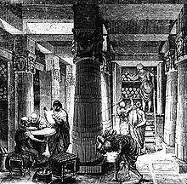
Why Team Science? Setting the Stage
ISSUE - Dealing with Scholarly Structure
Disciplines are distinguished partly for historical reasons and reasons of administrative convenience (such as the organization of teaching and of appointments)... But all this classification and distinction is a comparatively unimportant and superficial affair. We are not students of some subject matter but students of problems. And problems may cut across the borders of any subject matter or discipline (Popper, 1963).
ISSUE - Dealing with University Structure
What is critical to realize is that “the way in which our universities have divided up the sciences does not reflect the way in which nature has divided up its problems” (Salzinger, 2003, p. 3)
ISSUE - Collaborations influencing the practice of science and production of knowledge. To achieve success in scientific collaboration we must surmount these challenges.
Popper, K. (1963). Conjectures and Refutations: The Growth of Scientific Knowledge. London: Routledge.
Salzinger, K. (2003). Moving Graveyards. Psychological Science Agenda, Summer, 3. Washington, DC: American Psychological Association.

Slide 5
Why Team Science? Setting the Stage
Consider what was published on this topic in the journal Science:
“The interdisciplinary approach is becoming one of the prominent characteristics of [science] and represents a synthesizing trend which focuses the specialized research techniques on problems common to a number of separate disciplines. Such cooperative research has to overcome serious obstacles when operating within the existing departmentalized framework of the universities. It appears that real progress in this direction will be made in institutions which are organized on a permanent and frankly cooperative basis. Psychologically, interdisciplinary research requires not only abstract, theoretical intelligence…, but also ‘social intelligence.’ Cooperative work is a social art and has to be practiced with patience.”

Slide 6
Part 1. Laying the Foundation for a Science of Team Science
What is informative here?
Increasing influence/importance of interdisciplinarity as method of inquiry
Challenge of interdisciplinarity distinguished in 2 ways:
1) The problem of INFRASTRUCTURE - tangible and tacit
Inherent challenge associated with structure of the modern university - the discipline bound department
Tacit norms which prevent or stifle interaction amongst them
2) The problem of INTERACTION
Difficulty in communicating across disciplines
Need for patience and particular form of social intelligence to effectively collaborate

Slide 7
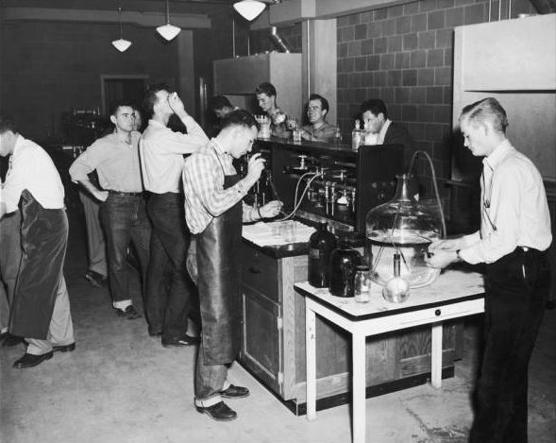
Part 1. Laying the Foundation for a Science of Team Science
Anyone familiar with some manner of cross-disciplinary collaborative effort will likely have experienced some or all of these factors
So one might wonder why this quote is particularly informative
What is informative is not what was said, it is when it was said
Written well over a half century ago in one of first articles specifically addressing interdisciplinary research (Brozek & Keys, 1944).
Science still struggles so why should we think anything will change?
Should we be so bold as to think that we have a better chance at overcoming these challenges than those from generations before us?

Slide 8
Part 1. Laying the Foundation for a Science of Team Science
YES - for THREE main reasons:
Increased emphasis on collaborative research projects that create a team of scholars cutting across disciplines to address complex phenomena
Policy, Academia, and Industry communities all making more of a concerted effort to understand and improve collaborations
Tremendous growth in study and understanding of teams
It is the scientific study of teamwork that could be the true catalyst for change
Matured into its own area of inquiry producing a rich base of knowledge
Helped us to better understand the complex coordinative processes engaged by teams

Slide 9
Overview of ARCUS and Team Science
OVERVIEW - Why Team Science?
Setting the Stage
Part I. ARCUS Challenge 1
Defining Research Approaches
Part II. ARCUS Challenge 2
Understanding Team Science
Part III. ARCUS Challenge 3
Understanding Teamwork
Part IV. ARCUS Challenge 4
Preparing for Team Science
Part V. ARCUS Challenge 5
Education and Learning for Team Science

Slide 10
Part I. ARCUS Challenge 1 Defining Research Approaches
ARCUS CHALLENGE 1 - Understand what it means to do research across disciplines
CROSS-disciplinary Research
Offer this as a general term to describe:
Research meant to utilize, in some way, varied concepts, methods, and theories from differing fields
Where science team members contribute their disciplinary expertise and collectively contribute to the production of new knowledge
Multi-, Inter-, and Trans-disciplinary Research
Fiore, S.M., Phillips, E., & Sellers, B. (2014). A Transdisciplinary Perspective on Hedonomic Sustainability. Ergonomics in Design. 22(2), 22-29.
Hall, K.L., Vogel, A. L., Stipelman, B.A., Stokols, D., Morgan, G., & Gehlert, S. (2012). A four-phase model of transdisciplinary team-based research: Goals, team processes, and strategies. Translational Behavioral Medicine, 2(4), 415-430.
Klein, J. T. (2010). A taxonomy of interdisciplinarity. In R. Frodeman, J. T. Klein, & C. Mitcham (Eds.), The Oxford Handbook of Interdisciplinarity (pp. 15-30). Oxford: Oxford University Press.
National Academies, Committee on Facilitating Interdisciplinary Research (2004). Facilitating interdisciplinary research. Washington, DC: National Academies Press.
Stokols, D., Hall, K.L, Taylor, B., Moser, R.P., (2008). The science of team science: Overview of the field and introduction to the supplement. American Journal of Preventative Medicine, 35(2S), S77-S89.

Slide 11
Part I. ARCUS Challenge 1 Defining Research Approaches
MULTI-disciplinary Research
Collaborative effort of several disciplines to achieve a common goal
Purpose is to achieve broader analyses of common research problems
Work independently or sequentially
Periodically come together to share perspectives
Contributions drawn from different disciplines are complementary
In service of objective, adopts but not necessarily integrate methods, concepts, theories
Scientists in multidisciplinary teams remain firmly anchored in the concepts and methods of their respective disciplines.

Slide 12
Part I. ARCUS Challenge 1 Defining Research Approaches
INTER-disciplinary Research
Demands more than just complementarity
Team members combine or juxtapose concepts and methods from different disciplines
Overarching goal is systematic integration
Integrates information, data, techniques, tools, perspectives, concepts, and/or theories from two or more disciplines or bodies of specialized knowledge
Goal is to advance fundamental understanding or to solve problems whose solutions are beyond the scope of a single discipline or field of research practice.

Slide 13
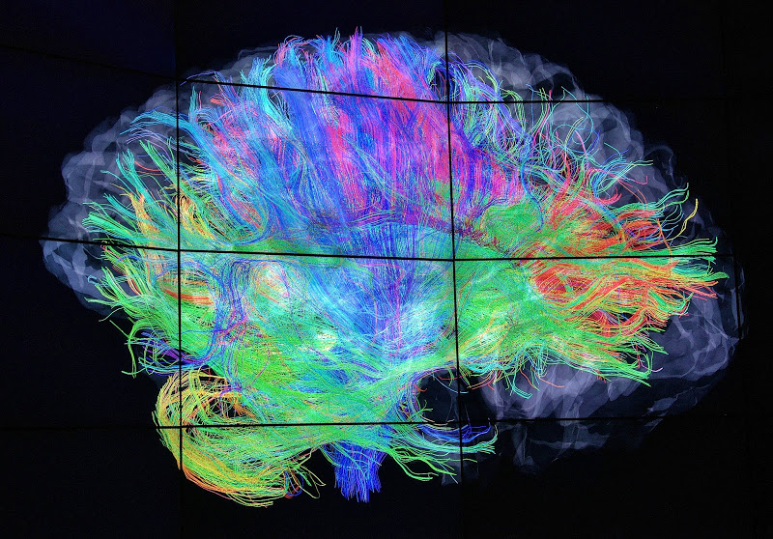
Part I. ARCUS Challenge 1 Defining Research Approaches
TRANS-disciplinary Research
Integrates and builds from discipline-specific theories, concepts, and methods
Pursues collaboration across levels of analysis (e.g., from cells to society)
Develops comprehensive understanding of problem (as a system)
May also include:
A focus on societal problems and development of practical knowledge
Translational partners from differing sectors (NGO, Community, Industry)
Transcends disciplinary perspectives and professions and enables development and application of new methodologic or conceptual frameworks

Slide 14
Part I. ARCUS Challenge 1 Defining Research Approaches
Addressing ARCUS Challenge 1
Helps research teams realize mission
To advance (inter/trans)disciplinary education, research, practice
Support research teams in their scientific goals
To utilize complementary approaches and/or to integrate knowledge
Cultivate involvement of stakeholders
To develop knowledge… to translate scientific findings for societal gains
ARCUS Goals
Assist members in building collaborations that strengthen research that does (or will) transcend disciplinary boundaries and solves (or will solve) complex problems
ARCUS MESSAGE: ARCUS should help teams pursue the appropriate form of cross-disciplinary research.

Slide 15
Overview of ARCUS and Team Science
OVERVIEW - Why Team Science?
Setting the Stage
Part I. ARCUS Challenge 1
Defining Research Approaches
Part II. ARCUS Challenge 2
Understanding Team Science
Part III. ARCUS Challenge 3
Understanding Teamwork
Part IV. ARCUS Challenge 4
Preparing for Team Science
Part V. ARCUS Challenge 5
Education and Learning for Team Science

Slide 16
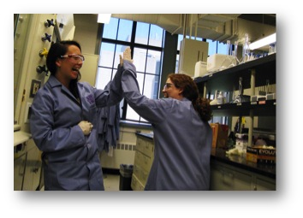
Part II. ARCUS Challenge 2 Understanding Science of Team Science
ARCUS CHALLENGE 2 – Understand what is the Science of Team Science
What do we mean by teams
Multiple information sources and intensive communication
Task-relevant knowledge with meaningful task interdependencies
Affective and attitudinal factors influence group dynamics
Coordination among members with specialized roles
Reframing interdisciplinarity as a process of teamwork to be mastered (Fiore, 2008)
Allows us to leverage science of teams
Changes question to understanding team activities necessary for science
Makes the achievement and measurement of interdisciplinarity more tractable
Fiore, S. M. (2008). Interdisciplinarity as teamwork: How the science of teams can inform team science. Small Group Research, 39(3), 251-277.

Slide 17
Part II. ARCUS Challenge 2 Understanding Science of Team Science
A New Field - Science of Team Science
Commitment to develop scholarly examination of teamwork in science
Goal to understand and improve how scholars interact and integrate across disciplinary, professional, and institutional boundaries
“the inherent complexity of contemporary public health, environmental, political, and policy challenges… [leads to] realization that an integration of multiple disciplinary perspectives is required to better understand and ameliorate these problems” (Stokols et al., 2008).
Must understand how to make full use of the scientific capacity of science teams (Salazar et al., 2012)
Salazar, M. R., Lant, T. K., Fiore, S. M., & Salas, E. (2012). Facilitating innovation in diverse science teams through integrative capacity. Small Group Research, 43(5), 527-558.
Stokols, D., Misra, S., Moser, R. P., Hall, K. L., & Taylor, B. K. (2008). The ecology of team science - Understanding contextual influences on transdisciplinary collaboration. American Journal of Preventive Medicine, 35(2), S96-S115.

Slide 18
Hall, K. L., Stipelman, B. A., Vogel, A. L., & Stokols, D. (in press). Understanding cross-disciplinary team-based research: Concepts and conceptual models from the Science of Team Science. In Frodeman, R., Klein, J. T., & Mitcham, C. (Eds). Oxford Handbook on Interdisciplinarity, 2nd Edition. Oxford, UK: Oxford University Press.

Slide 19
Part II. ARCUS Challenge 2 Understanding Science of Team Science
National Academies of Science Consensus Study
Rationale: Clear need to provide research-based guidance to improve the processes and outcomes of team science
Sponsor: National Science Foundation, Directorate of Computer and Information Sciences and Engineering
Goal: Enhance effectiveness of collaborative research in science teams, research center, and institutes.
Audiences: NSF and other public and private research funders and scientific community.
Enhancing the Effectiveness of Team Science (2015) -- http://www.nap.edu/catalog/19007/enhancing-the-effectiveness-of-team-science

Slide 20
Part II. ARCUS Challenge 2 Understanding Science of Team Science
NRC Report on Enhancing the Effectiveness of Team Science
Key Features | Ranges Possible in Team Science
Size | Small (2) | Mega (1000s)
Task Interdependence | Low | High
Boundaries | Stable | Fluid
Goal Alignment | Aligned | Divergent or Misaligned
Integration | Unidisciplinary | Transdisciplinary
Diversity | Homogeneous | Heterogeneous
Proximity | Co-located | Globally Distributed
Notes:
Teams outside of science increasingly share these features (e.g., intelligence analysis teams, surgical teams, top management teams, new product development teams) and they can pose challenges to effective coordination of work. The committee assumes that insights from teams in other contexts provides a rich foundation of knowledge to inform interventions to improve the effectiveness of science teams.

Slide 21
Part II. ARCUS Challenge 2 Understanding Science of Team Science
The GOOD NEWS
The science points to interventions for:
Assembling teams
Providing professional development and education opportunities
Supporting leadership development opportunities
Virtual collaboration
P&T credit for team-based work
Study and measurement of science teams
ARCUS MESSAGE: ARCUS help researchers understand that there is a rich and robust scholarly literature on team performance that can improve team science effectiveness

Slide 22
Overview of ARCUS and Team Science
OVERVIEW - Why Team Science?
Setting the Stage
Part I. ARCUS Challenge 1
Defining Research Approaches
Part II. ARCUS Challenge 2
Understanding Team Science
Part III. ARCUS Challenge 3
Understanding Teamwork
Part IV. ARCUS Challenge 4
Preparing for Team Science
Part V. ARCUS Challenge 5
Education and Learning for Team Science

Slide 23
Part III. ARCUS Challenge 3 Understanding Teamwork Basics
Guidance for ARCUS
GOAL 1: Provide summary of subset of concepts necessary for team effectiveness
GOAL 2: Make explicit key areas of teamwork necessary for success on collaborative research
Good scientists already reflect on their scientific process; that is, they reflect on the research processes
In which s/he is engaged
In which his/her colleagues and peers are engaged
In which his/her students are engaged
OUTCOME: Recognize that, to be a good ‘team scientist’ researchers also need to reflect on team processes

Slide 24
Part III. ARCUS Challenge 3 Understanding Teamwork Basics
THINK
FEEL
DO
Cognition
Affect
Behaviors
Knowledge Component
Attitudinal
Components
Skill
Components
Mental Models
Metacognition
Decision Making
Problem Solving
Cohesion
Collective Efficacy
Collective Orientation
Trust
Leadership Sharing
Communication
Performance Monitoring
Backup Behavior

Slide 25
Part III. ARCUS Challenge 3 Understanding Teamwork Basics
Effective teams engage in both taskwork and teamwork (Fiore et al., 2015; Fiore, 2008)
TASKwork refers to what needs to be accomplished to meet goals and complete objectives
This is the scientific “work” of science teams
Understanding the relevant theory and constructs
Developing studies and executing appropriate methods
Conducting analyses and interpreting results and writing up findings
TEAMwork refers to the attitudinal, behavioral, and cognitive factors required to function effectively as part of an interdependent team
Attitudinal – Affect arising from working with teammates (trust)
Behavioral – Skills supporting interacting with teammates (communication)
Cognitive - Knowledge associated with teammates (roles, responsibilities)
Fiore, S. M. (2008). Interdisciplinarity as Teamwork: How the Science of Teams can inform Team Science. Small Group Research, 39(3), 251-277.
Fiore, S.M., Carter, D.R., & Asencio, R. (2015). Conflict, Trust, and Cohesion: Examining Affective and Attitudinal Factors in Science Teams. In E. Salas, W.B. Vessey, & A.X. Estrada (Eds.), Team Cohesion: Advances in Psychological Theory, Methods and Practice (pp. 271-301). Emerald Group Publishing Limited.

Slide 26
Part III. ARCUS Challenge 3 Understanding Teamwork Basics
Need to MEASURE Taskwork and Teamwork
Questionnaires using Self and Peer Ratings
Ohland et al. (2012) - Comprehensive Assessment of Team Member Effectiveness (CATME)
Assesses teamwork and taskwork using behavioral referents:
(1) contributing to the team’s work
(2) interacting with teammates
(3) keeping the team on track
(4) expecting quality
(5) having relevant KSAs
Ohland, M.W., Loughry, M.L., Woehr, D.J., Finelli, C.J., Bullard, L.G., Felder, R.M., Layton, R.A., Pomeranz, H.R., & Schmucker, D.G. (2012). The Comprehensive Assessment of Team Member Effectiveness: Development of a Behaviorally Anchored Rating Scale for Self and Peer Evaluation. Academy of Management Learning & Education, 11 (4), 609-630.

Slide 27
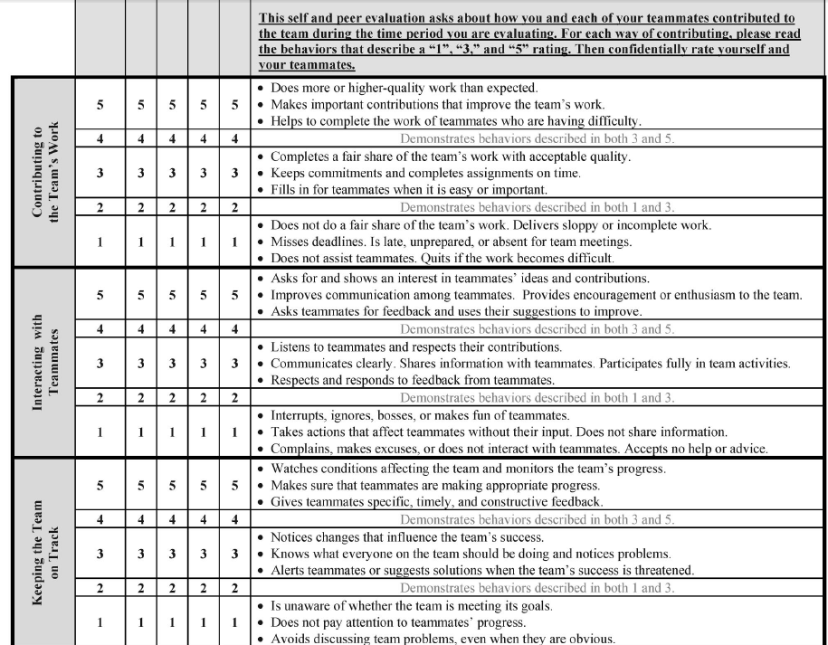

Slide 28
What about conflict…?
HANDOUT - Teamwork Conflict Survey
Part IV. Collaboration Challenge 4 Reflecting on Science Team Leadership
Item | Type | Rank | Conflict Experienced
1 | L |  | TEAM members disagree about the optimal amount of time to spend in meetings
2 | T |  | TEAM argues the pros and cons of different options
3 | R |  | Personality conflicts are evident in your TEAM
4 | C |  | Tension in your TEAM is caused by member(s) not completing their assignment(s) on time
5 | T |  | Members of your TEAM engage in debate about different opinions or ideas
6 | R |  | There is tension among members of your TEAM
7 | T |  | TEAM members discuss evidence for alternative viewpoints
8 | L |  | TEAM members disagree about the optimal amount of time to spend on different parts of teamwork
9 | L |  | Members of your TEAM disagree about who should do what
10 | R |  | Friction exists among members of your TEAM
11 | C |  | Tension in your TEAM is caused by member(s) not performing as well as expected
12 | R |  | There is emotional tension among members of your TEAM
13 | C |  | Tension in your TEAM is caused by member(s) arriving late to meetings
Behfar, K. J., Mannix, E. A., Peterson, R. S., & Trochim, W. M. (2011). Conflict in Small Groups: The Meaning and Consequences of Process Conflict. Small Group Research, 42(2), 127-176.
Notes:
Do Individual First and then Do Group

Slide 29
Part III. ARCUS Challenge 3 Understanding Teamwork Basics
Need to Distinguish Between FORMS of CONFLICT
TASK Conflict
Awareness of differences in viewpoints regarding group’s task
Discussing pros and cons, considering alternative courses of action, or evaluating how conflicting evidence fits with the group’s decisions.
RELATIONSHIP Conflict
Awareness of interpersonal incompatibilities, including feelings of tension/friction
Associated with negative emotion and strongly reflects operating norms
CONTRIBUTION Conflict
Conflict about member contributions (or lack thereof) that disrupts group process.
Influences member satisfaction and commitment to the group
Disrupts planned process for getting work done (members must compensate)
LOGISTICAL Conflict
Disagreements about how to most effectively organize/utilize resources to accomplish task
Assigning member responsibilities and deciding how to best use group’s time and resources.
Behfar, K. J., Mannix, E. A., Peterson, R. S., & Trochim, W. M. (2011). Conflict in Small Groups: The Meaning and Consequences of Process Conflict. Small Group Research, 42(2), 127-176.

Slide 30
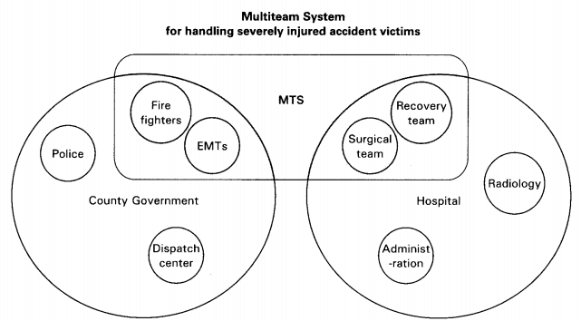
Part III. ARCUS Challenge 3 Understanding Teamwork Basics
Multiteam System (MTS)
“two or more teams that interface directly and interdependently in response to environmental contingencies toward the accomplishment of collective goals” (Mathieu, Marks, & Zaccaro, 2001, p. 290).
Challenges
Maintain internal team dynamics, manage collaborations across team boundaries
Deal with conflicting sub-goals while achieving overall goal
Understanding how problem solving unfolds within and across teams
Mathieu, J. E., Marks, M. A., & Zaccaro, S. J. (2001). Multi-team systems. In N. Anderson, D. Ones, H. K. Sinangil, & C. Viswesvaran (Eds.), International handbook of work and organizational psychology (pp. 289 –313). London: Sage.
Notes:
Publishing or data sharing (different goals)
Compliance versus research (different goals)

Slide 31
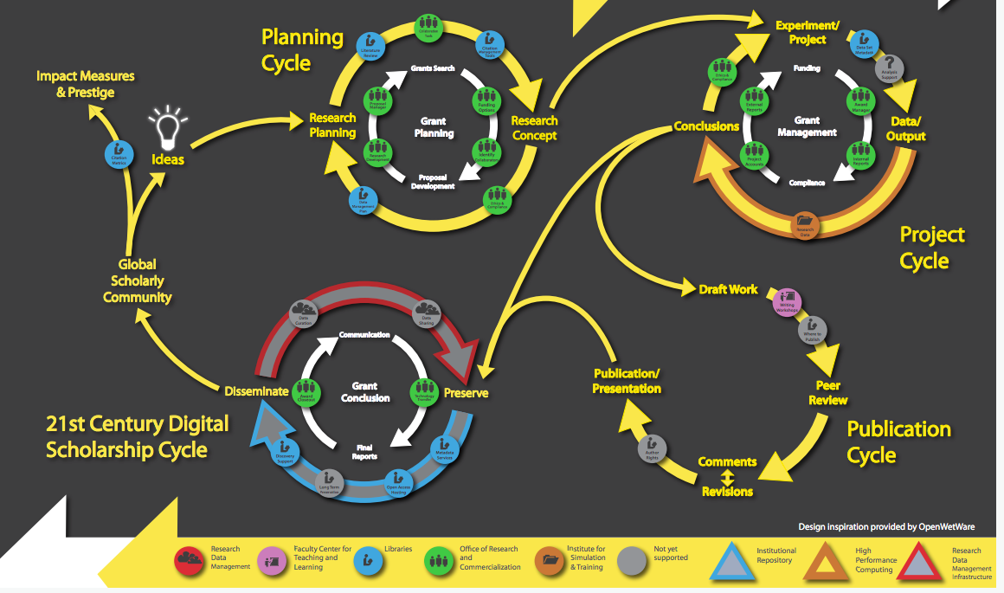
Part III. ARCUS Challenge 3 Understanding Teamwork Basics
MTS particularly applicable to scientific ecosystem - Complexity of transdisciplinary scientific problems and translation of knowledge

Slide 32
Part III. ARCUS Challenge 3 Understanding Teamwork Basics
Collaboration CHALLENGE 3 – Understand Teamwork Basics
We must understand the complex inter-relations between these factors and how they relate to scientific productivity (Fiore, 2008).
Management of TEAMwork and TASKwork related to effectiveness of science teams (e.g., addressing variations in knowledge and conflict arising)
Nature of the teamwork competencies will vary tremendously and influence outcomes of scientific collaboration
Recognize that varied forms of conflict will occur as project complexity increases.
Recognize complexity inherent in multi-team systems approach to scientific ecosystem
ARCUS MESSAGE: Develop understanding of foundational concepts in teamwork to make scientific discoveries and develop solutions in service of society.

Slide 33
Overview of ARCUS and Team Science
OVERVIEW - Why Team Science?
Setting the Stage
Part I. ARCUS Challenge 1
Defining Research Approaches
Part II. ARCUS Challenge 2
Understanding Team Science
Part III. ARCUS Challenge 3
Understanding Teamwork
Part IV. ARCUS Challenge 4
Preparing for Team Science
Part V. ARCUS Challenge 5
Education and Learning for Team Science

Slide 34
Part IV. ARCUS Challenge 4 Preparing for the Team in Team Science
ARCUS CHALLENGE 4 – Challenge in preparing researchers for the team part of team science initiatives
Research Orientation Scale (Hall, Stokols, et al., 2008)
Assesses collaboration values and attitudes in science team members
Measures each of four major research orientations:
Unidisciplinary
Multidisciplinary
Inter/Transdisciplinary
Hall, K. L., Stokols, D., Moser, R. P., Taylor, B. K., Thornquist, M. D., Nebeling, L. C., et al. (2008). The collaboration readiness of transdisciplinary research teams and centers findings from the National Cancer Institute's TREC Year-One evaluation study. American Journal of Preventive Medicine, 35(2S), S161-S172.

Slide 35
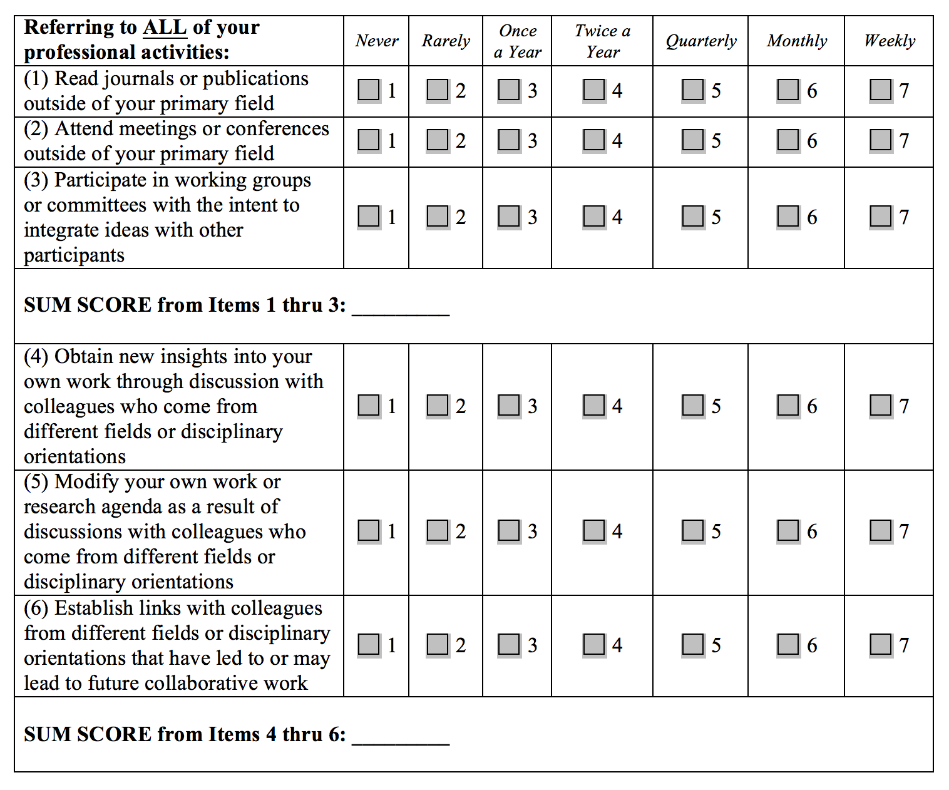
Part IV. ARCUS Challenge 4 Preparing for the Team in Team Science
Scholarly Activities Scale (Hall, Stokols, et al., 2008)
Assesses intentions for exploration in science team members
Assesses behaviors demonstrating integration in science team members
Hall, K. L., Stokols, D., Moser, R. P., Taylor, B. K., Thornquist, M. D., Nebeling, L. C., et al. (2008). The collaboration readiness of transdisciplinary research teams and centers findings from the National Cancer Institute's TREC Year-One evaluation study. American Journal of Preventive Medicine, 35(2S), S161-S172.

Slide 36
Part IV. ARCUS Challenge 4 Preparing for the Team in Team Science
NIH Field Guide’s Scientific “Prenuptial Agreement”
Collaborative agreement first and most important step toward a successful research partnership
Best way to begin to develop trust among those with whom you wish to have strong, highly collaborative scientific interactions
Can lay the foundation for the continued relationship by putting a system in place that establishes and supports trust.
Explicitly and precisely state goals of the project
Describe how each of the collaborators will contribute to the project
Delineate how to handle communications, data sharing, differences of opinion, and other project management process issues
Address administrative aspects of the collaboration—finances, accountability, staffing, etc.
Provide an opportunity to reflect on potential conflicts of interest
ADAPTED FROM: Bennett, L. M., Gadlin, H., & Levine-Finley, S. (2010). Collaboration & Team Science: A Field Guide. Bethesda, MD: National Institutes of Health.

Slide 37
Part IV. ARCUS Challenge 4 Preparing for the Team in Team Science
Overall Goals [VISION]
[K] What are the scientific issues to be addressed?
[H] What are the scientific goals we are pursuing?
[R] What are the anticipated products of the collaboration?
Who Will Do What? [TASK ORIENTED]
[S] What are the expected contributions of each participant?
[N] Who will write any progress reports and final reports?
[B] How and by whom will data be managed? How will access to data be managed? How will you handle long-term storage and access to data after the project is complete?
Who Will Do What? [PROCESS ORIENTED]
[M] What will be your mechanism for routine communications among members of the research team (to ensure that all appropriate members of the team are kept fully informed of relevant issues)?
[E] How and by whom will personnel decisions be made?
[T] How and by whom will personnel be supervised?
Authorship, Credit [MANAGEMENT]
[F] What will be the criteria and the process for assigning authorship and credit?
[J] How will credit be attributed to each collaborator’s institution for public presentations, abstracts, and written articles?
[I] How and by whom will public presentations be made?
[C] How and by whom will media inquiries be handled?
[U] When and how will you handle intellectual property and patent applications?
Contingencies [OUTCOMES ORIENTED]
[G] When is the project over?
[L] How will you decide about redirecting the research agenda as discoveries are made?
[P] How will you negotiate the development of new collaborations and spin-off projects, if any?
[D] Should one of the principals of the research team move to another institution or leave the project, how will you handle data, specimens, lab books, and authorship and credit?
Conflict of Interest [ETHICS ORIENTED]
[O] How will you identify potential conflicts of interest among collaborators?
[A] Could a collaborator or any close family members or associates benefit financially from the research?
[Q] Is a collaborator receiving money from someone who could benefit financially from the research?
Notes:
Fighting over intellectual property – might as well be a scene out of “Breaking Bad”

Slide 38
Part IV. ARCUS Challenge 4 Preparing for the Team in Team Science
Overall Goals [VISION]
[K] What are the scientific issues to be addressed?
[H] What are the scientific goals we are pursuing?
[R] What are the anticipated products of the collaboration?
Who Will Do What? [TASK ORIENTED]
[S] What are the expected contributions of each participant?
[N] Who will write any progress reports and final reports?
[B] How and by whom will data be managed? How will access to data be managed? How will you handle long-term storage and access to data after the project is complete?
Who Will Do What? [PROCESS ORIENTED]
[M] What will be your mechanism for routine communications among members of the research team (to ensure that all appropriate members of the team are kept fully informed of relevant issues)?
[E] How and by whom will personnel decisions be made?
[T] How and by whom will personnel be supervised?
Authorship, Credit [MANAGEMENT]
[F] What will be the criteria and the process for assigning authorship and credit?
[J] How will credit be attributed to each collaborator’s institution for public presentations, abstracts, and written articles?
[I] How and by whom will public presentations be made?
[C] How and by whom will media inquiries be handled?
[U] When and how will you handle intellectual property and patent applications?
Contingencies [OUTCOMES ORIENTED]
[G] When is the project over?
[L] How will you decide about redirecting the research agenda as discoveries are made?
[P] How will you negotiate the development of new collaborations and spin-off projects, if any?
[D] Should one of the principals of the research team move to another institution or leave the project, how will you handle data, specimens, lab books, and authorship and credit?
Conflict of Interest [ETHICS ORIENTED]
[O] How will you identify potential conflicts of interest among collaborators?
[A] Could a collaborator or any close family members or associates benefit financially from the research?
[Q] Is a collaborator receiving money from someone who could benefit financially from the research?
Notes:
Fighting over intellectual property – might as well be a scene out of “Breaking Bad”

Slide 39
Part IV. ARCUS Challenge 4 Preparing for the Team in Team Science
Developing a Collaboration Agreement
Building and maintaining trust takes work
There is a risk in hoping (assuming) there will be interpersonal agreement
Being explicit about trust is challenging but effective collaboration tool
Difficult to achieve trust if not explicit about what expect from each other
Helps focus on quality of scientific and relational interactions in teams
Remember
Written collaborative agreement can provide guidelines and processes for addressing every major issue that might arise in a collaboration
ARCUS MESSAGE: The time to decide how to address issues is at the beginning of the collaboration before there are any problems to resolve.
ADAPTED FROM: Bennett, L. M., Gadlin, H., & Levine-Finley, S. (2010). Collaboration & Team Science: A Field Guide. Bethesda, MD: National Institutes of Health.

Slide 40
Part IV. ARCUS Challenge 4 Preparing for the Team in Team Science
Research teams need to understand how to plan for variety of research outcomes when working on team science
Outcomes from Team Science (Pennington, 2011)
Quality and form of the material artifacts produced
Quality and nature of shared vocabulary developed
Density and diffusion of social ties created/strengthened
Number of collaboration skills developed
Project Outcomes (Cummings & Kiesler, 2005)
Ideas
Started new field or area of research
Created new grants or spin-off projects
Developed new methodologies
Recognized for contribution to field
Tools
Created new software
Created new hardware
Generated new datasets
Submitted patent application
Education/Learning
Undergrad/graduate student finished thesis
Undergrad/graduate/postdoc got academic job
Undergrad/graduate/postdoc got industry job
Outreach
Formed partnership with industry
Formed community relationships through research
Formed collaborations with different researchers
Cummings, J.N., S. Kiesler. (2005). Collaborative Research Across Disciplinary and Organizational Boundaries. Social Studies of Science, 35(5), 703-722.
Pennington, D., (2011), Collaborative, cross-disciplinary learning and co-emergent innovation in informatics teams. International Journal of Earth System Informatics, 4(2), 55-68.

Slide 41
Overview of ARCUS and Team Science
OVERVIEW - Why Team Science?
Setting the Stage
Part I. ARCUS Challenge 1
Defining Research Approaches
Part II. ARCUS Challenge 2
Understanding Team Science
Part III. ARCUS Challenge 3
Understanding Teamwork
Part IV. ARCUS Challenge 4
Preparing for Team Science
Part V. ARCUS Challenge 5
Education and Learning for Team Science

Slide 42
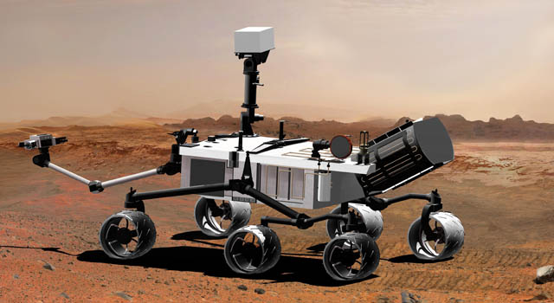
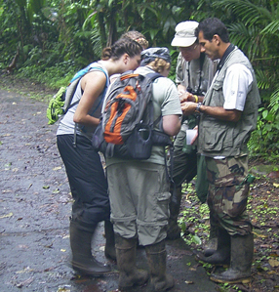
Part V. ARCUS Challenge 5 Educating for Team Science
ARCUS CHALLENGE 5 – Faculty and students do not necessarily have the competencies to engage in team science
Team Competencies
TEAM GENERIC competencies are those necessary regardless of the context or the setting
TEAM SPECIFIC competencies are more directly related to teams and include knowledge of the abilities held by team members
Task Competencies
TASK GENERIC competencies are those necessary across task situations
TASK SPECIFIC competencies important within particular task

Slide 43
Part V. ARCUS Challenge 5 Educating for Team Science
 |  | Relation to TASK
 |  | Specific | Generic
Relation to TEAM | Specific | CONTEXT DRIVEN Knowledge – Team objectives and resources Skills – Particular analyses Attitudes - Collective efficacy | TEAM CONTINGENT Knowledge – Teammate characteristics Skills – Providing teammate guidance Attitudes – Team cohesion
 | Generic | TASK CONTINGENT Knowledge – Procedures for task accomplishment Skills – Problem analysis Attitudes – Trust in technology | TRANSPORTABLE Knowledge – Understanding group dynamics Skills – Communication and assertiveness Attitudes – Interdisciplinary appreciation

Slide 44
Summary of ARCUS and Team Science
CHALLENGES for ARCUS to Help Advance Team Science
ARCUS CHALLENGE 1
Challenge in defining what is meant by cross-disciplinarity
ARCUS should help teams pursue the appropriate form of cross-disciplinary research..
ARCUS CHALLENGE 2
Challenge in understanding what is meant by team science
ARCUS help researchers understand that there is a rich and robust scholarly literature on team performance that can improve team science effectiveness
ARCUS CHALLENGE 3
Challenge in understanding how to do scientific teamwork
ARCUS should develop understanding of foundational concepts in teamwork to make scientific discoveries and develop solutions in service of society.
ARCUS CHALLENGE 4
Challenge in preparing researchers for the team part of team science initiatives
ARCUS should prepare to help researchers address issues at the beginning of the collaboration before there are any problems to resolve.
ARCUS CHALLENGE 5
Challenge in that faculty and students do not have competencies to engage in team science
ARCUS needs to recognize that collaborators need support in learning both TASK and TEAM competencies.

Slide 45
Annual International Science of Team Science Conference (SciTS)
June 12-14, 2017, Clearwater Beach, FL
Conference is a forum to enhance our understanding of how best to engage in team science to meet society’s needs (www.scienceofteamscience.org)

Slide 46
Thank You! Questions or Comments?
ARCUS webinar recordings are available online at: https://www.youtube.com/user/ARCUSvideo
Future Speakers in the 2017 Arctic Research Seminar Series
14 April 2017: Mia Bennett, UCLA
3 May 2017: Robert Corell, University of Tromso
March 24th – Anchorage Day of Arctic Research
UAA Rasmuson Hall in Anchorage, AK
Keynote by Fran Ulmer, USARC Chair
Register: https://www.arcus.org/meetings/2017/ arctic-research-day
#arcuswebinar

