Slide 1


Slide 2
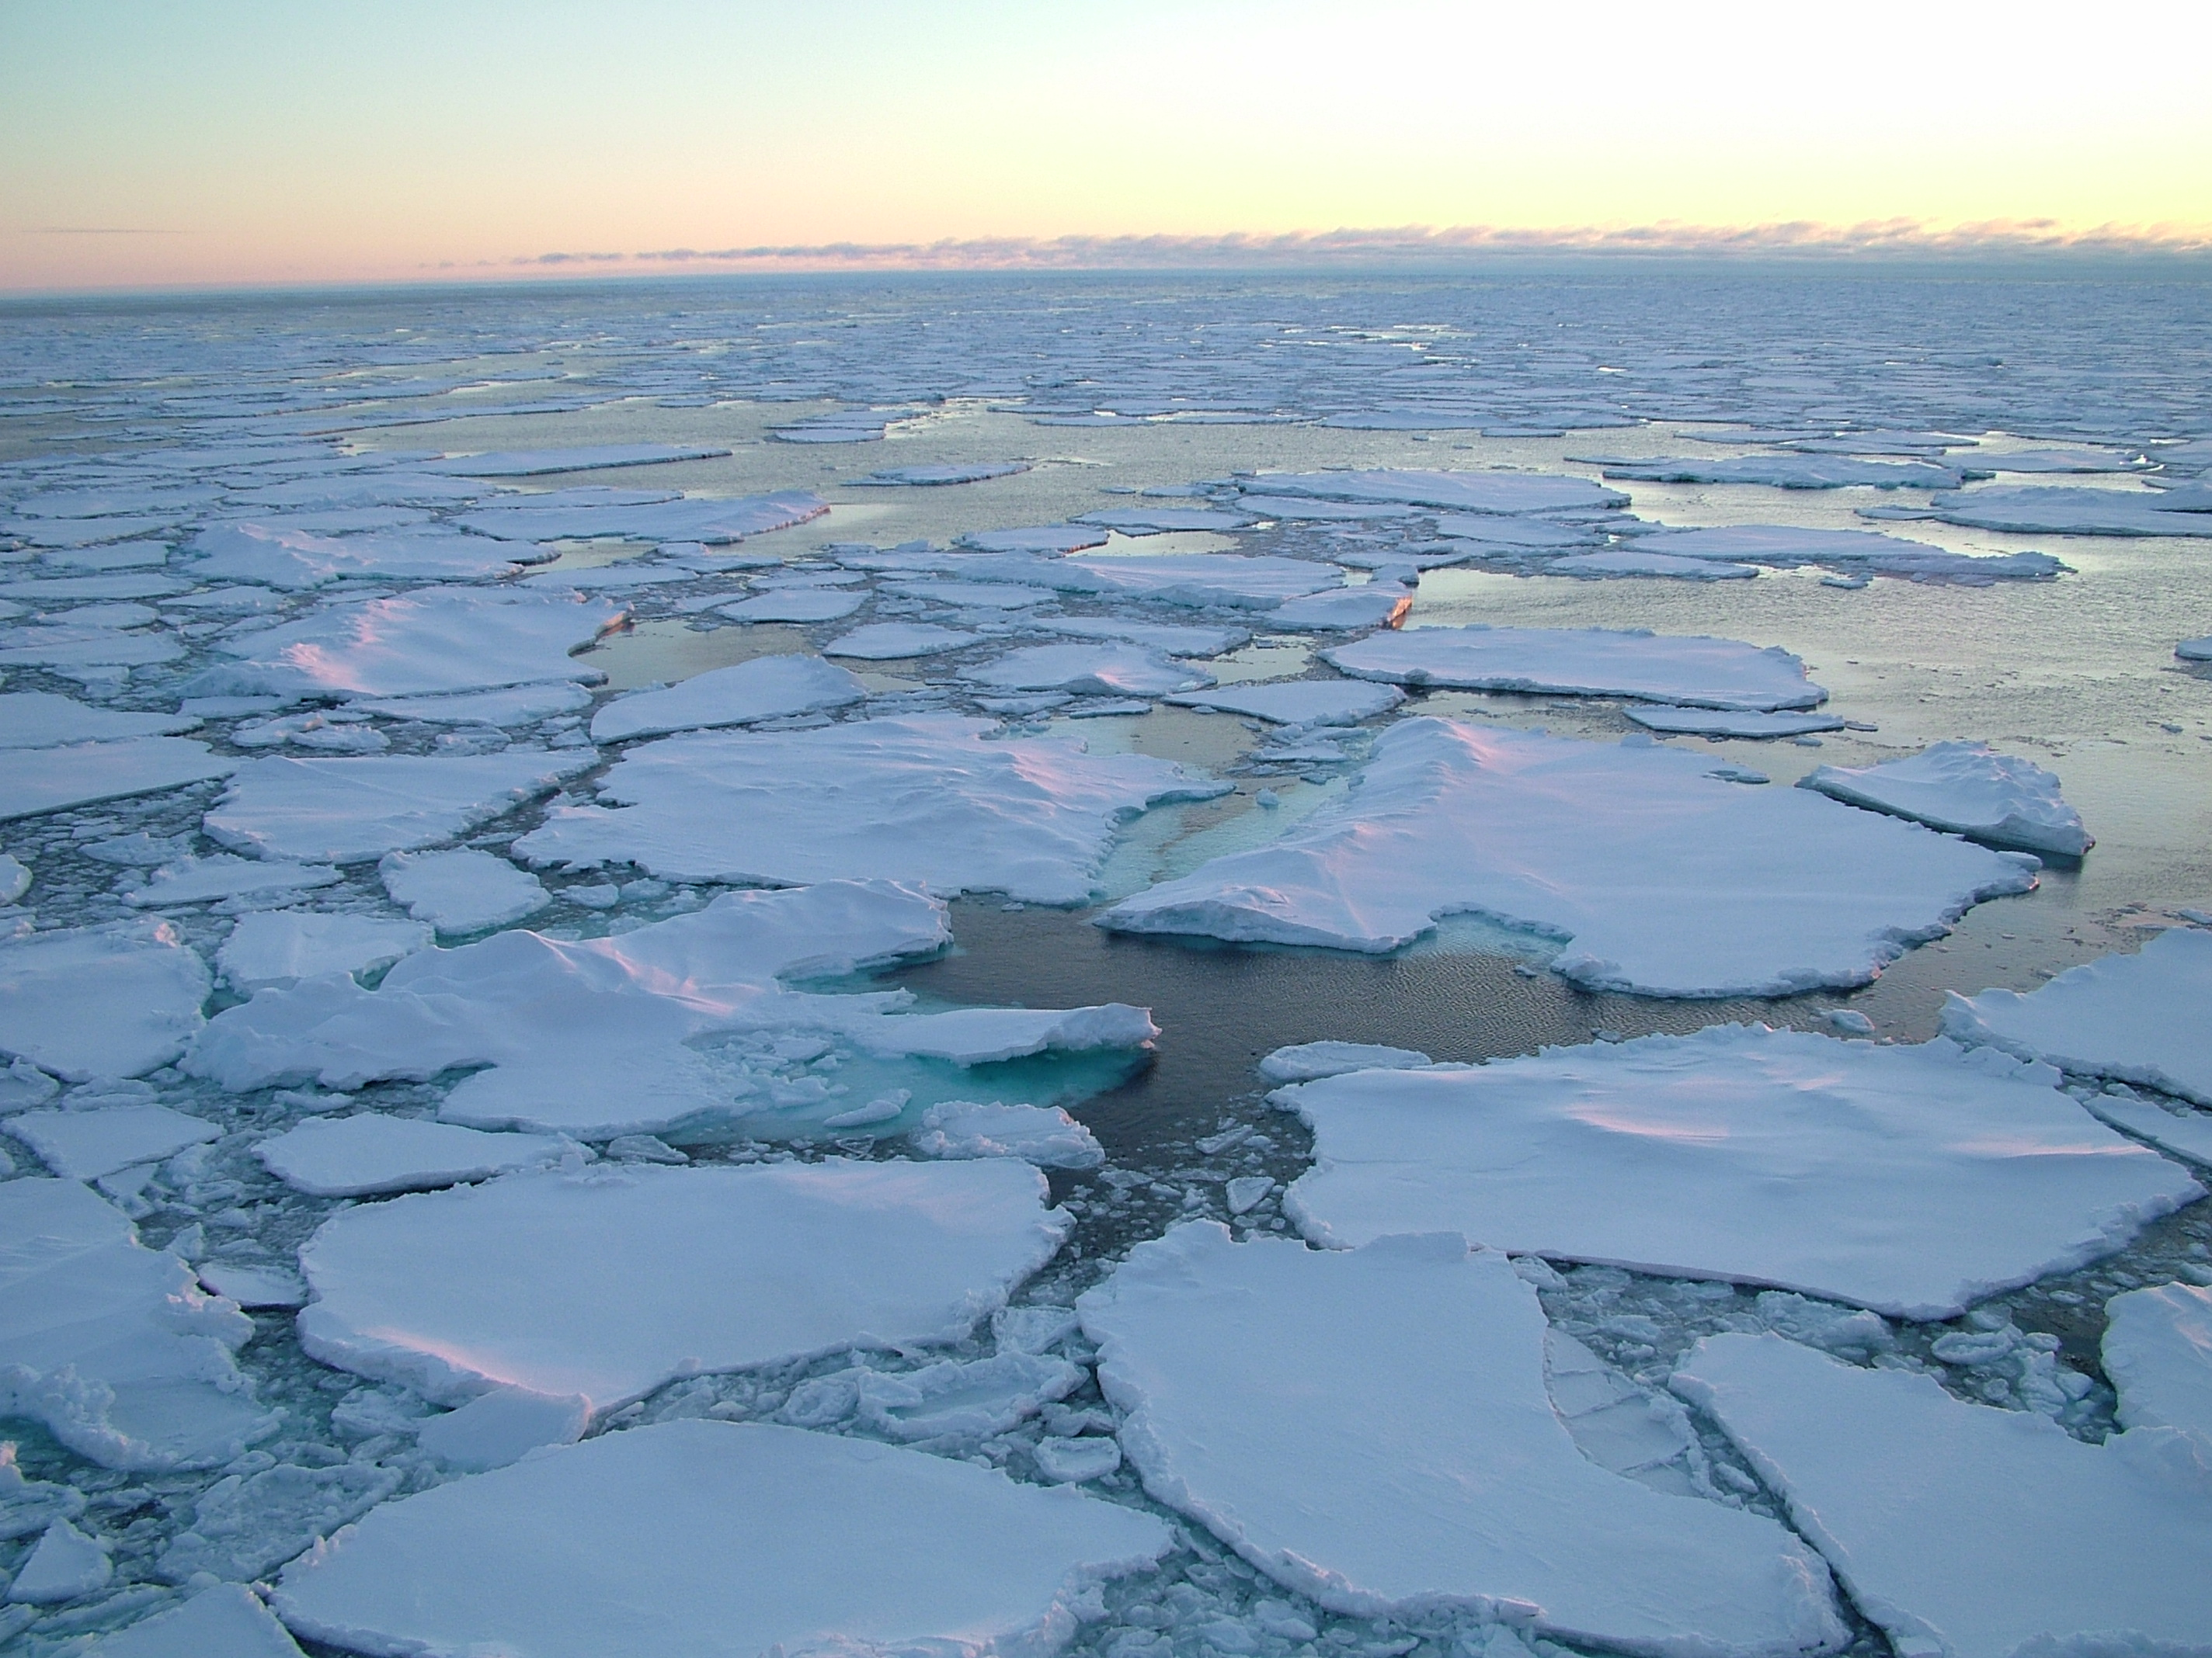


Welcome
ARCUS Arctic Research Seminar Series
“The Pacific Arctic: An Ecosystem in Transition”
21 September 2018
Presenter:
Jacqueline M. Grebmeier,
Chesapeake Biological Laboratory, University of Maryland Center for Environmental Science
#ARCUSwebinar
Background photo by Ute Kaden

Slide 3
For Those Joining via Webinar
You are invited to chat with other webinar participants at any time.
  To do so, click the Chat icon at the bottom of the screen and select the name of the participant that you wish to chat with.
  There is also an option to chat with everyone participating in the webinar.
Questions will be addressed at the end of the
presentation.
  Type your questions into the chat window at any
  time. A facilitator will ask your question during Q&A.
#ARCUSwebinar
Background photo by Ute Kaden

Slide 4
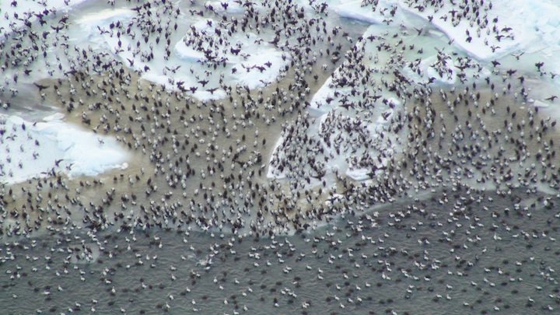
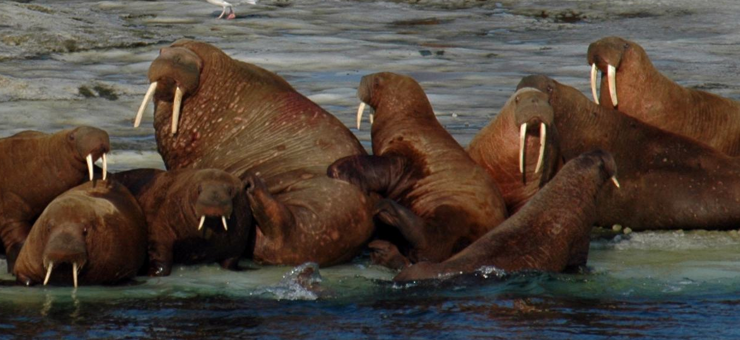
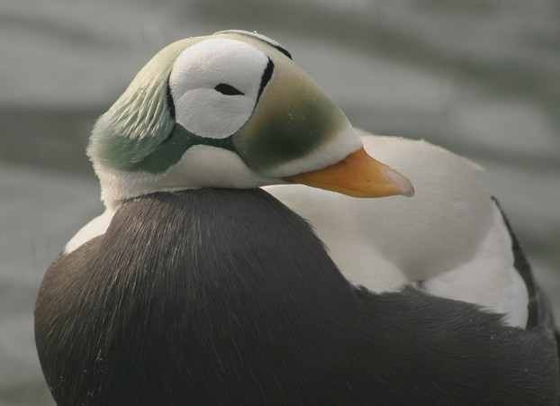
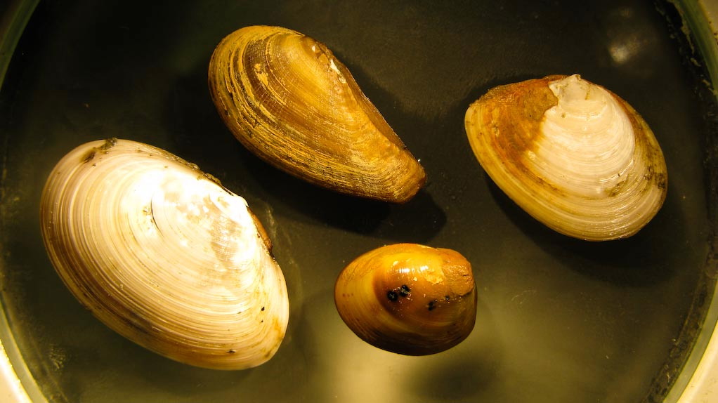
The Pacific Arctic: An Ecosystem in Transition
Jackie M. Grebmeier¹, Karen E. Frey, Lee W. Cooper, and Monika Kędra
¹Chesapeake Biological Laboratory, University of Maryland Center for Environmental Science, Solomons, Maryland, USA; ²Graduate School of Geography, Clark University, Worcester, MA, USA; ³Institute of Oceanology Polish Academy of Sciences, Powstańców Warszawy 55, 81-712 Sopot Poland
September 21, 2018, 12-1 pm-ARCUS Arctic Research Seminar, Washington DC
http://arctic.cbl.umces.edu

Slide 5
Key Points of Presentation
  Overview of key environmental drivers that influence benthic processes, prey-predator interactions, and ecosystem dynamics
  Decrease in sea ice extent and duration
  Seasonally warming bottom seawater temperatures
  Change in prey concentrations
  Northward movement of core benthic faunal biomass in hotspot areas associated with variable carbon deposition
Decadal scale studies provide status and trends of ecosystem response to advective shifts on the Arctic shelves
Repeat sampling on both temporal and spatial scales facilitate evaluation of the seasonality of ecosystem status and trends, such as the international Distributed Biological Observatory (DBO)

Slide 6
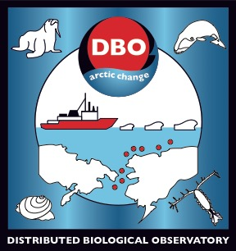
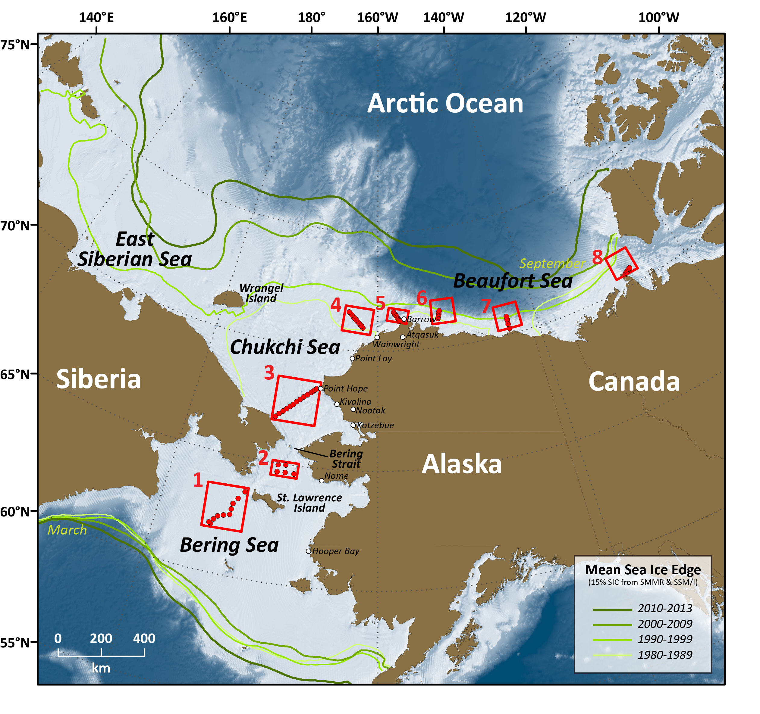













Linking Physics to Biology: the Distributed Biological Observatory (DBO)
Ship-based sampling:
    CTD and ADCP
    Chlorophyll, nutrients, carbon products
    Plankton (size, biomass and composition)
    Benthos (size, biomass and composition)
    Seabird and marine mammal surveys
    Fishery acoustics
    Bottom trawling (every 3-5 years)
Autonomous sensor sampling:
  Gliders, moorings, saildrone
  Satellite observations
  DBO lines also embedded in process cruises
[modified by Karen Frey from Grebmeier et al. 2010, EOS 91]
DBO sites (red boxes) are regional “hotspot” transect lines and stations, based on high productivity, biodiversity, and/or overall rates of change
DBO serves as a change detection array for consistent monitoring of biophysical responses
Sites occupied by national and international entities with shared data plan
Notes:
Change MAP to 4 sites

Slide 7
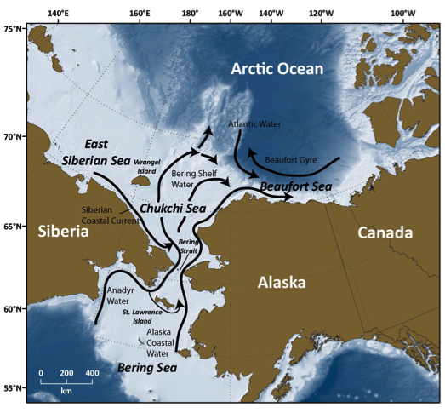
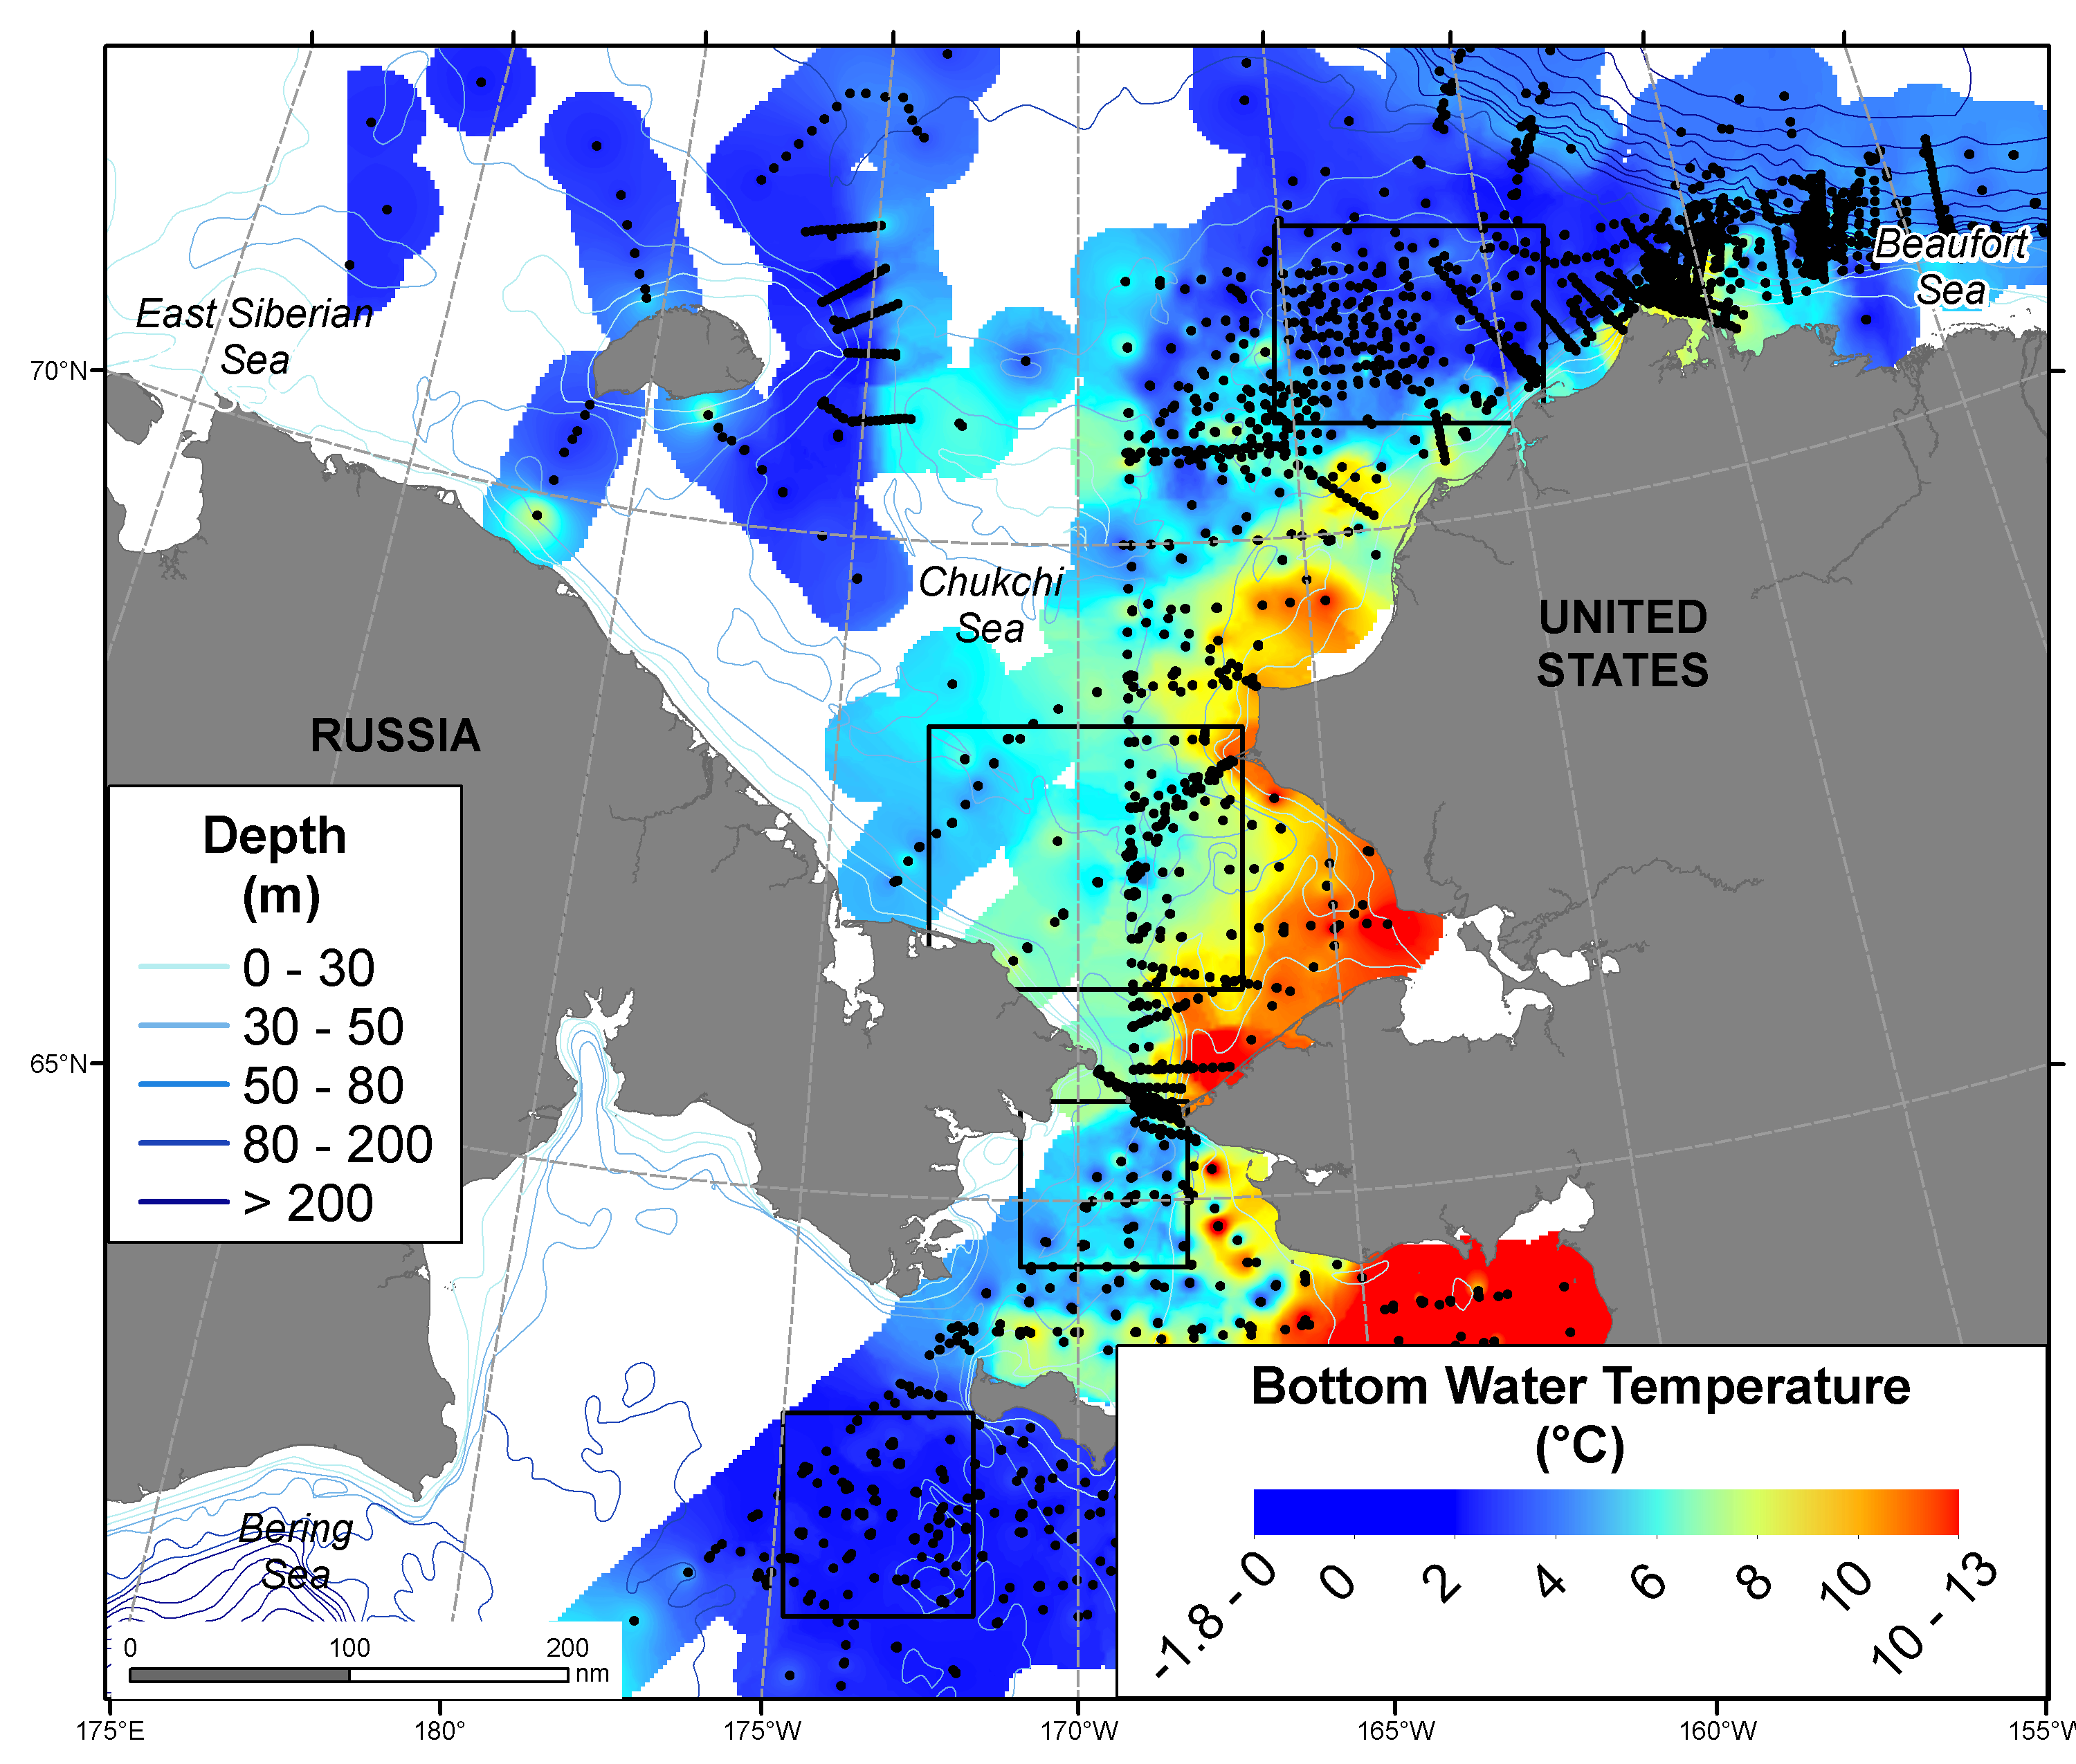
Current flow and bottom water temperatures from March-October
Advective regime
High nutrients western side
Increasing volume of warm Pacific water through Bering Strait in recent years [Woodgate 2018]
2000-2012
[Grebmeier 2012]
Latitudinal warming bottom water temperatures
Coldest: Northern Bering Sea south of St. Lawrence Island & Northeast Chukchi Sea, plus downslope western Chukchi Sea
[Grebmeier+16 co-authors, 2015 SOAR Prog. Oceangr.]

Slide 8
Monthly and Interannual Variability of Chlorophyll a (Chl-a)
based on MODIS-Aqua satellite data
DBO1-2: Earlier spring blooms
DBO2-5: Increasing observation of fall blooms
Interannual variability relative to advection of nutrients into system

Slide 9
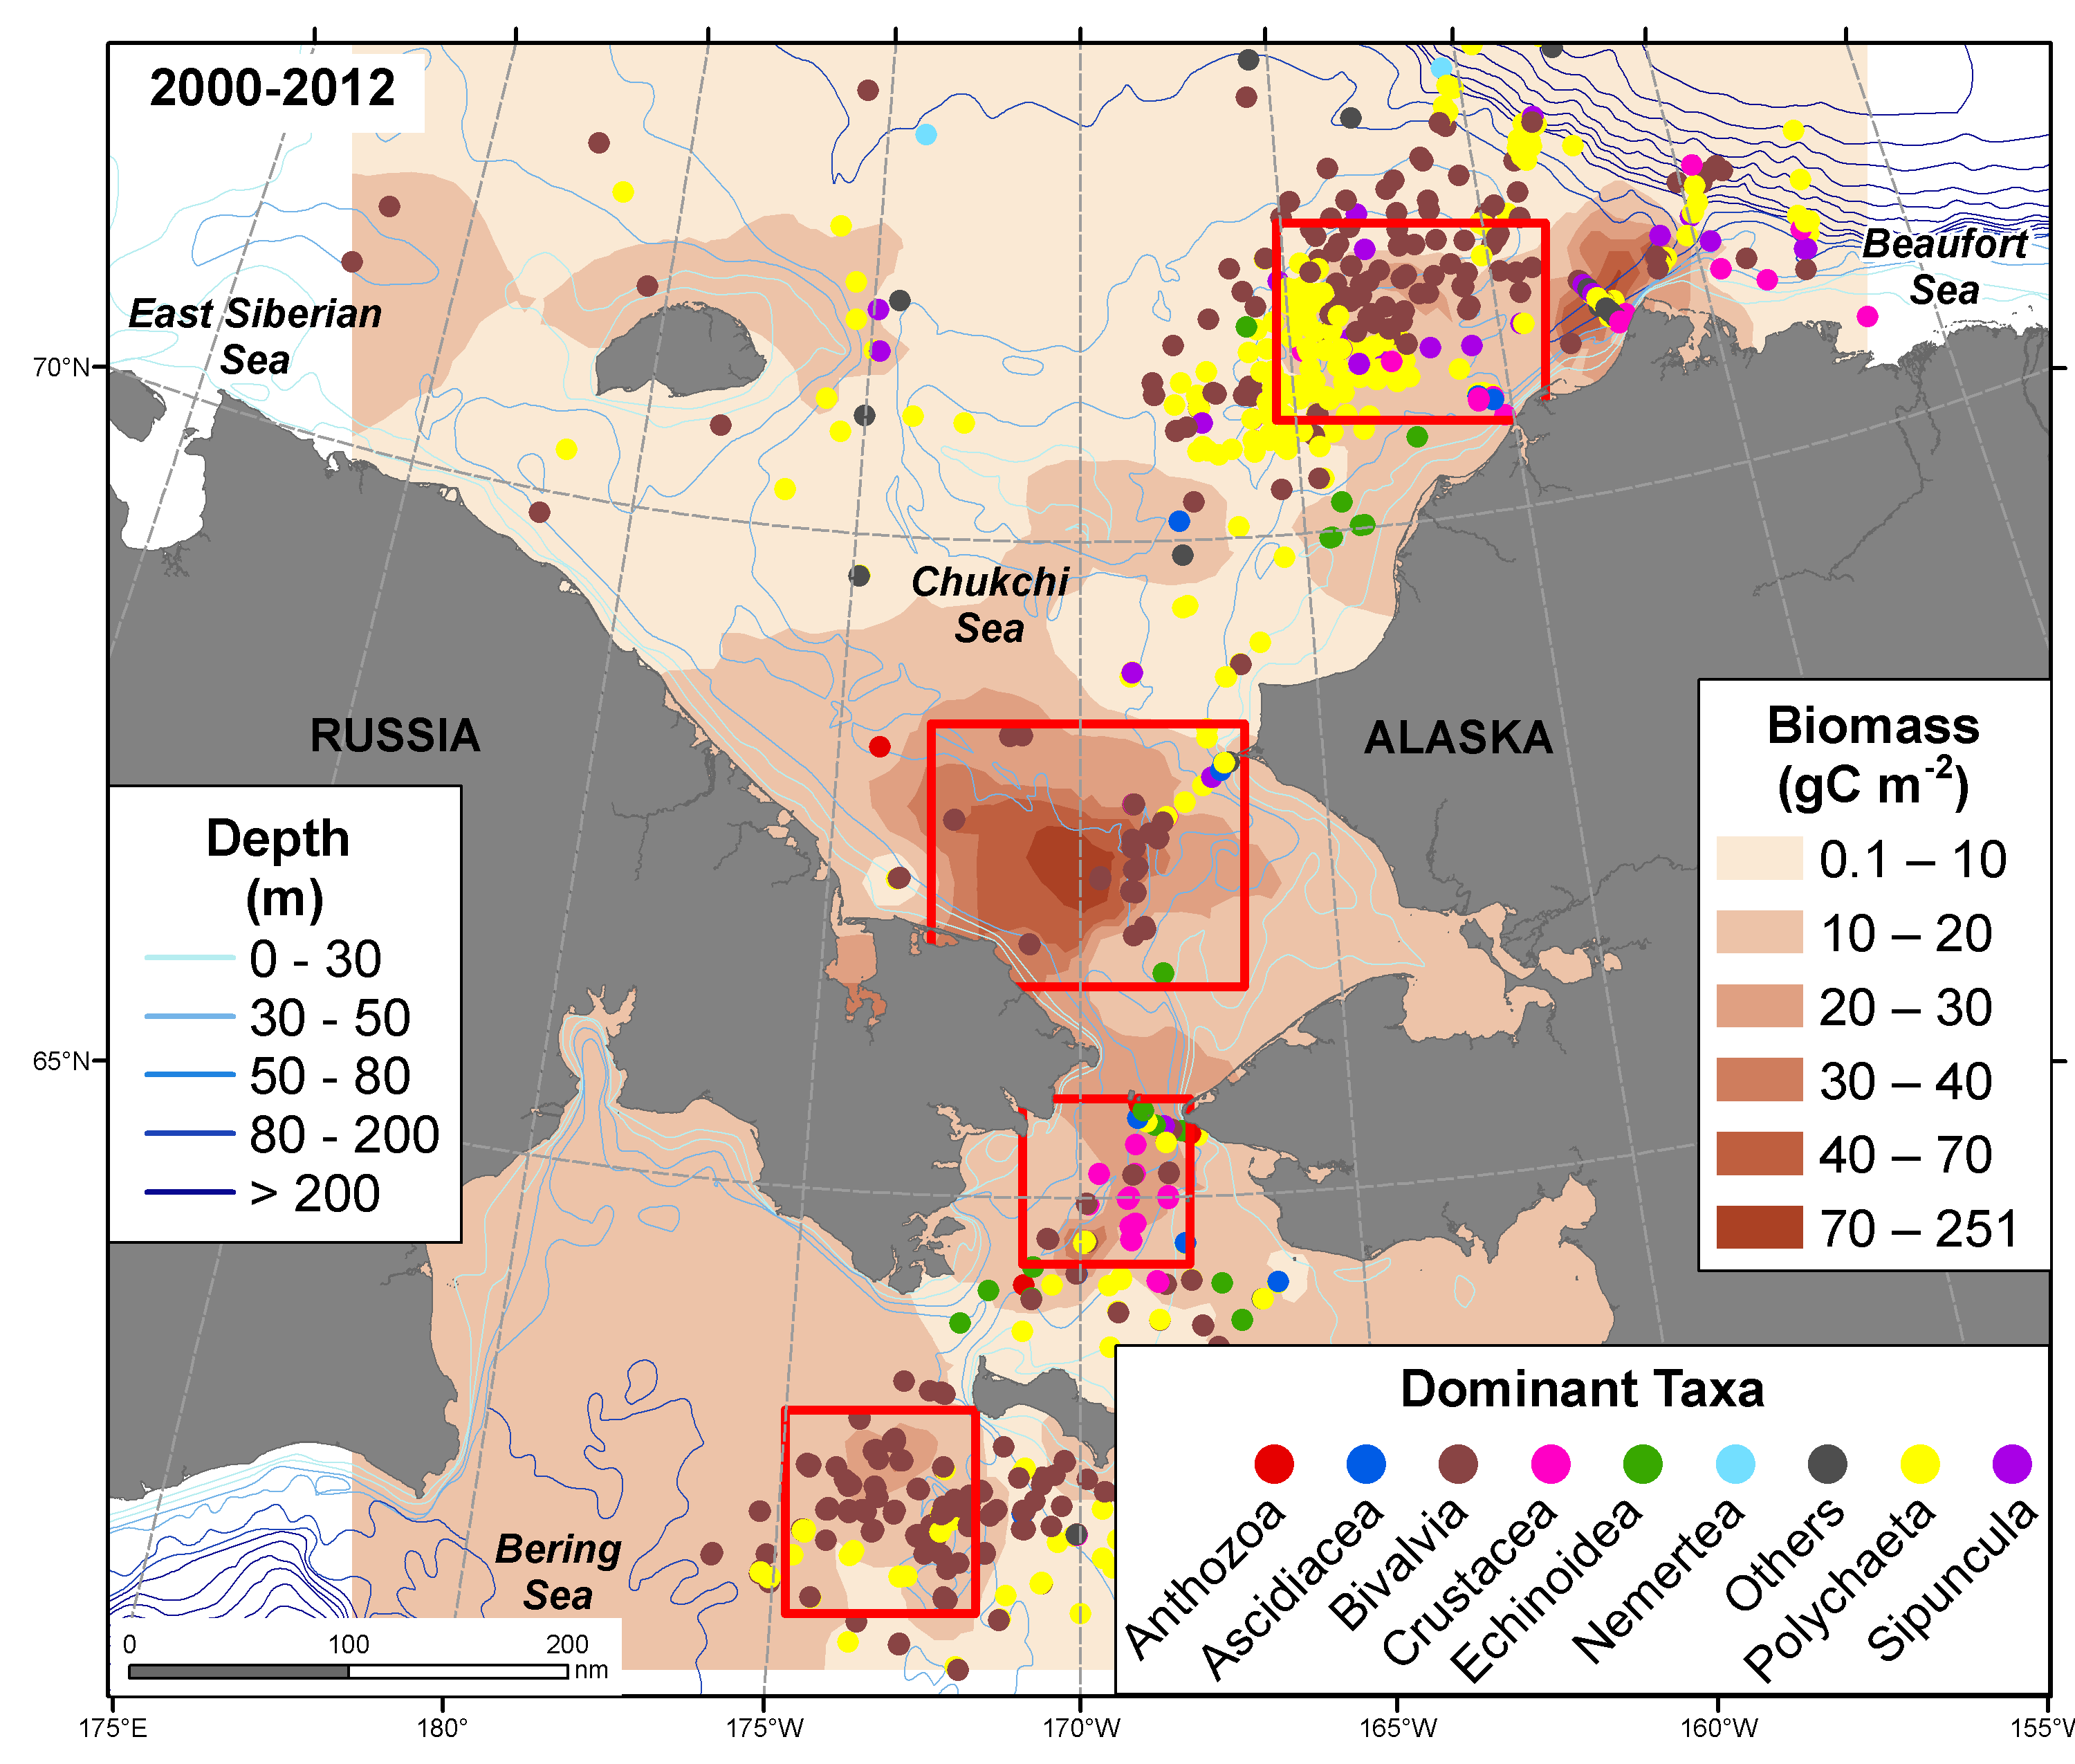
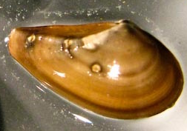
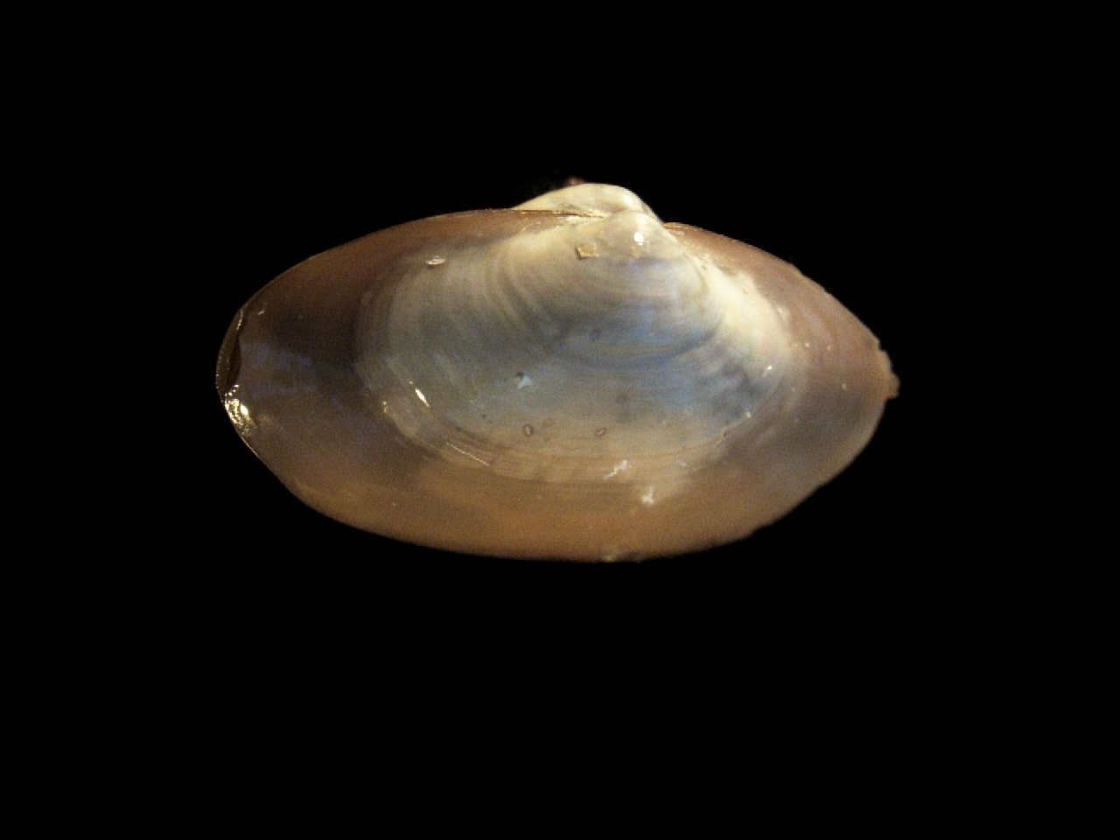
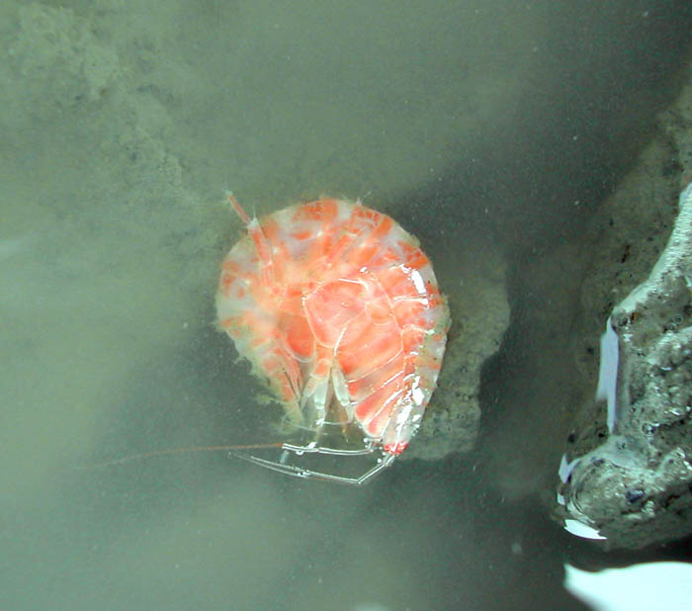
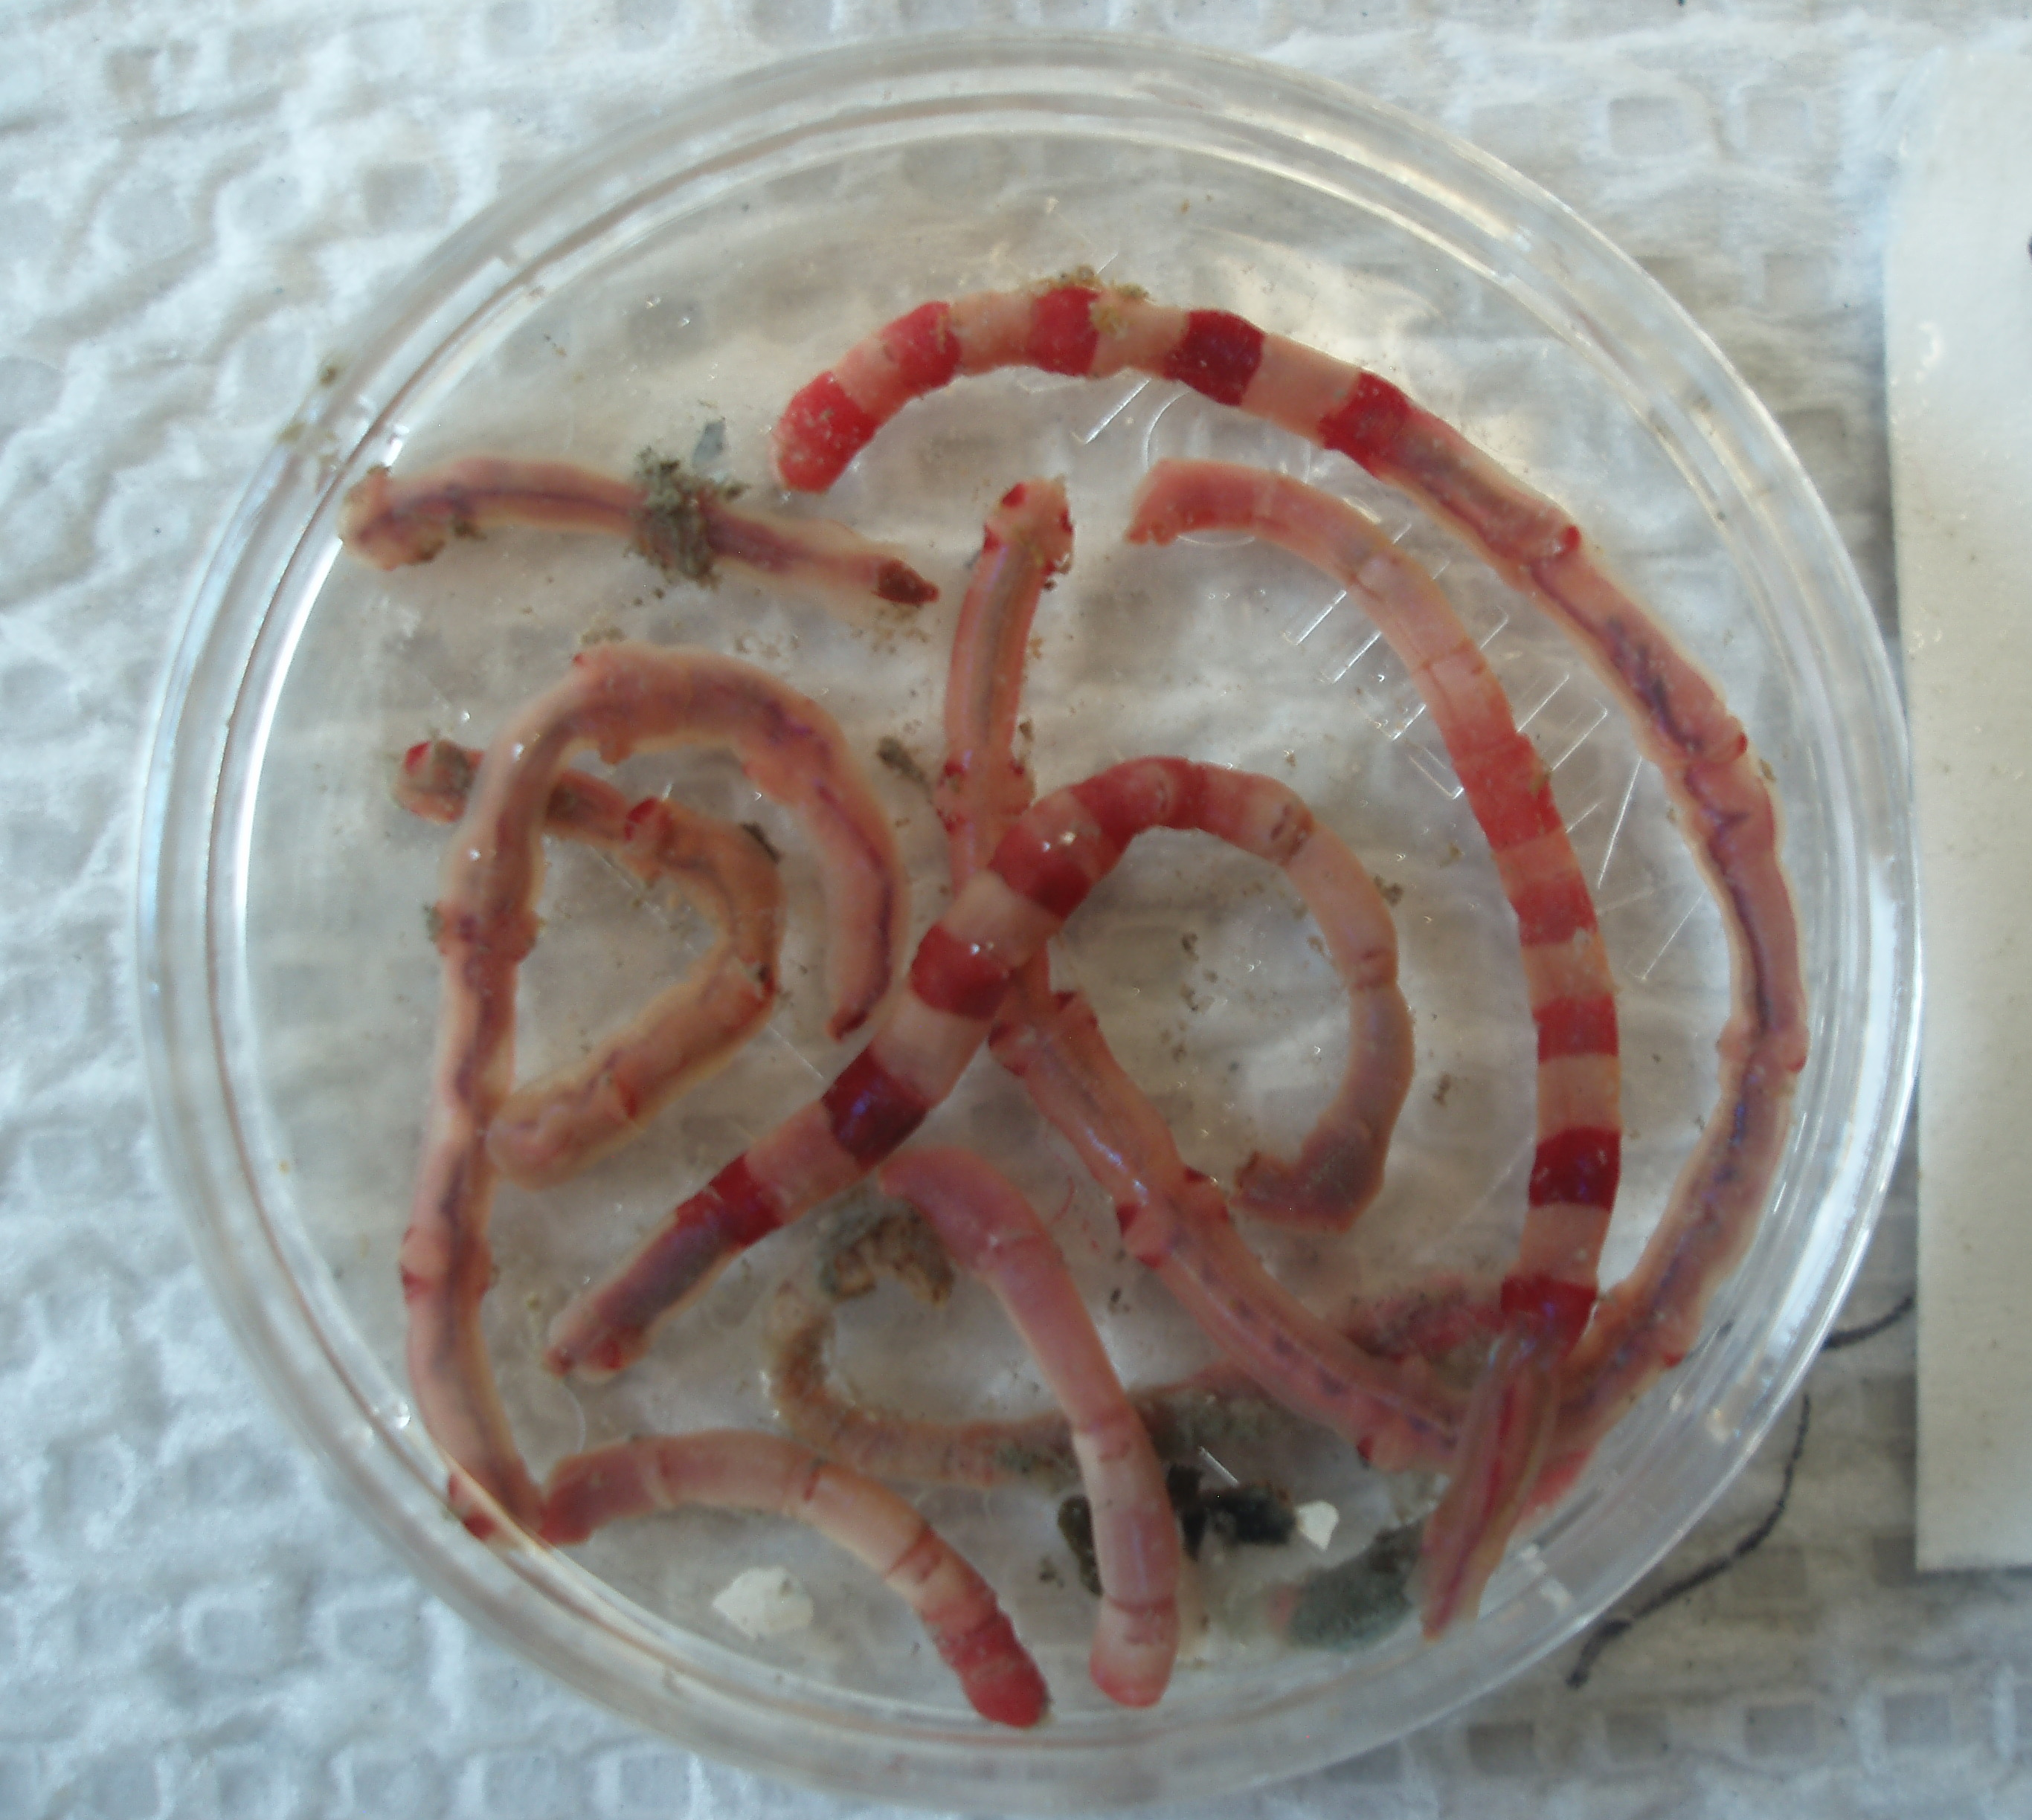
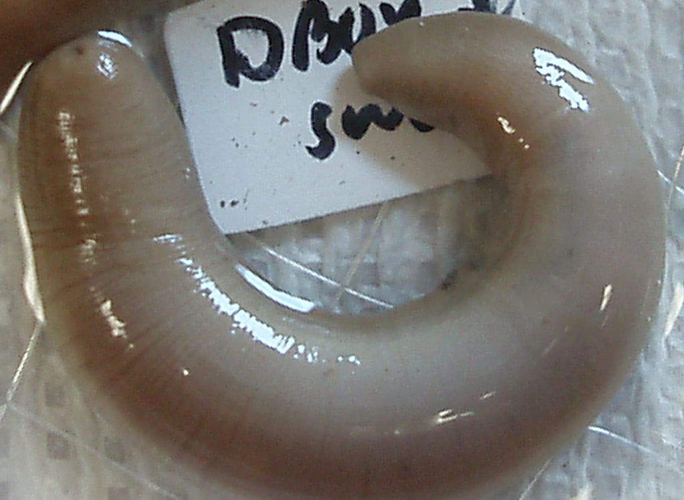
Rich benthic communities on the western side of the
Bering/Chukchi Sea system 2000-2015
“foot prints” of high benthic biomass reflect pelagic-benthic coupling and export of carbon to sediments
macrofauna dominated by amphipods, bivalves, polychaetes, and sipunculids
[updated from Grebmeier et al. 2015, Prog. Oceangr.]

Slide 10
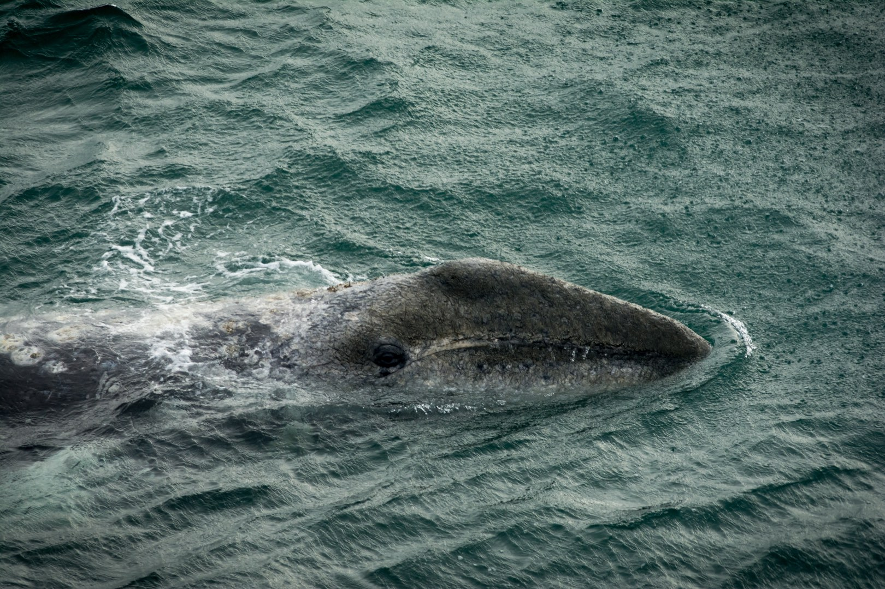
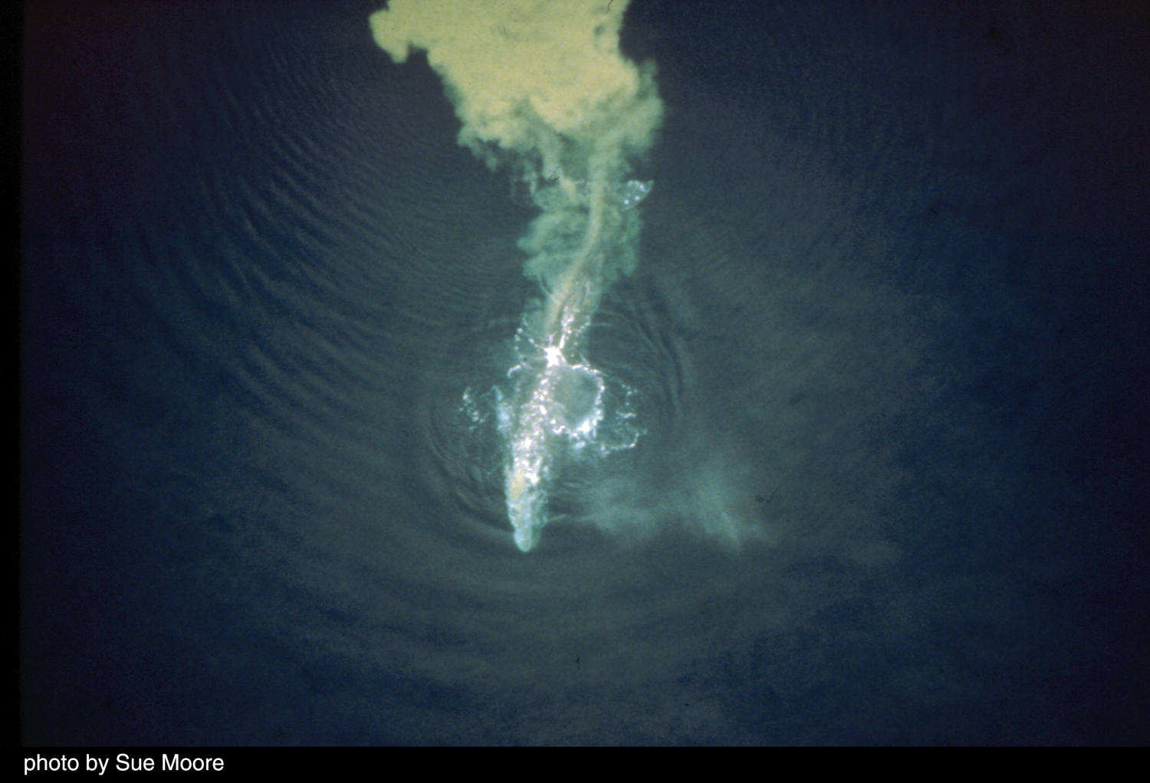
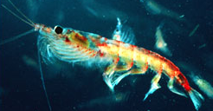
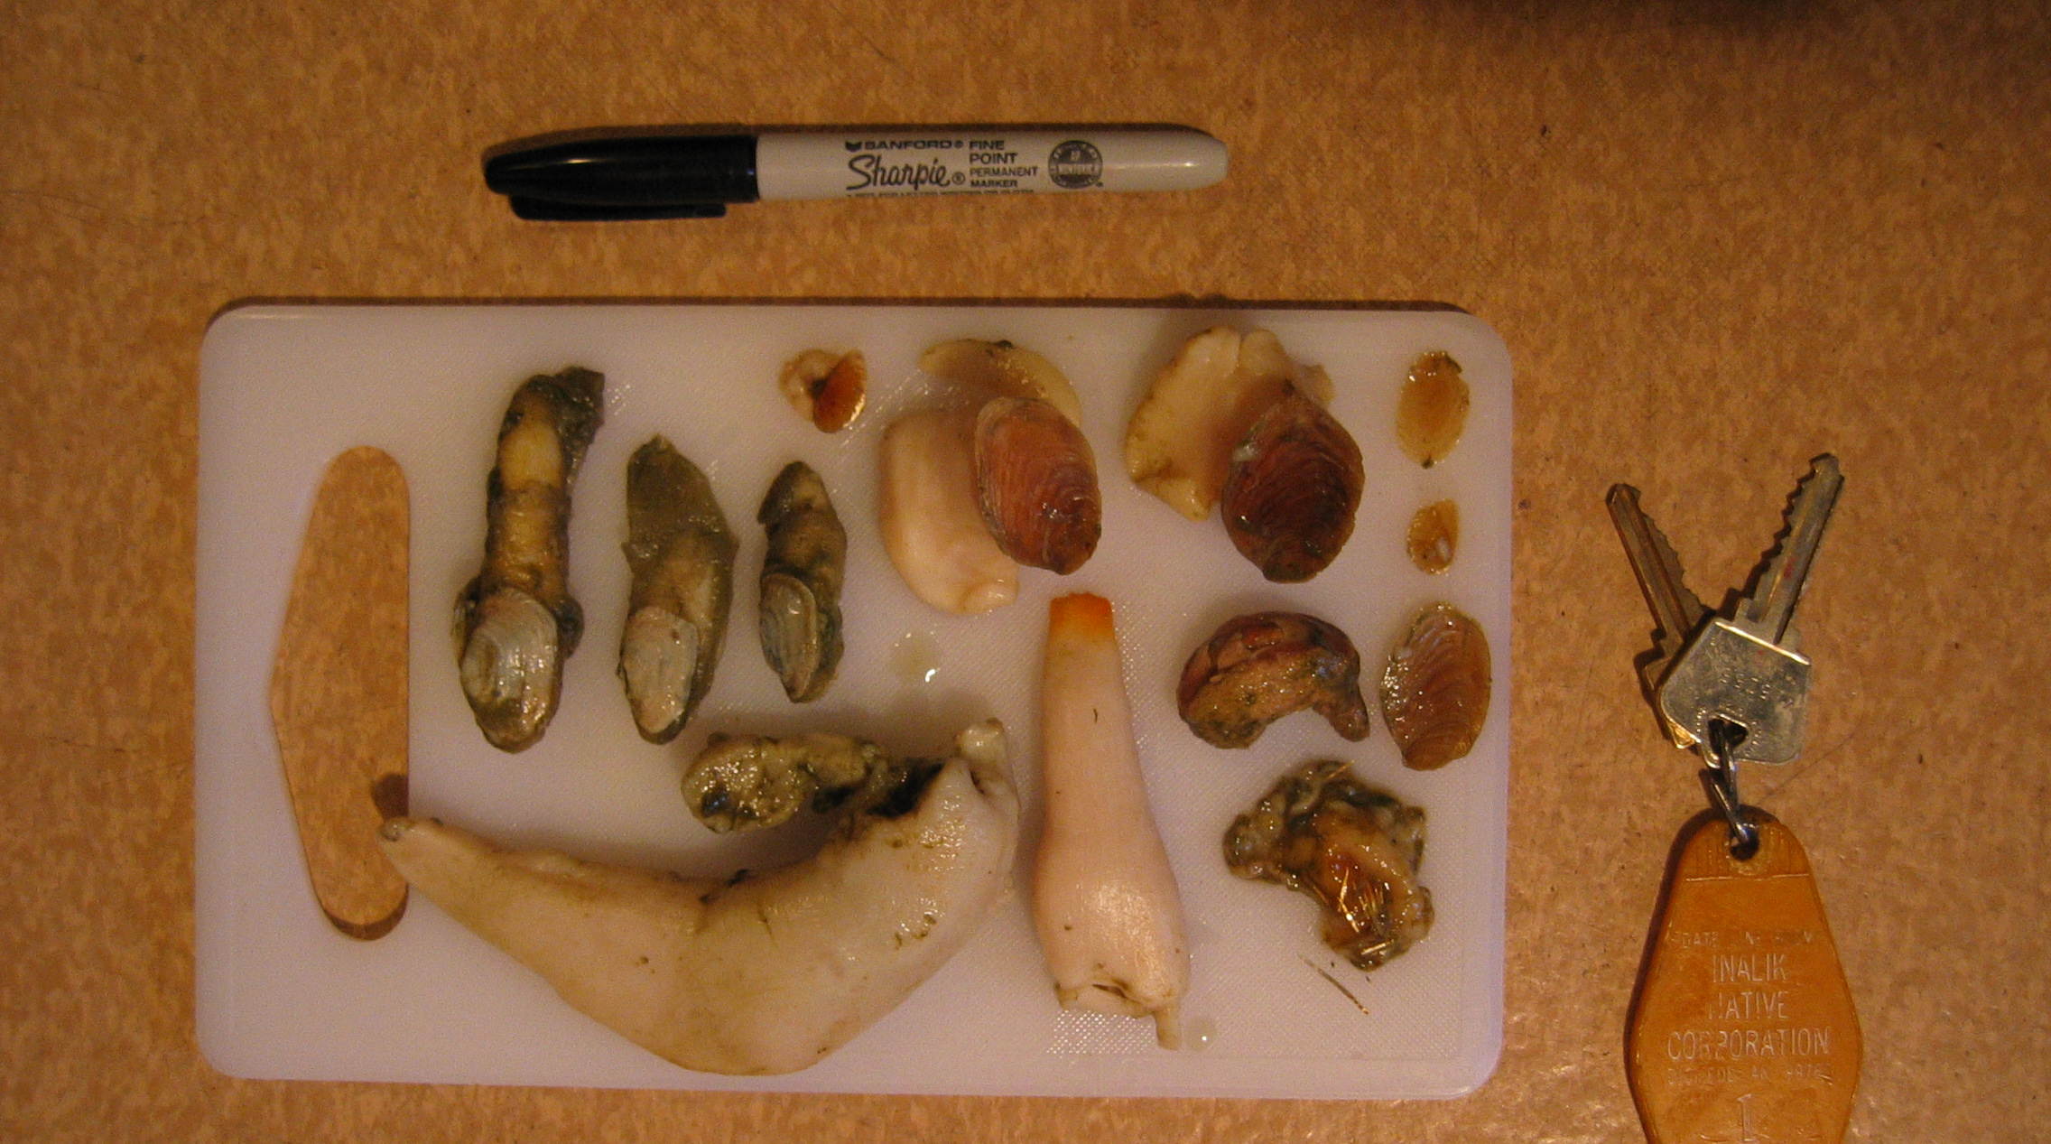
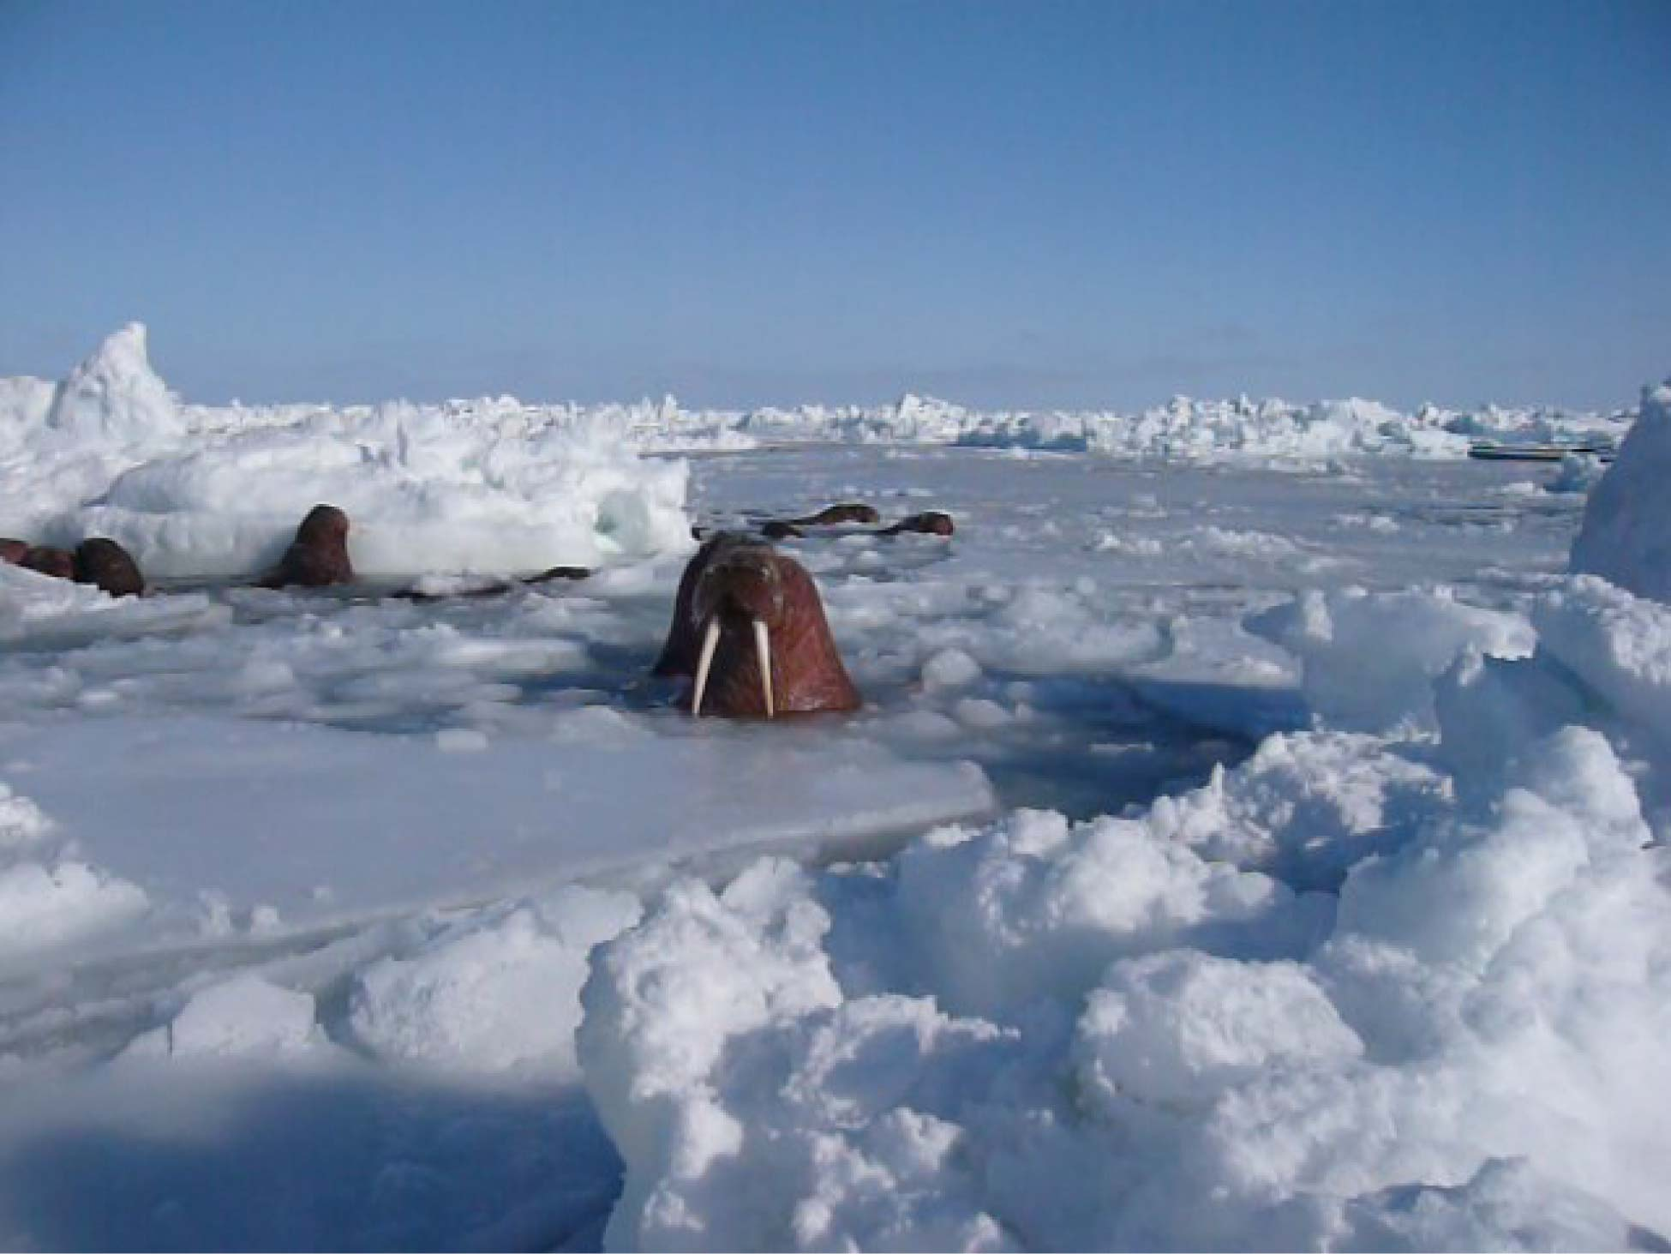
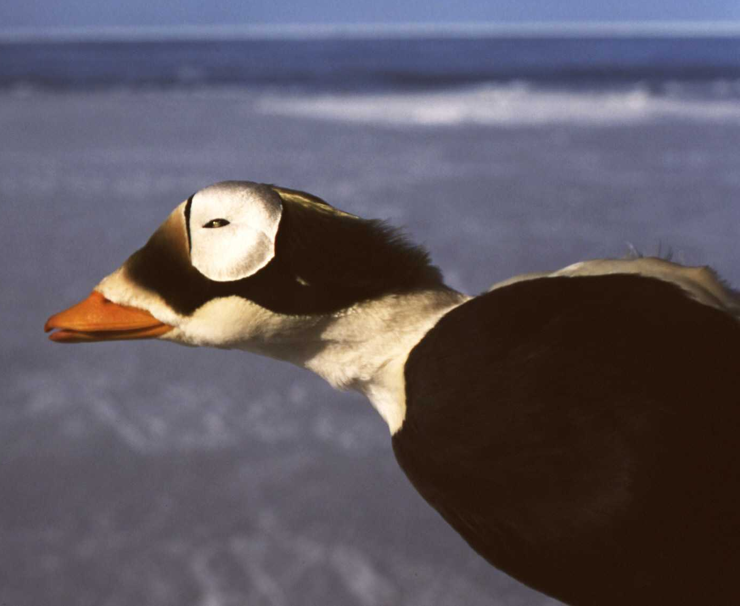
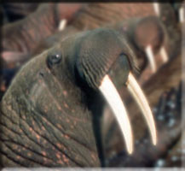
Benthic Foragers: Response to Changes in Sea Ice
Gray whales = shifts in distribution reflects sea-ice related prey decrease (amphipods: time and space), plus opportunity feed on euphausiids and staying longer north near Barrow to feed
[Charlie Wright, USFWS]
Walrus = loss of sea ice platform for riding, resting, nursing calves & access to Chukchi shelf feeding areas
Diving seaducks = changing sea ice location as resting platform
[Tony Fischbach, USGS]

Slide 11
Distributed Biological Observatory Sea-floor Videos
Samples from 10 minute clips at each station are posted on youtube.com at: https://www.youtube.com/watch?v=QGvJm1VjGrk&index=15&list=PL47bWgz8o1VnF23-mAnnGdTsEdupDEGei
Or search at youtube.com for “distributed biological observatory”

Slide 12
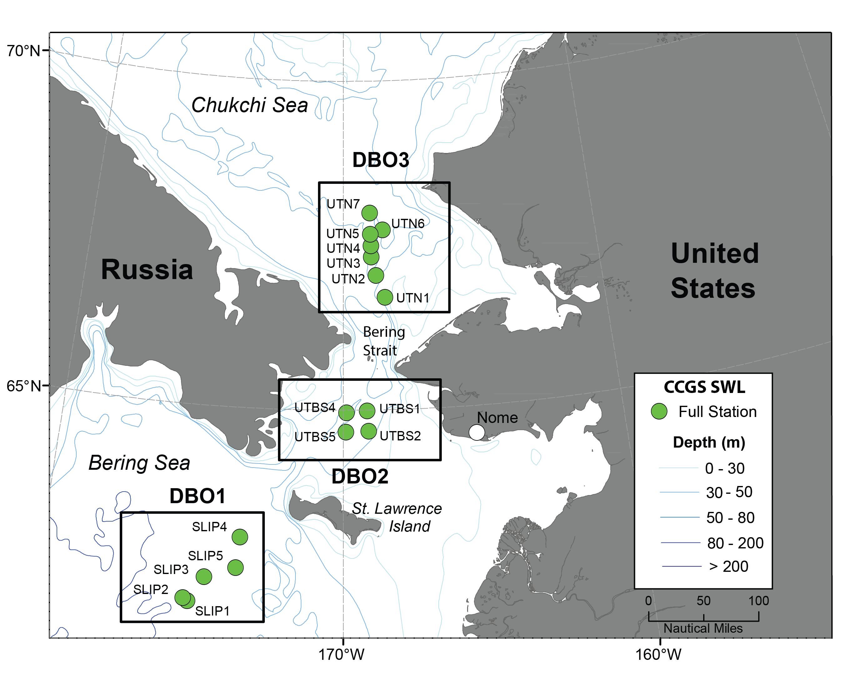
Time series sites occupied in July annually from 1998-2015 in
DBO1, DBO2, and DBO3

Slide 13
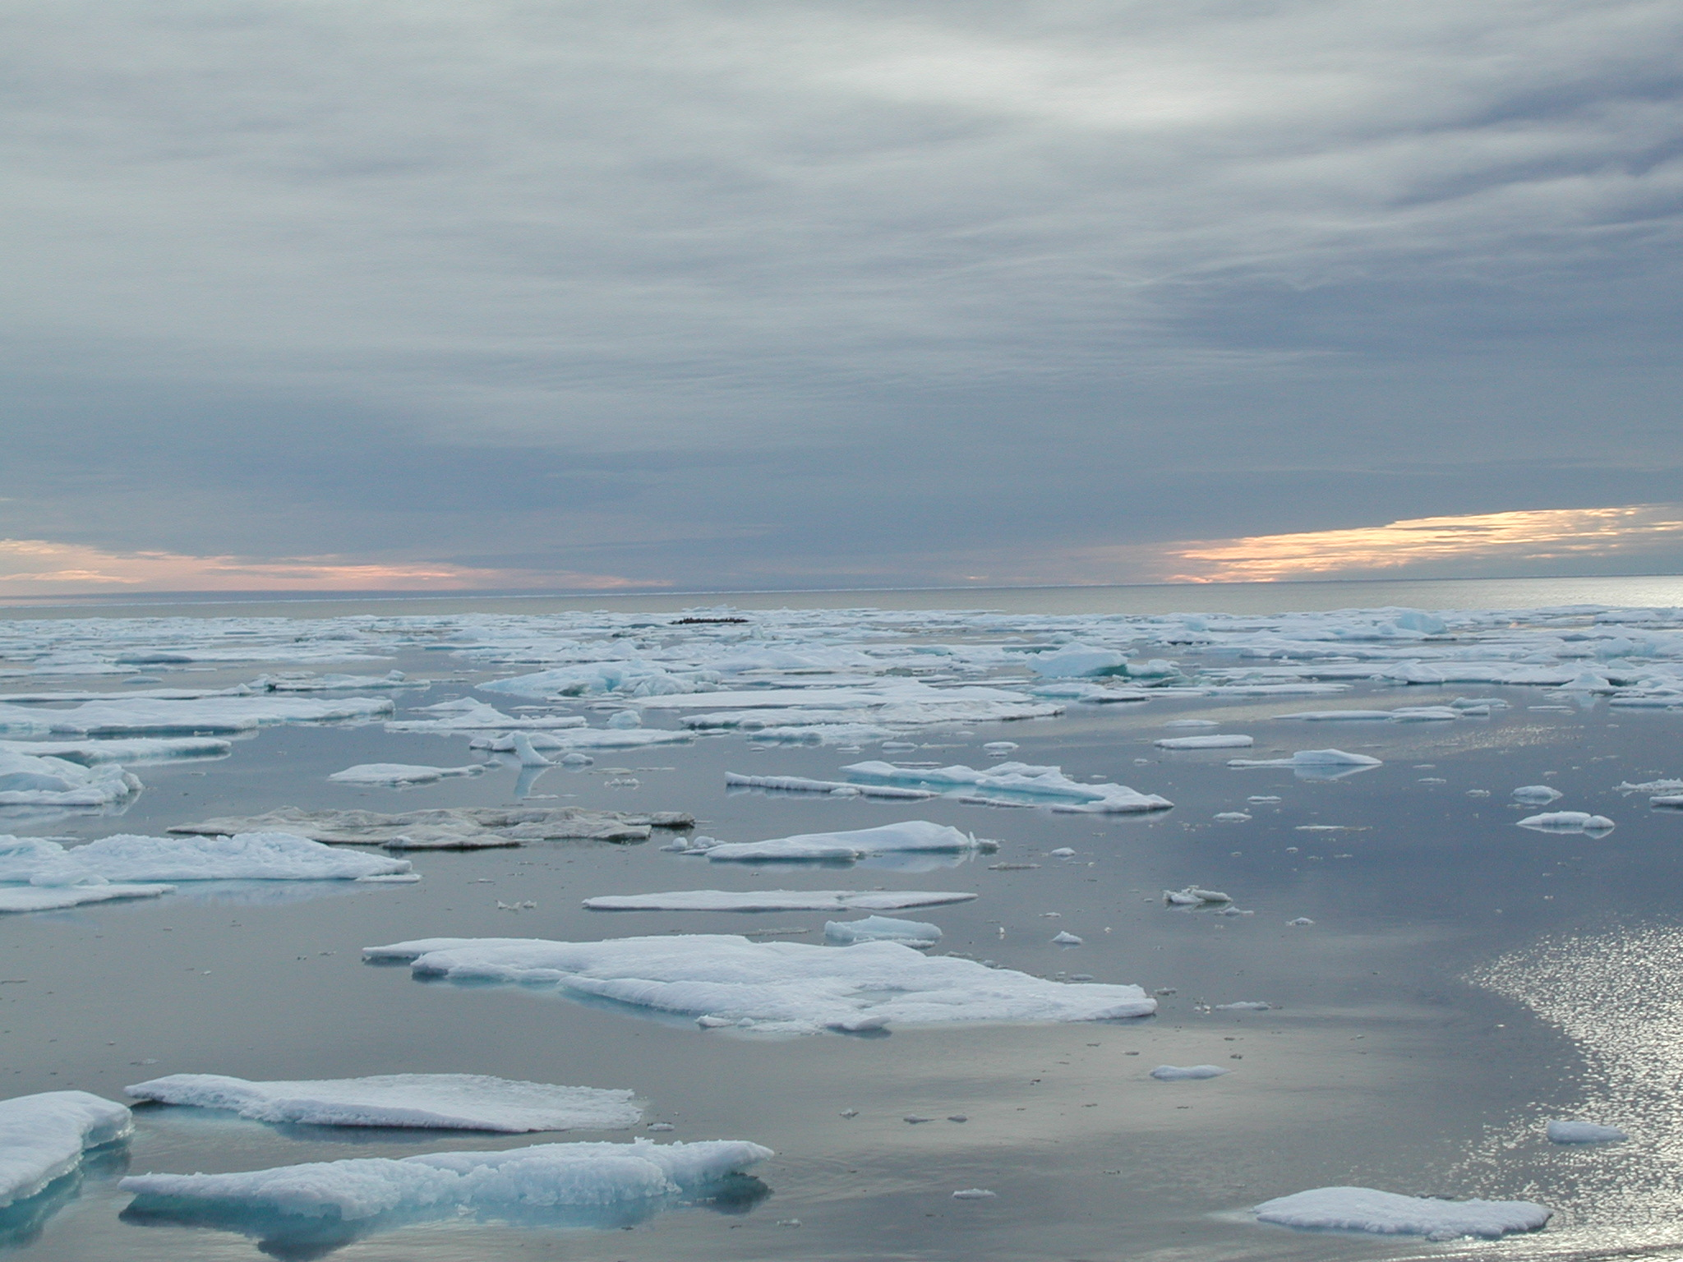
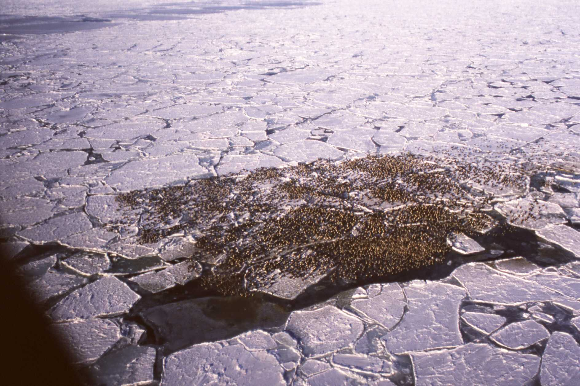
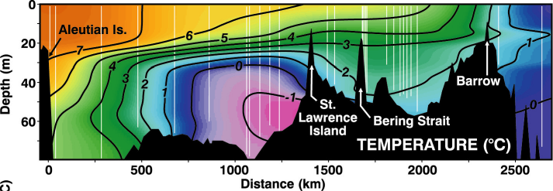
Threatened spectacled eiders keyed to sea ice and specific bivalves (DBO1)
feed on 3 species of bivalves
shallow shelf system, high cascade potential lower to higher trophic levels
ocean acidification potential dissolve bivalve shells
[courtesy Matt Sexson]
extent & duration cold pool (<0°C) critical to benthic infauna by exclusion of benthic fish and epibenthic predators
[Andrew Trites]
[Grebmeier et al. 2006, Science 311]
Notes:
The threatened spectacled eiders are a top trophic consumer of bivalves in the northern Bering Sea south of St. Lawrence Island. There are three major groups of bivalves consumed by these burds.

Slide 14
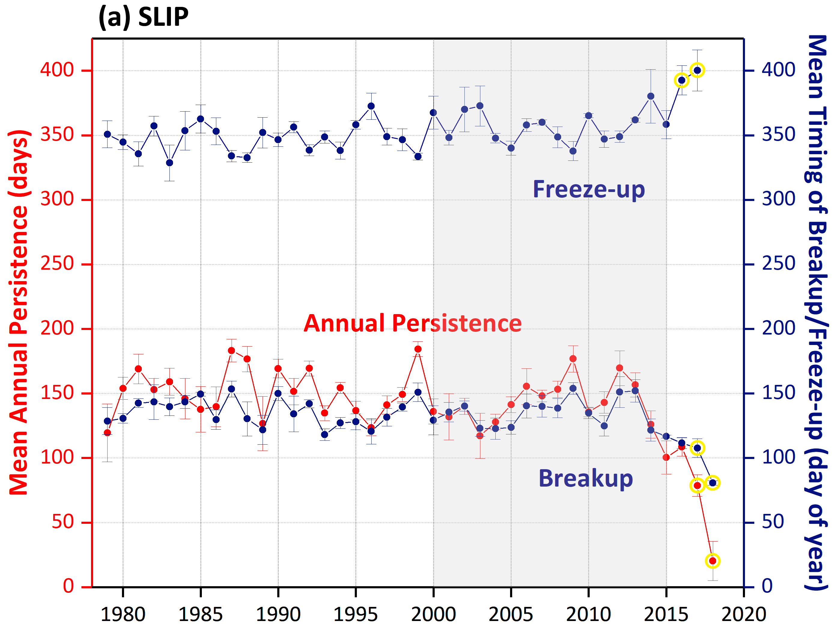
Sea ice trends (Freeze-up, Annual Persistence, and Breakup)
in the northern Bering Sea (DBO1)
DBO1
gray boxes outline the time period of the focused 1998-2015 macrofaunal biomass analysis
yellow circles indicate significant outliers at p<0.0001, using Grubb’s test for outliers
Notes:
Figure 2. Sea ice trends (Freeze-up, Annual Persistence, and Breakup) in the northern Bering Sea: (a) St. Lawrence Island Polynya region (SLIP) and Chirikov Basin (Chirikov), and southeastern Chukchi Sea (SECS) from 1979-2017 (to 2018 for SLIP). The gray boxes outline the time period of the focused 1998-2015 focused analysis of macrofaunal biomass for this paper showing the major decline starting of sea ice persistence in 2012. The yellow circles indicate significant outliers at p<0.0001, using the Mann-Kendall trend statistics.

Slide 15
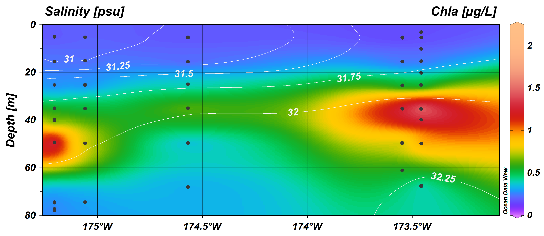
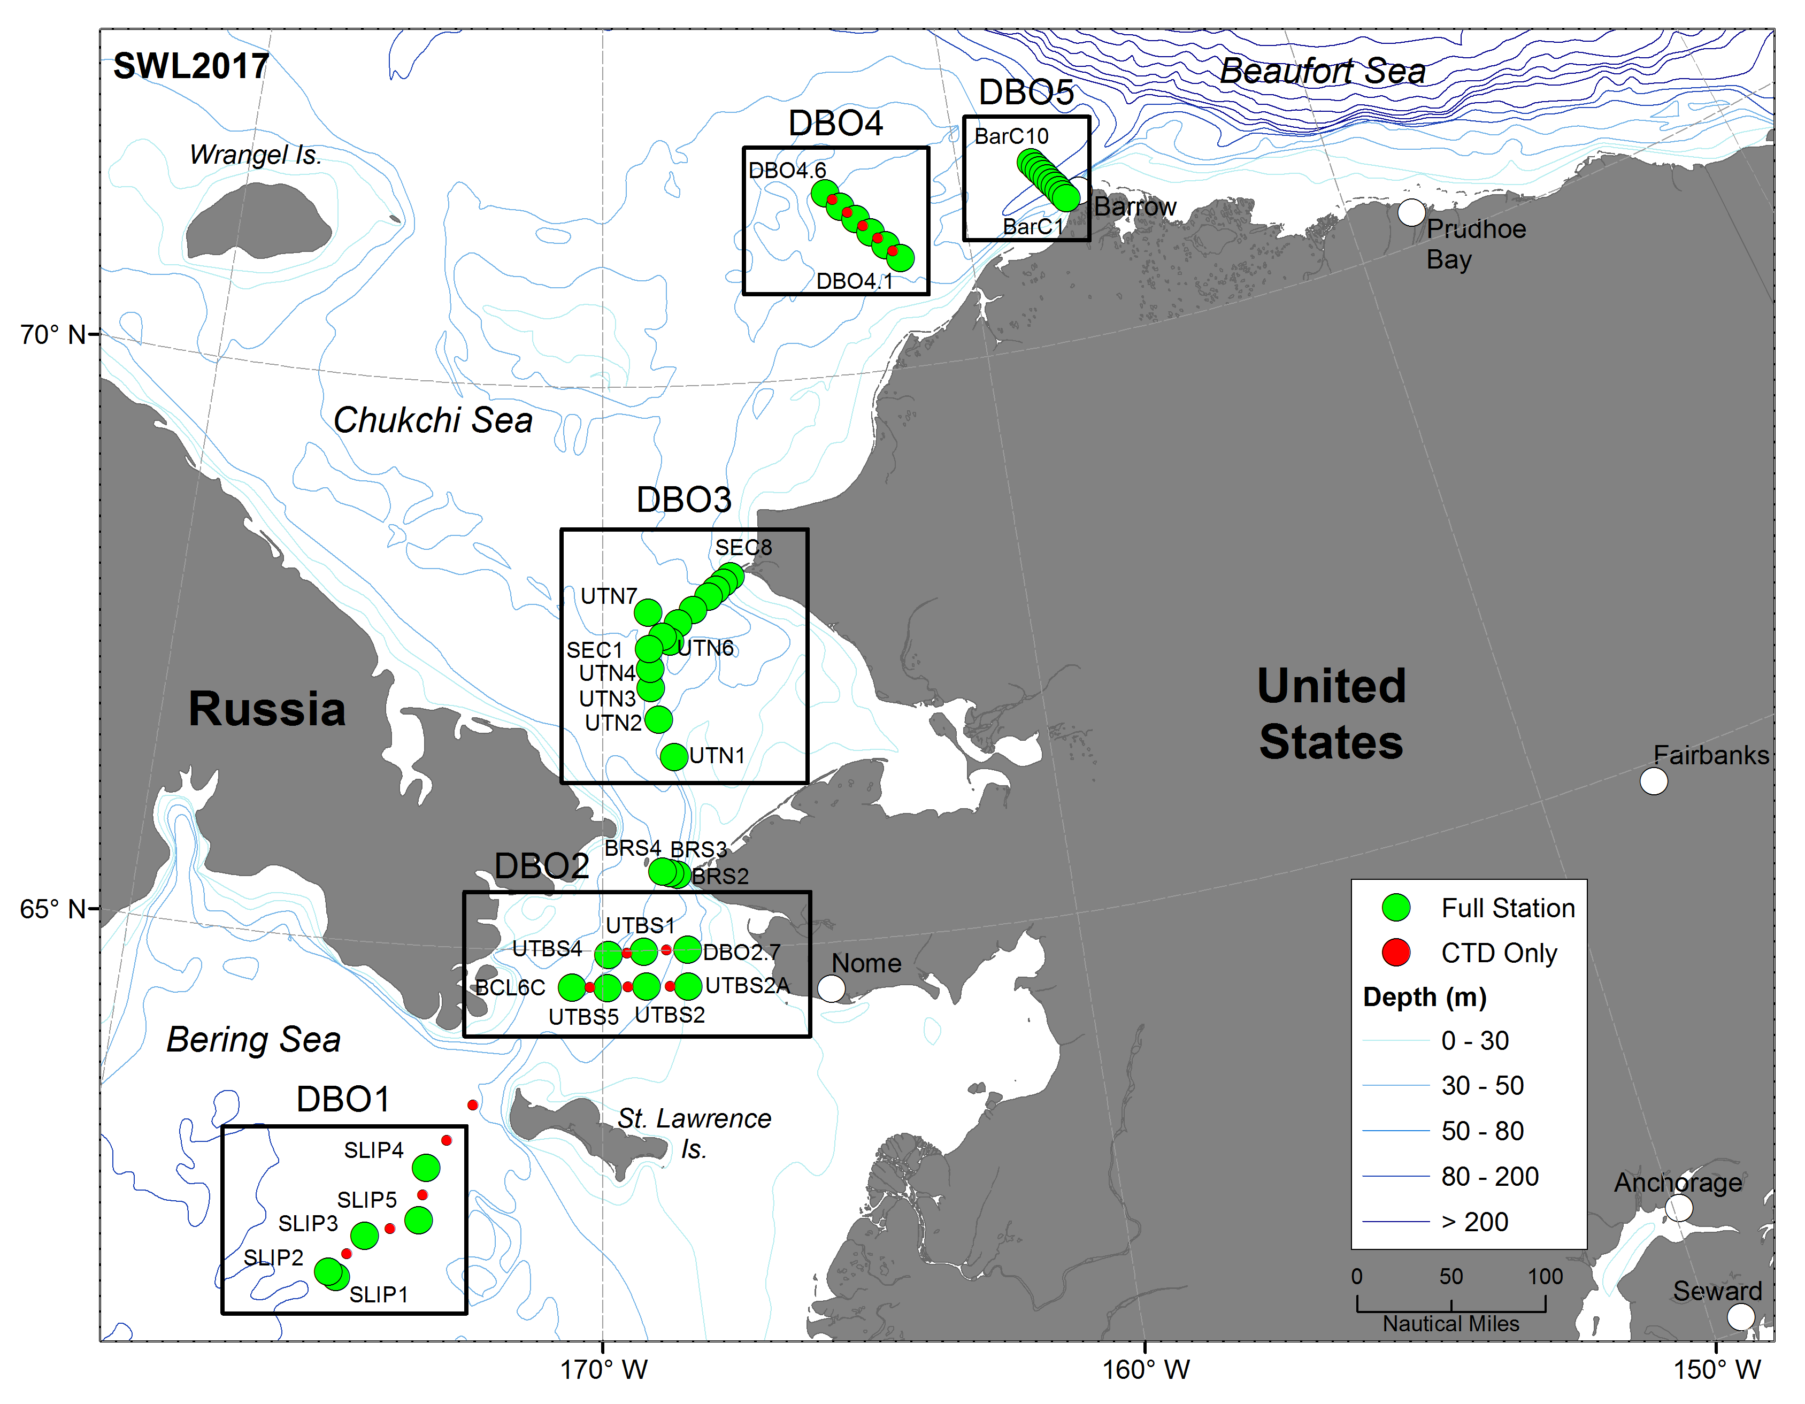
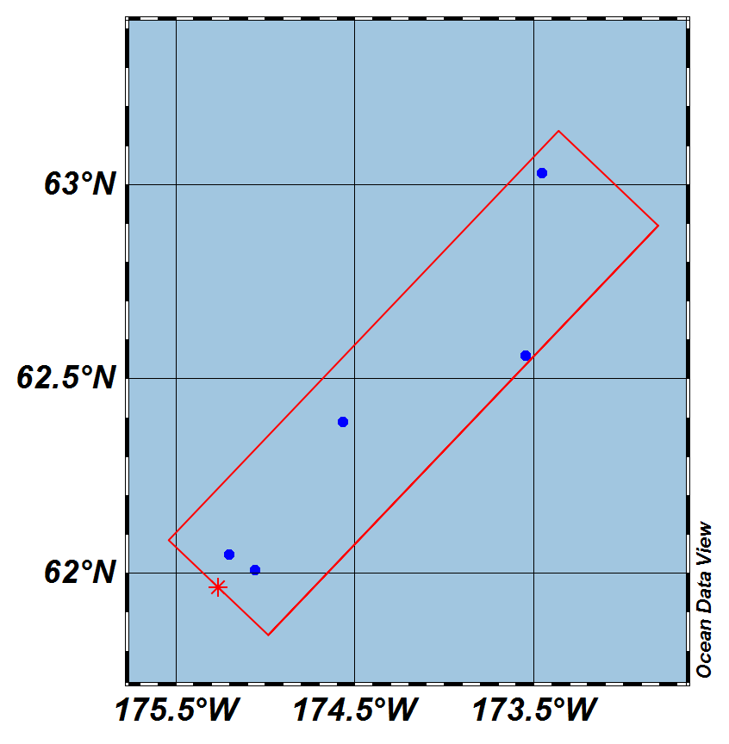
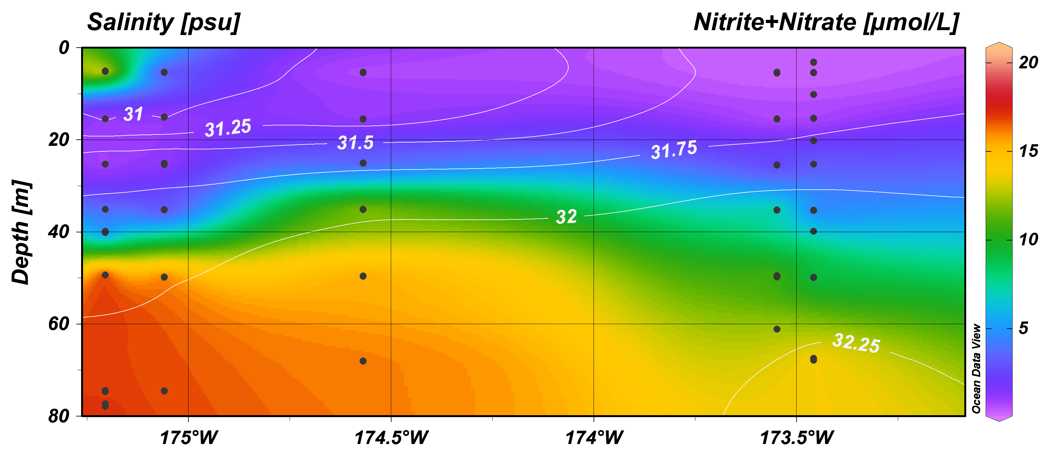
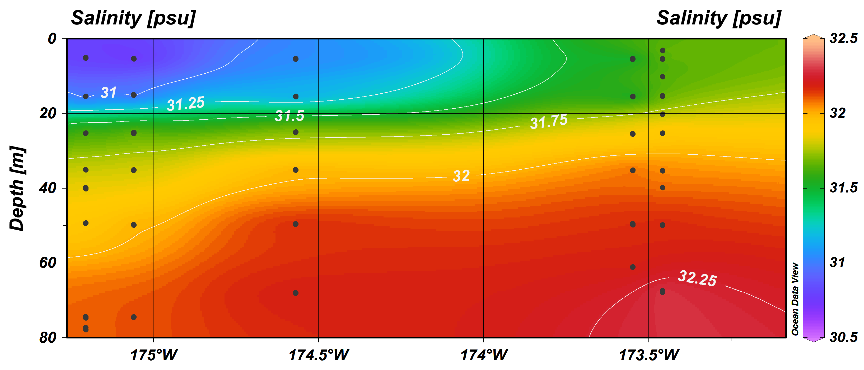
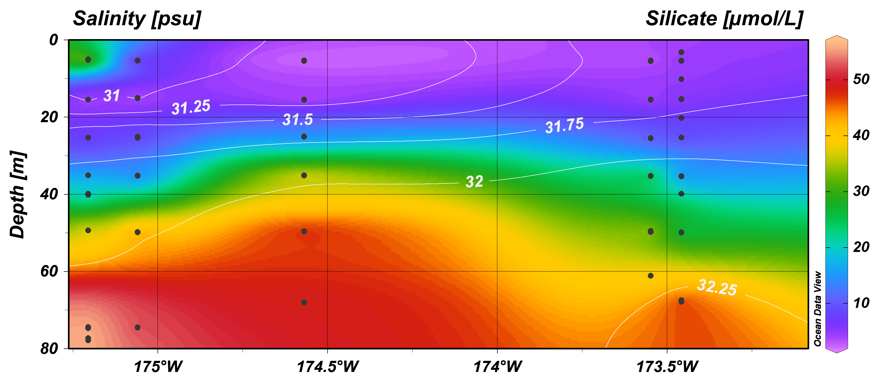
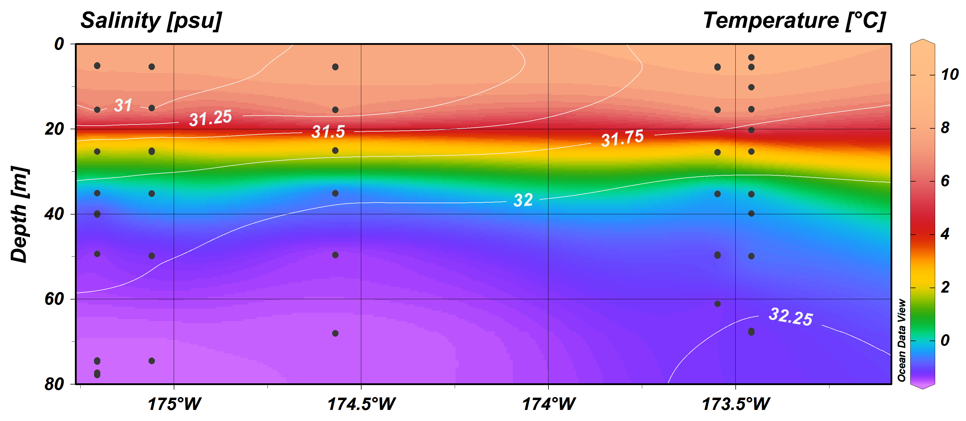
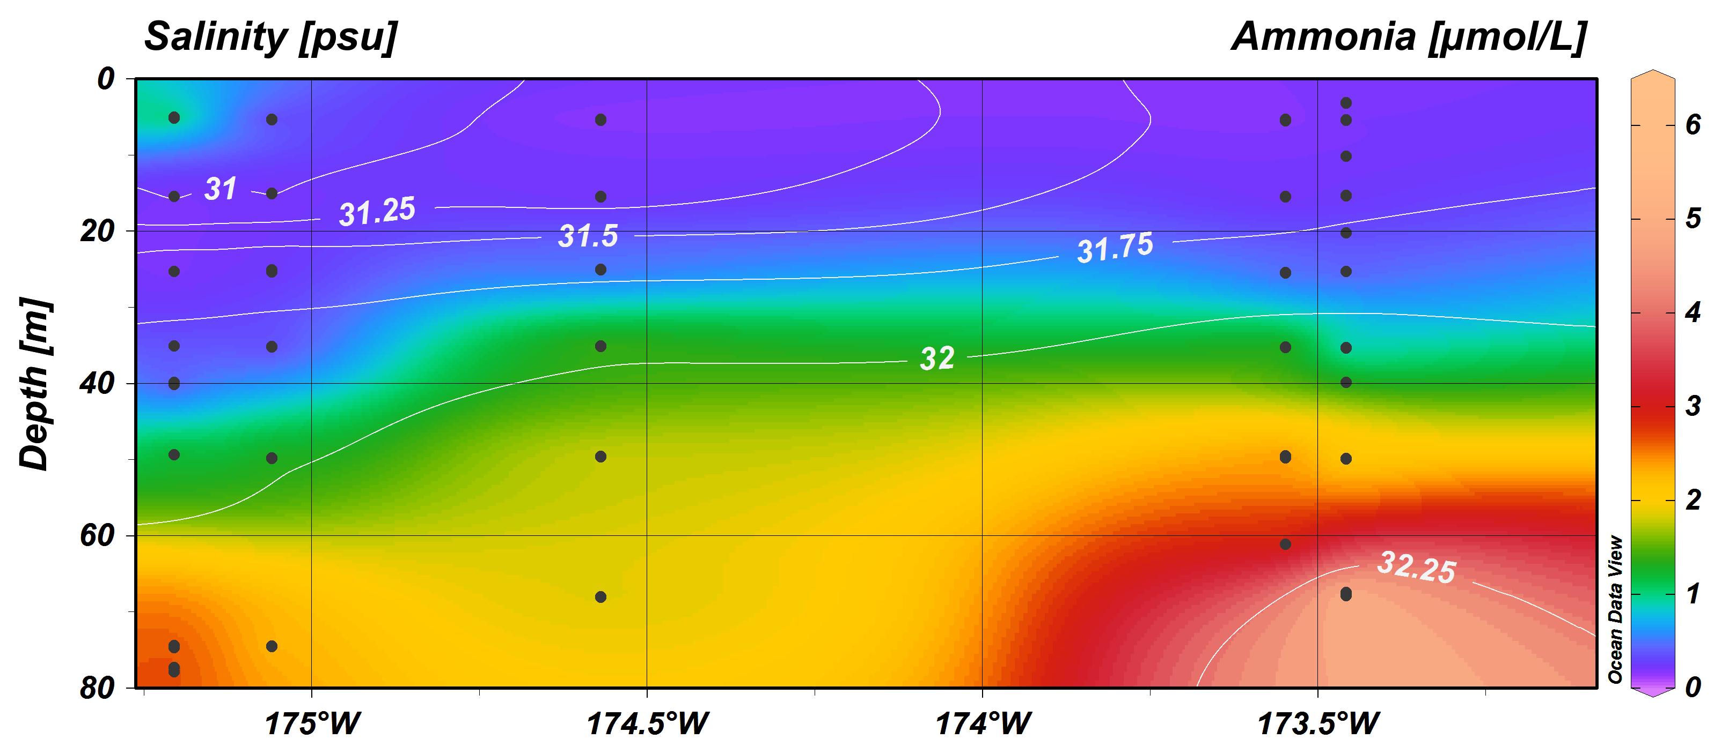
SWL July 2017-DBO1: Hydrography
Water temperature <0°C year-round
[Grebmeier, Cooper], Vagle]
Notes:
done

Slide 16
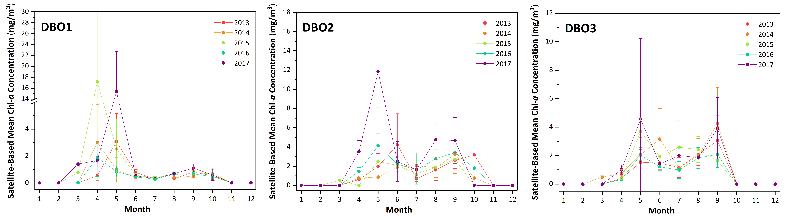
Satellite-based Chlorophyll a concentrations (mg/m²)
South of St. Lawrence Island (DBO1)
[courtesy K. Frey]

Slide 17

DBO1 - St. Lawrence Island Polynya region

Slide 18
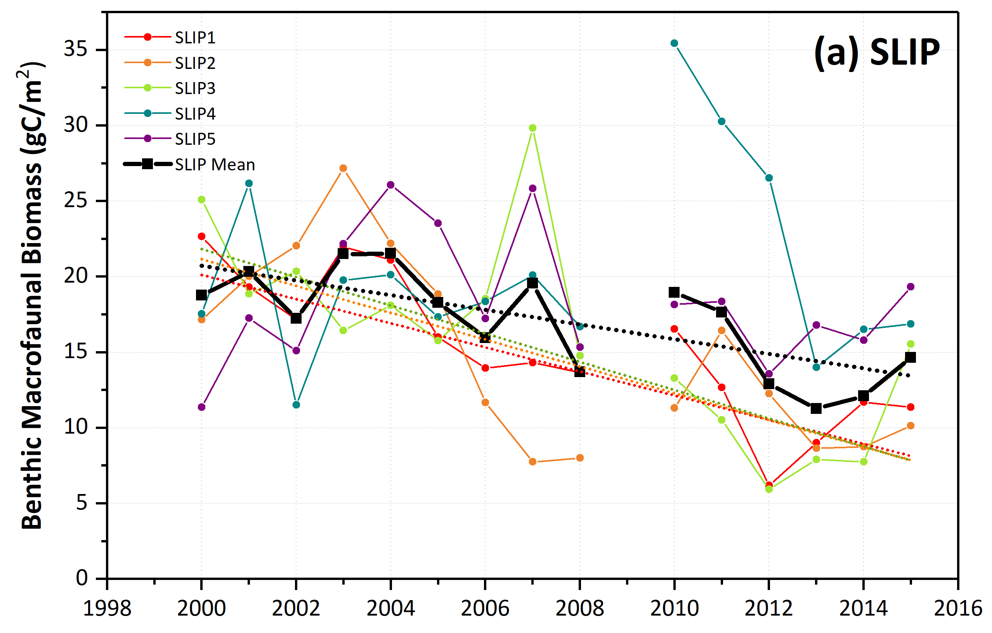
Time series benthic biomass for the DBO1 region
DBO1
Significant declining trend (dotted lines) in southern SLIP1-3 stations and average values using Mann-Kendall (Kendall’s tau) trend analysis (p<0.0001)

Slide 19
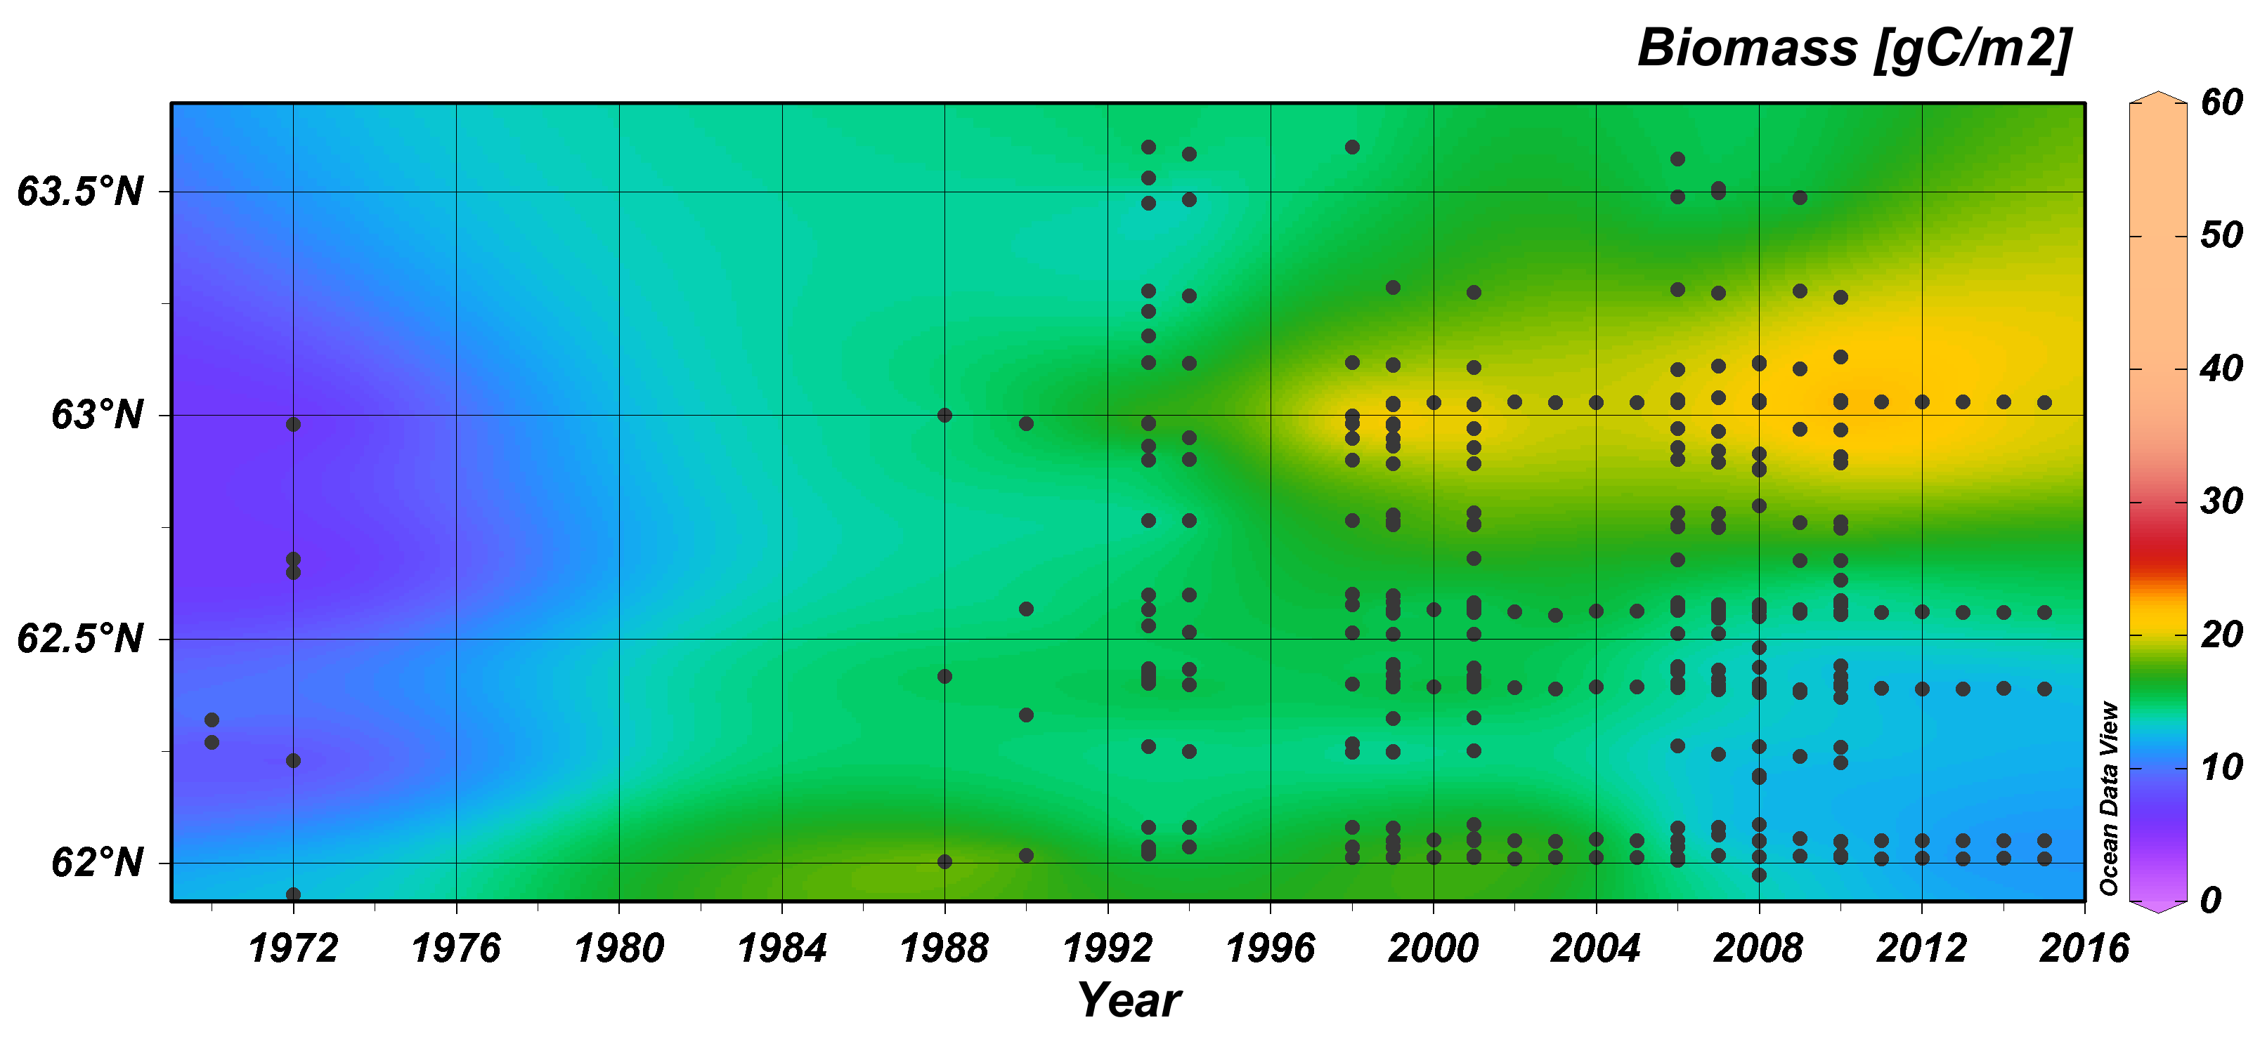
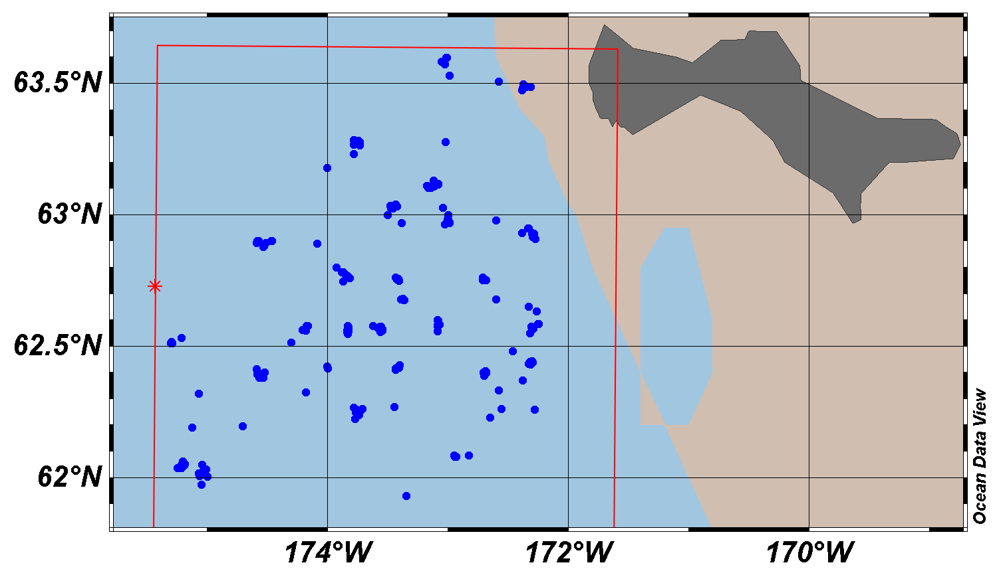
DBO1 - Benthic biomass in relation to full data series
1971-2015
4
5
SLIP
3
2
1
SLIP4
SLIP5
SLIP3
SLIP2
SLIP1
The 5 core time series sites (SLIP1-5) are indicated in black on both the station map
Northward movement of high biomass region
All sites dominated by bivalves (Nuculana radiata, Ennucula tenuis, and Macoma calcarea)
Notes:
order to have a statistically significant trend, it has to be more than just a single outlier that does it as seen if– so you can make the point that when it does detect a trend (like for your biomass values), it is robust/strong and not just reflective of a fleeting data point…
Note that to have a statistically significant trend, it has to be more than just a single outlier that does it, so when there is a significant trend detected (like for your biomass values), it is robust/strong and not just reflective of a fleeting data point

Slide 20
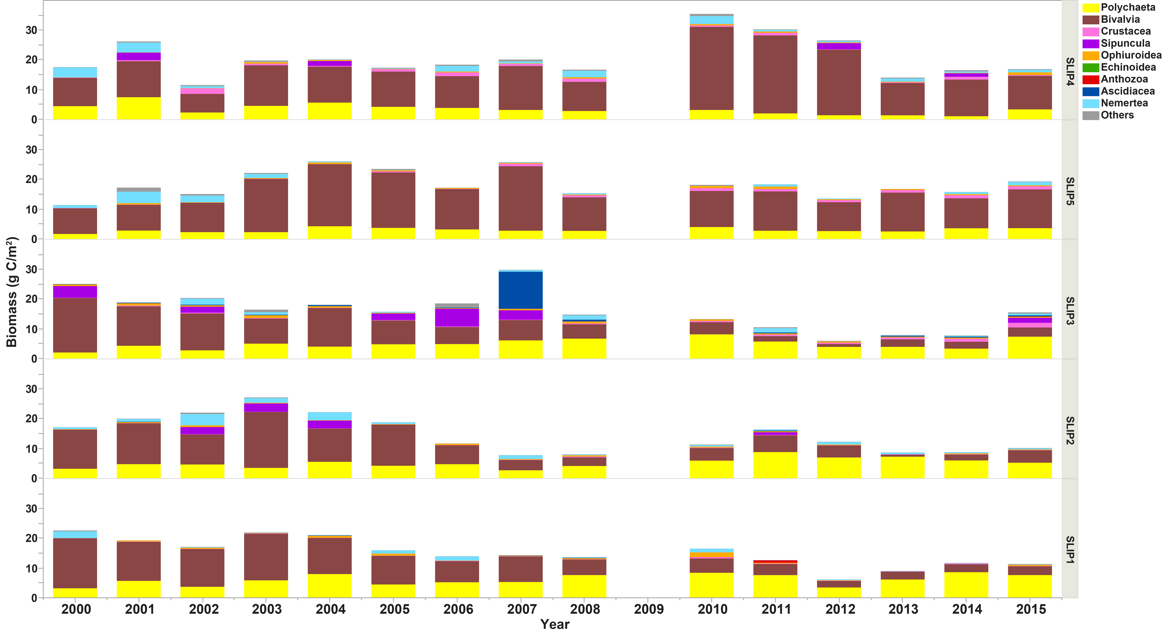
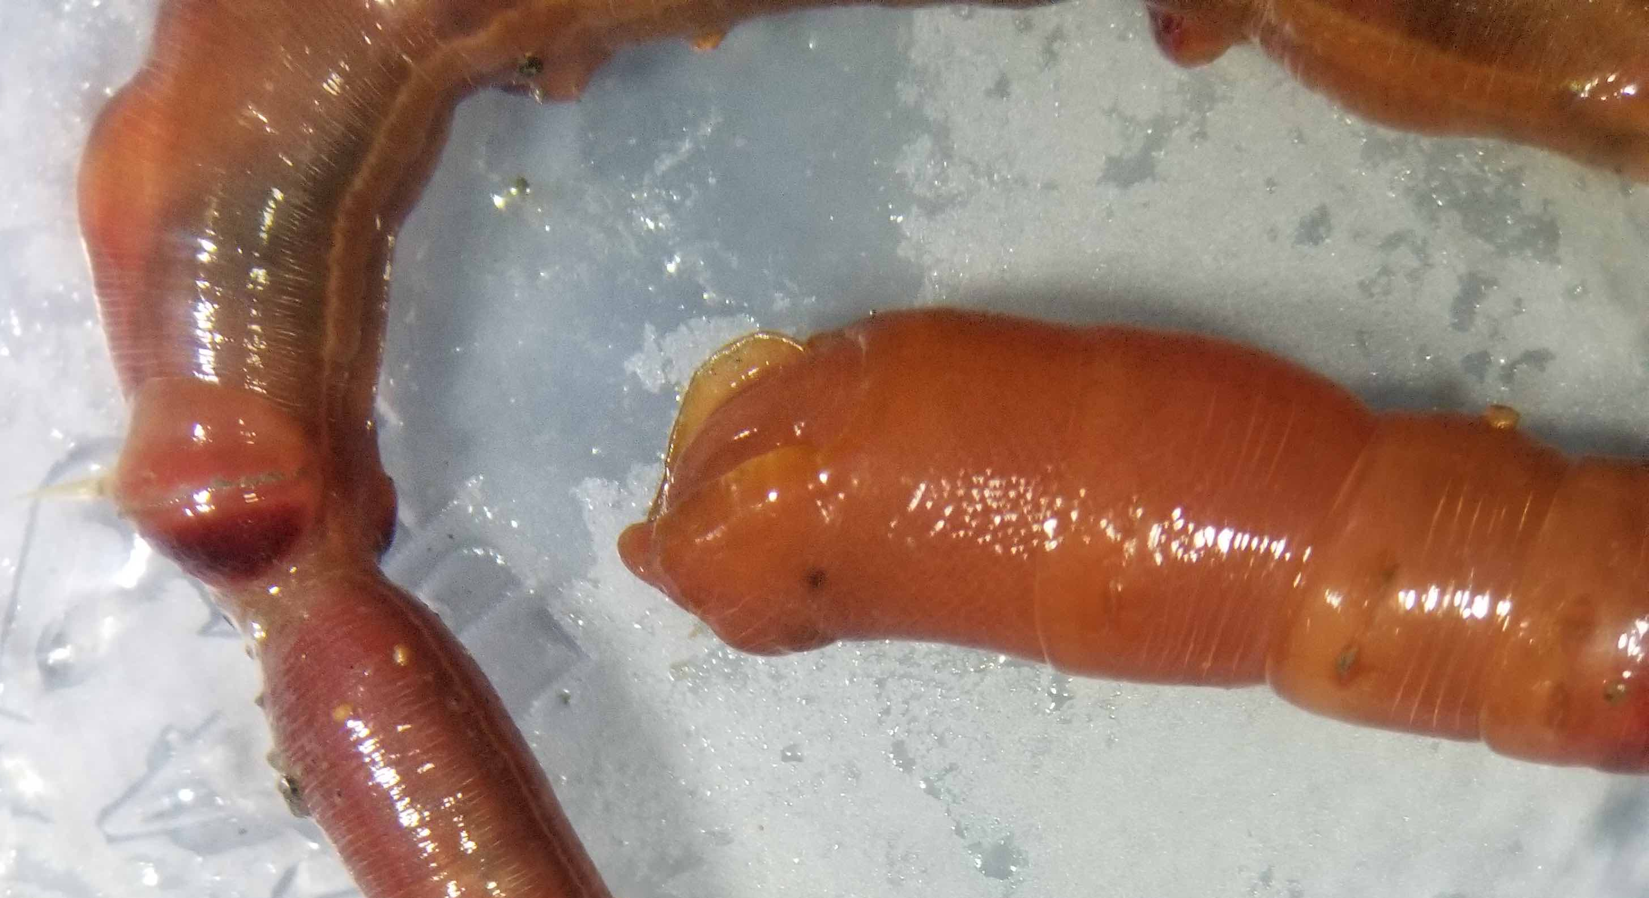
Macrofaunal composition for SLIP1-5 time series stations south of St. Lawrence Island from 2000-2015 (DBO1)
N
S
Station stacked from southern site (SLIP1) to northern site (SLIP4)
Note change in dominance from bivalves to polychaetes in 2008 in southern sites
Notes:
Figure 4. Distribution of macrofaunal composition(by % gC/m2 of total biomass) for the time series stations in the 3 regions: (a) SLIP, (b) Chirikov, and (c) SECS.

Slide 21
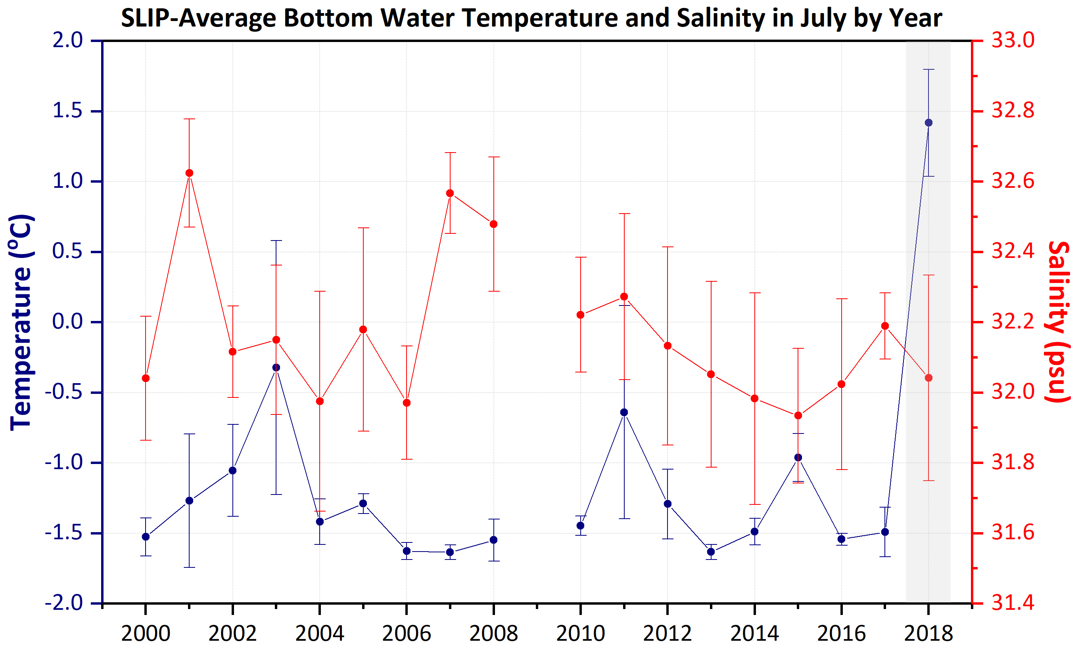
2018: A Tipping Point for the Northern Bering Sea (DBO1)?
Gray shading: SLIP1-5 stations in 2018 had a BW temperature that was a statistically significant outlier, without any standard deviation (s.d.) bar overlap
Although salinities are getting fresher in SLIP in July, they still have overlapping s.d. bars
Notes:
order to have a statistically significant trend, it has to be more than just a single outlier that does it as seen if– so you can make the point that when it does detect a trend (like for your biomass values), it is robust/strong and not just reflective of a fleeting data point…
Note that to have a statistically significant trend, it has to be more than just a single outlier that does it, so when there is a significant trend detected (like for your biomass values), it is robust/strong and not just reflective of a fleeting data point

Slide 22
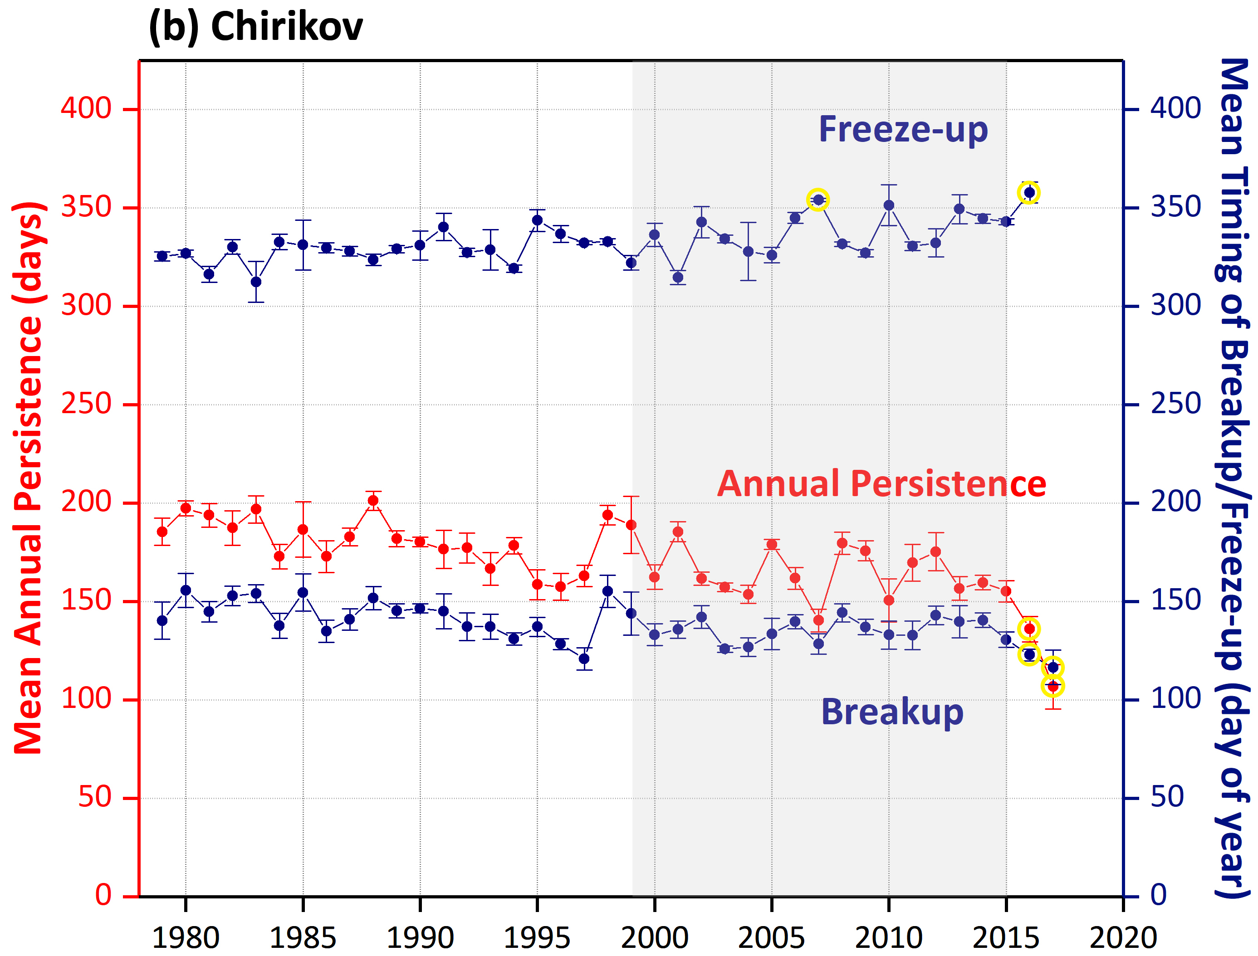
Sea ice trends (Freeze-up, Annual Persistence, and Breakup) in the Chirikov Basin (DBO2)
DBO2
gray boxes outline the time period of the focused 1998-2015 macrofaunal biomass analysis; yellow circles indicate significant outliers at p<0.0001, using Grubb’s test for outliers
Notes:
Figure 2. Sea ice trends (Freeze-up, Annual Persistence, and Breakup) in the northern Bering Sea: (a) St. Lawrence Island Polynya region (SLIP) and Chirikov Basin (Chirikov), and southeastern Chukchi Sea (SECS) from 1979-2017 (to 2018 for SLIP). The gray boxes outline the time period of the focused 1998-2015 focused analysis of macrofaunal biomass for this paper showing the major decline starting of sea ice persistence in 2012. The yellow circles indicate significant outliers at p<0.0001, using the Mann-Kendall trend statistics.

Slide 23
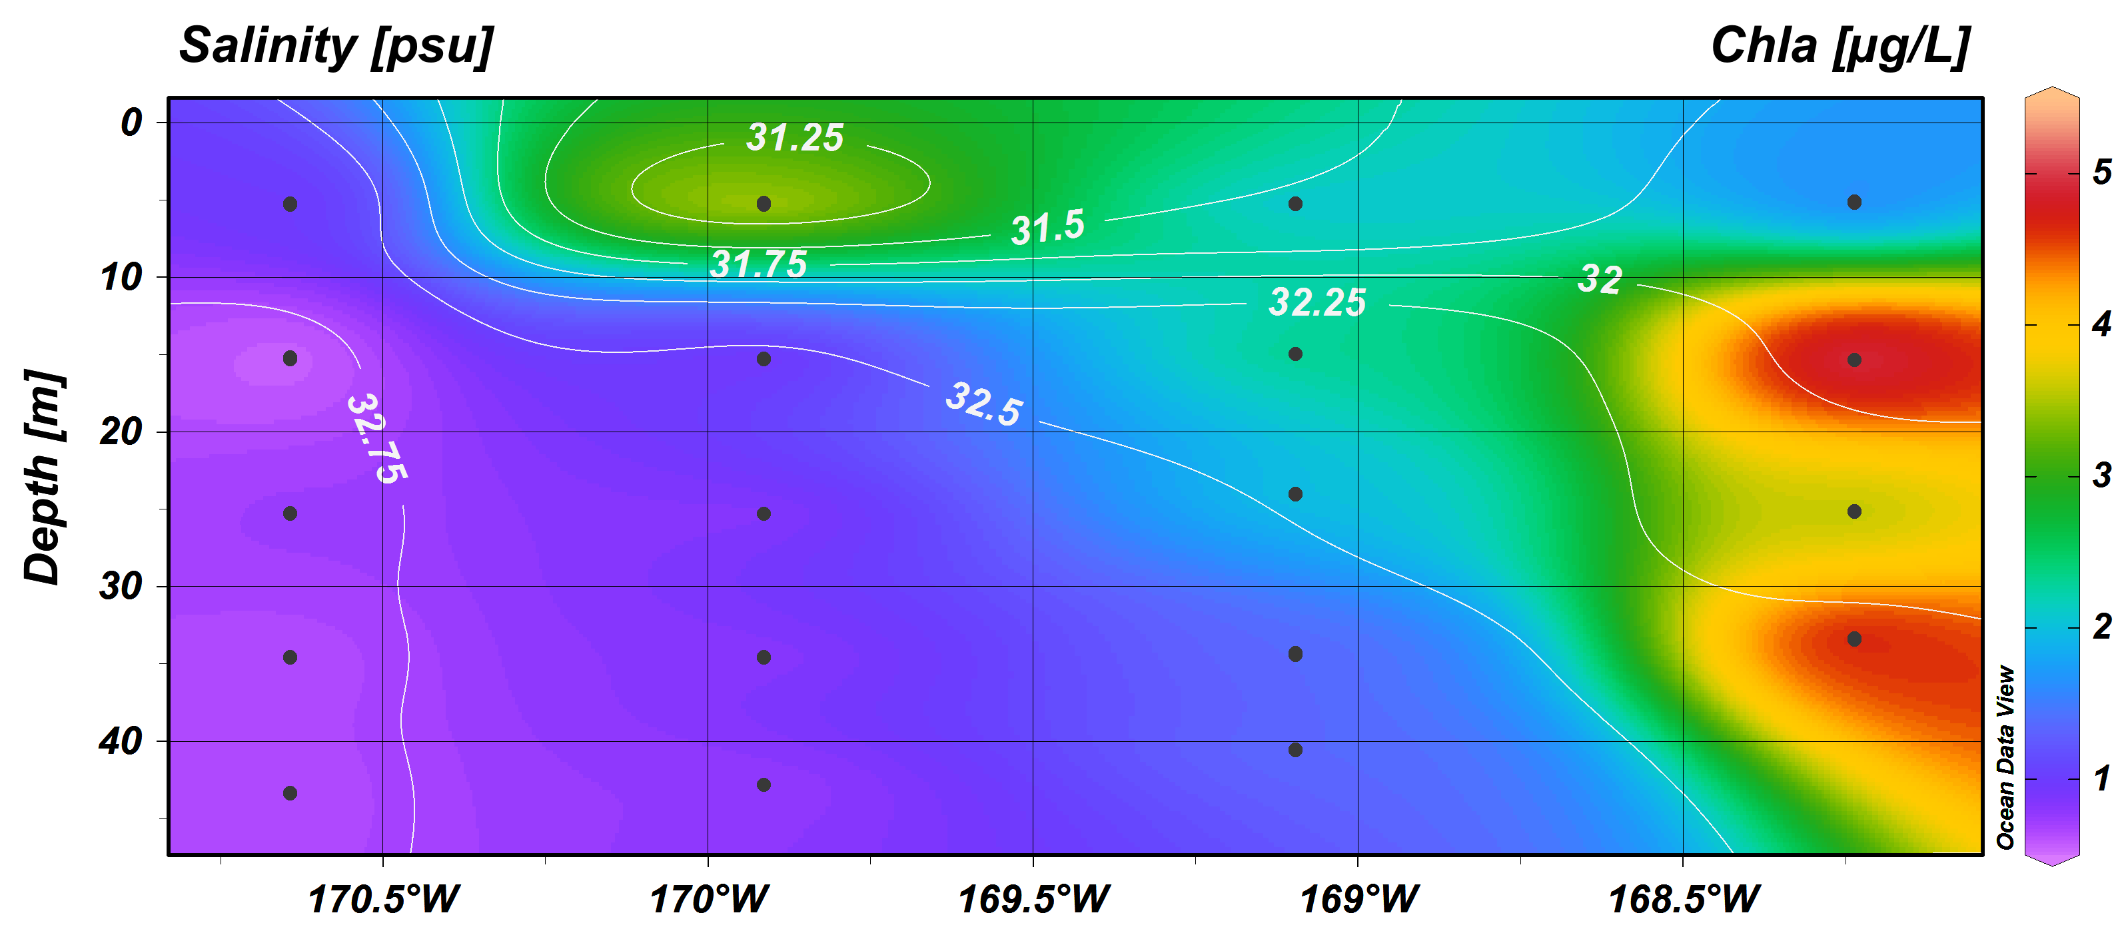
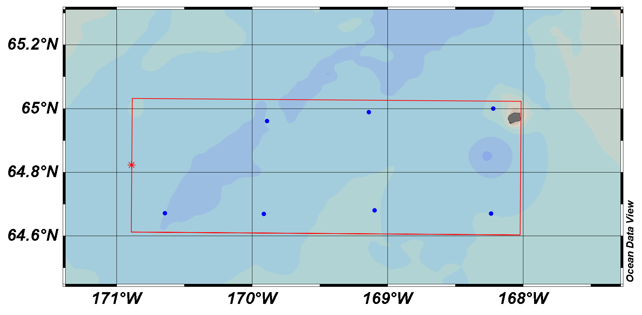
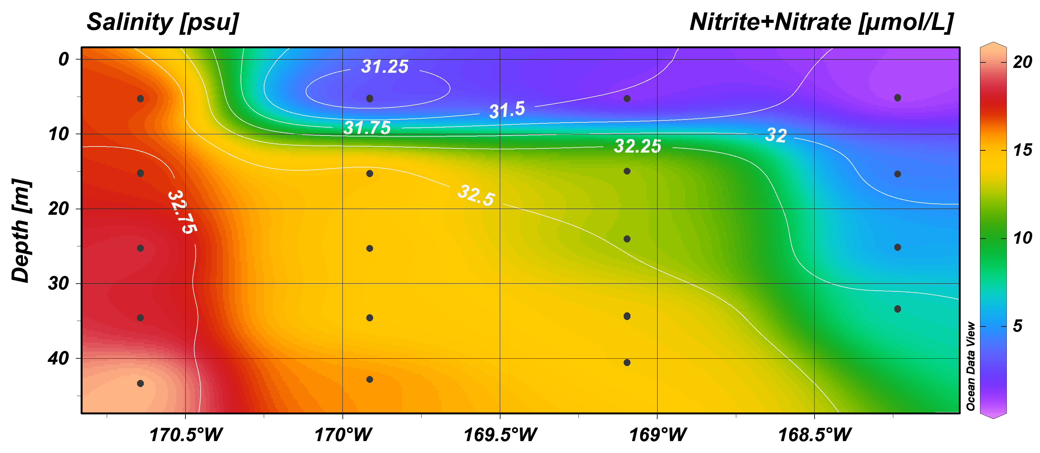
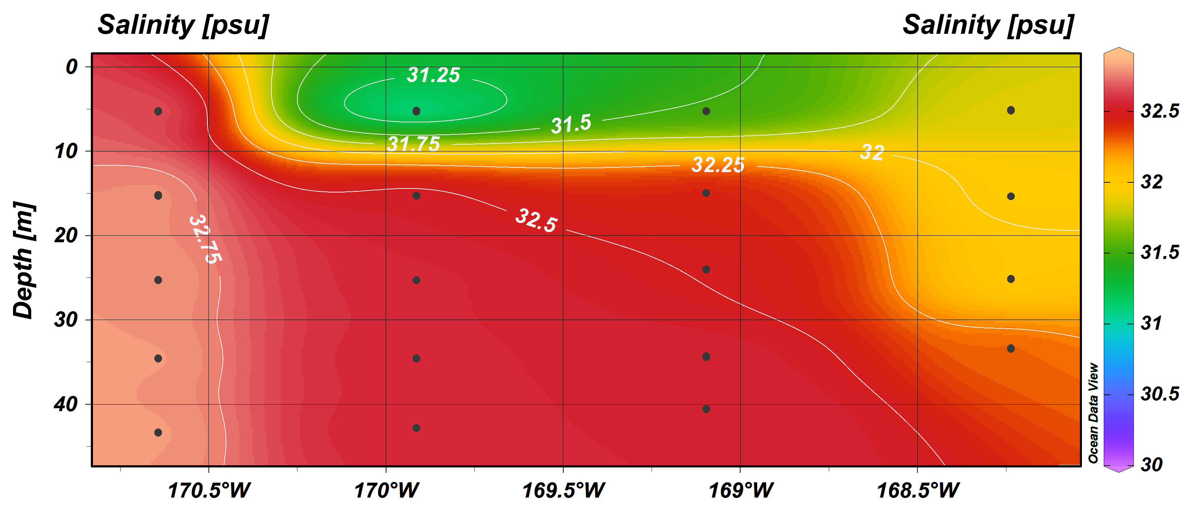
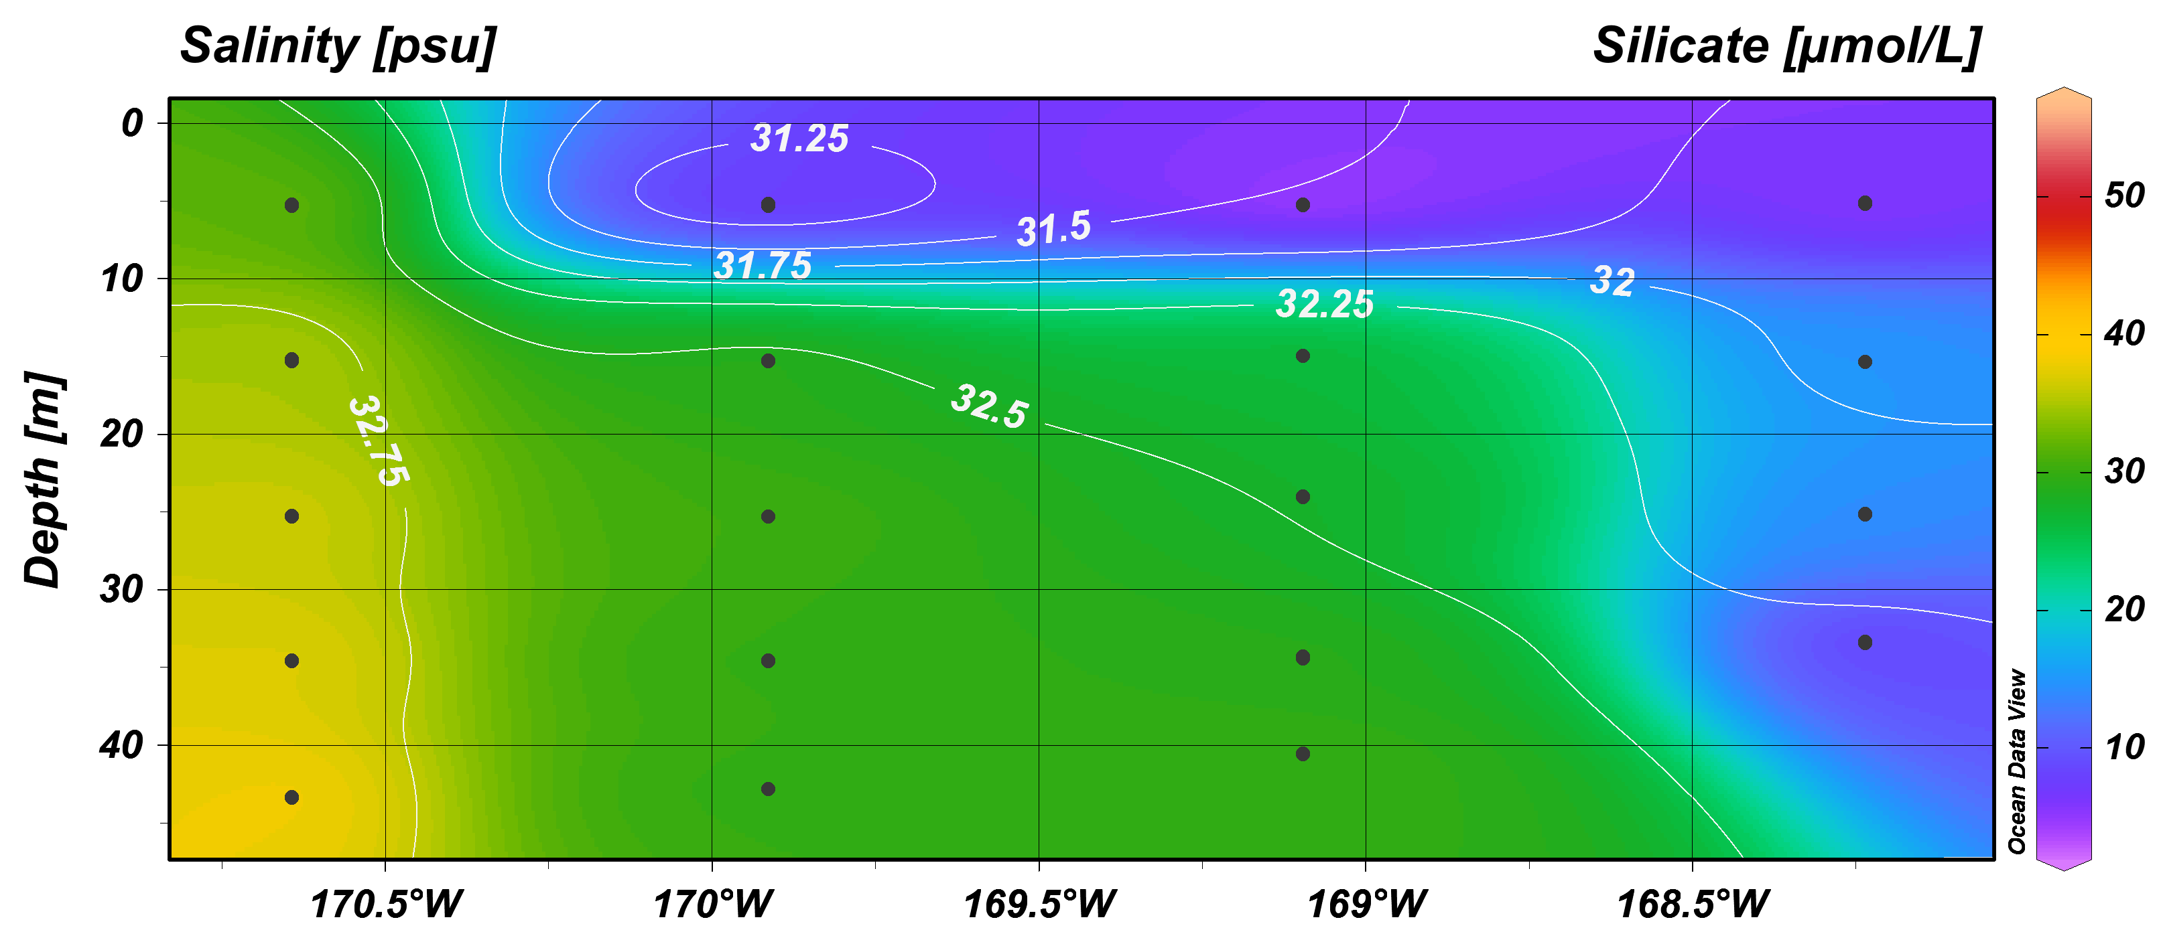
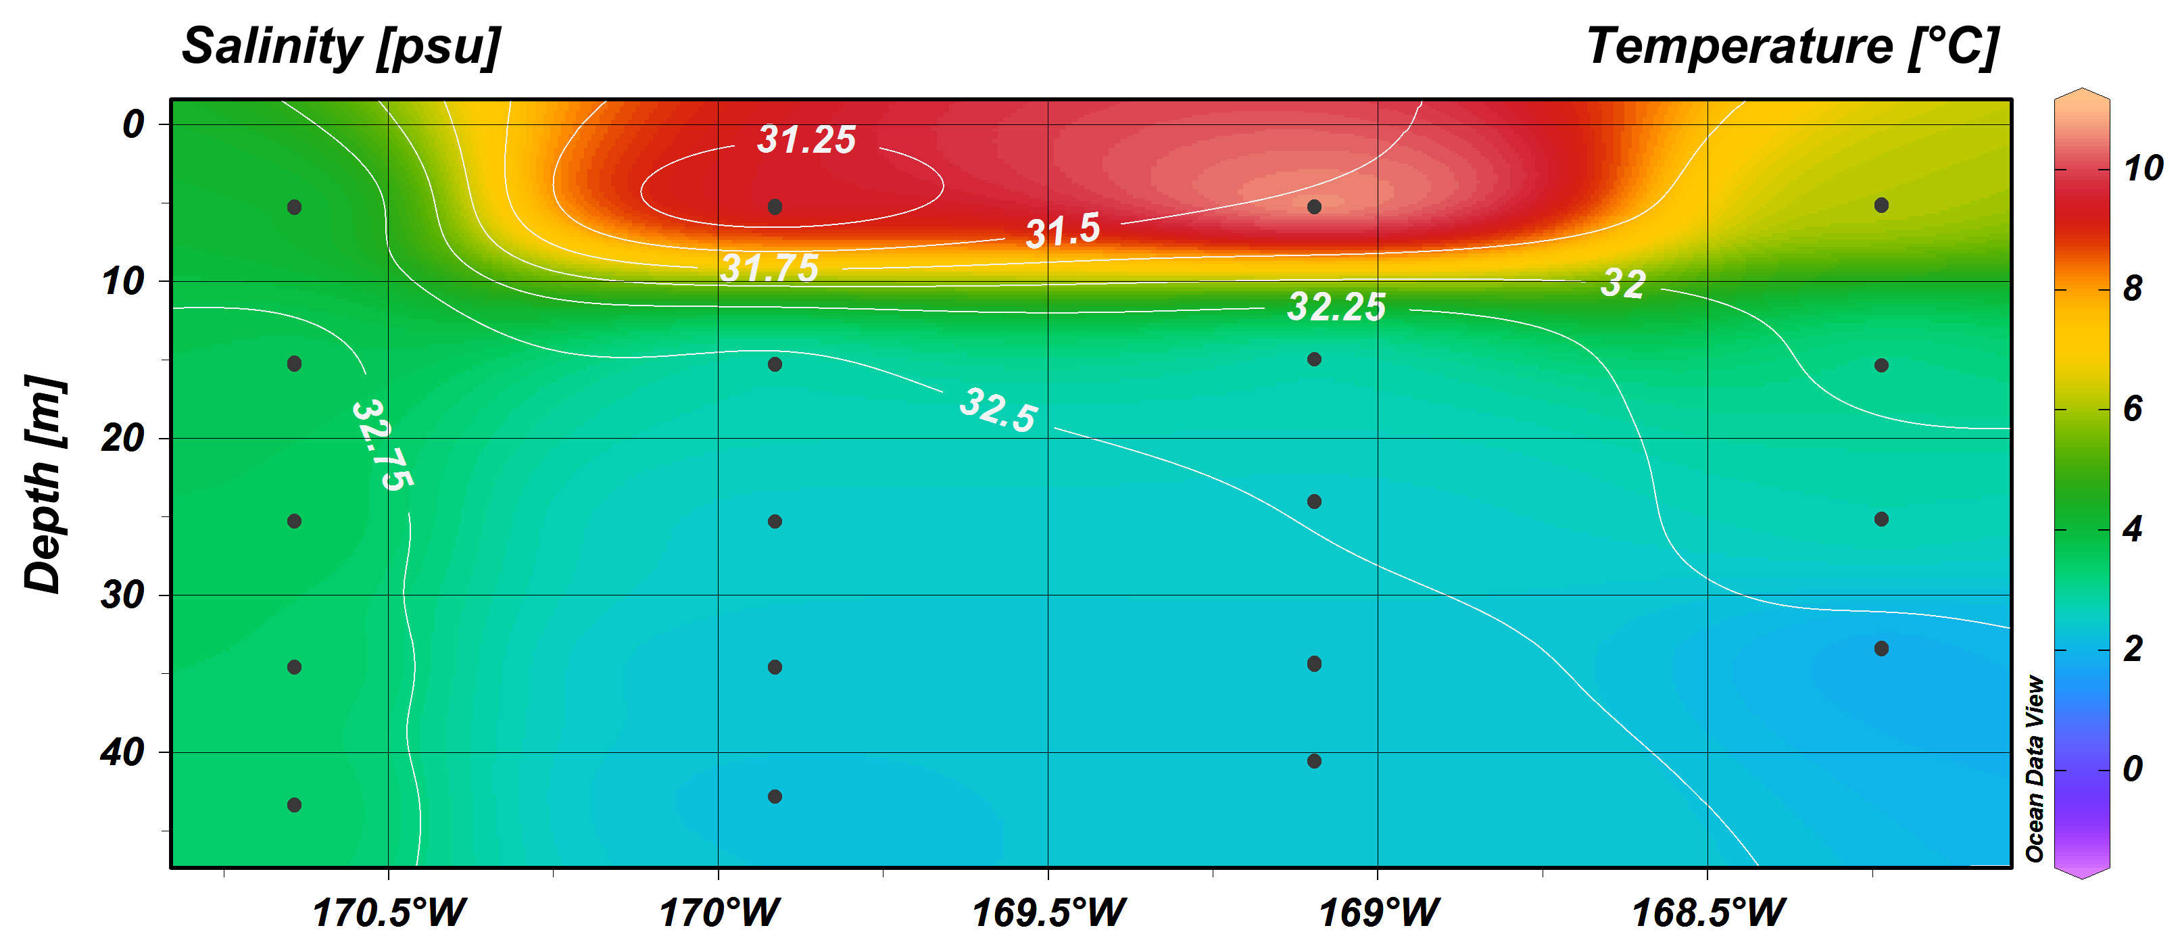
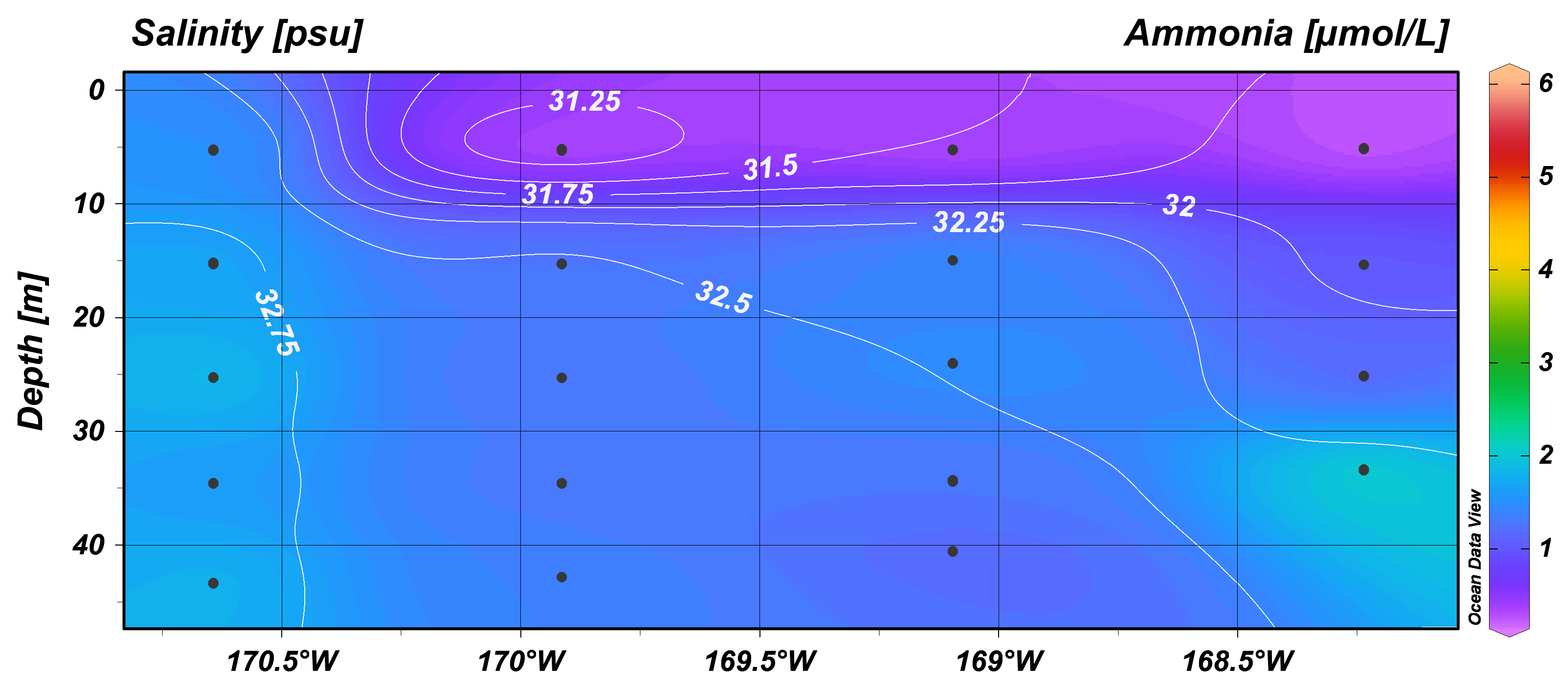
SWL July 2017-DBO2: Hydrography
Water temperature ~2-4°C
[Grebmeier and Cooper]

Slide 24
Satellite-based Chlorophyll a concentrations (mg/m²) in the
Chirikov Basin, north of St. Lawrence Island (DBO2)
[K. Frey]

Slide 25
DBO2-Chirikov Basin

Slide 26

Time series benthic biomass for the DBO2 region
(NE)
DBO2
(SE)
(NW)
(SW)
Only significant decliining benthc biomass trend UTBS4 (NW)-now bivalves
Complexity over time in W (bivalves, polychaetes) to E (amphipods)

Slide 27


DBO 2 - Chirikov Basin ampeliscid amphipod prey hotspot contracting spatially northward
[Kate Stafford]
2000-2015
Northward direction of core benthic biomass of amphipods in hotspot
Polychaetes and bivalves replacing amphipods in the SW and NW, respectively

Slide 28

Macrofaunal composition for UTBS1-4 time series stations north of St. Lawrence Island from 2000-2015 (DBO2)
NE
SE
NW
SW
Station stacked spatially from UTBS5 (SW) and UTBS4 (NW) and UTBS2 (SE) and UTBS1 (NE)
UTBS5 (lower graph) was dominated by ampeliscid amphipods in the 1980s, but changed to bivalves in the early 2000s and polychaetes became dominant from 2003

Slide 29







SWL July 2017: DBO3-Hydrography
Water temperature ~4°C
[Grebmeier and Cooper]

Slide 30
Satellite-based Chlorophyll a concentrations (mg/m²)
SE Chukchi Sea (DBO3)
[courtesy K. Frey]

Slide 31

Sea ice trends (Freeze-up, Annual Persistence, and Breakup)
in the Chirikov Basin (DBO3)
DBO3
Significant declining trend all sea ice parameters using Kendal tau’s trend analysis

Slide 32

Time series benthic biomass in the DBO3 region
DBO3
Significant increasing trend at UTN1 (S) and UTN5 (N), as well as average values
Expanding high biomass region spatially since 2012

Slide 33
DBO3-SE Chuckhi Sea

Slide 34

Macrofaunal composition for UTN1-7 time series stations in Southeast Chukchi Sea from 2000-2015 (DBO3)
N
S
Station stacked latitudinally from UTN1 in the south to UTN7 in the north
Large biomass expansion southward from UTN5 to UTN2 since 2012 coincident with observations of increased primary production in SECS (Arrigo and van Dijken 2015)

Slide 35

Trends in benthic macrofaunal biomass at time series sites in
DBO1, DBO2, and DBO3
* indicates significant trend, p <0.05

Slide 36


Conceptual Models
[Moore and Stabeno 2015]
[Grebmeier et al. 2015]
Need to capture seasonality in carbon production and deposition, advection, and freshwater inflow into modeling activities
Develop models to include biological parameters, temporally and spatially, as response indicators to ecosystem change
(AMP)
Courtesy of Jack Cook (WHOI Graphics)
[Feng et al. 2018]
Ice-Ocean-Biogeochemical Model
Biology-Ice-Ocean Modeling & Assimilation System (BIOMAS) ^{[2]}:
Dynamically coupled sub-models for sea ice/snow, ocean circulation, biogeochemical cycling, and ice algae;
Climate Forecast System (CFS) reanalysis forcing;
Data assimilation for sea ice concentration (SIC) and sea surface temperature (SST).
~10 km horizontal resolution.
Ice algae
2 P
3 Z
3 N + Si
2 D
A simplified schematic of the 11-component Nutrient-Phytoplankton-Zooplankton-Detritus (NPZD) model
Daily physical and biological variables in two contrasting years 2007 and 2008 were analyzed and presented.

Slide 37

[Moore et al. 2018 in press]

Slide 38
Summary
Biological sampling across a range of spatio-temporal scales is required to detect ecological shifts in response to environmental forcing
Repeat time and space collections of various environmental and biological parameters, coincident with process studies, is allowing us to evaluate seasonality and interannual Arctic ecosystem status and trends
Strong need for time series analyses in multiple components of the biological and biogeochemical system in relation to changes in physical forcing factors
Benthic macrofaunal time series data indicate a northward shift in benthic biomass in the persistent biological hotspot areas in the Bering Strait region
Tracking macrofaunal prey base with associated seasonal benthivore feeding and movement providing insight of ecosystem status and trends at the subarctic-arctic interface in the Pacific Arctic

Slide 39





Thank you for your attention.
Questions and comments?
Thank you to all Pacific Arctic Region science colleagues and DBO collaborators, field and laboratory technicians over the years for the time series efforts. Financial support for the science provided by the US NSF, NOAA, BOEM, NASA, and ongoing international science partners in the Pacific Arctic Group.
http://www.arctic.noaa.gov/dbo/
http://pag.arcticportal.org/

Slide 40
Thank You!
The next Arctic Research Seminar will be:
  30 October 2018: Karin Buhmann, Copenhagen Business School
Arctic Community Meeting Rooms will be available during the AGU Fall Meeting
  Reservations will open in late September
Please visit ARCUS online to find:
  ARCUS Seminar recordings:
  https://www.arcus.org/research-seminar-series/archive
  Information on how to become an ARCUS member:
  https://www.arcus.org/arcus/member-information
#ARCUSwebinar
Background photo by Ute Kaden

Slide 41
We welcome your feedback!
Please help us improve the Arctic Research Seminar Series by taking our short seminar evaluation survey at:
https://goo.gl/YZ3QsT
This link is available for webinar participants in the chat window.
This link will also be included in the follow-up email you will
receive once the seminar video recording has been posted online.
Background photo by Ute Kaden

