Slide 1
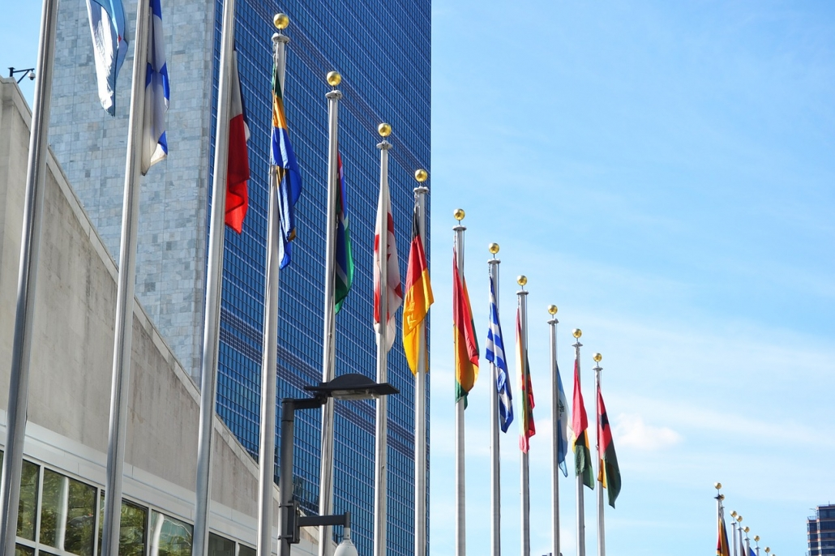
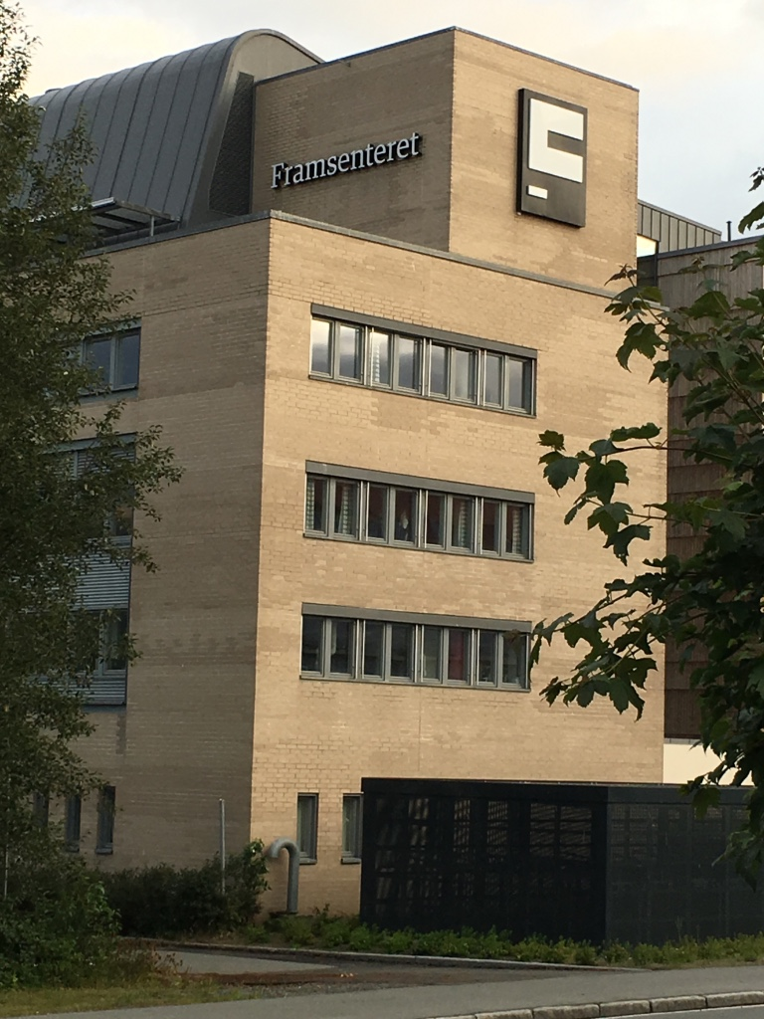
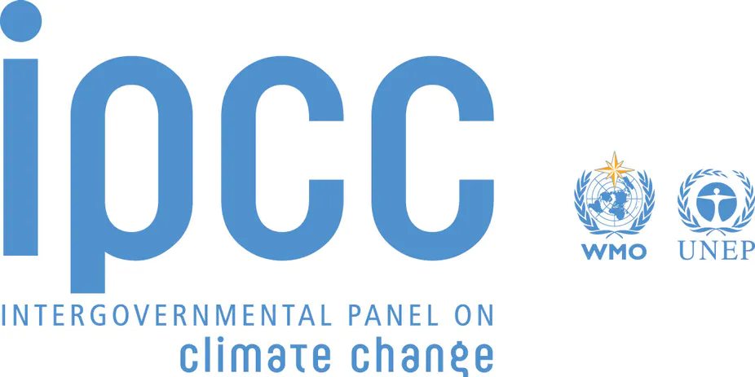
Question: How do Arctic researchers leverage their scientific research to affect outcomes in multilateral forums?
Kathryn C. Lavelle
Professor
Political Science
kathryn.lavelle@case.edu
(216) 368-2691
CWRU
10900 Euclid Avenue
Cleveland, OH 44106-7109
https://politicalscience.case.edu/faculty/kathryn-lavelle/

Slide 2
Concepts:
Multilateralism (the efforts of states at coordinating relations among themselves according to commonly agreed on principles ⁾
International Organization (formal institution established by treaty with states as members)
Science Diplomacy (link science and policy)
Examples:
United Nations, Arctic Council, Arctic Circle Assembly, etc.

