Slide 1




Industry needs for seasonal and sub-seasonal sea ice predictions: Canadian perspective
Adrienne Tivy
Canadian Ice Service
August 11, 2015

Slide 2
Outline
Brief overview of industry activity in Canadian ice infested waters (Gulf of St. Lawrence beyond scope)
Targeted interviews to identify stakeholder needs
Specific examples of stakeholder needs
Brief review of how needs are currently met
General summary
Suggestions for SIPN
Project is a work in progress, a final write-up will made public after circulation to all interview participants

Slide 3
Shipping in Canada’s Arctic
Type of Shipping | Transits 2010
Supply ships for Arctic communities | 30 cargo; 26 fuel
Mining | 7 cargo; 2 fuel
Oil and gas | 0
Tourism | 18
Wheat – port of Churchill | 22
Northwest passage transits | 0
Arctic only
Churchill shipping is in open water
Mining = FEDNAV
Greatest increase in short-term is expected to be mining industry
Fednav NWP in 2014
[data from WWF]

Slide 4
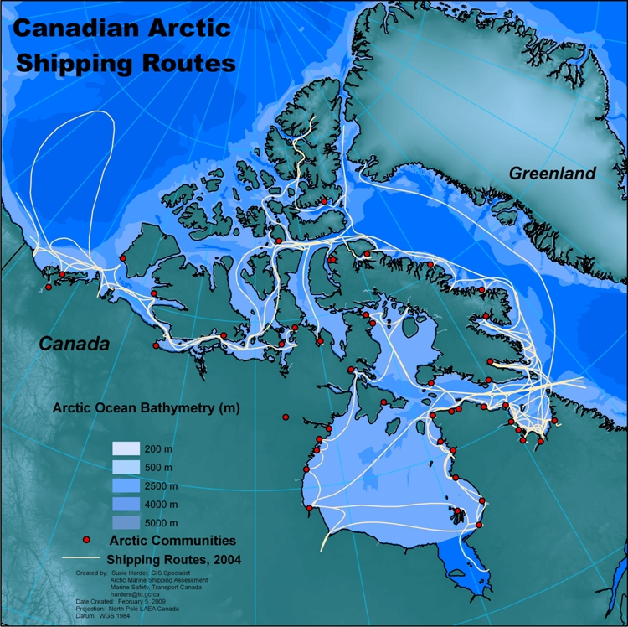
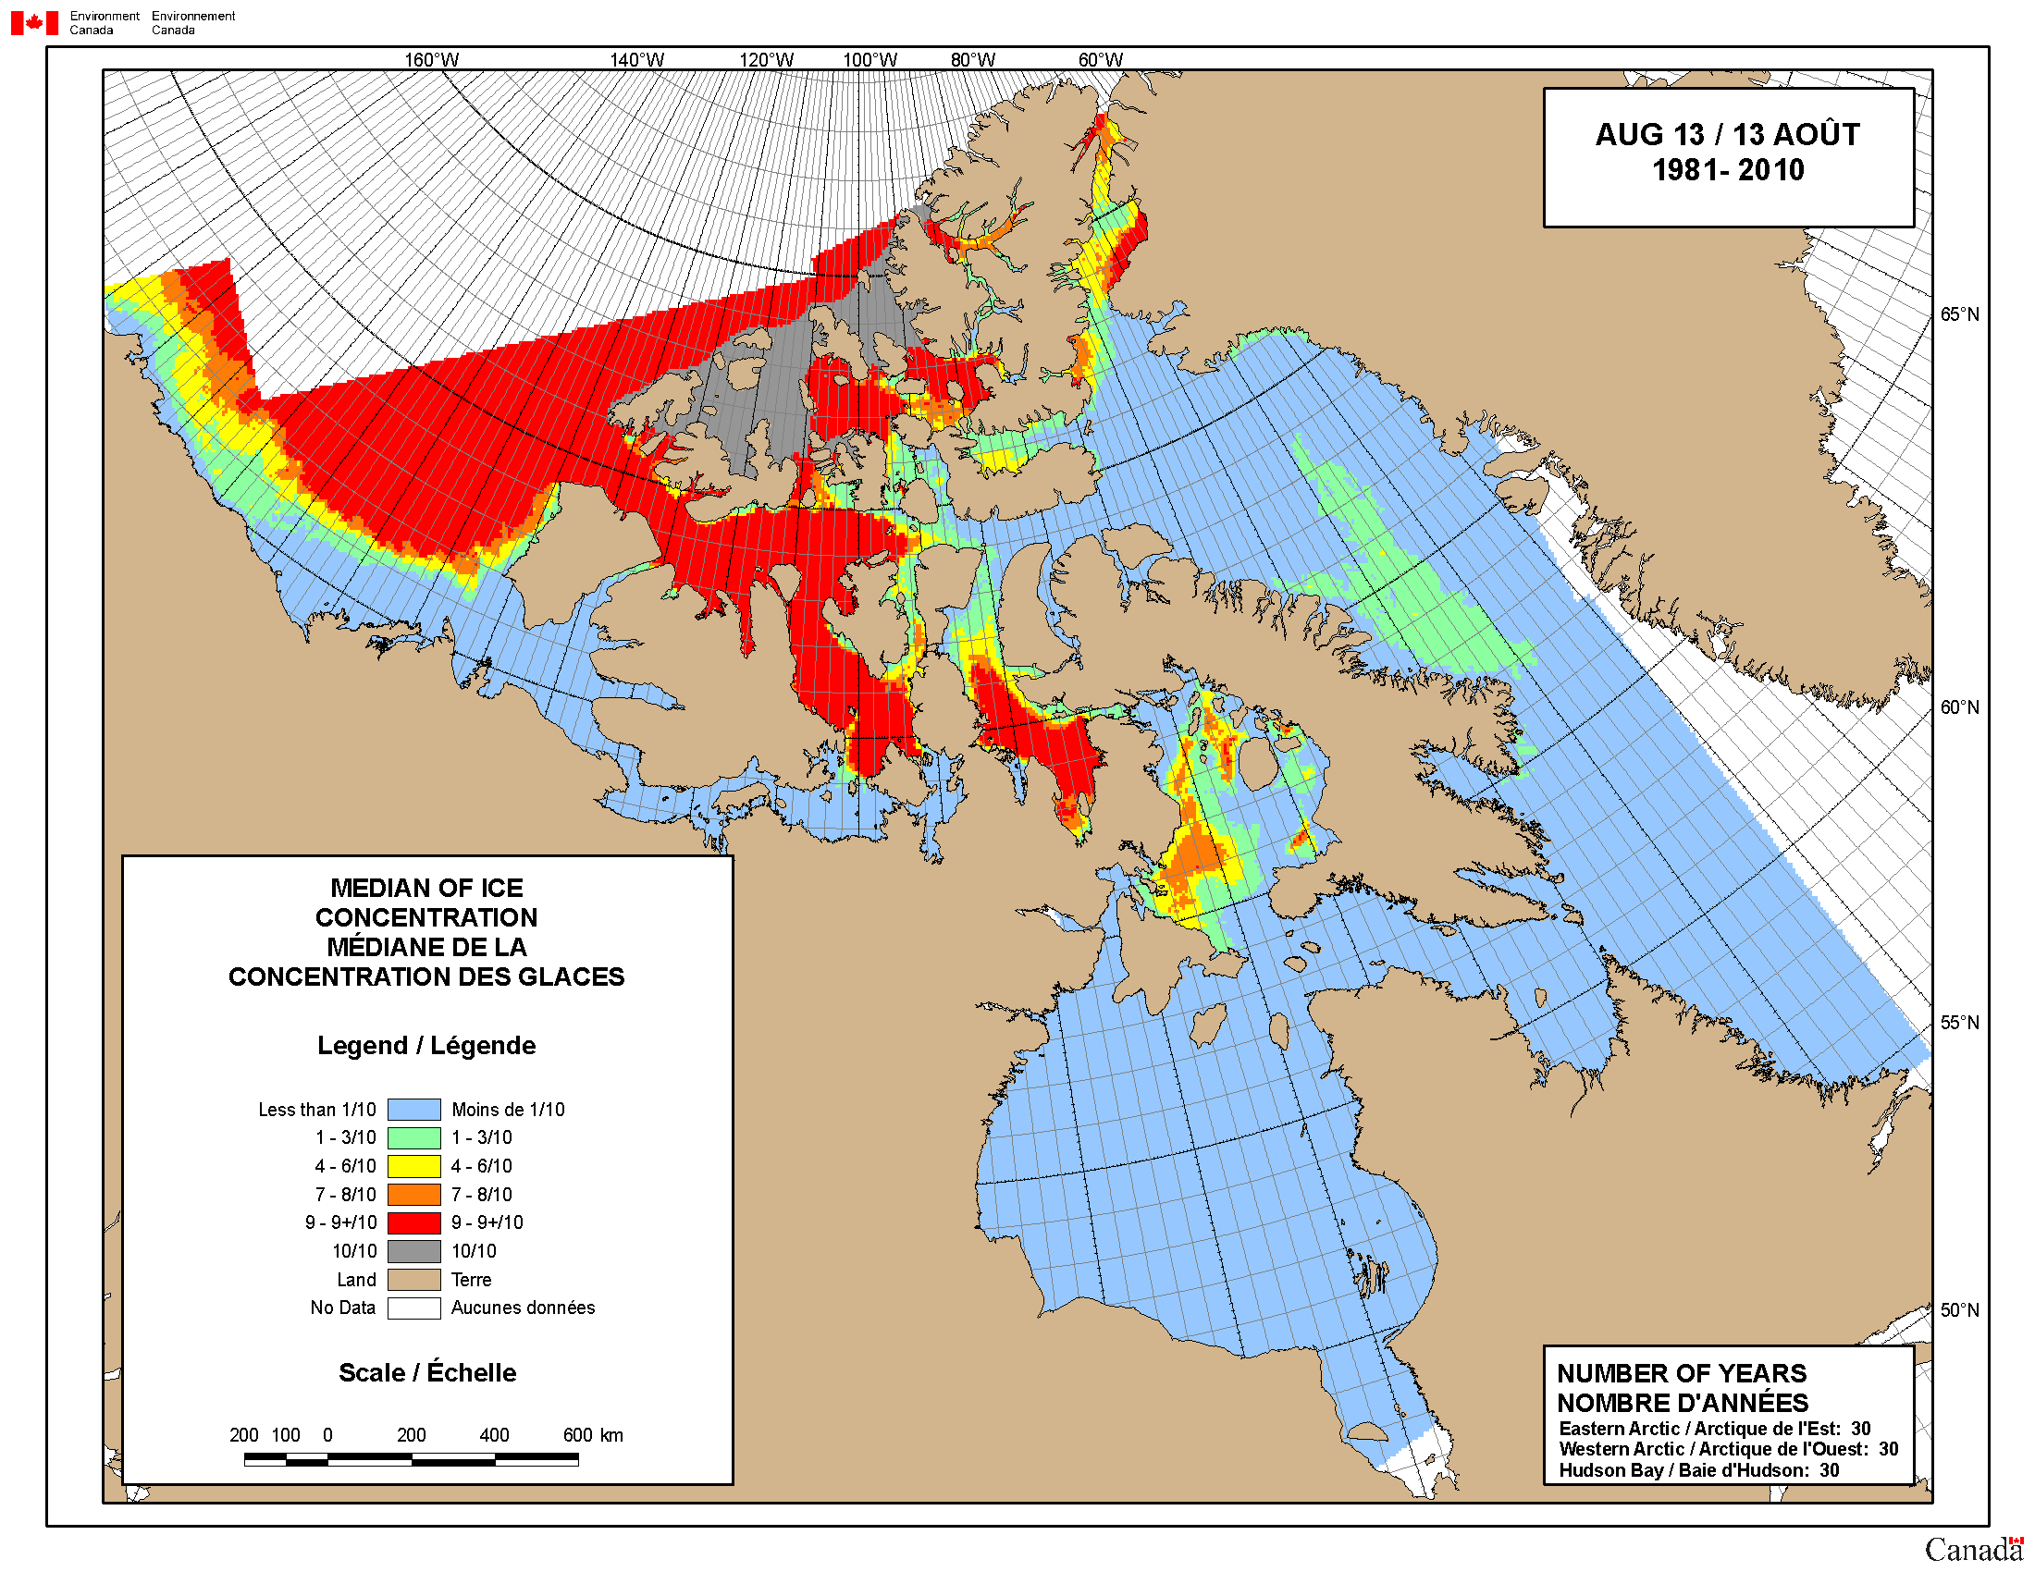
Shipping in Canada’s Arctic
Community re-supply in summer

Slide 5
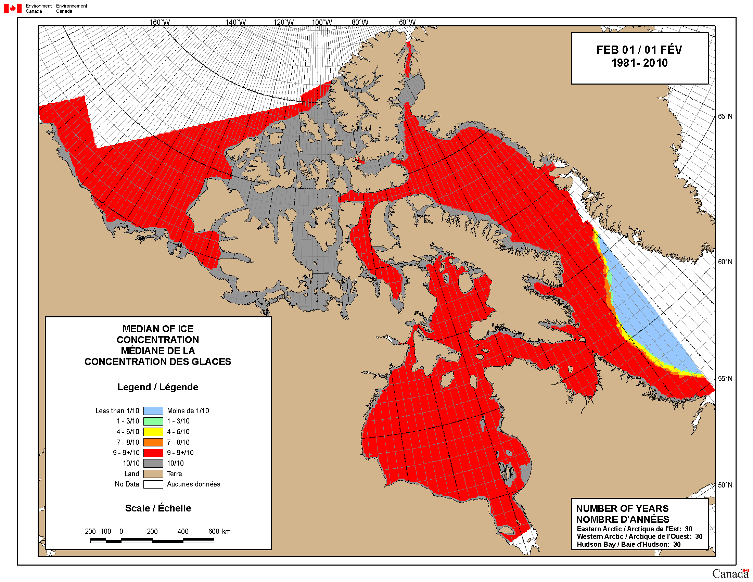
Shipping in Canada’s Arctic
FEDNAV has year-round shipping to Raglan, Voisey’s Bay and Mary River
MARY RIVER
RAGLAN MINE
VOISEY’S BAY

Slide 6
Shipping in Canada’s Arctic
Wheat shipments from the Port of Churchill – summer only; open water
CHURCHILL

Slide 7
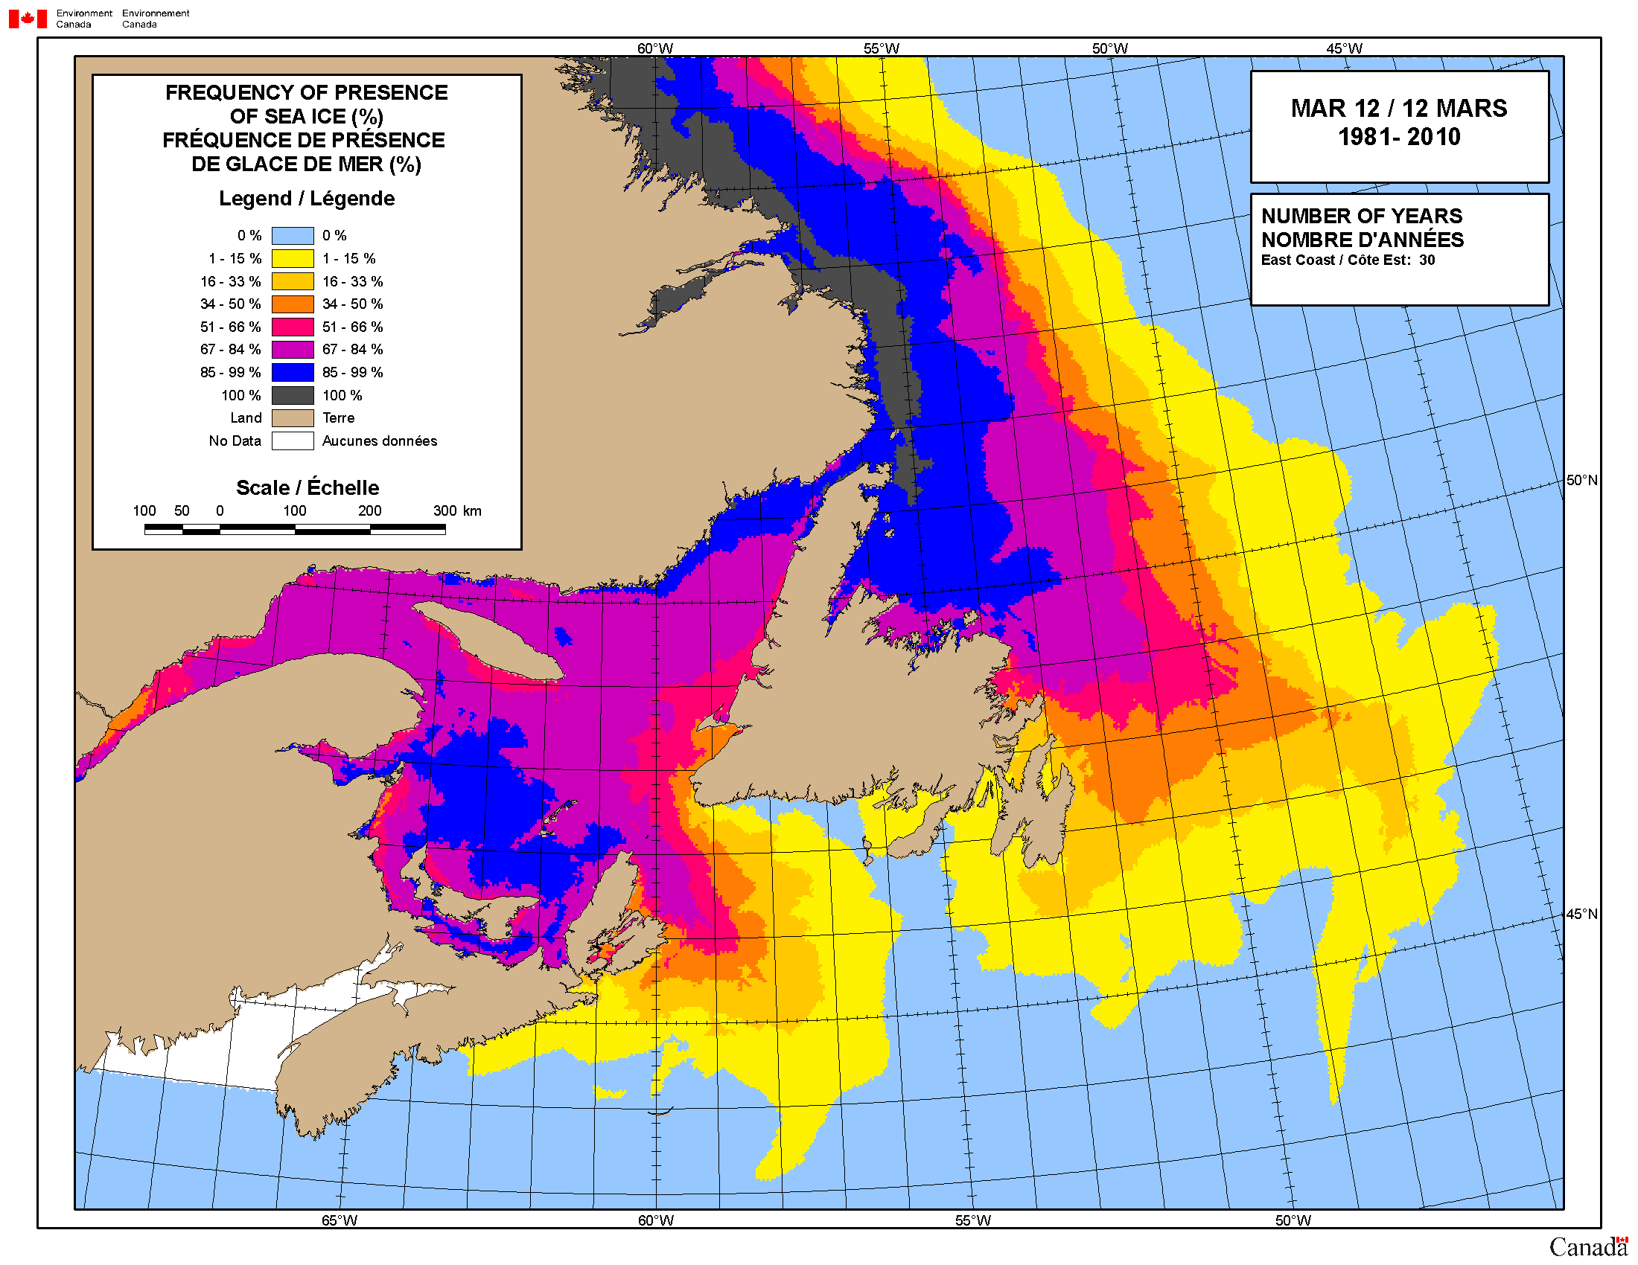
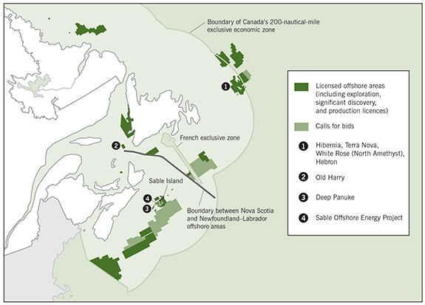
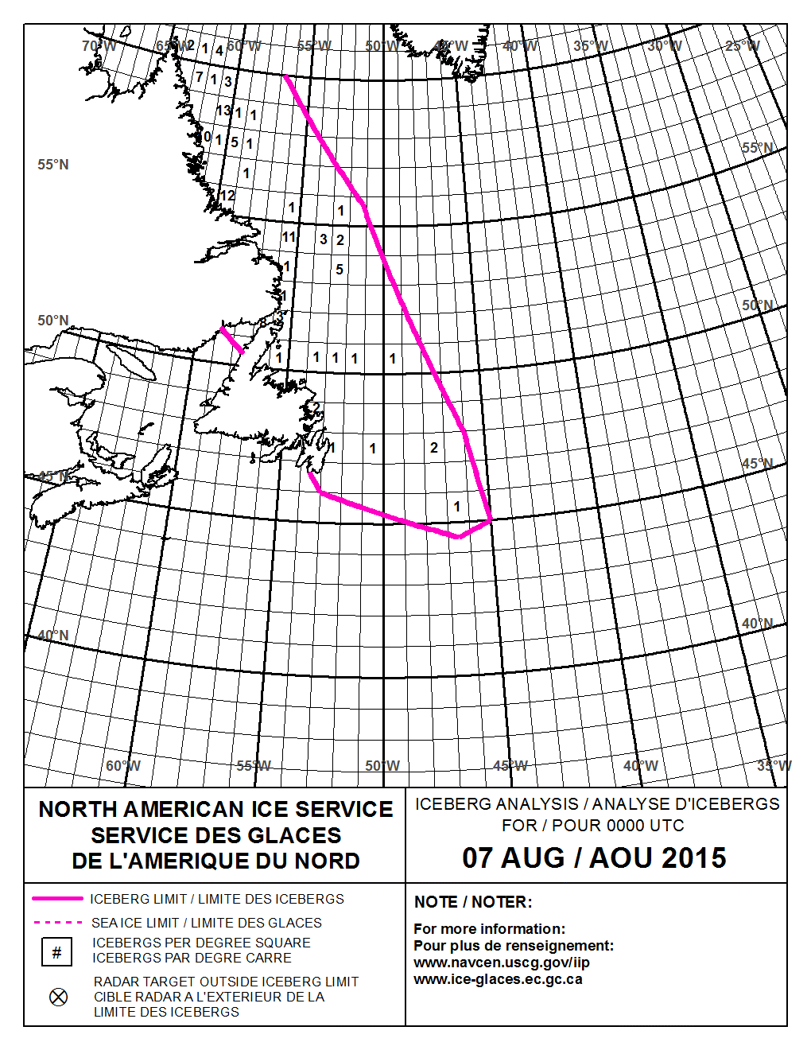
Offshore oil production in NFLD

Slide 8
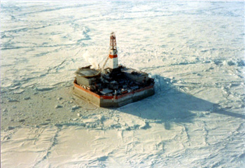
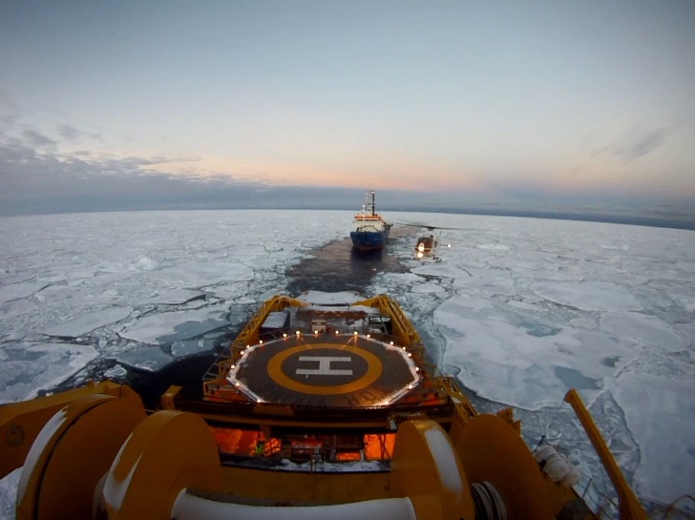
Oil and gas exploration
Renewed interested in Beaufort Sea
Interest in Labrador Coast
NE/NW Greenland … Canadian companies involved

Slide 9
Targeted Interviews
Decision makers / planners / ice management
10 so far
FEDNAV, retired CCG captains, Husky, Chevron, Shell, Crowley
consulting ice experts – experience from Beaufort days, work as ice advisors to industry
all had at least 20 years experience, most 30+
Unstructured interview but asked everyone:
  “ How do you use current operational products?”
  “Are you aware of SIPN, if yes how do you use the predictions?”
  “What seasonal forecast products would have a direct impact on decision making?”

Slide 10
Need for seasonal forecasts (shipping): long-term planning
Scheduling done months in advance, e.g. CCG late winter for summer season
Ice climate is one piece of the puzzle in planning (mine schedules, wildlife restrictions)
Seasonal: How many transits? Icebreaker support?
Sub-seasonal forecasts could change transit plan
Key sea ice parameters are break-up and freeze-up along shipping routes
Definition of break-up and freeze-up depends on ice capability of the ship

Slide 11
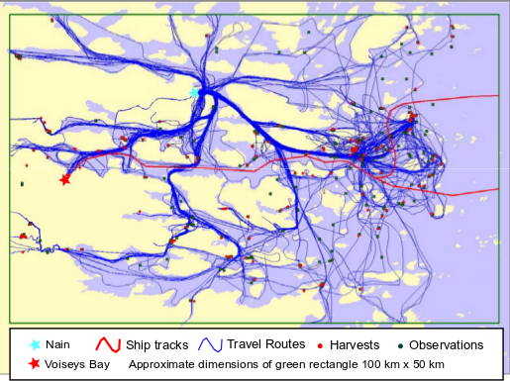
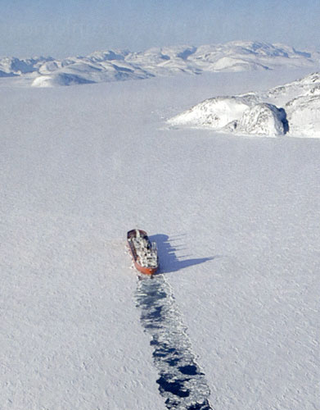
Need for seasonal forecasts (shipping): inform negotiation between local communities and mine operator on winter shipping closure dates
Winter shipping is disruptive to on-ice travel

Slide 12
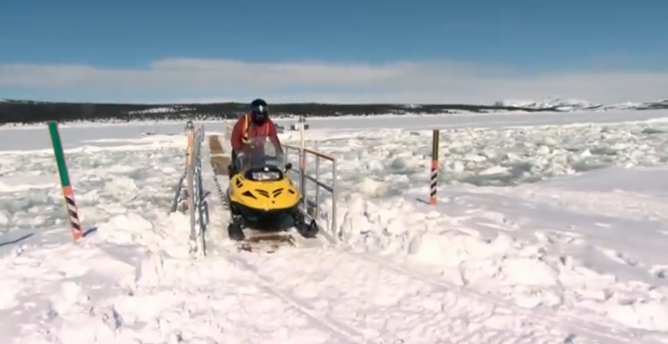
Need for seasonal forecasts (shipping): inform negotiation between local communities and mine operator on winter shipping closure dates
Pontoon bridges are an interim solution
Before each winter shipping season, closure dates are negotiated between local community and mine operator (Christmas, Easter, hunting)
Ice is a major factor
Potential products: long-term climatology of freeze-up and break-up, seasonal forecast of freeze-up and break-up
2015 CLOSURES (www.vale.com)
No shipping December 7–January 21
No shipping April 7–May 21

Slide 13
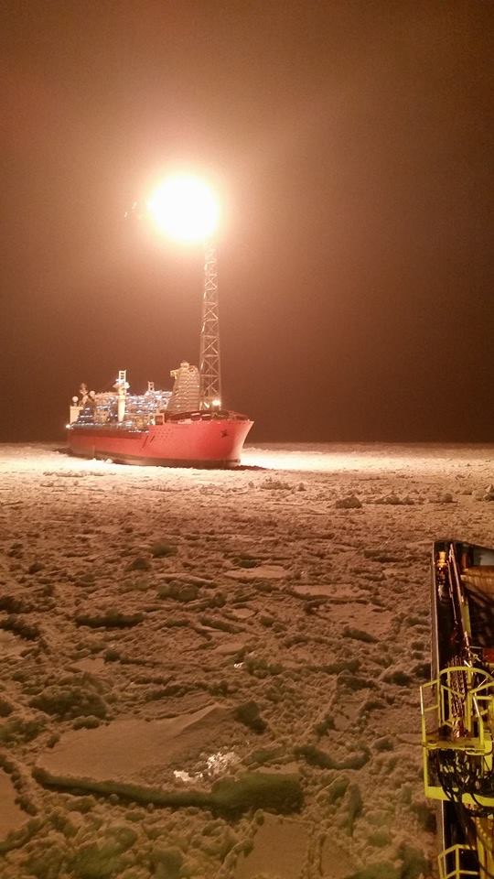
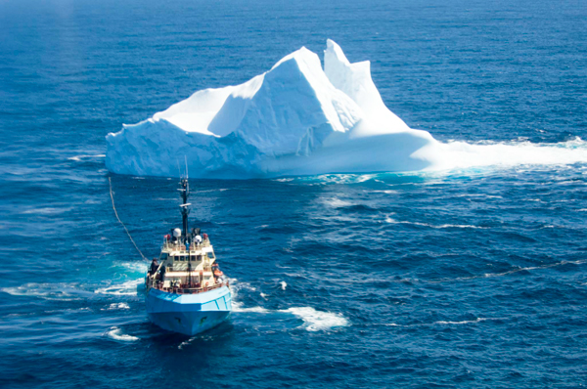
Need for seasonal forecasts (offshore platforms): planning ice management
Production is year-round, seasonal ice
Pack ice and icebergs, large range in
year to year severity
Icebergs are managed – towing
Pack ice is managed – icebreaking
Seasonal forecasts are needed to plan
resources required for ice management
Accurate forecast of severity
(below normal, normal, above normal)
Accuracy - ~80%, reliable
~20-40 mile radius

Slide 14
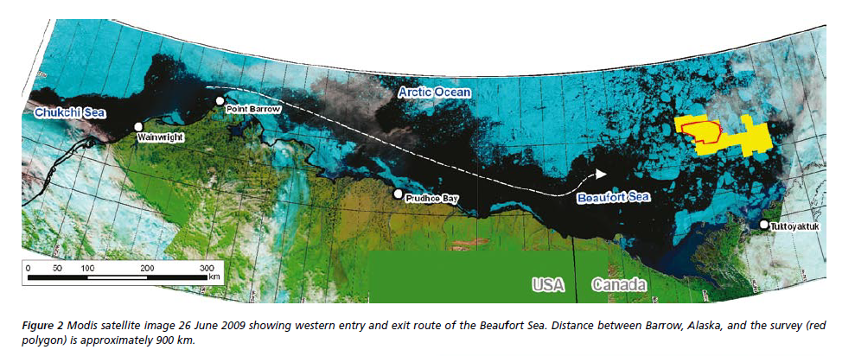
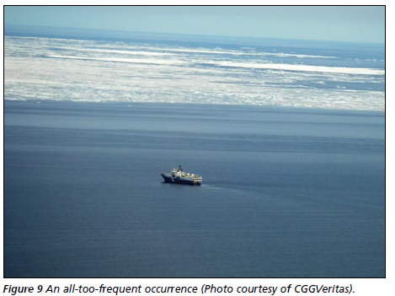
Need for sub-seasonal forecasts (exploration): planning seismic surveys
Seismic – area free of ice for a few days
Regions of interest (MIZ Beaufort, NE/NW Greenland) potential for ice all summer
Approach route is also a factor
Ross et al., 2010. A towed streamer 3D seismic survey in the Arctic marginal ice zone. First Break, p.71-77

Slide 15
Need for sub-seasonal forecasts (exploration): planning seismic surveys
Need for seasonal forecast – specific areas in MIZ ice free for a period of days – unrealistic
Sub-seasonal - beyond reliable weather forecast (~week)
  When to mobilize? ~ 1 to 2 weeks
  When to demobilize? ~ 1 to 2 weeks
Beaufort example … limiting factor is passing point barrow (no icebreaker support), most critical decision was when to demobilize
Challenge of operational medium-term predictions:
  “ To summarize the ice prediction problem, the forecasters, without current data [ocean], used unreliable wind predictions to predict the motion of sea ice that had been moving in unknown directions in the hours or days since the last useable satellite image” – Ross et al. 2010

Slide 16
Current products / techniques: Gov’t
North American Ice Service issues seasonal sea ice forecasts (www.ec.gc.ca / www.natice.noaa.gov)
  NAIS Seasonal Outlook North American Arctic Waters (mid-June)
  NAIS Seasonal Outlook Gulf of St. Lawrence and East Newfoundland Waters (mid-Dec)
  NAIS Seasonal Outlook Great Lakes (mid-December)
Content of the Arctic Outlook:
    Specific dates for three types of events: Fracture, Open drift or less, Open water/bergy water
    Text description of end of winter ice condition and predicted ice conditions throughout the summer season
Outlook based on:
- past winter/spring air temperature
- station ice thickness and current ice conditions
- summer air temperature outlook
- predictions from statistical/empirical models

Slide 17
Current techniques: Industry
Interviews: Seasonal forecasts are not being used to inform decisions: too broad in scale, issued to late in the season, skill too low
Stakeholders looking for ice information to inform decision
In-house techniques:
  Climatology: median, earliest and latest historical dates of an event
  Analog approach: current conditions are compared to previous years, predictions are based on seasonal progression in analog years
  Empirical methods: statistical relationship, e.g. FDD and break-up dates

Slide 18
General comments from interviews
Keen interest in all seasonal and sub-seasonal forecasts even if they don’t inform decision making
Without exception, an inherent understanding of the complexity of seasonal forecasting and limits of predictability …. expectations are reasonable if not pessimistic
Seasonal forecasts are not being used to inform decisions: issued too late in the season, skill too low
For a forecast to have an impact on operations, it would need an established track record and be very accurate
Seasonal and sub-seasonal forecasting, with a varying range of complexity, is being done within industry

Slide 19
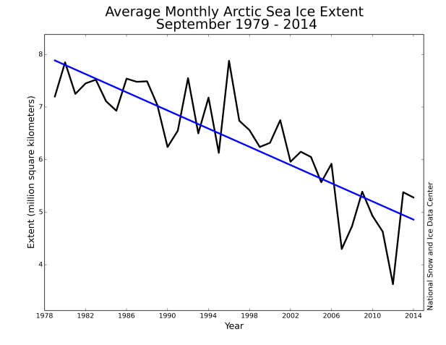
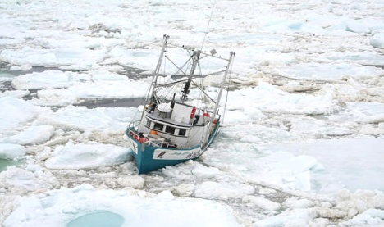
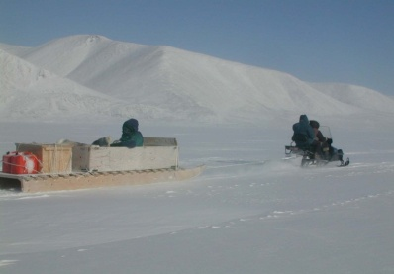
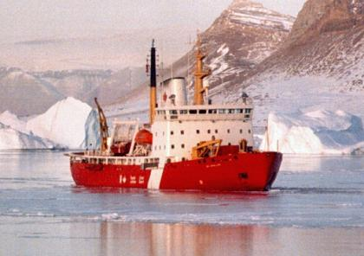

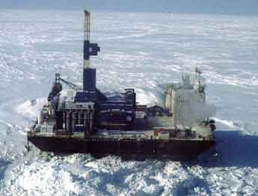
SIPN and stakeholder needs
Regional predictability?
- moving beyond pan-Arctic extent and area

Slide 20
SIPN and stakeholder needs
Predictability at longer lead times?
* planning is done well before SIPN outlook effort begins and official CIS outlook is published (forecasters give presentations to specific groups earlier in the season)
* If predictability of ice is low, predictions of other parameters such as NAO which is known to effect ice would be useful.

Slide 21
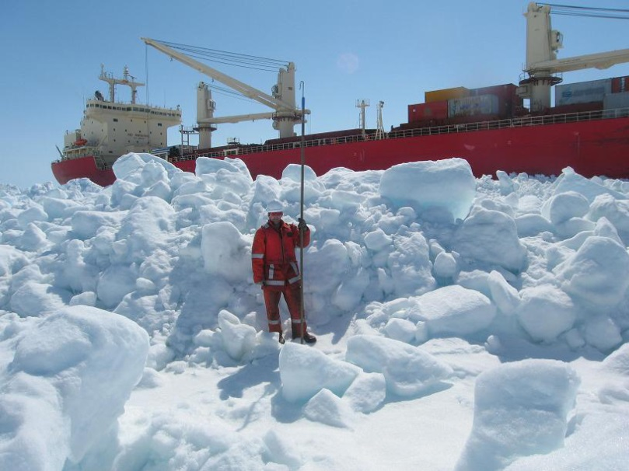
SIPN and stakeholder needs
Predictability of a wider range of sea ice variables?
* Concentration, area and extent
not restricted to september
* Thickness/volume …. level ice
vs deformed ice
* ‘Trafficability’ – viability of routes; severity of ice conditions effect transit times …. ice strength, ice pressure, ridging

Slide 22
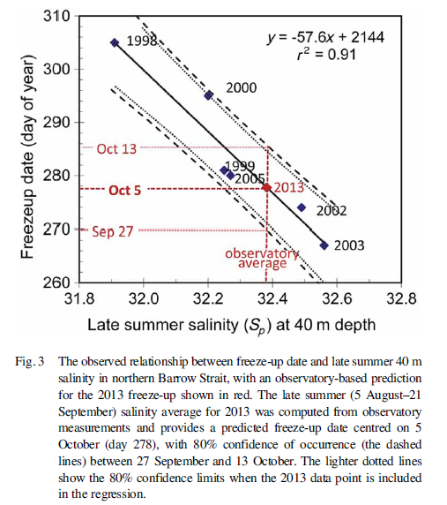
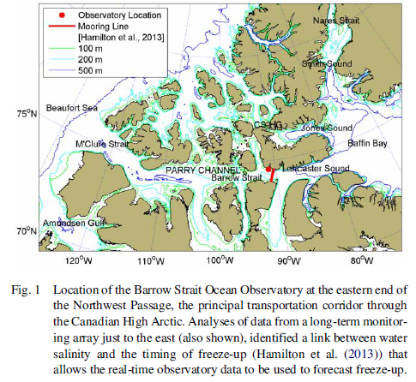
SIPN and stakeholder needs
Can local observations improve regional predictability?
James M. Hamilton and Merle D. Pittman (2015): Sea-ice freeze-up forecasts with an operational ocean observatory, Atmosphere-Ocean, DOI: 10.1080/07055900.2014.1002447

Slide 23
Stakeholder engagement in SIPN
Informal partnerships between individual scientists and end-users?
  Evaluate model products and provide feedback
  Articulate specific needs to aid in decision making
Webinar by stakeholders to communicate needs directly?

Slide 24
Next Steps
Complete interviews within the coming weeks
Summarize key results more formally / citeable reference
  Draft will be circulated to participants for comments/approval
  Thank you!!
  If you have any questions/comments please do not hesitate to contact me.
  Adrienne Tivy
  adrienne.tivy@ec.gc.ca
  613-996-5099

