Slide 1
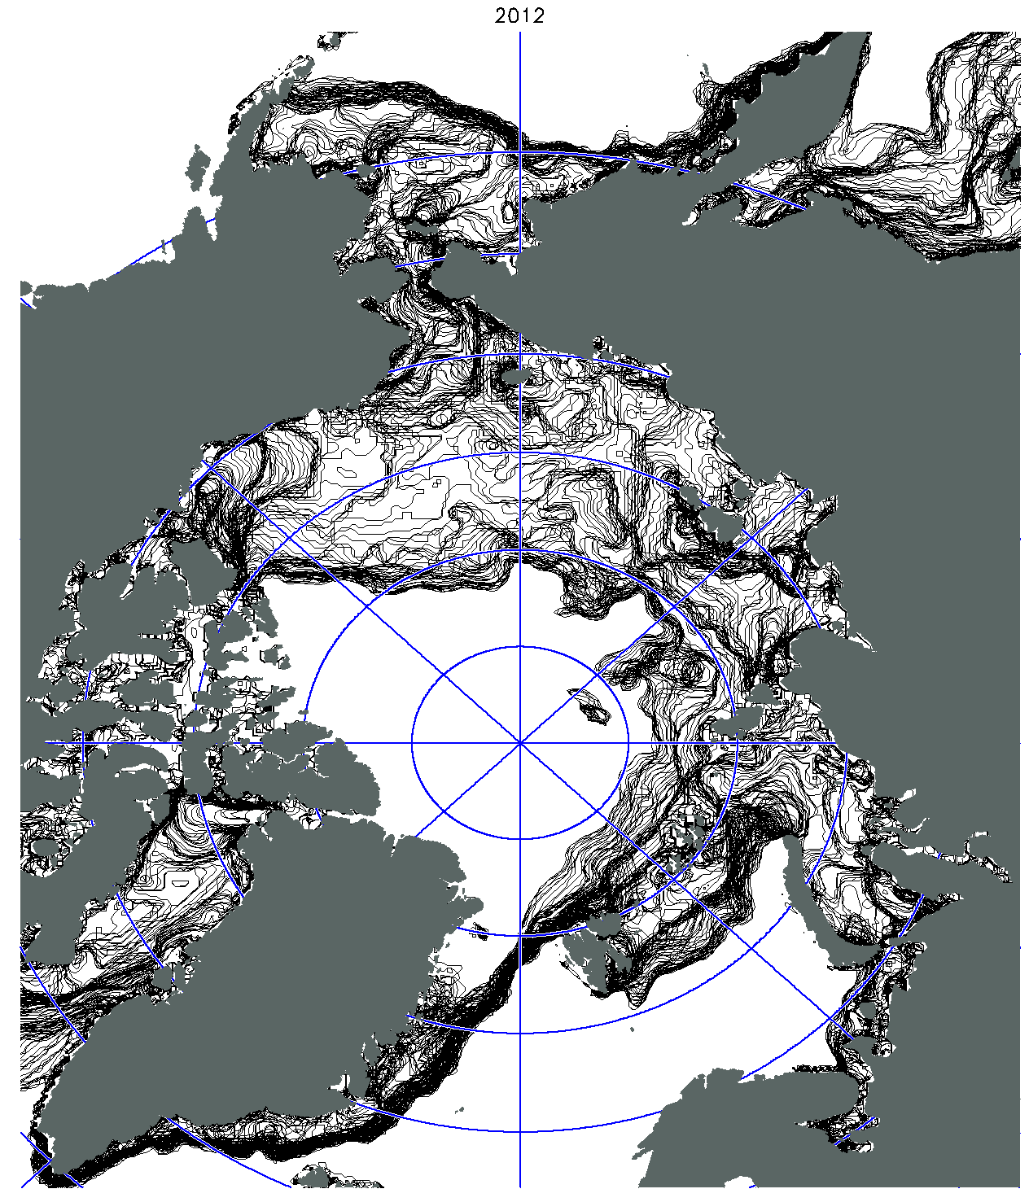
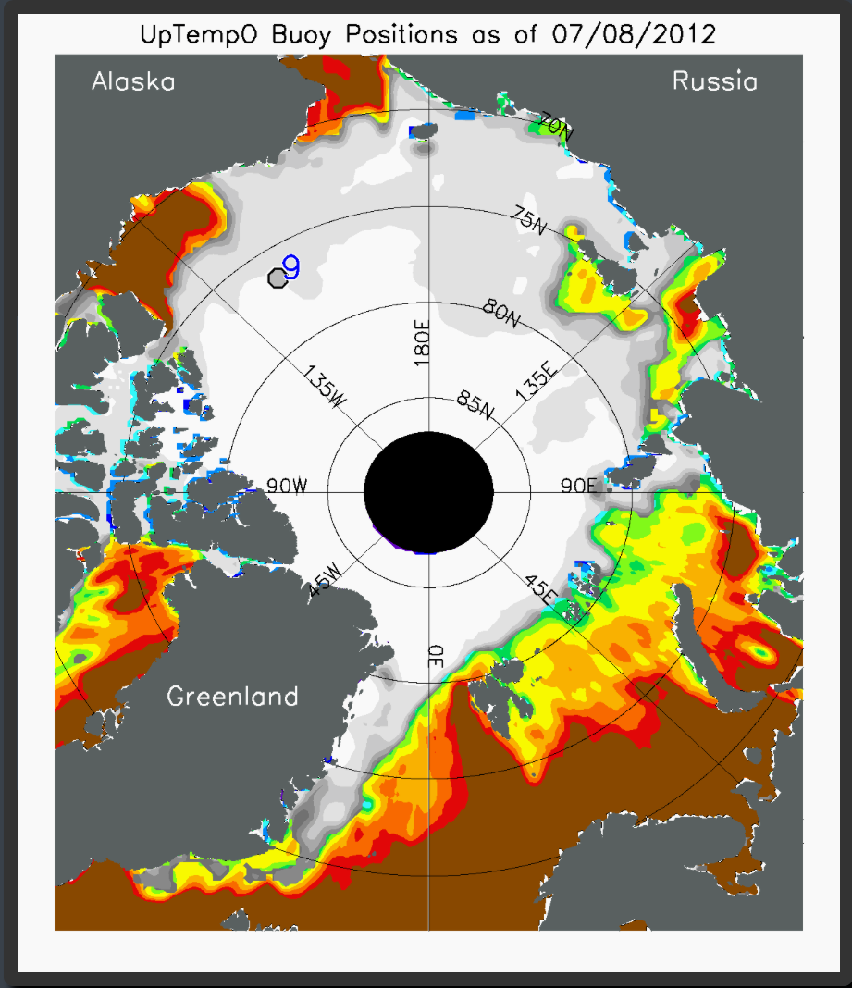
Loitering of the Retreating Sea Ice Edge in the Arctic Seas
mas@apl.washington.edu
1 (206) 302-8129
Michael Steele & Wendy Ermold (2015). J. Geophys. Res., doi:10.1002/2015JC011182.
Daily ice edge from satellites
(Contours of
15% ice concentration)
The pace of ice retreat is not constant! We find that sometimes, ice retreat is rapid (contours widely spaced). Other times, retreat stalls for up to ~7-11 days (contours over-plotting, red oval areas). We call this phenomenon "loitering."
How does it work? Loitering results from off-ice winds that move floes into warm water, where they melt.
Alaska
Russia
Sea Surface
Temperature
Who cares? A loitering ice edge might be very productive biologically (good fishing)! Also, this could help with daily ice edge forecasting. ➜ Loitering has also been observed during ice advance in fall.
Canada
Greenland
But… Is this observed by locals? If yes, what is their explanation? And: What are the user needs for daily ice edge forecasting? What parameters are most important?
2012
Mar 13 – Sep 23
2012
July 8
-2 -1 0 1 2 3 4 5
SST (°C)
(NOAA OI.v2
AVHRR)
ice conc.
(SSMIS passive μwave)
0.2 0.3 0.4 0.5 0.75
Notes:
1
Steele, M., and W. Ermold (2015), Loitering of the retreating sea ice edge in the Arctic Seas, J. Geophys. Res. Oceans, 120, doi:10.1002/2015JC011182.
Abstract:
Each year, the arctic sea ice edge retreats from its winter maximum extent through the Seasonal Ice Zone (SIZ) to its summer minimum extent. On some days, this retreat happens at a rapid pace, while on other days, parts of the pan-arctic ice edge hardly move for periods of days up to 1.5 weeks. We term this stationary behavior “ice edge loitering,” and identify areas that are more prone to loitering than others. Generally, about 20–25% of the SIZ area experiences loitering, most often only one time at any one location during the retreat season, but sometimes two or more times. The main mechanism controlling loitering is an interaction between surface winds and warm sea surface temperatures in areas from which the ice has already retreated. When retreat happens early enough to allow atmospheric warming of this open water, winds that force ice floes into this water cause melting. Thus, while individual ice floes are moving, the ice edge as a whole appears to loiter. The time scale of loitering is then naturally tied to the synoptic time scale of wind forcing. Perhaps surprisingly, the area of loitering in the arctic seas has not changed over the past 25 years, even as the SIZ area has grown. This is because rapid ice retreat happens most commonly late in the summer, when atmospheric warming of open water is weak. We speculate that loitering may have profound effects on both physical and biological conditions at the ice edge during the retreat season.
Notes:.
(i) We have also found loitering in higher resolution passive microwave data (ie, AMSR2 3.25 km resolution) and in multi-sensor products from the National Ice Center & the National Snow and Ice Data Center (ie, MASIE 4 km ice extent). We also see it in the UW's PIOMAS coupled sea ice – ocean model. We have seen it in every year from the start of the SSMI era (ie 1989) and find an interesting LACK of trend in the total area that loiters each year (see abstract and paper).
(ii) We hope to further explore loitering in Antarctic waters and in the fall advance season.
(iii) We'd like to look at the detailed biophysical processes in both numerical models and using more satellite and in situ observations, e.g., using ocean color observations.
(iv) We have marine mammal colleagues who think that loitering might help explain hunting and migration patterns.
(v) We suspect that recently loitering mixed layers that have been "left behind" by the retreating ice edge may become unstable and exhibit submesoscale mixing and frontal slumping.

