Slide 1
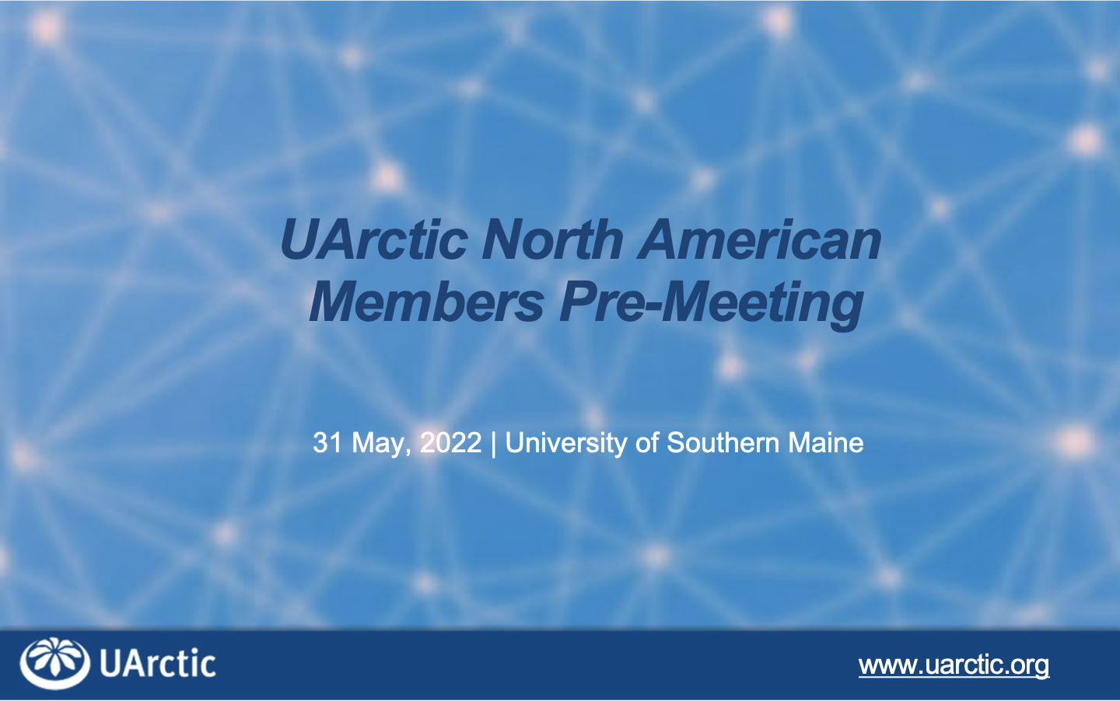

Slide 2
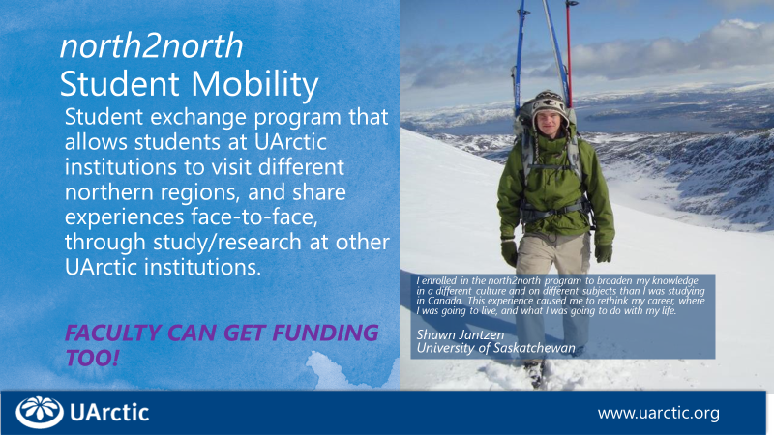

Slide 3
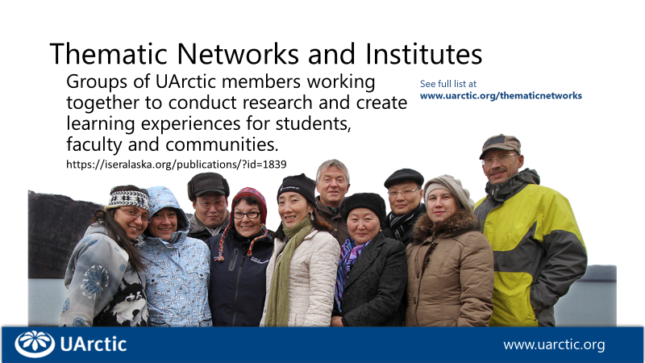

Slide 4
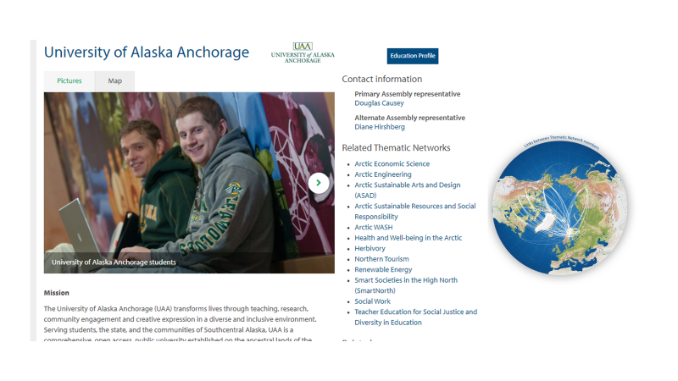

Slide 5
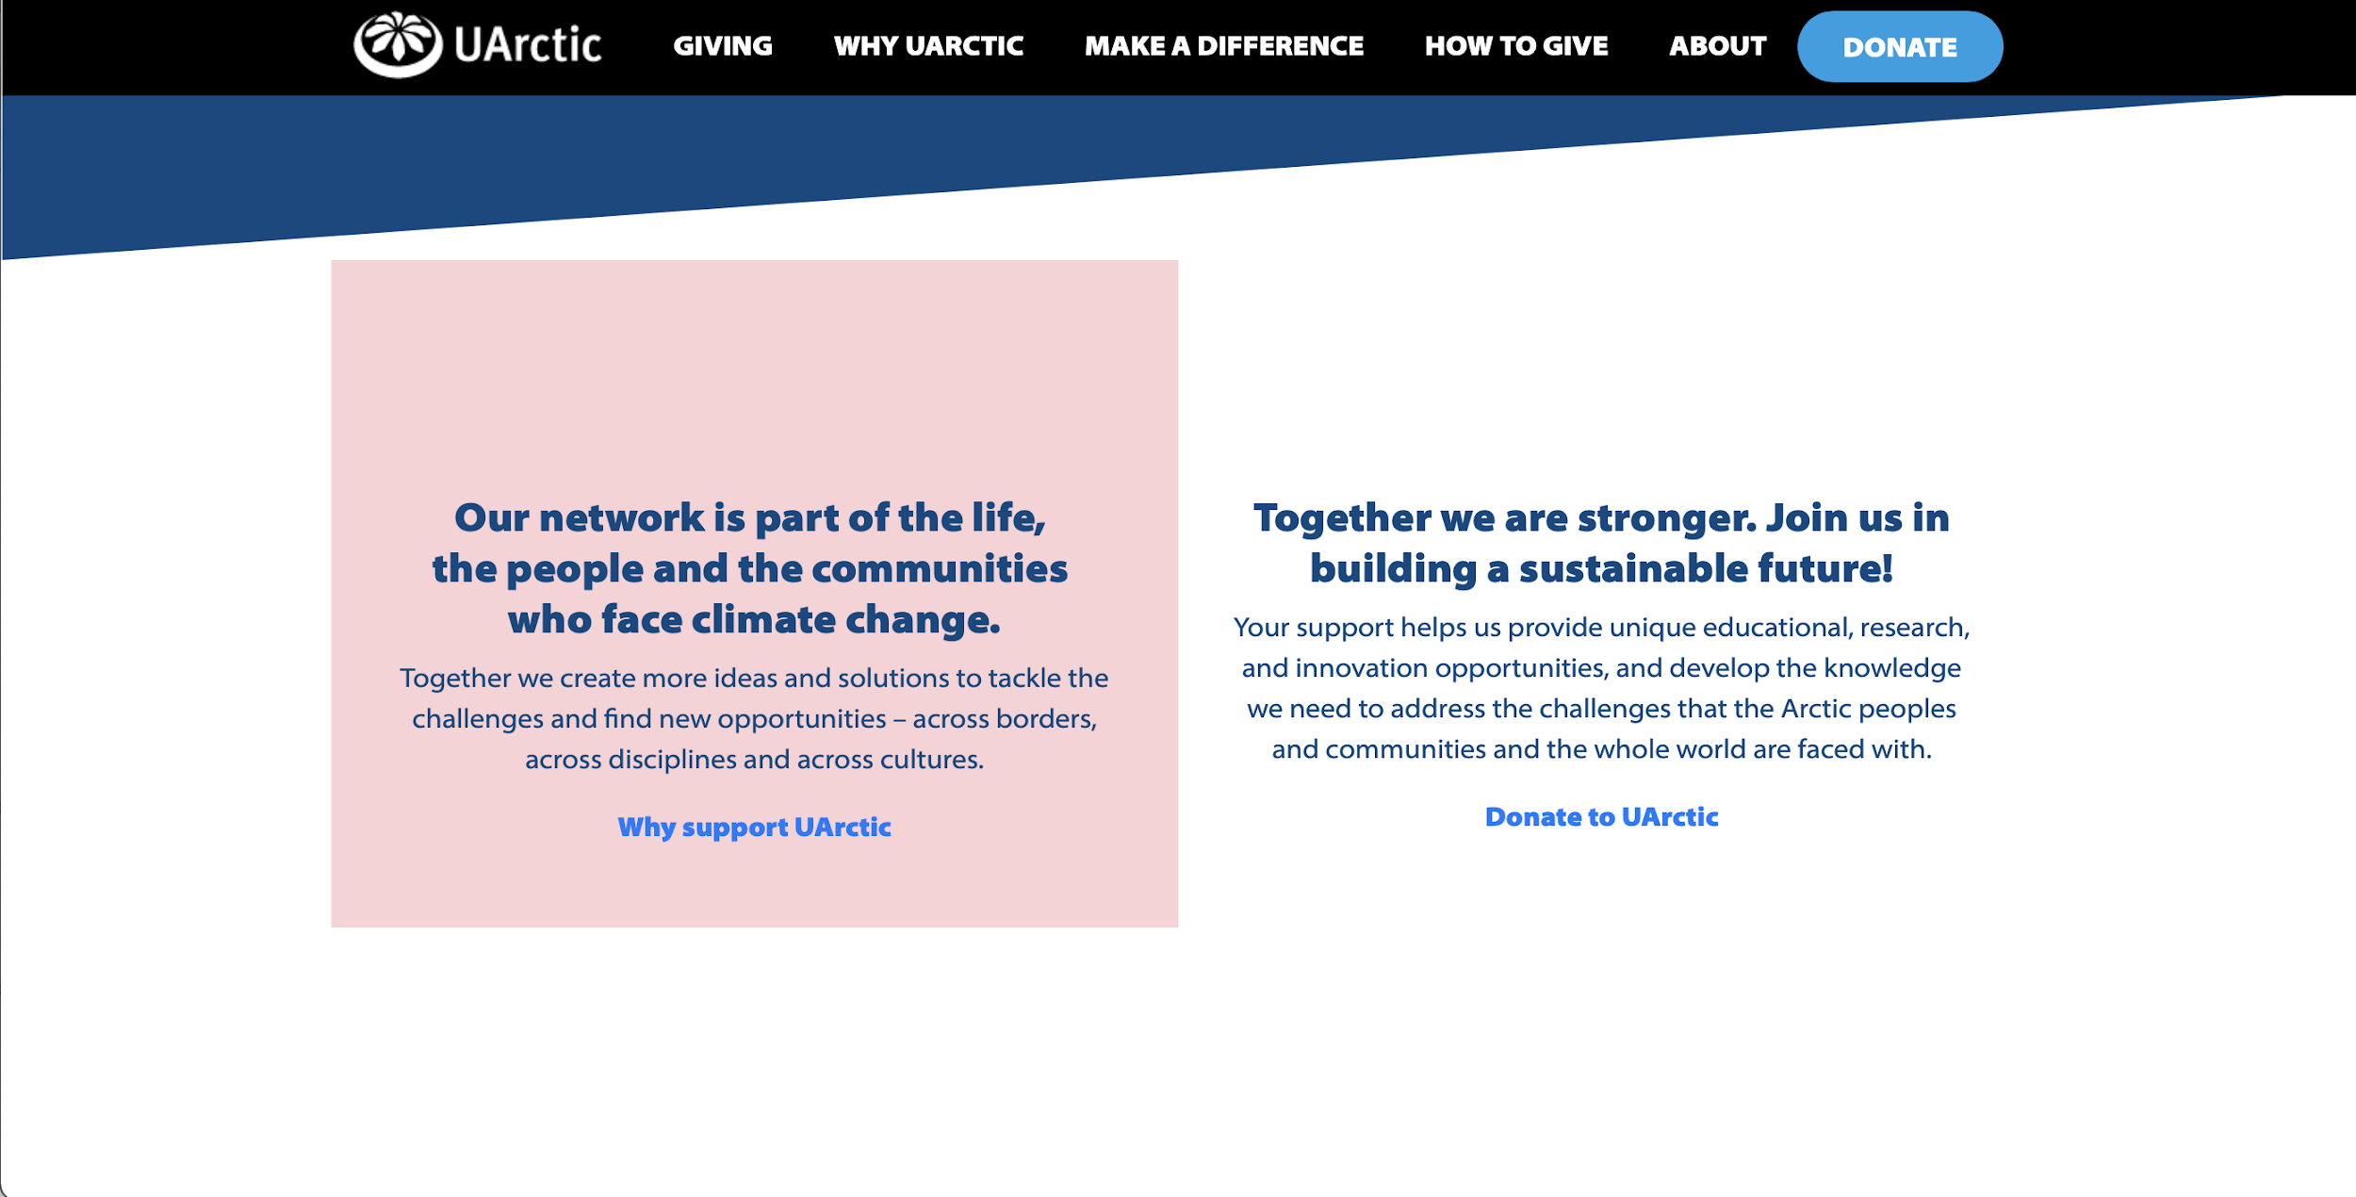
National Funding Supports
For Mobility
For Collaborative Research and Education Initiatives
Denmark - UArctic
Norway - UiT
Canada – Memorial University & Yukon University

Slide 6
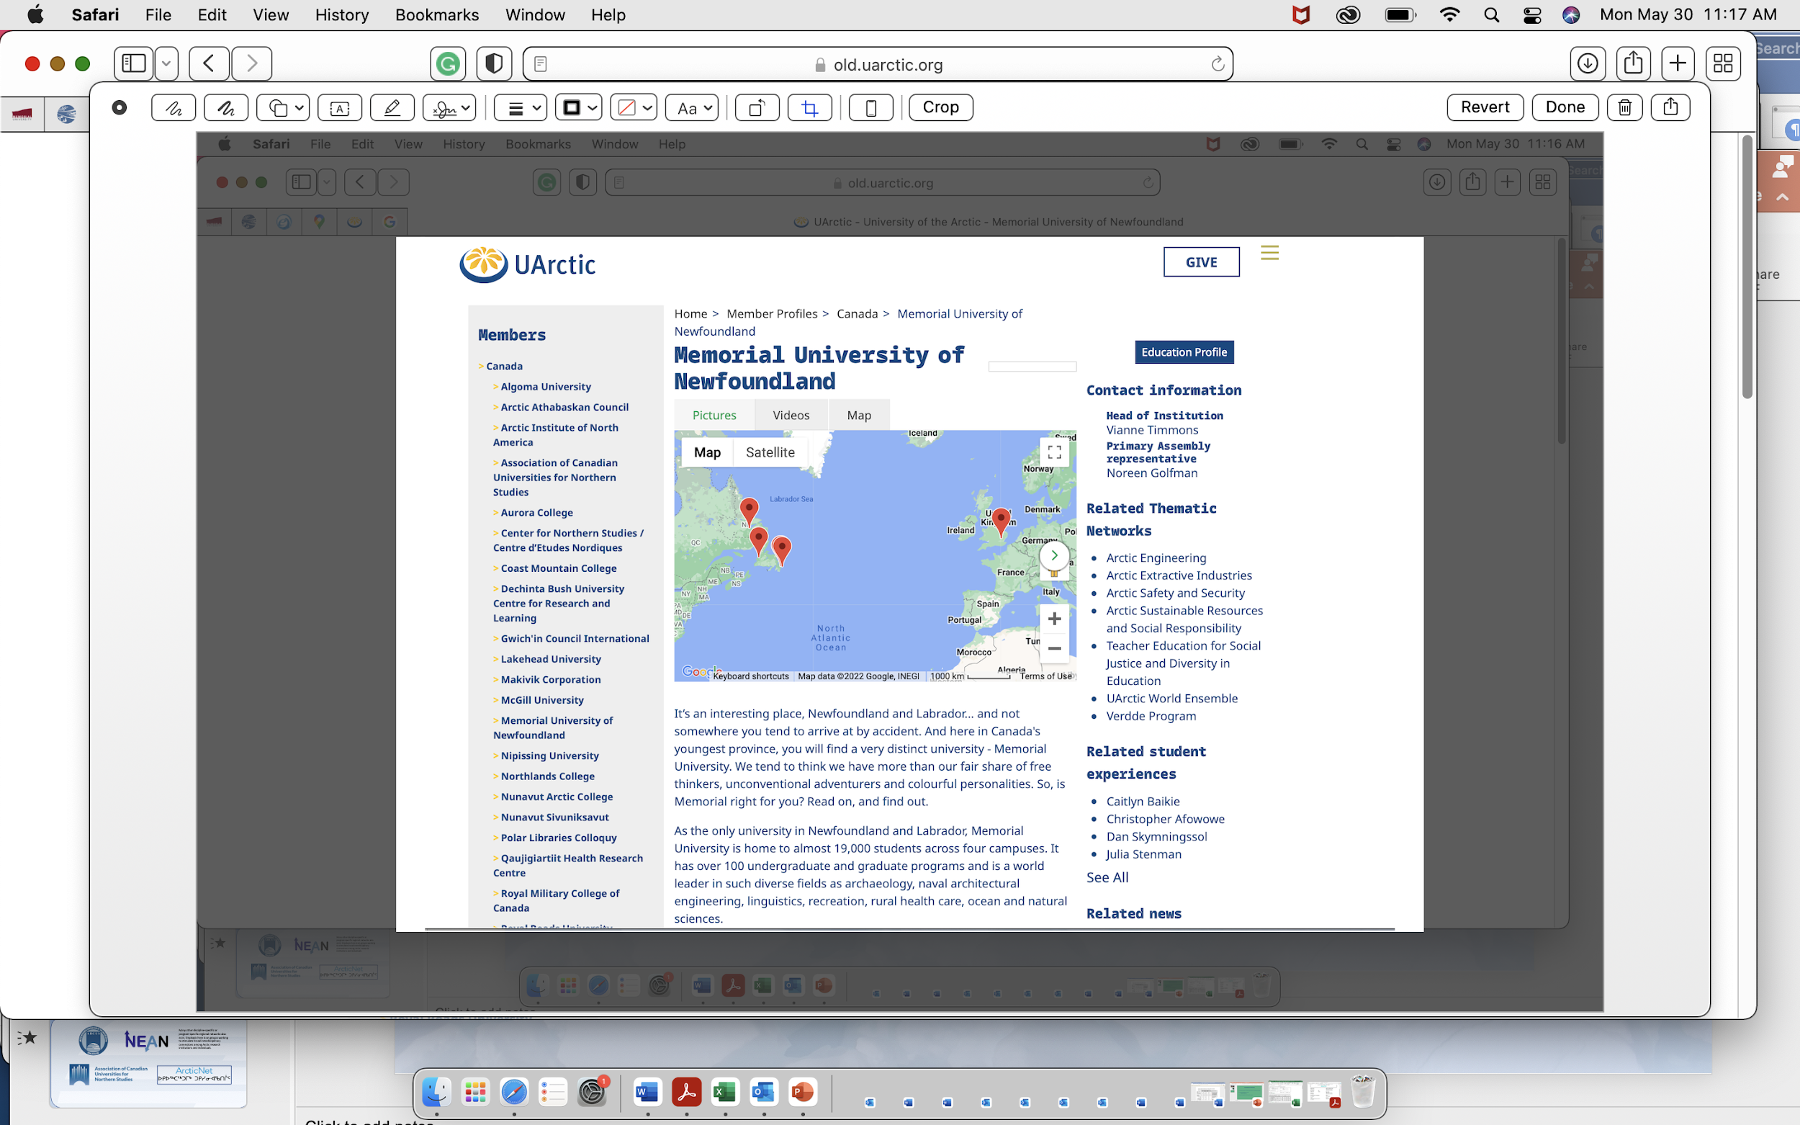

Slide 7
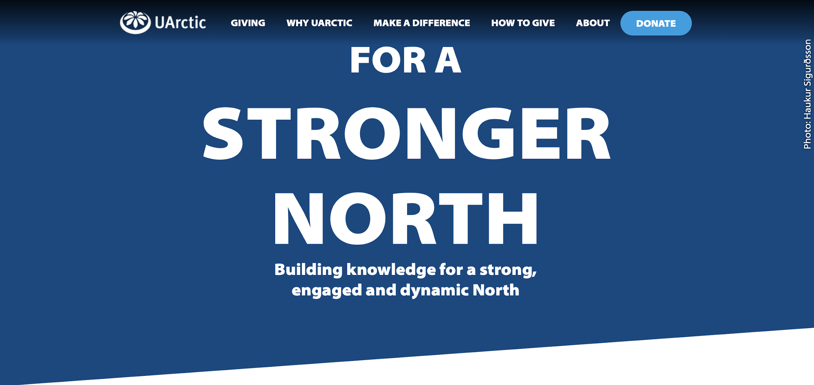
Canada’s National Funding
2022-2026 - Supporting UArctic collaborations between members and partners
Focus on supporting collaborative, co-created research and education projects with Indigenous & Northern members and partners - 2 Funds
  Indigenous & Northern Relationship Development Fund
    Maximum funding per project - $15,000
    Maximum project duration – 1 Year
    Canadian member lead
  Indigenous & Northern Collaborative Research
    & Education Fund
    Maximum funding per project - $40,000
    Maximum project duration – 2 Years
    Canadian member lead

Slide 8
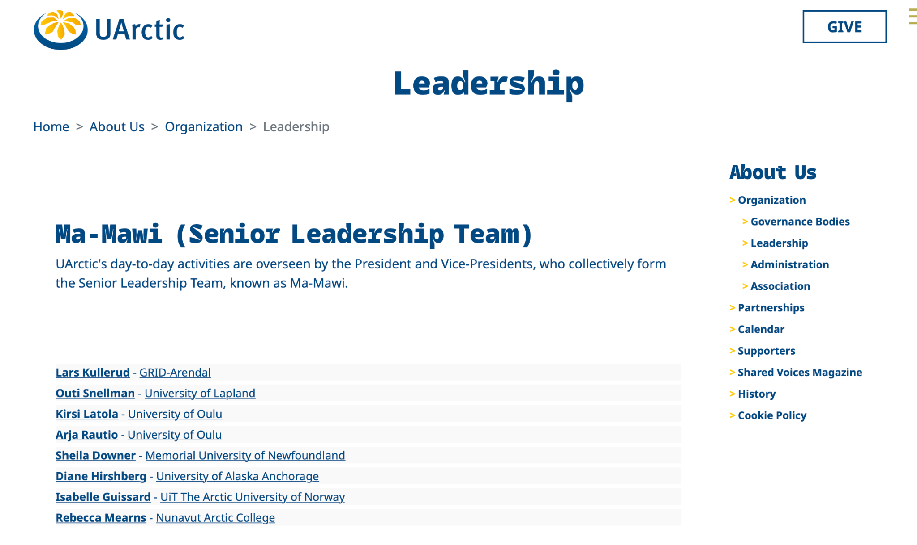
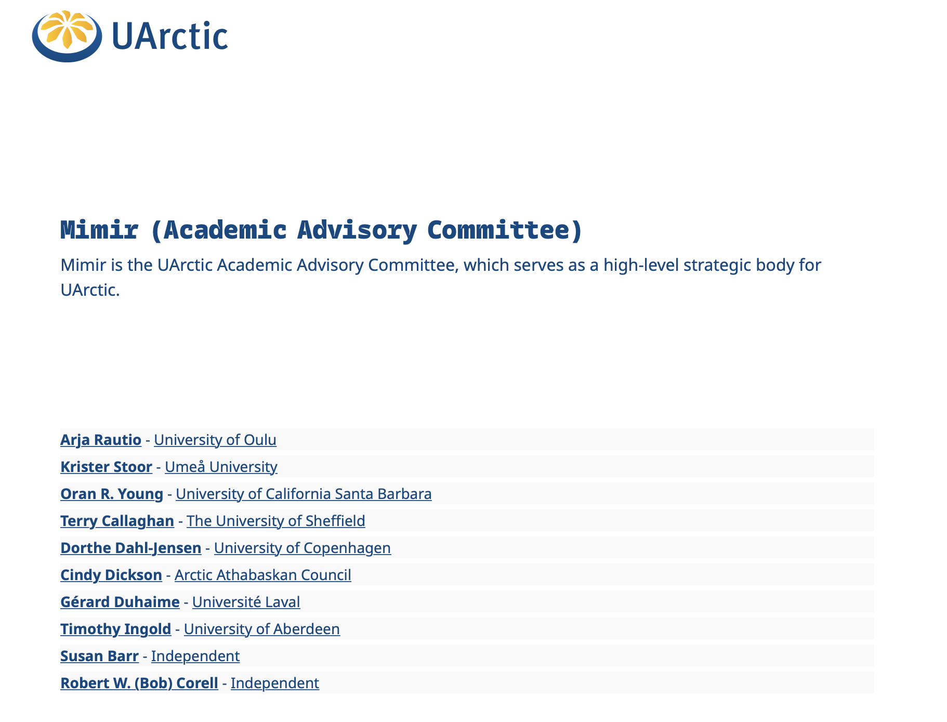
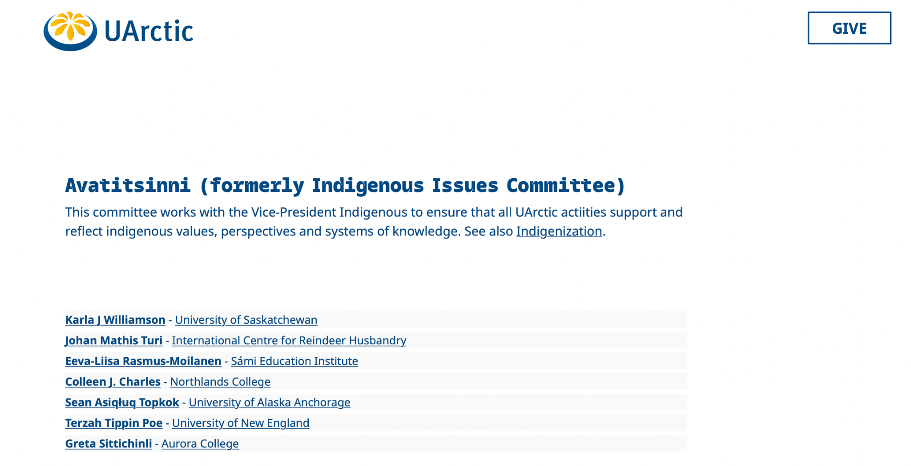
UArctic Leadership

Slide 9





Regional Arctic Research Networks
Many other discipline-specific or program-specific regional networks also exist. Emphasis here is on groups working to stimulate broad interdisciplinary connections among Arctic research institutions and individuals.
Notes:
We wanted to convene UArctic’s North American members because we recognize that there are many issues and topics that would benefit from stronger regional & national alliances. With that goal in mind, it is also worth remembering that another resource and tool available to this group are the national & regionally focused Arctic research networks like ARCUS (which is a member of UArctic)... NEAN which we will be learning a lot more about at this particular Assembly meeting… as well as Canadian organizations such as ACUNS & ArcticNet.

Slide 10
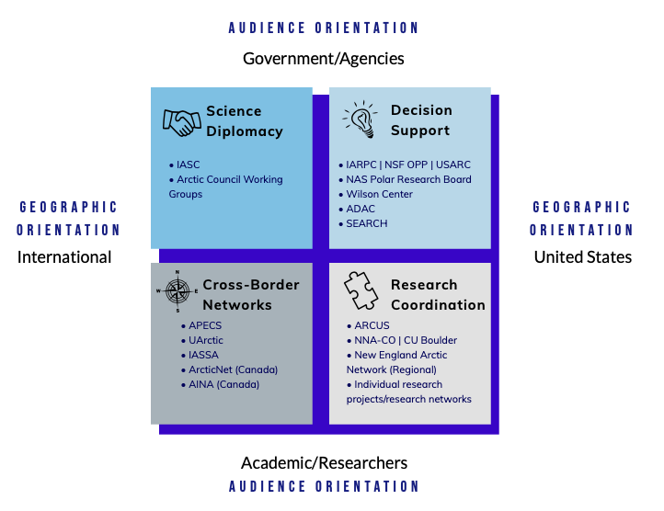
A Complement to UArctic
Regional Network “Niche”
More connections to the regional government, business, and community organizations.
Greater awareness of regional issues and funding opportunities.
Communications that reach more members of a regional target audience.
The ability to leverage different kinds of funding sources or collaboration support frameworks.
More opportunity/flexibility for diverse researchers to initiate new activities.
Notes:
These national & regional networks are highly complementary to the goals and activities of UArctic… emphasis on building stronger community connections, drawing attention to & increasing community exposure to critical information, providing a framework & support for projects that bring researchers together across multiple organizations, and expanding the opportunities for a wider range of people with an interest in Arctic research to become active community leaders. Key message for UArctic members - there is value in being aware of, supporting, and developing intentional relationships and partnerships with these types of national and regional networks.

Slide 11


















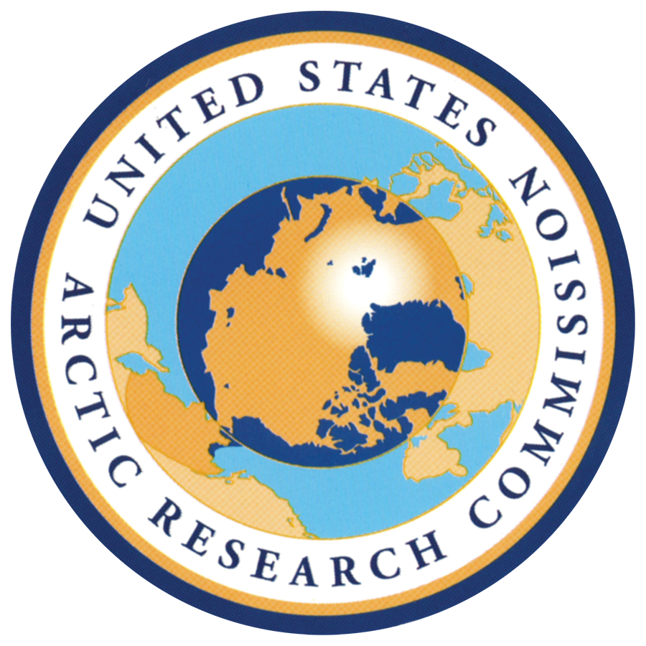







ARCUS Institutional Members
Notes:
27 members - including research universities, government agencies/labs, nonprofits, small businesses, indigenous groups
We also have individual members…
Smaller than UArctic… but different players… including more U.S. Arctic Indigenous organizations & U.S. federal agency involvement…
Funded through a cooperative agreement w/ the U.S. National Science Foundation… so, much of what we do is open to everyone… you don’t have to be a member to participate in our events or benefit from our programs… so the Member and Partners are a snapshot to help demonstrat that complementary but different focus from UArctic.

Slide 12







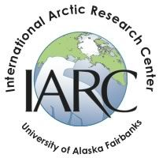




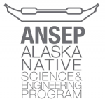
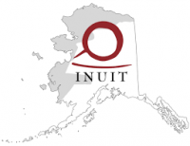
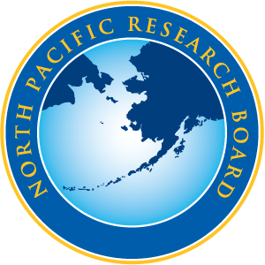


ARCUS Institutional Partners
Notes:
-In addition to our members, we also partner with many different organizations on projects and events to achieve our shared goals

Slide 13
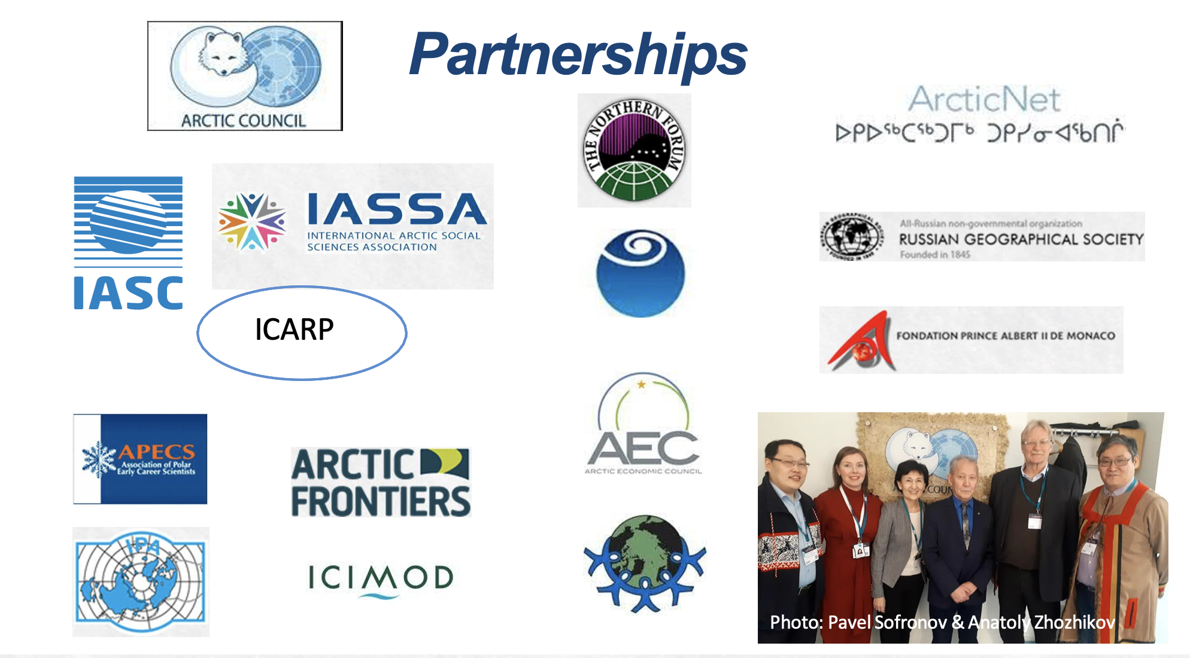








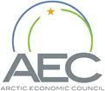

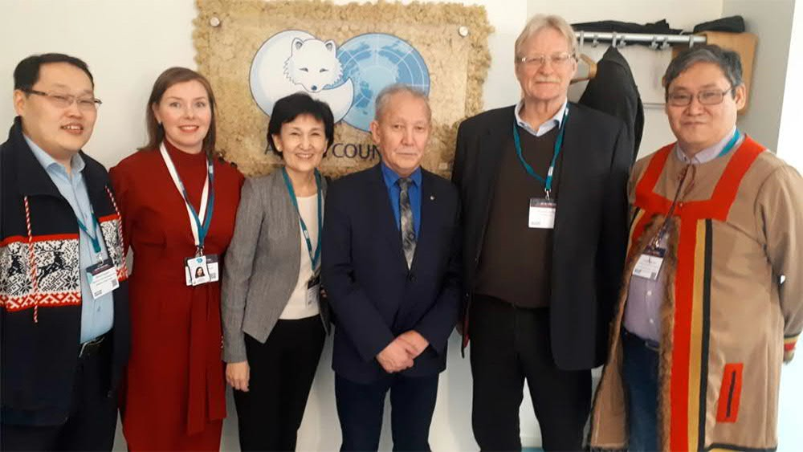






Partnerships
ICARP
Photo: Pavel Sofronov & Anatoly Zhozhikov
www.uarctic.org
Notes:
UArctic members & partners more internationally focused.

Slide 14
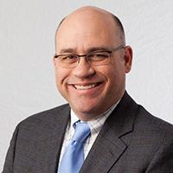
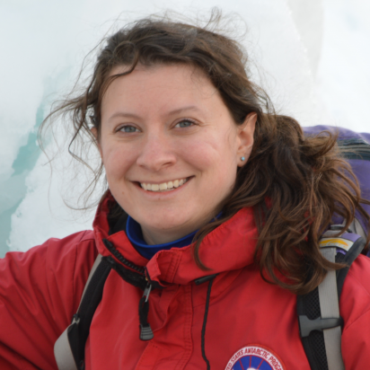
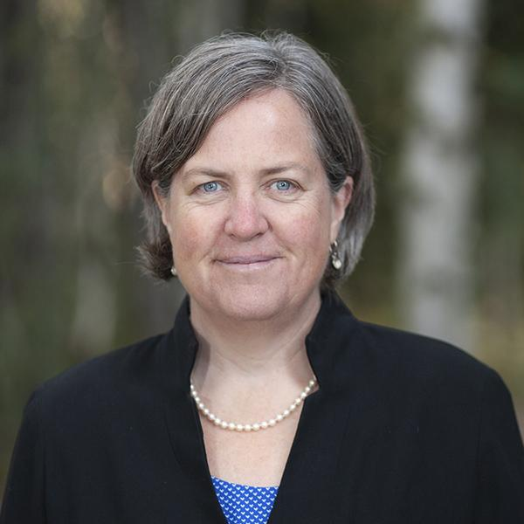
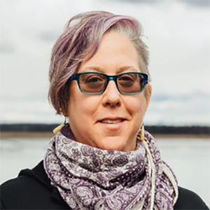
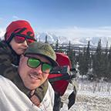
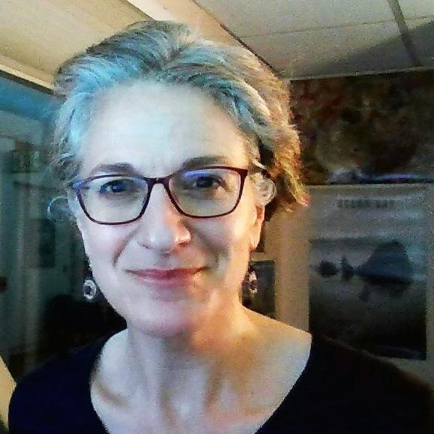
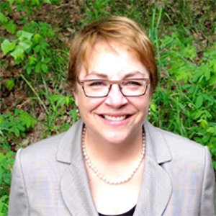
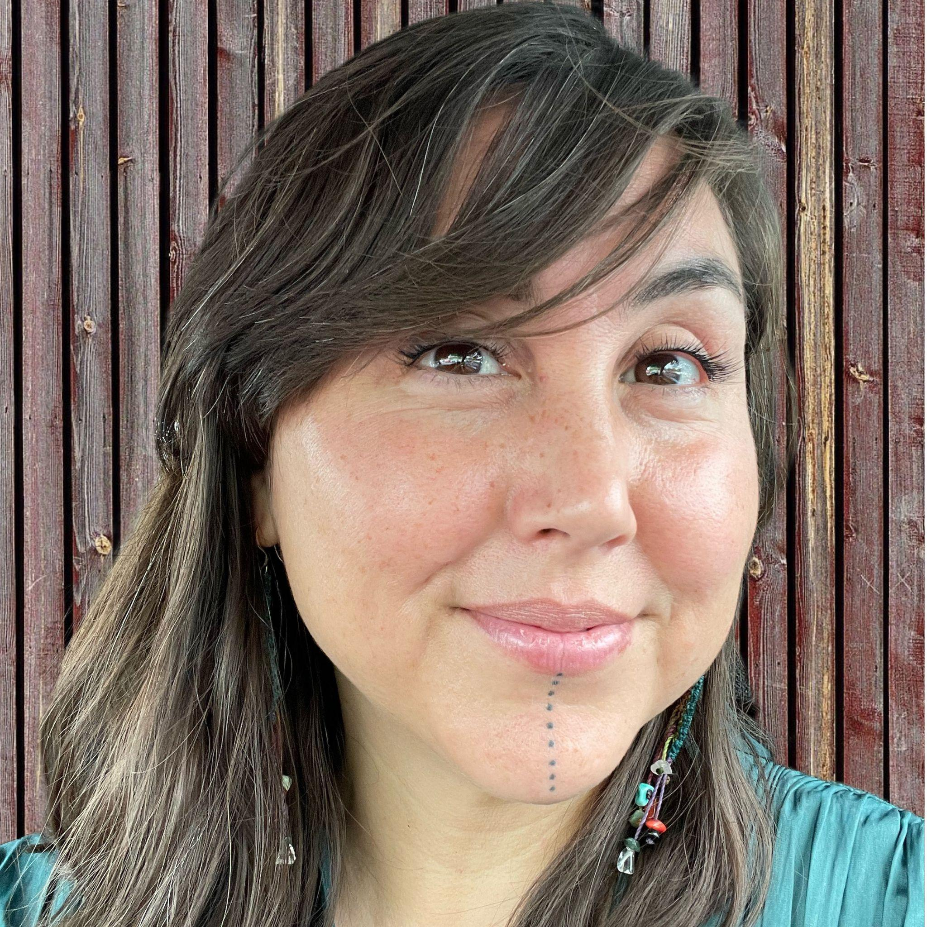
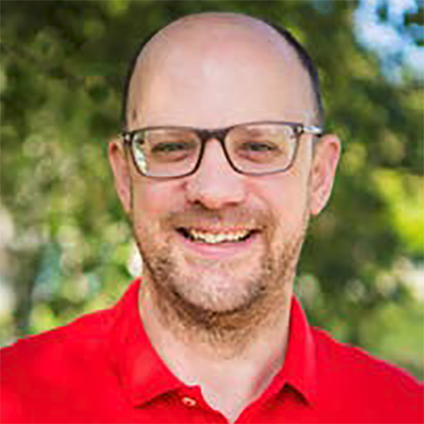
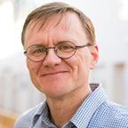
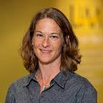
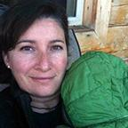
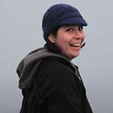
ARCUS Board of Directors 2022
David Cairns
Texas A&M
(President)
Lauren Culler
Dartmouth College
Pips Veazey
University of Maine
Julie Raymond-Yakoubian
Kawerak, Inc.
(Member-at-large)
Kaare Sikuaq Erickson
Ikaaġun Engagement
Stacey Fritz
CCHRC/NREL
Diane Hirshberg
U. Alaska Anchorage
(Treasurer)
Cana Uluak Itchuaqiyaq
Virginia Tech
Peter Webley
U. Alaska Fairbanks
(Secretary)
Timo Koivurova
University of Lapland
Board Members are elected by ARCUS Institutional Member Representatives
Audrey Taylor
U. Alaska Anchorage
(Member-at-large)
Cheryl Rosa
U.S. Arctic Research
Commission
Adrian Gall
ABR, Inc.
Notes:
Shout out to a couple people who are here today - Diane Hirshberg & Pips Veazey both of whom are ARCUS Board Members and who are wonderful points of connection, working to keep all these different kinds of community connections that support Arctic research across different scales alive & well.

Slide 15
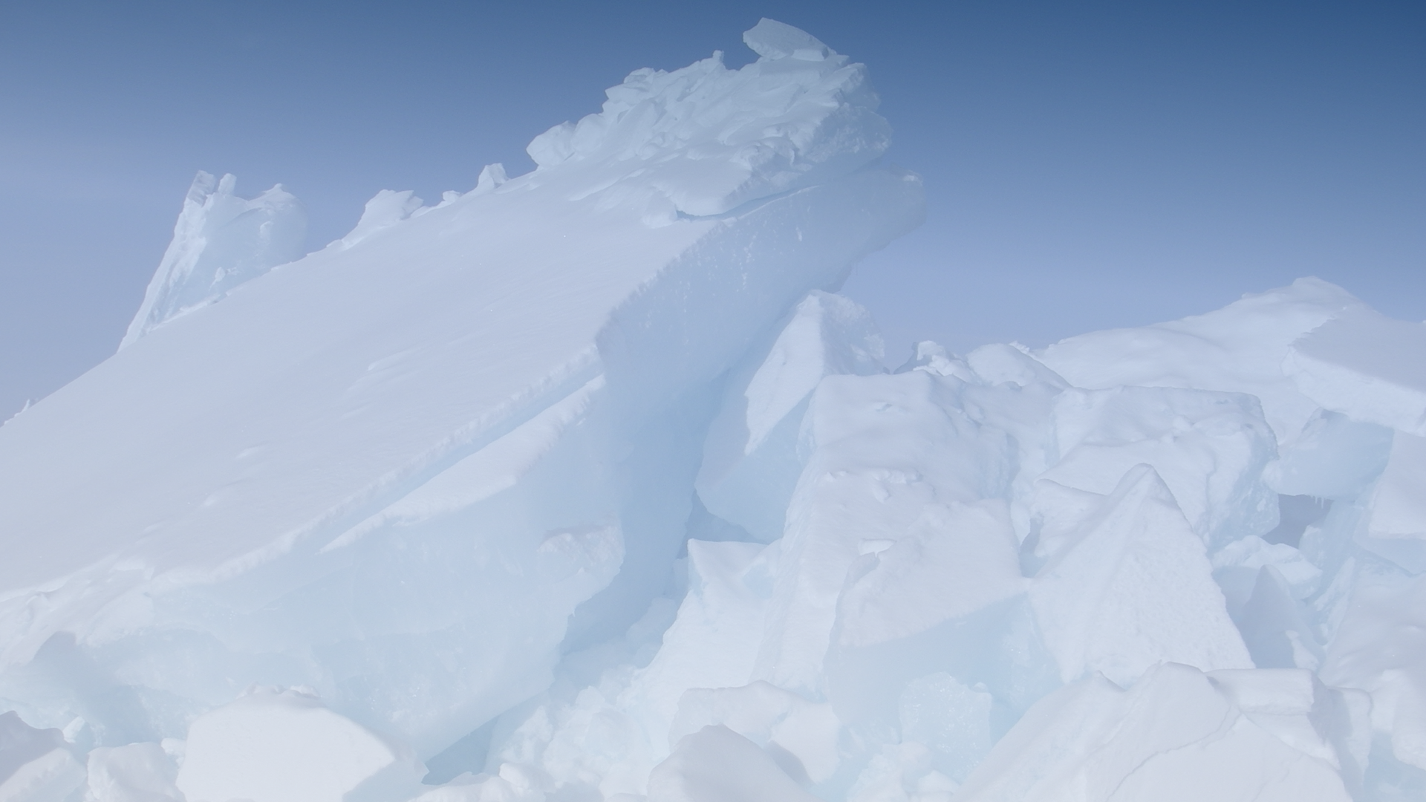



arcus.org
facebook.com/arcticresearchconsortium
@ArcticResearch
Notes:
If you are interested in learning more about ARCUS (may be curious about membership or partnership)... you can learn more about us online at www.arcus.org.

Slide 16

Introductions
Representatives from each organization are invited to provide a brief 2-3 minute introduction to their organization’s Arctic research activities/interests as well as to identify any support mechanisms specific to their institution that might encourage greater collaboration between UArctic’s North American Members.

Slide 17
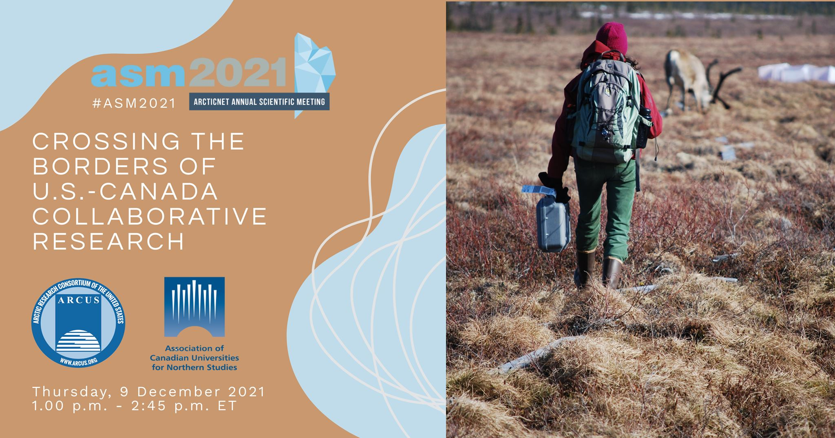
Open Discussion: Focus on ideas & opportunities for U.S. - Canada Cooperation
What has been done in the past?
What has worked well?
What types of challenges arise?
What types of collaborative projects could we pursue together?
What mechanisms can support the implementation of these ideas?

Slide 18
10:55AM - 11:15AM - Coffee Break
11:15AM - 12:15PM - National Break-Out Sessions

Slide 19
Next Steps
Written report on today’s discussions
Virtual North American Member networking meeting in late August/early September

